Slide 1
GLOBE
Aerosols Protocol

Slide 2
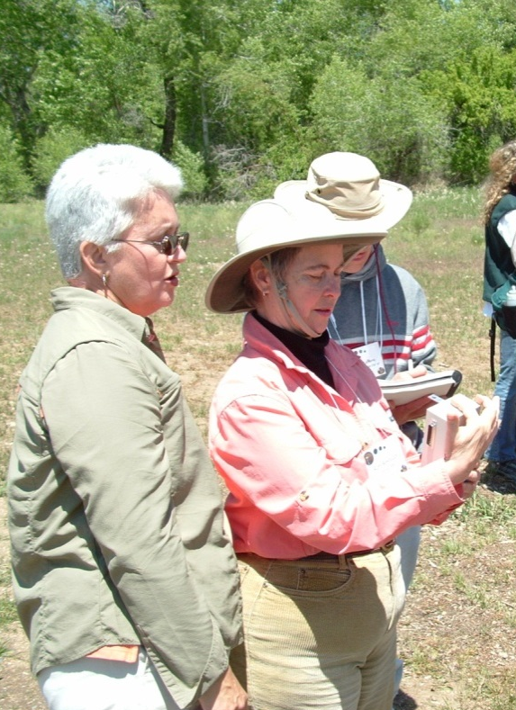
Goals for the Training Session
Provide an inquiry context for the data collection and science content
Provide accurate science content
Review procedures for data collection
Review data entry and analysis

Slide 3
What are Aerosols?
List from participants
What are Sources of Aerosols?
List from participants

Slide 4
Science Content: What are Aerosols?
Solid or liquid particles suspended in the air
Too small to be seen individually
Can cause sky to appear hazy or dirty
Brilliant orange skies at sunrise/sunset may indicate presence of aerosols

Slide 5
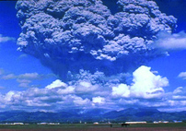

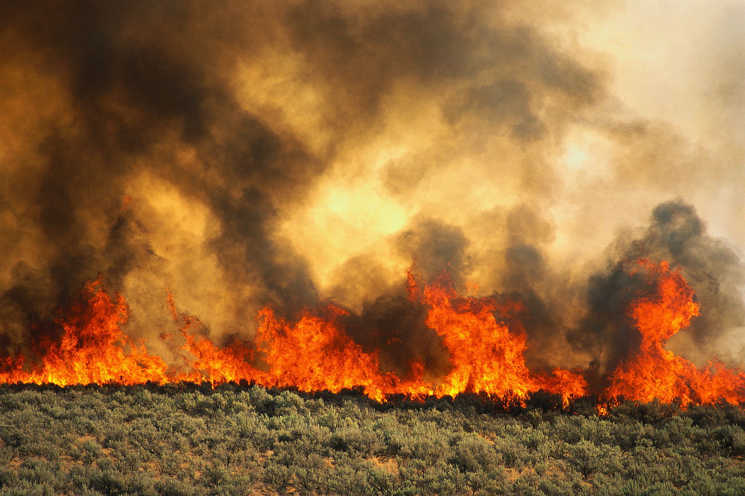
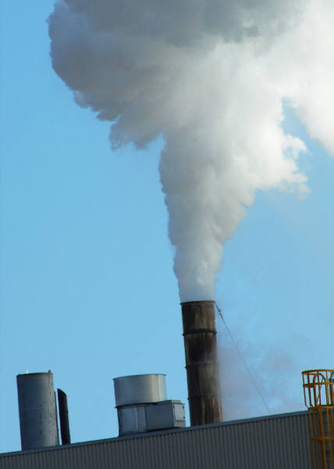
Science Content: Sources of Aerosols
Natural: volcanoes, sea spray, dust, smoke, wind erosion, water droplets, ice particles, pollen
Human: plowing, surface mining, combustion, biomass burning

Slide 6
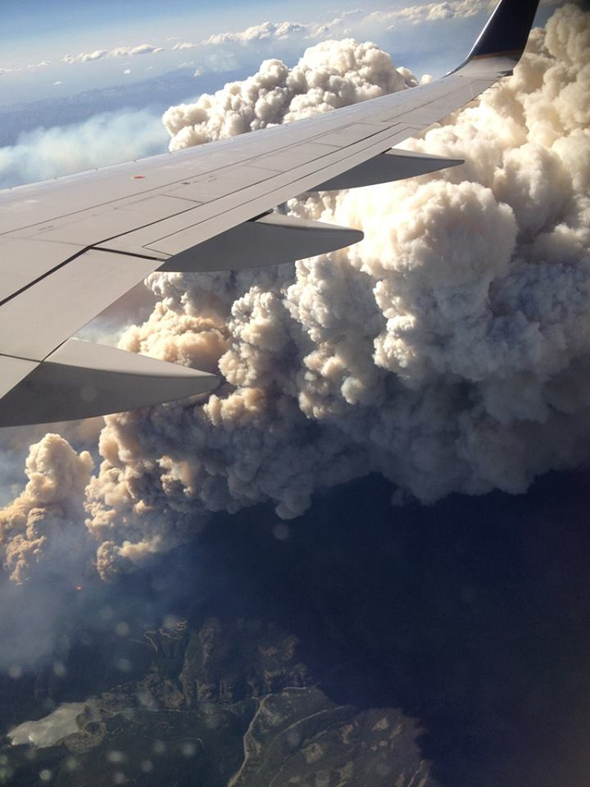
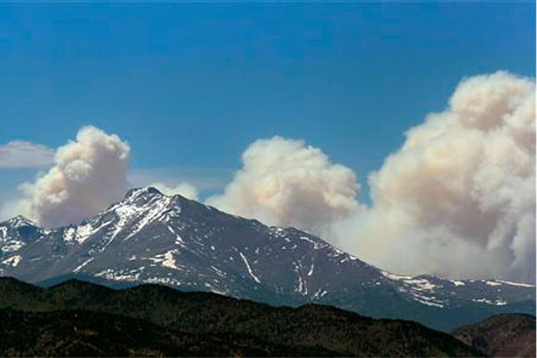
Local Inquiry Example:
Fires in the Rocky Mountains
Source: www.csmonitor.com
Source: Rafat Jambi, GLOBE Saudi Arabia

Slide 7
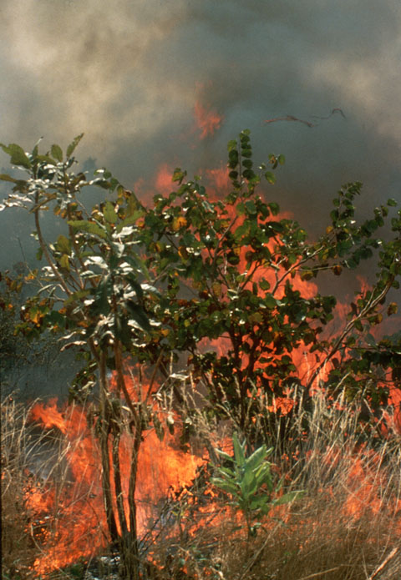
Inquiry Context
How are aerosol concentrations related to changes in the seasons?
How can aerosols be used to tell where air comes from?
How does smoke from large forest fires affect sunlight reaching Earth’s surface?
© National Center for Atmospheric Research

Slide 8
Why do GLOBE scientists research aerosols?
To provide ground-based data that assesses the performance of satellite measurements of aerosols
To add to data provided by remotely-sensed data
To help track the effects of dust storms, fires, volcanic eruptions, and pollution around the world
To add to knowledge scientists have about the energy cycle and the water cycle

Slide 9
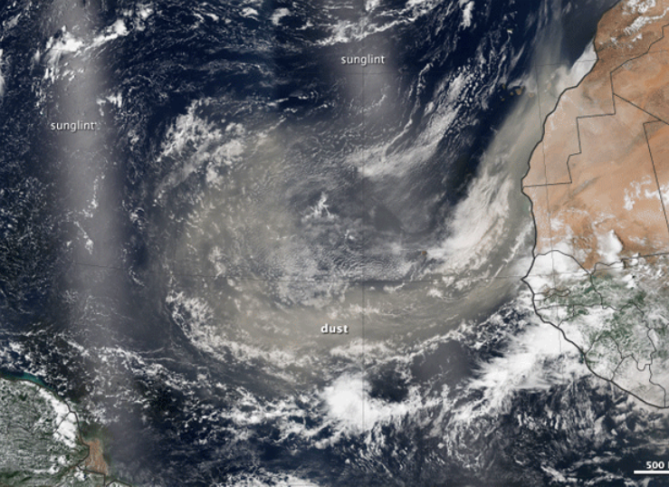
Science Content:
Tracking dust across the Atlantic
http://earthobservatory.nasa.gov/IOTD/view.php?id=81864&src=eoa-iotd

Slide 10
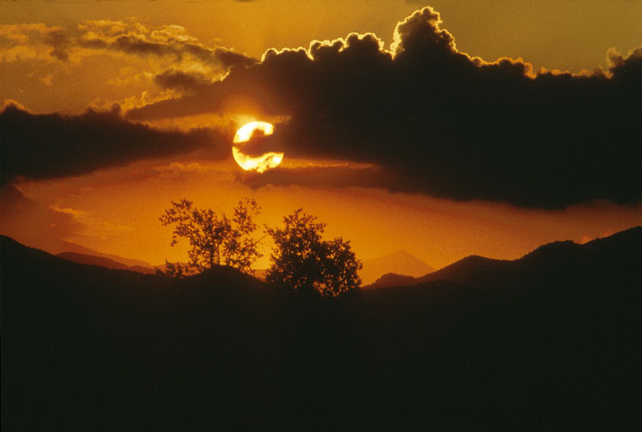
Science Content: Effects of Aerosols
Aerosols are too small to be seen individually (100’s – 1000’s nm)
Aerosols scatter visible sunlight:
  Making the sky looks dirty or hazy
  Creating brilliant orange and red skies at sunrise and sunset
  Creating a large aureole around the sun or full moon
  Sometimes acting as CCNs (cloud condensation nuclei)
Photo taken by Carlye Calvin
© University Corporation for Atmospheric Research

Slide 11
Science Content: Aerosols and Light Absorption
Sunlight includes a range of wavelengths
Aerosols and gases absorb and scatter light best at wavelengths that match their size (in nanometers)
Both gases and aerosols absorb and scatter sunlight
If we know (1) atmospheric pressure, and (2) the elevation angle of the sun, we know the amount of gas between us and the sun
In the absence of clouds, any light absorption not caused by atmospheric gas is from aerosols

Slide 12
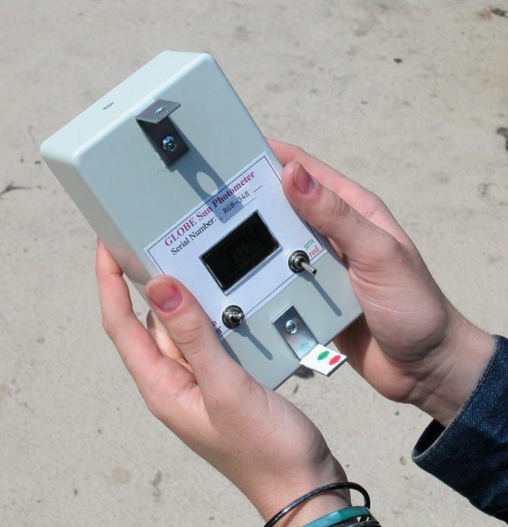
Instruments: Sun Photometer
Aerosol Optical Thickness (AOT) can range from 0 (100% light transmission) to >5.0 (<1% light transmission)
Sun photometers can be obtained from GLOBE scientists, manufacturers, or purchased as a kit that can be built

Slide 13
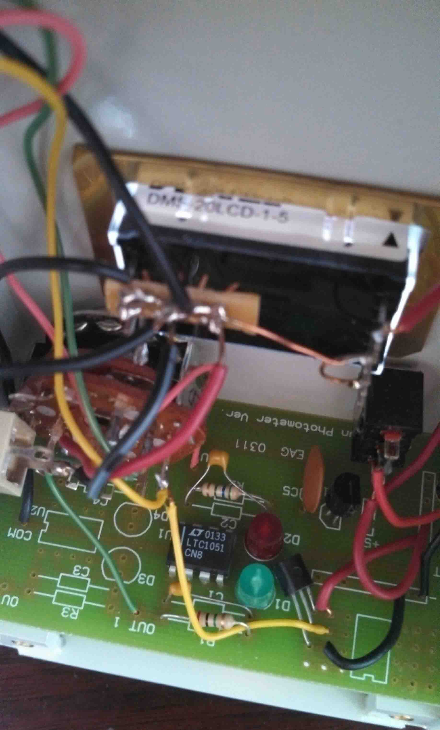
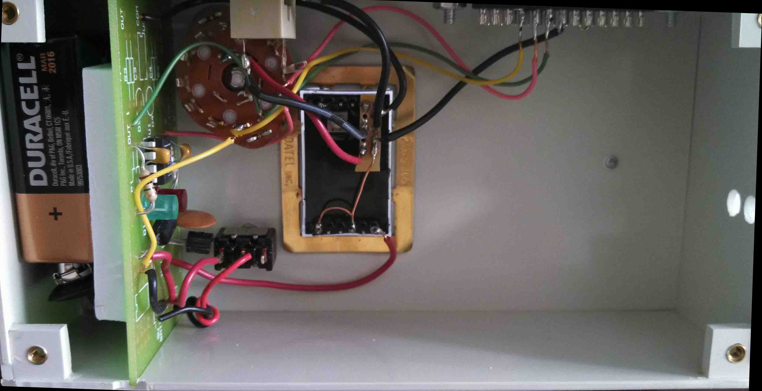
Instruments: How the sun photometer works

Slide 14
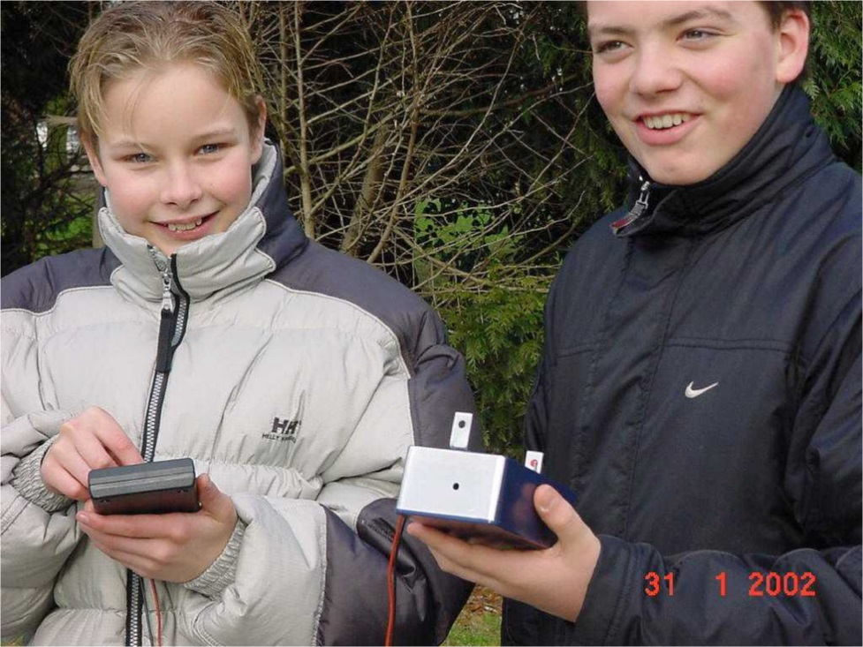
The Measurements
  Maximum Voltage in Sunlight
  Dark Voltage
  Aerosol Optical Thickness (AOT)
  Cloud Protocols
  Current Air Temperature
  Relative Humidity

Slide 15
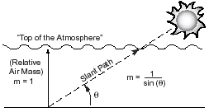

Collecting Data: Protocol
  Collect initial photometer temperature
  Select red or green channel (three to five measurements needed for each)
  Record maximum voltage reading
  Record dark voltage reading
  Record the precise time for each
  Collect ending photometer temperature
  Observe and record cloud conditions, current air temperature, relative humidity, and barometric pressure
Ideally at a particular sun angle in the morning when the sun is visible

Slide 16
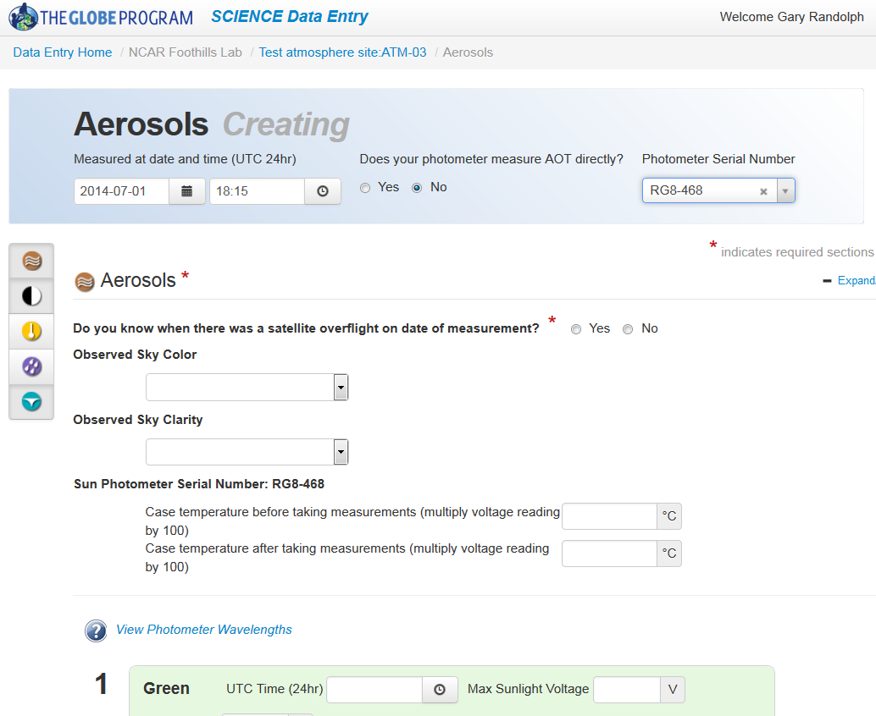
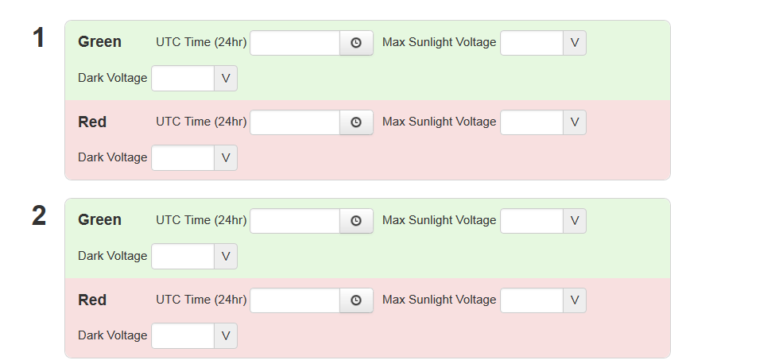
Enter Data on the GLOBE Website
  Step 1: Define a study site, choose Atmosphere site type
  Step 2: Select “New observation” under Aerosols
  Step 3: Enter date and Universal Time (UTC) and select whether your sun photometer measures AOT directly or not
  Step 4: Enter data collected (red asterisks* indicate required data
  Step 5: Click on Send Data

Slide 17
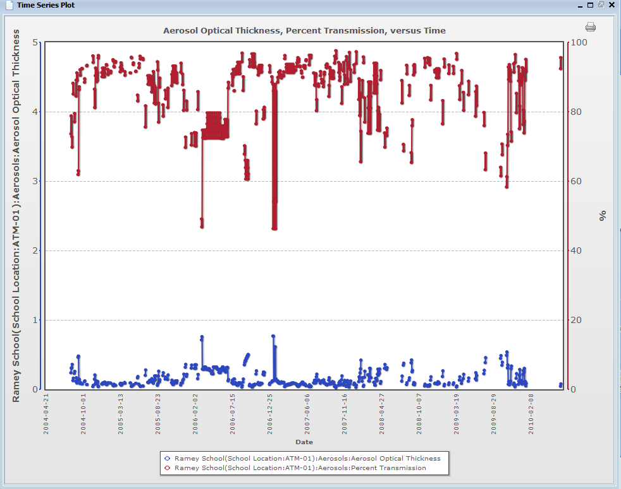
Looking at GLOBE Data
  AOT, Aerosol Optical Thickness, (blue in this time series) ranges from 0 to 5
  Percent Transmission (red in this time series) ranges from 0 to 100%
  As AOT increases, Percent Transmission (of sunlight) decreases

