Slide 1
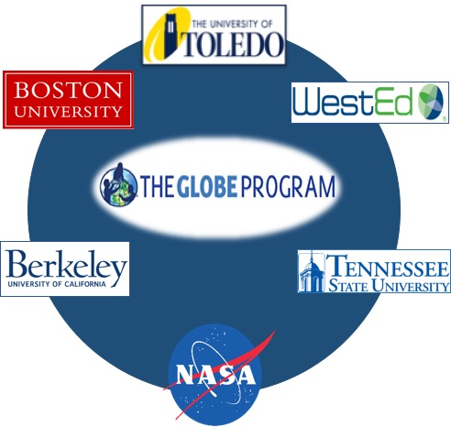
Mission Earth:
Fusing GLOBE with NASA Assets to Build Systemic Innovation in STEM Education
Kevin Czajkowski
The University of Toledo

Slide 2

Mission Earth: Fusing GLOBE with NASA Assets to Build Systemic Innovation in STEM Education
Team Members and Institutions
Kevin Czajkowski, The University of Toledo
Peter Garik, Boston University
Svetlana Darche, WestEd
David Padgett, Tennessee State University
Jessica Taylor, NASA Langley Research Center
Jennifer Bourgeault, Earth Mosaics

Slide 3
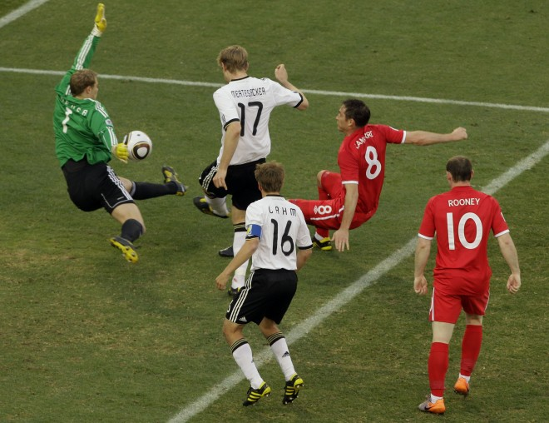
Play the Game: Do Science

Slide 4


NASA Goals Met by Mission Earth
Improve STEM Instruction
Increase and Sustain Youth and Public Engagement in STEM
Enhance STEM Experience for Undergraduate Students
Better Serve Groups Historically Underrepresented in STEM
Notes:
Improve STEM Instruction by creating developmentally appropriate vertically-integrated K-12 materials and activities which link NASA and GLOBE learning materials, supported by high quality professional development and ongoing support, engaging teachers from all grades (elementary, middle and high school) to work together in both program implementation and continuous improvement.
Increase and Sustain Youth and Public Engagement in STEM through project activities and engagement of citizen scientists through GLOBE’s new citizen science initiative.
Enhance STEM Experience for Undergraduate Students, through service learning for pre-service teachers and engineering challenges.
Better Serve Groups Historically Underrepresented in STEM through serving high-need school districts (Providence, RI, Toledo, OH, Nashville, TN, Oakland, CA) and engagement of Historically Black Colleges and Universities, Tennessee State University.

Slide 5
MISSION EARTH’s Goals
Develop vertically-integrated activities and materials to support program implementation
Provide K-12 professional development (PD) and year-long as well as multi-year support for teachers with scaling through Train-the-Trainer models
Enhance STEM Experience for Undergraduate Students
Engage the public by supporting and enhancing GLOBE, MY NASA DATA and S’COOL citizen science initiatives.
Disseminate the program widely through the National Science Teachers Association and the GLOBE Partner Network, the National Career Academy Coalition (for the high school component), and other relevant networks.
Notes:
Specifically, MISSION EARTH will;
Develop vertically-integrated activities and materials to support program implementation
Gather community through an annual meeting/conference to share best practices
Develop, implement, evaluate and refine NASA-infused GLOBE activities, drawing on the expertise of both partners and teacher teams.
Provide K-12 professional development (PD) and year-long as well as multi-year support for teachers with scaling through Train-the-Trainer models
Recruit high-need schools to participate, targeting multiple teachers from one school/district at elementary, middle and high school levels.
Provide PD and develop a professional learning community (PLC) of teachers, scientists and engineers and science educators; host online meetings, follow-up telecons and annual conferences.
Provide support to pilot schools and elicit feedback for further development
Train and support lead teachers as future GLOBE trainers employing Train-the-Trainer approach.
Engage district and state education agencies as appropriate to leverage existing PD structures for replication and sustainability.
Enhance STEM Experience for Undergraduate Students
Facilitate pre-service teachers and STEM undergraduates to mentor K-12 students in service learning projects.
Engage undergraduate students in engineering design challenges of observing instrumentation.
Engage the public by supporting and enhancing GLOBE, MY NASA DATA and S’cool citizen science initiatives.
Disseminate the program widely through the National Science Teachers Association and the GLOBE Partner Network, the National Career Academy Coalition (for the high school component), and other relevant networks.

Slide 6
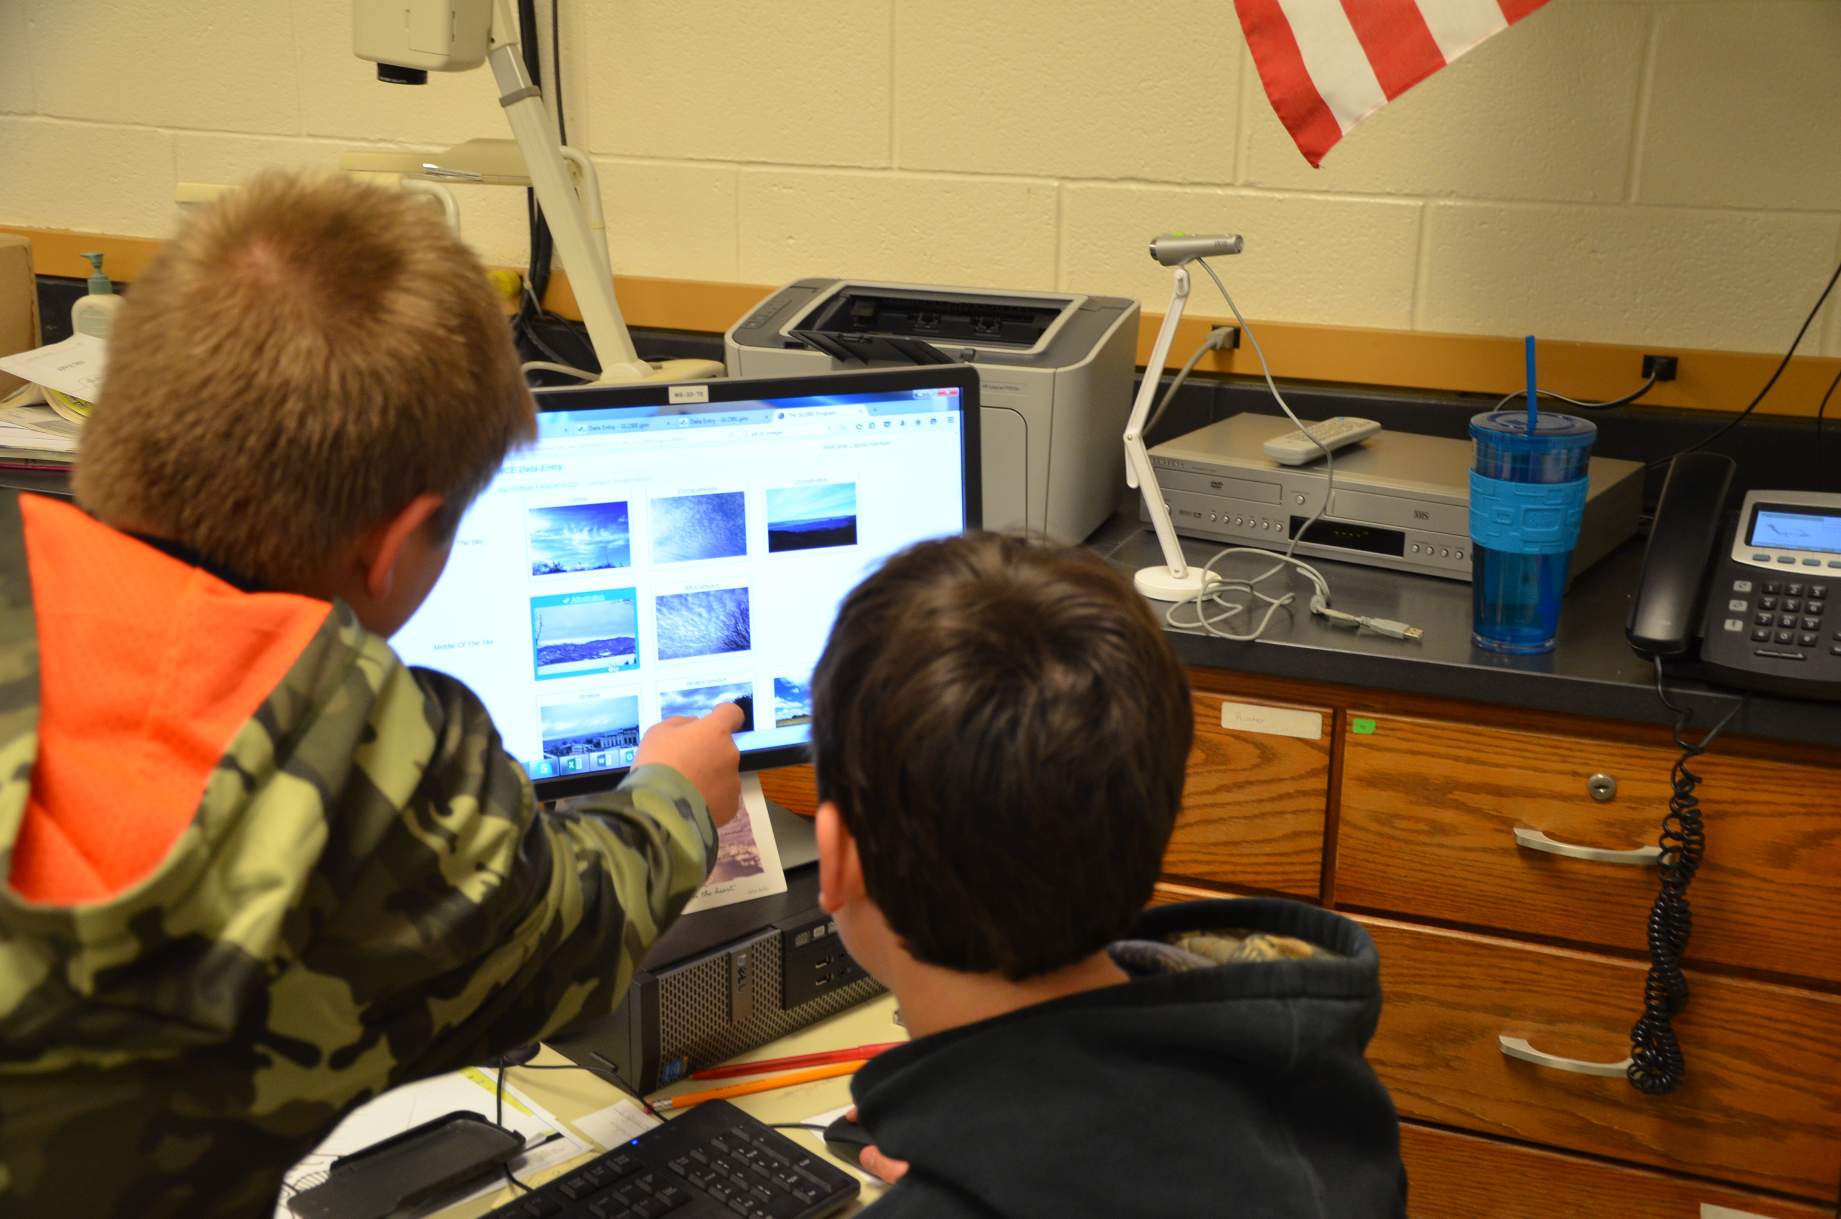
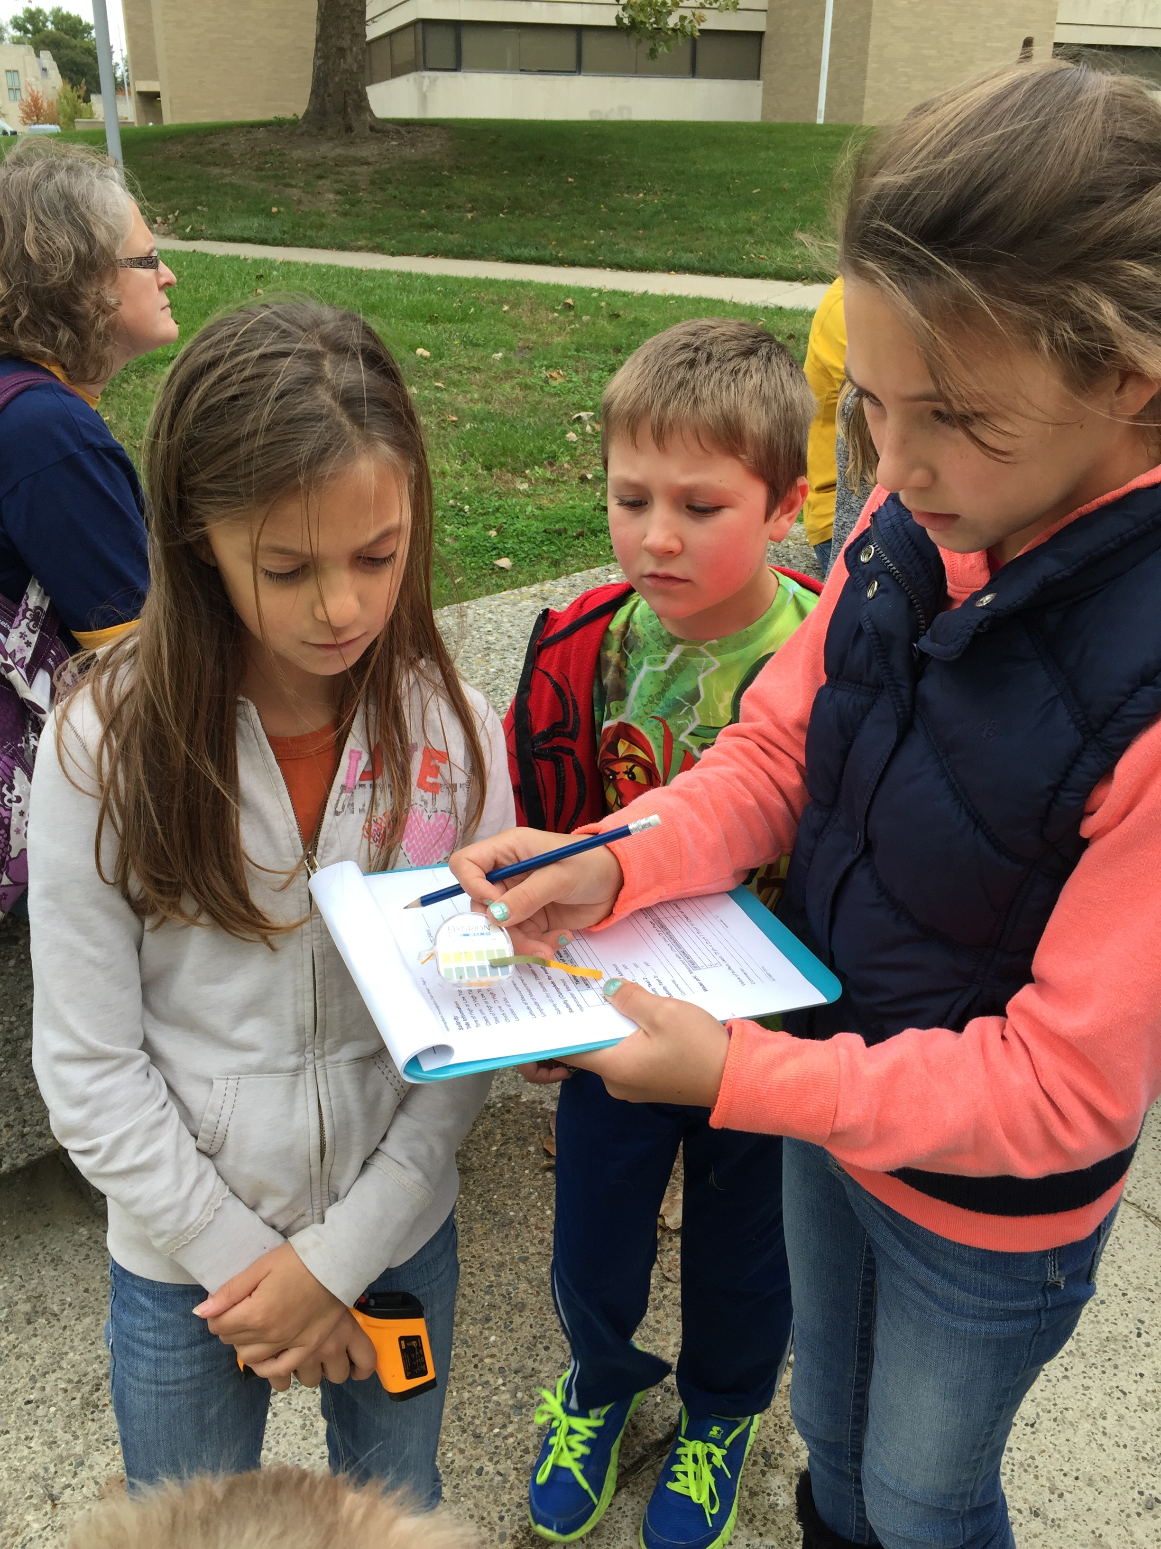
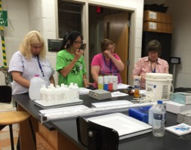

Boston University
Elementary School
Boston University, offered “immersive” professional development courses for K–8 teachers on green
energy and on climate change. Elementary teachers learned new pedagogy, project-based, well through professional development but their increase in content knowledge was much lower than they personally believed.
Notes:
Working in the Providence School District, the Boston University (BU) team will link curricula developed by BU for elementary grades with curricula developed by the University of Toledo for middle school, and that developed by WestEd for high school, into a vertically and horizontally integrated Earth as a system approach to science education and science literacy.
The BU team will run summer institutes for the professional development of both middle and high school teachers, and during the school year scaffold the use of the materials in classrooms.
BU is a GLOBE partner and will prepare lead teachers in Providence to be teacher trainers.
The BU team will develop automated weather station kits for Providence high school students to assemble for use by schools in the district.
At the university level, the BU team will
Use NASA learning assets in undergraduate Earth Science courses. (Dr. Bruce Anderson, team member)
Train elementary education majors in GLOBE protocols and the use of NASA learning and teaching resources. (Dr. Peter Garik, co-I)
Introduce pre-service science teachers to NASA and GLOBE learning and teaching assets in their science methods courses. (Dr. Donald DeRosa, co-I)

Slide 7
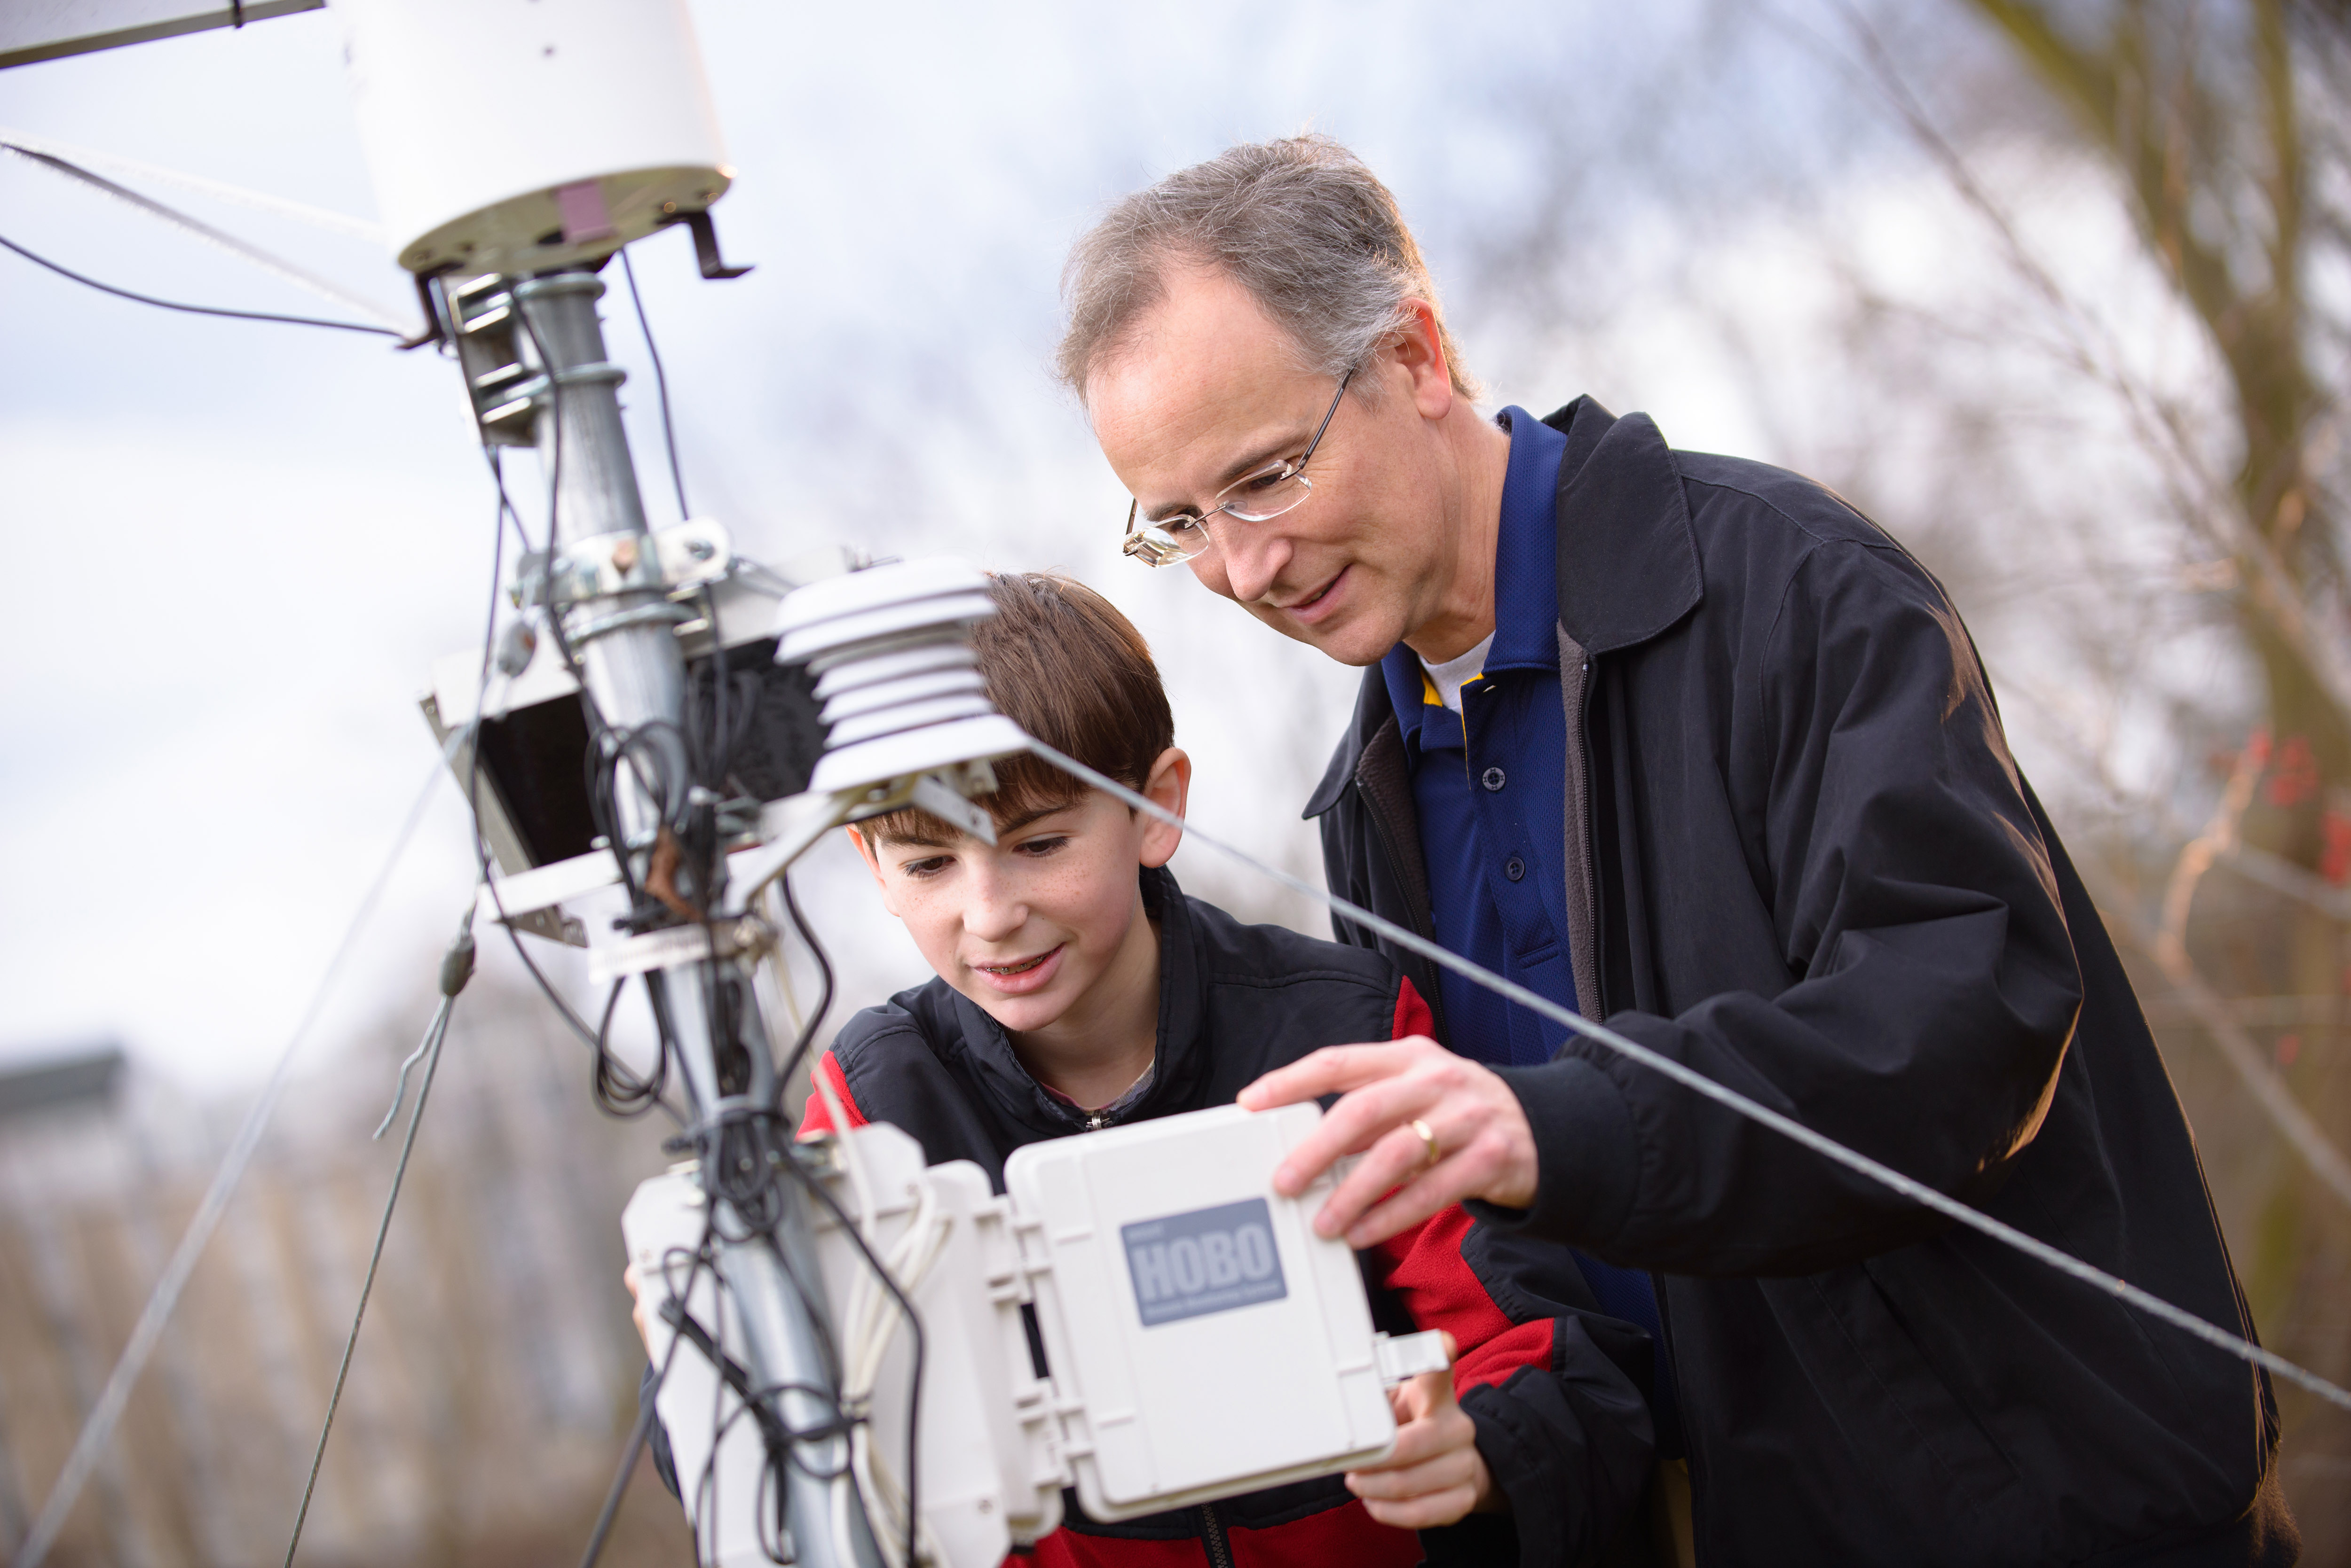
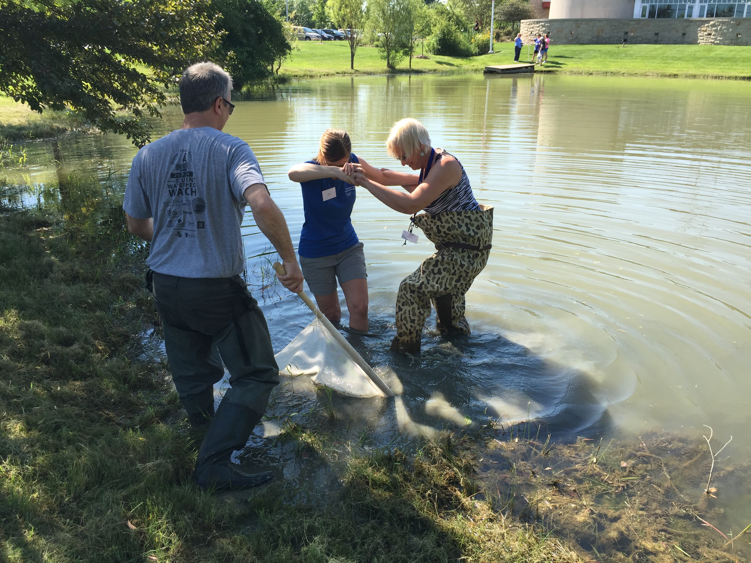
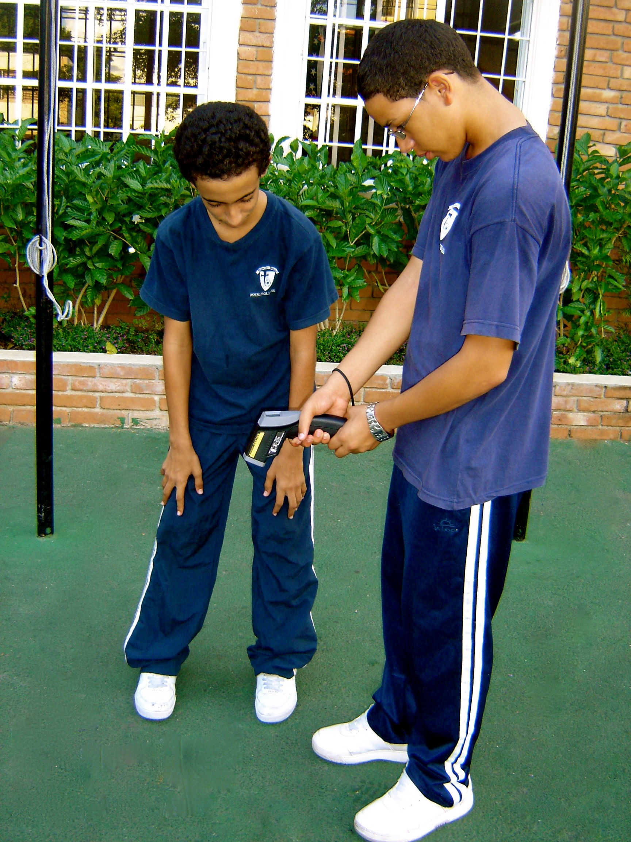
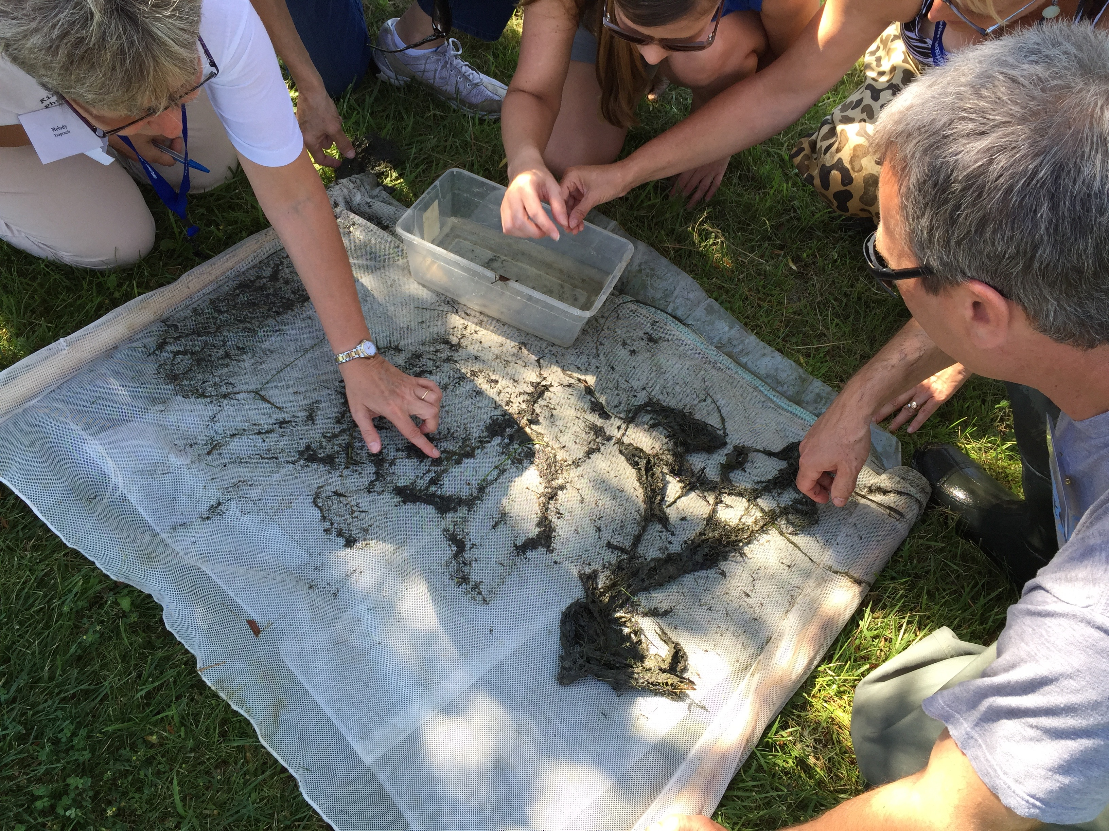

University of Toledo
Middle School
The University of Toledo has developed a student/teacher/scientist (STS) partnership model called SATELLITES (Students
and Teachers Evaluating Local Landscapes to Interpret the Earth from Space). Students develop projects and present them at a science conference. The SATELLITES Model has proven effective in introducing PBS to teachers using GLOBE and NASA assets.
Notes:
Working with rural districts in Ohio and Michigan, the University of Toledo team will expand its teacher PD from its middle school focus to the elementary and high school levels.
The UT team will run summer institutes for the professional development of both middle and high school teachers, and during the school year scaffold the use of the materials in classrooms.
UT is a GLOBE partner and will prepare lead teachers in Michigan and Ohio to be teacher trainers.
The UT team will develop automated weather station kits for Michigan and Ohio high school students to assemble for use by schools in the district.
At the university level, the UT team will
Use NASA learning assets in undergraduate Engineering courses and implement engineering challenges. (Dr. Glenn Lipscomb, Co-I)
Introduce pre-service science teachers to NASA and GLOBE learning and teaching assets in their science methods courses. (Dr. Mark Templin, co-I)
The UT team will work with John Moore of the Plamyra Environmental Nature Park and Discovery Center and Shakila Merchant of the City University of New York (CUNY) Remote Sensing Earth Systems Institute. They will test the engineering design concepts at the high school level in New York, New Jersey and Pennsylvania.

Slide 8
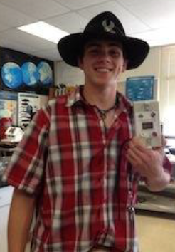
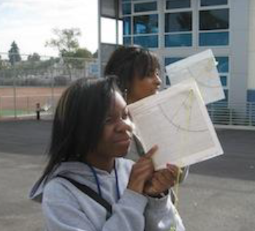
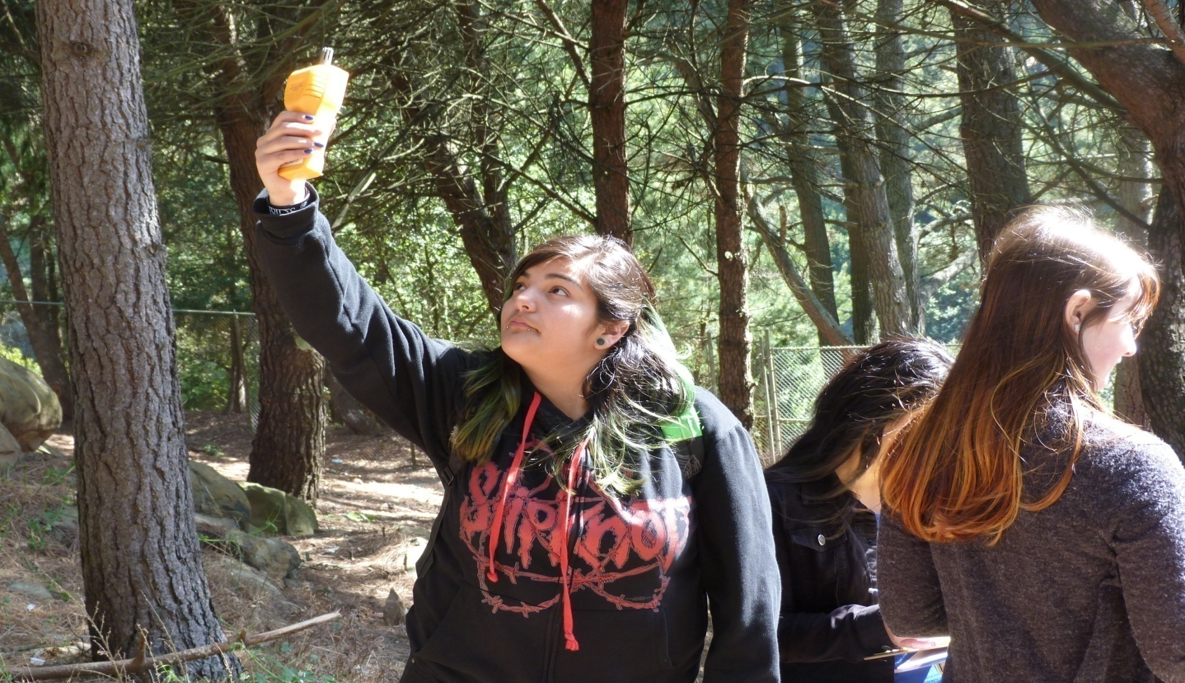


WestEd & UC Berkeley
High School and Career Technical Education
Build on GLOBE California Academy Program (CAP) to incorporate NASA assets into high school career academy CTE and science curricula
Vertically align with feeder middle schools
Support schools in integrating GLOBE with work-based/field-based learning, career exploration, NGSS, and development of 21st century skills
Support GLOBE Partner in New Mexico to expand NASA-infused GLOBE CAP to New Mexico schools, leveraging the support of the New Mexico Public Education Department
Coordinate high school work with team partners in New Mexico and Tennessee
Work with state and local-level partners to support program sustainability and expansion
Notes:
University of California at Berkeley. Four departments and centers will participate in this effort through The College and Career Academy Support Network (CCASN) that is dedicated to the goal of improving high schools, particularly through career academies and other small learning communities. CCASN offers professional development, materials, and coaching for schools and districts in California and other states that are trying to start or improve career academies and other small learning communities and has staff with expertise in the environmental sciences, past leadership experience in environmental academies, and extensive knowledge of curricula and teaching practices used in green academies. CCASN’s role will include:
Providing access to networks of schools
Technical assistance to STEM academies on curriculum integration
Professional development on academy development
Participation in formative evaluation
Ongoing development of practice and policy to support program expansion and sustainability
UC Berkeley Departments of Chemistry and Earth and Planetary Science. Dr. Ronald Cohen, co-I, and his graduate students will contribute their expertise in climate research, provide students access to sensor data, and contribute ideas on curriculum integration. They will also share information with teachers and students on careers in the sciences and support teachers in implementation of the GLOBE protocols.
UC Berkeley Center for Cities and Schools (CC&S). CC&S will implement the Y-PLAN methodology as a means for 12th grade GLOBE CAP students to apply their learning in meaningful local projects.

Slide 9
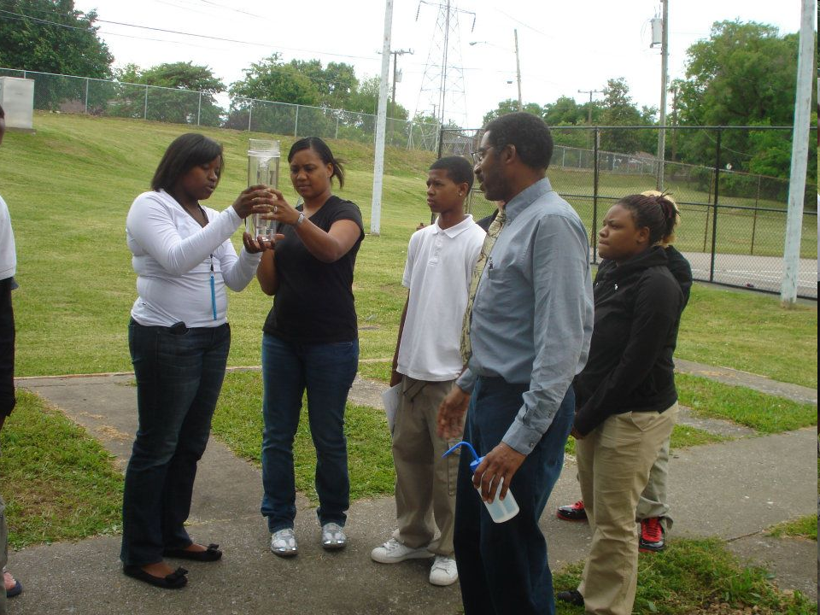
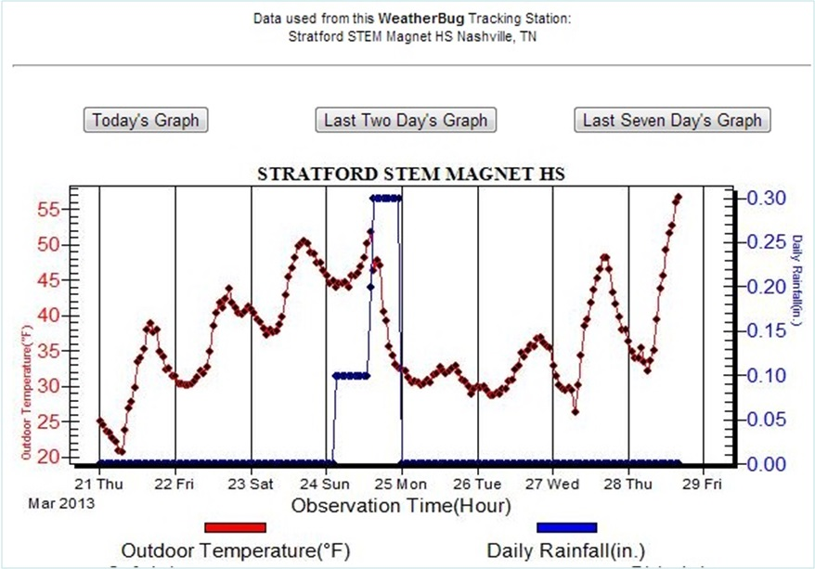

Tennessee State University
Pre-Service Education Students
Students enrolled in Weather & Climate (GEOG 3500) course are required to develop and teach learning modules for Stratford STEM Magnet High School students based upon GLOBE Atmosphere Protocol. The lesson was supplemented with geospatial technology applications and data from the school’s WeatherBug station. Stratford’s enrollment is 68% African American, 6% Hispanic with 91% of students qualifying for free and reduced price lunch.
Notes:
Tennessee State University (TSU): TSU has deep experience in implementing GLOBE Program Atmosphere and Weatherbug Protocols using students in service learning program support partner high schools use of the protocols. TSU will
Continue development of its service learning program
Assist other team members to disseminate this model
Provide other team members with developed materials

Slide 10
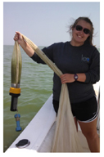
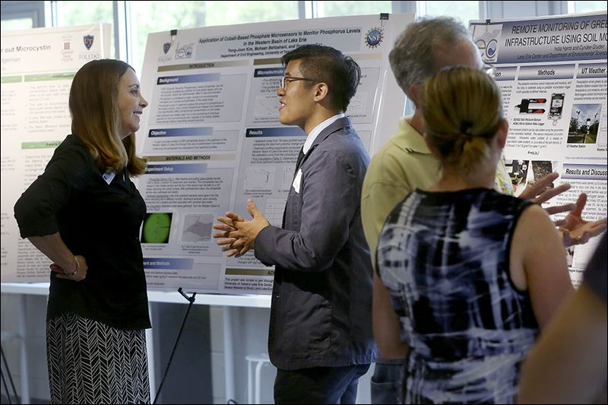
Boston University
STEM Undergraduate Engineering Challenge
Boston University will use project-based learning in design challenges to engage university engineering students in designing instrumentation. Winning designs will be passed to high school students to build and use to develop projects.
Notes:
Working in the Providence School District, the Boston University (BU) team will link curricula developed by BU for elementary grades with curricula developed by the University of Toledo for middle school, and that developed by WestEd for high school, into a vertically and horizontally integrated Earth as a system approach to science education and science literacy.
The BU team will run summer institutes for the professional development of both middle and high school teachers, and during the school year scaffold the use of the materials in classrooms.
BU is a GLOBE partner and will prepare lead teachers in Providence to be teacher trainers.
The BU team will develop automated weather station kits for Providence high school students to assemble for use by schools in the district.
At the university level, the BU team will
Use NASA learning assets in undergraduate Earth Science courses. (Dr. Bruce Anderson, team member)
Train elementary education majors in GLOBE protocols and the use of NASA learning and teaching resources. (Dr. Peter Garik, co-I)
Introduce pre-service science teachers to NASA and GLOBE learning and teaching assets in their science methods courses. (Dr. Donald DeRosa, co-I)

Slide 11
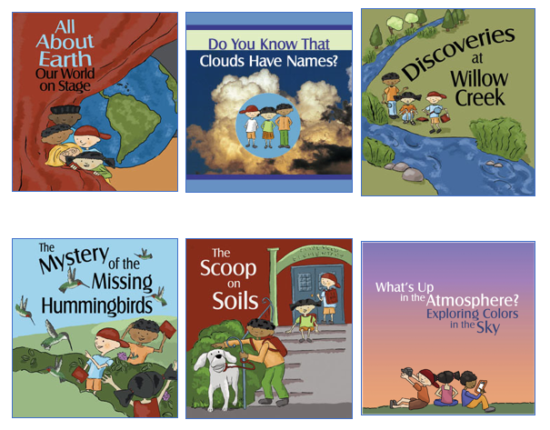
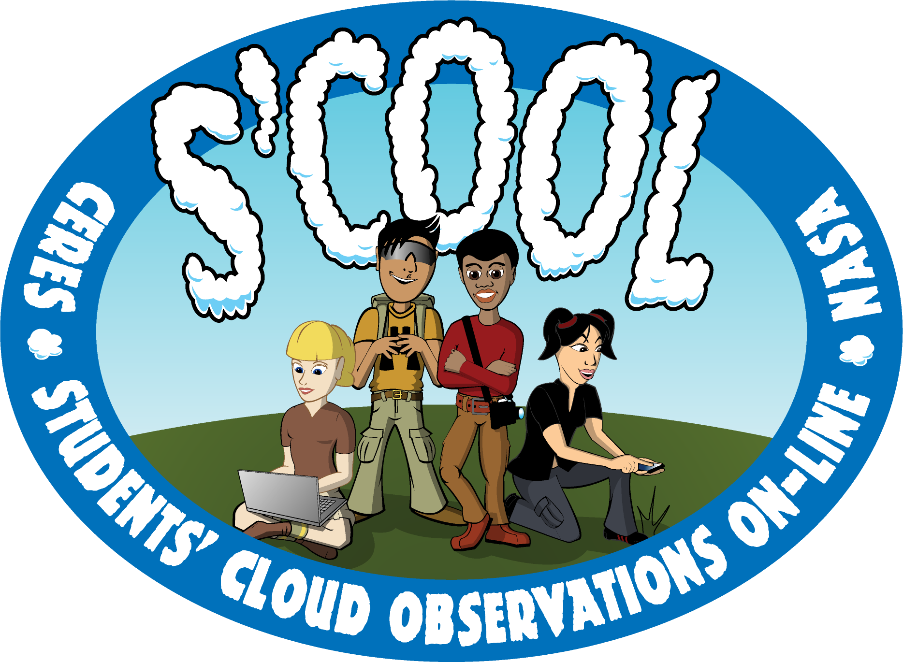
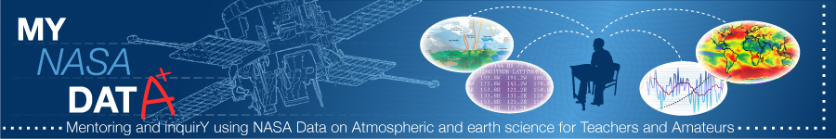
NASA Langley Research Center (LaRC)
Target: Working directly with University Liaisons to provide NASA resources that are relevant and assist with vertical integration. Available to provide GLOBE Trainer Certifications as needed.
Elementary: Elementary GLOBE and S’COOL Resources
Middle & High School: GLOBE and MY NASA DATA Resources
Overall: Liaison to NASA Science Mission Directorate activities and SMEs (subject matter experts)
MY NASA DATA developed to offer classrooms access to NASA Earth science data
Over 200 Earth science data parameters can be downloaded, viewed, and analyzed through the webtools
S’COOL provides satellite matches for cloud observations - Aqua, Terra, NPP, and CALIPSO and just added Geostationary Satellites!
Notes:
NASA Langley Research Center (LaRC): Dr. Jessica Taylor, co-I, is a research scientist at LaRC who is deeply engaged in building capacity of GLOBE Partners to implement GLOBE through the lens of NASA Science. Dr. Taylor will serve MISSION EARTH as
NASA content expert
Liaison to NASA Science Mission Directorate activities and SMEs (subject matter experts)
MISSION EARTH team liaison for MY NASA DATA which provides earth science datasets and online analysis tools for fusion with GLOBE lessons
MISSION EARTH team liaison for S'COOL through which satellite data can be provided to classrooms.

Slide 12
Example of Learning Progression
.
Notes:
Elementary School. Cloud observations lend themselves to the search for pattern both in space and time; from pattern comes prediction. Identifying different kinds of clouds can be done by students even in K-2. Following the NGSS, in Grade 3, students are expected to learn about weather and make predictions. Class projects can include the use of clouds to predict weather through association of weather with the kinds of clouds observed.
Middle School. By middle school, students are expected to organize their thinking about Earth as a system around the cross-cutting concepts of (i) cause and effect, (ii) systems and system models, and (iii) stability and change. With a background in cloud phenomenology, students in the middle grades are ready to understand the gradations of atmospheric temperature, and make linkages to the nature of the clouds at different altitudes, their appearance, and their expected contributions to precipitation. Project activities could include making predictions of the association of cloud cover at different altitudes with precipitation based on empirical observations from earlier grades and the use of MY NASA DATA to test class hypotheses.
High School. By the Grades 9-12 students should be progressing from guided discovery, to projects with questions set by the teacher but which the students must find the means to answer (with teacher’s mentorship), and finally to project questions that the students pose for themselves, and answer primarily on their own (with the teacher assisting with advice on resources or through connections with assisting GLOBE or NASA personnel). Projects that one might imagine could be connections between cloud, precipitation, and agricultural drought; average cloud coverage variation with latitude and global warming; floral phenological patterns correlated with cloud cover and global warming.

Slide 13
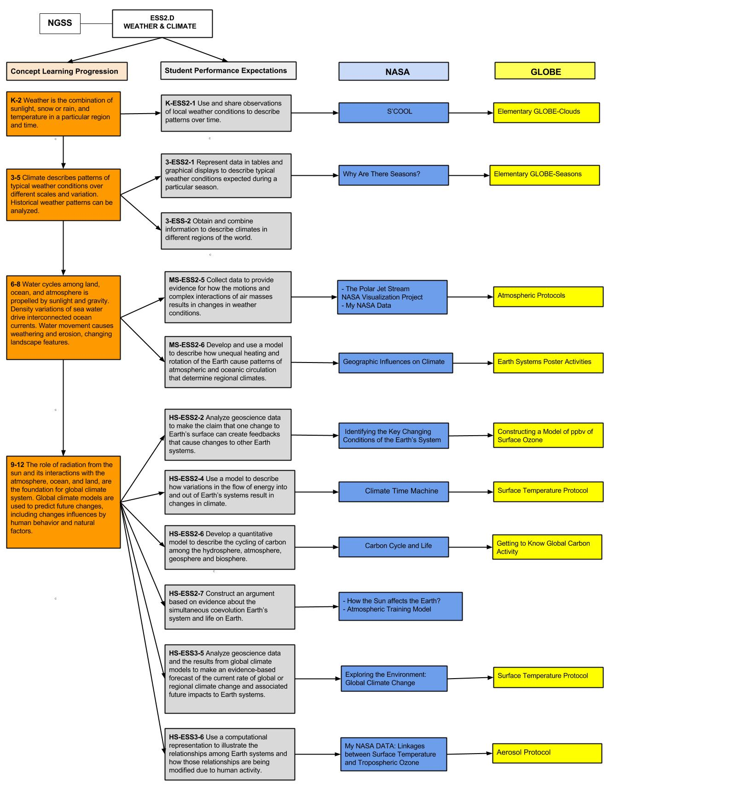
Vertical
Alignment
Example
NASA Assets GLOBE Protocols
NGSS
K-2
3-5
6-8
9-12

Slide 14
Project Approach
Develop
Implement
Notes:
Planning
Define purpose and scope
Specify evaluation questions
Development
Specify evaluation design
Create data collection action plan
Implementation
Collect data
Analyze data
Document findings
Feedback
Disseminate information
Feedback to program improvement

Slide 15
Evaluation
Efficiency
Effectiveness
Relevance
Impact
Sustainability
Scalability
SMART Objectives
Specific
Measurable
Achievable
Realistic (and Relevant)
Time-bound
Notes:
a) efficiency - the amount of time and resources put into the project relative to the outputs and outcomes.
b) effectiveness - the success of the project in reaching its goals and objectives, resulting in the desired outcomes.
c) relevance - the extent to which the objectives of the project’s interventions are consistent with the beneficiaries’ requirements/needs.
d) impact - the project’s impacts will be examined with respect to:
participating teachers’ content knowledge improvement
changes in the instructional practices of the educator that will participate in the trainings
effective implementation of the curricula offered by the program by participating teachers
improvement of the students’ performance in standardized and other targeted assessments in the cases their teachers have participated in the trainings. Scores of the students in participating teachers’ classrooms will be compared to the district average
changes in the students’ science portfolios. The science portfolios will be used for evidence of learning that is not accounted for on standardized tests
changes of student’s attitudes and engagement towards science
changes of students’ behaviors related to the environment
teacher and student acquisition of specific skills and practices
e) sustainability - the project’s capability and effectiveness to build on the capacity of the community involved to continue the proposed approaches.
f) scalability - the project’s capability to expand to other regions of the country.

Slide 16
Advisory Committee (max 10 people)
Rick Landenberger, West Virginia University, GLOBE scientist
Peter Schmidt, Queens College, GLOBE trainer/partner
Frank Marsik, University of Michigan, CYGNSS Education Team
Peggy Foletta, Kingsburg HS, CA, Teacher, GLOBE Master Trainer
Henry Ortiz, Los Angeles School District, GLOBE Master Trainer
Notes:
Provides guidance throughout the project, including monitoring the vertical integration.
Help direct the project and connect the project to other initiatives that will promote successful scaling and sustainability
Advisors have been identified for their content knowledge, experiences and understanding of target audiences, their vision, and their connections with other initiatives.

Slide 17
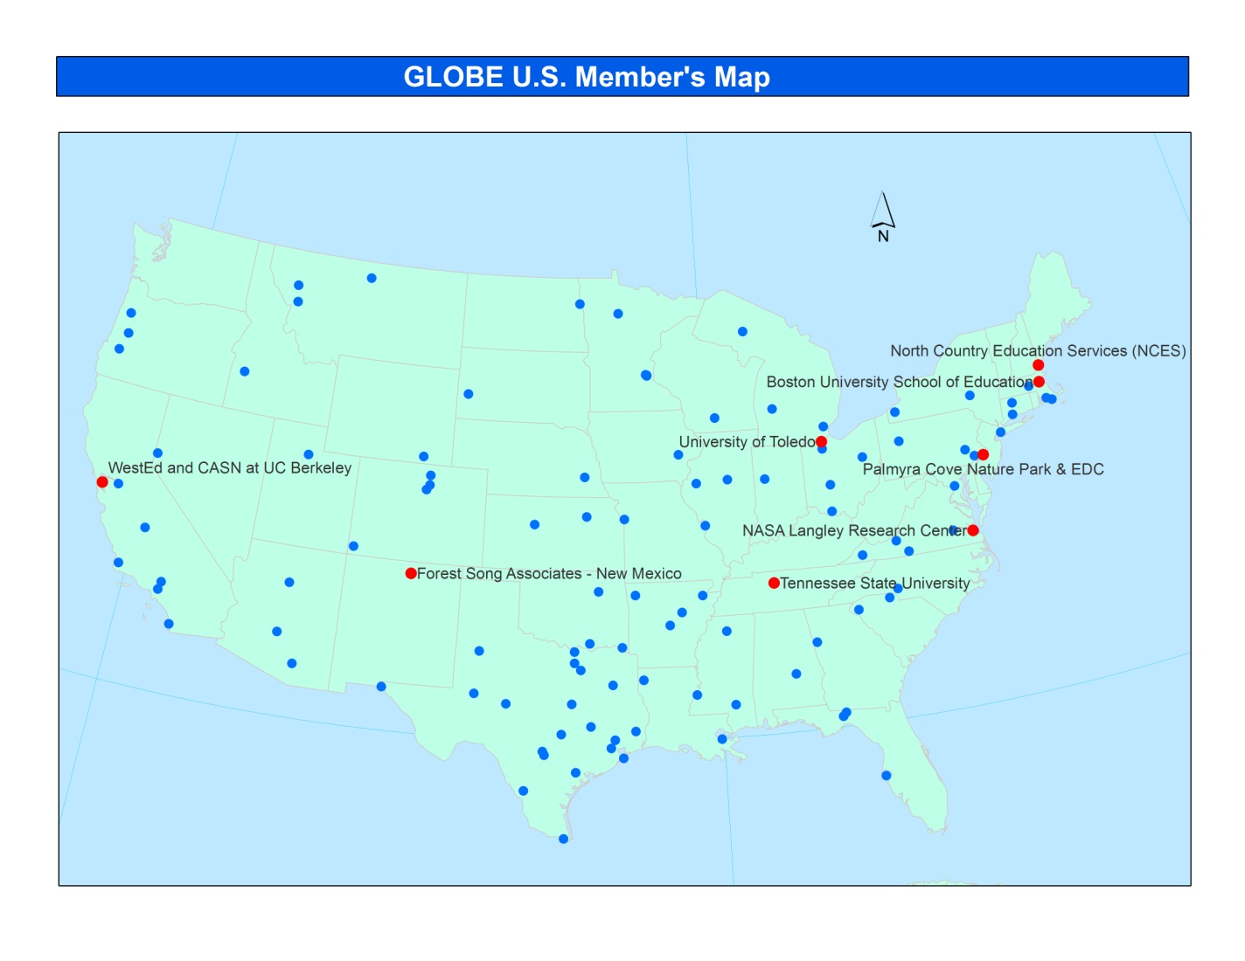
Dissemination of Products and Learning
Information integrated into the GLOBE Community
Presentations and Workshops at Professional Conferences
Publications to Education Research Journals
Information distributed to Informal Science Education and Citizen Science organizations
Jennifer Bourgeault: US GLOBE Country Coordinator will help spread program across the US.
Notes:
Results of the effectiveness of this project will be presented in multiple venues. Presentations of evaluation results will be made at the professional conferences of the American Geophysical Society, the American Education Research Association (AERA), the National Association for Research in Science Teaching (NARST), the National Science Teachers Association (NSTA), and the Association for Science Education. Workshops will be proposed for AERA, NARST, and NSTA on how to conduct the professional development and its outcome. Workshops and presentations will further be proposed for other venues such as the annual Massachusetts STEM Summit meeting, and state meetings of superintendents, principals and science supervisors in Rhode Island, Massachusetts and adjacent New England states. Finally, articles detailing the impact of the project will be submitted to education research journals, as well as to science teachers journals, e.g., Science Teacher.
The GLOBE Community will be a major focus of our dissemination efforts. We will leverage the GLOBE interactions of our team members to inform the broader GLOBE community. For example, Dr. Kevin Czajkowski is the North America representative on the GLOBE Science Working Group, Jessica Taylor is a member of the U.S. GLOBE Partners Forum, and Svetlana Darche and Nektaria Adaktilou are both on the GLOBE Evaluation Work Group. Jennifer Bourgeault, the US GLOBE Country Coordinator, will assist the proposal team with K-12 integration by facilitating conversations between partners and coordinating webinars, email discussions and work-groups around the new materials as they are developed to ensure efficient and timely integration into GLOBE trainings across the country.
While most of the work of this proposal is focused on K-12 formal education, the proposers also realize that this work can translate to the informal science education and citizen science audiences effectively. GLOBE's US partnerships include several informal science centers and organizations, i.e. Talcott Mountain Science Center in Connecticut, WeatherSTEM in Florida, Pacific Resources for Education and Learning in Hawaii, Sci-Port in Louisiana, the Watershed Action Team in Oregon, Berks Conservancy in Pennsylvania, the Hilton Pond Center for Piedmont Natural History in South Carolina, and the South Dakota Discovery Center in South Dakota. Staffing these centers and organizations are GLOBE partnership coordinators with the experience in using these types of materials in their work with the public (school field trips, homeschooling, after-school programming, out-of-town visitors, and local citizens interested in science). Ms. Bourgeault will coordinate a work team of these partners, and other partners using GLOBE as citizen science, to focus on how to integrate MISSION EARTH into these diverse settings.
Material products of the project, such as learning activities adapted to the GLOBE protocols, and lesson plans, including web quests and other activities designed to increase content knowledge through web resources, will be posted on the project website maintained by Boston University. All materials will be provided in PDF format ready for download with full instructions for protocols. Sources of equipment, and plans for do-it-yourself equipment will similarly be provided on the website. Materials will also be made available to GLOBE.

Slide 18
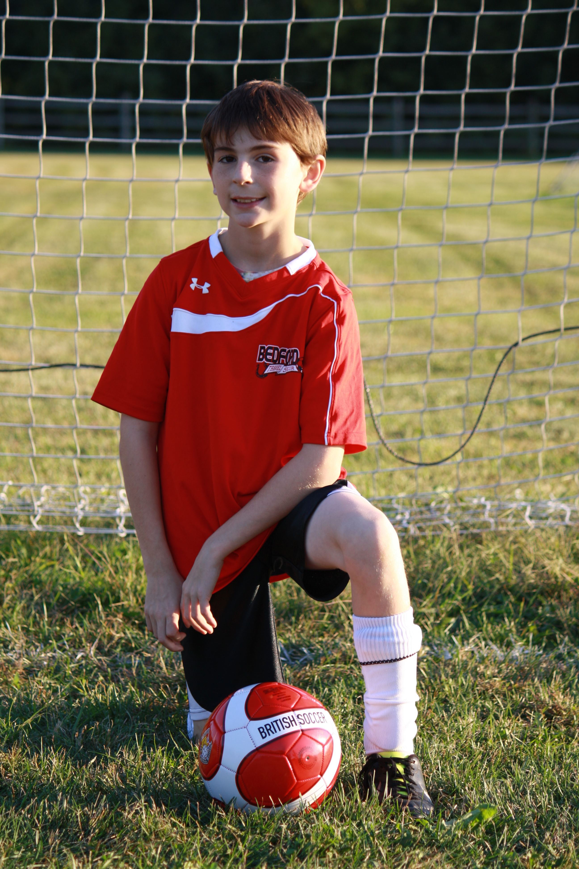
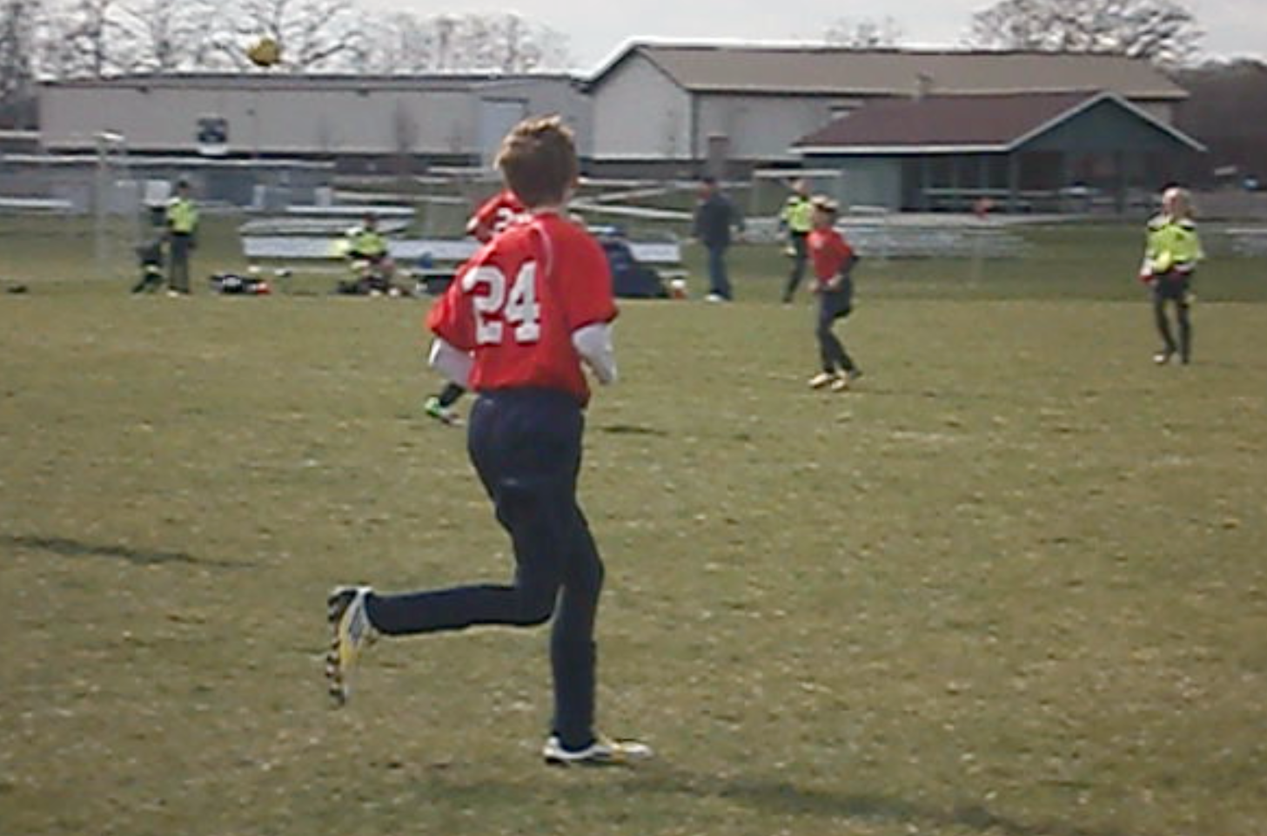
Thank you!
Dr. Kevin Czajkowski
GLOBE Scientist
The University of Toledo
Kevin.czajkowski@utoledo.edu

