Slide 1
NASA Earth Science Education Collaborative (NESEC)
NASA Investigations
with GLOBE:
Campaigns and Challenges
Wednesday, July 17, 2019
Detroit, Michigan, United States

Slide 2
Overview
From Observations to Maps and Decisions (Peder Nelson, Oregon State University)
Community Science with Challenge Leads:
Clouds (Marilé Colón Robles, NASA LaRC)
U.S. Air Quality (Tina Rogerson, NASA LaRC)
GLOBE Mission Mosquito (Dorian Janney, NASA GSFC)
GO on a Trail (Holli Kohl, NASA GSFC)
Trees Around the GLOBE (Brian Campbell, NASA GSFC)
Notes:
format = panel discussion with moderator prompts so everyone is discussing and addressing the same topic

Slide 3
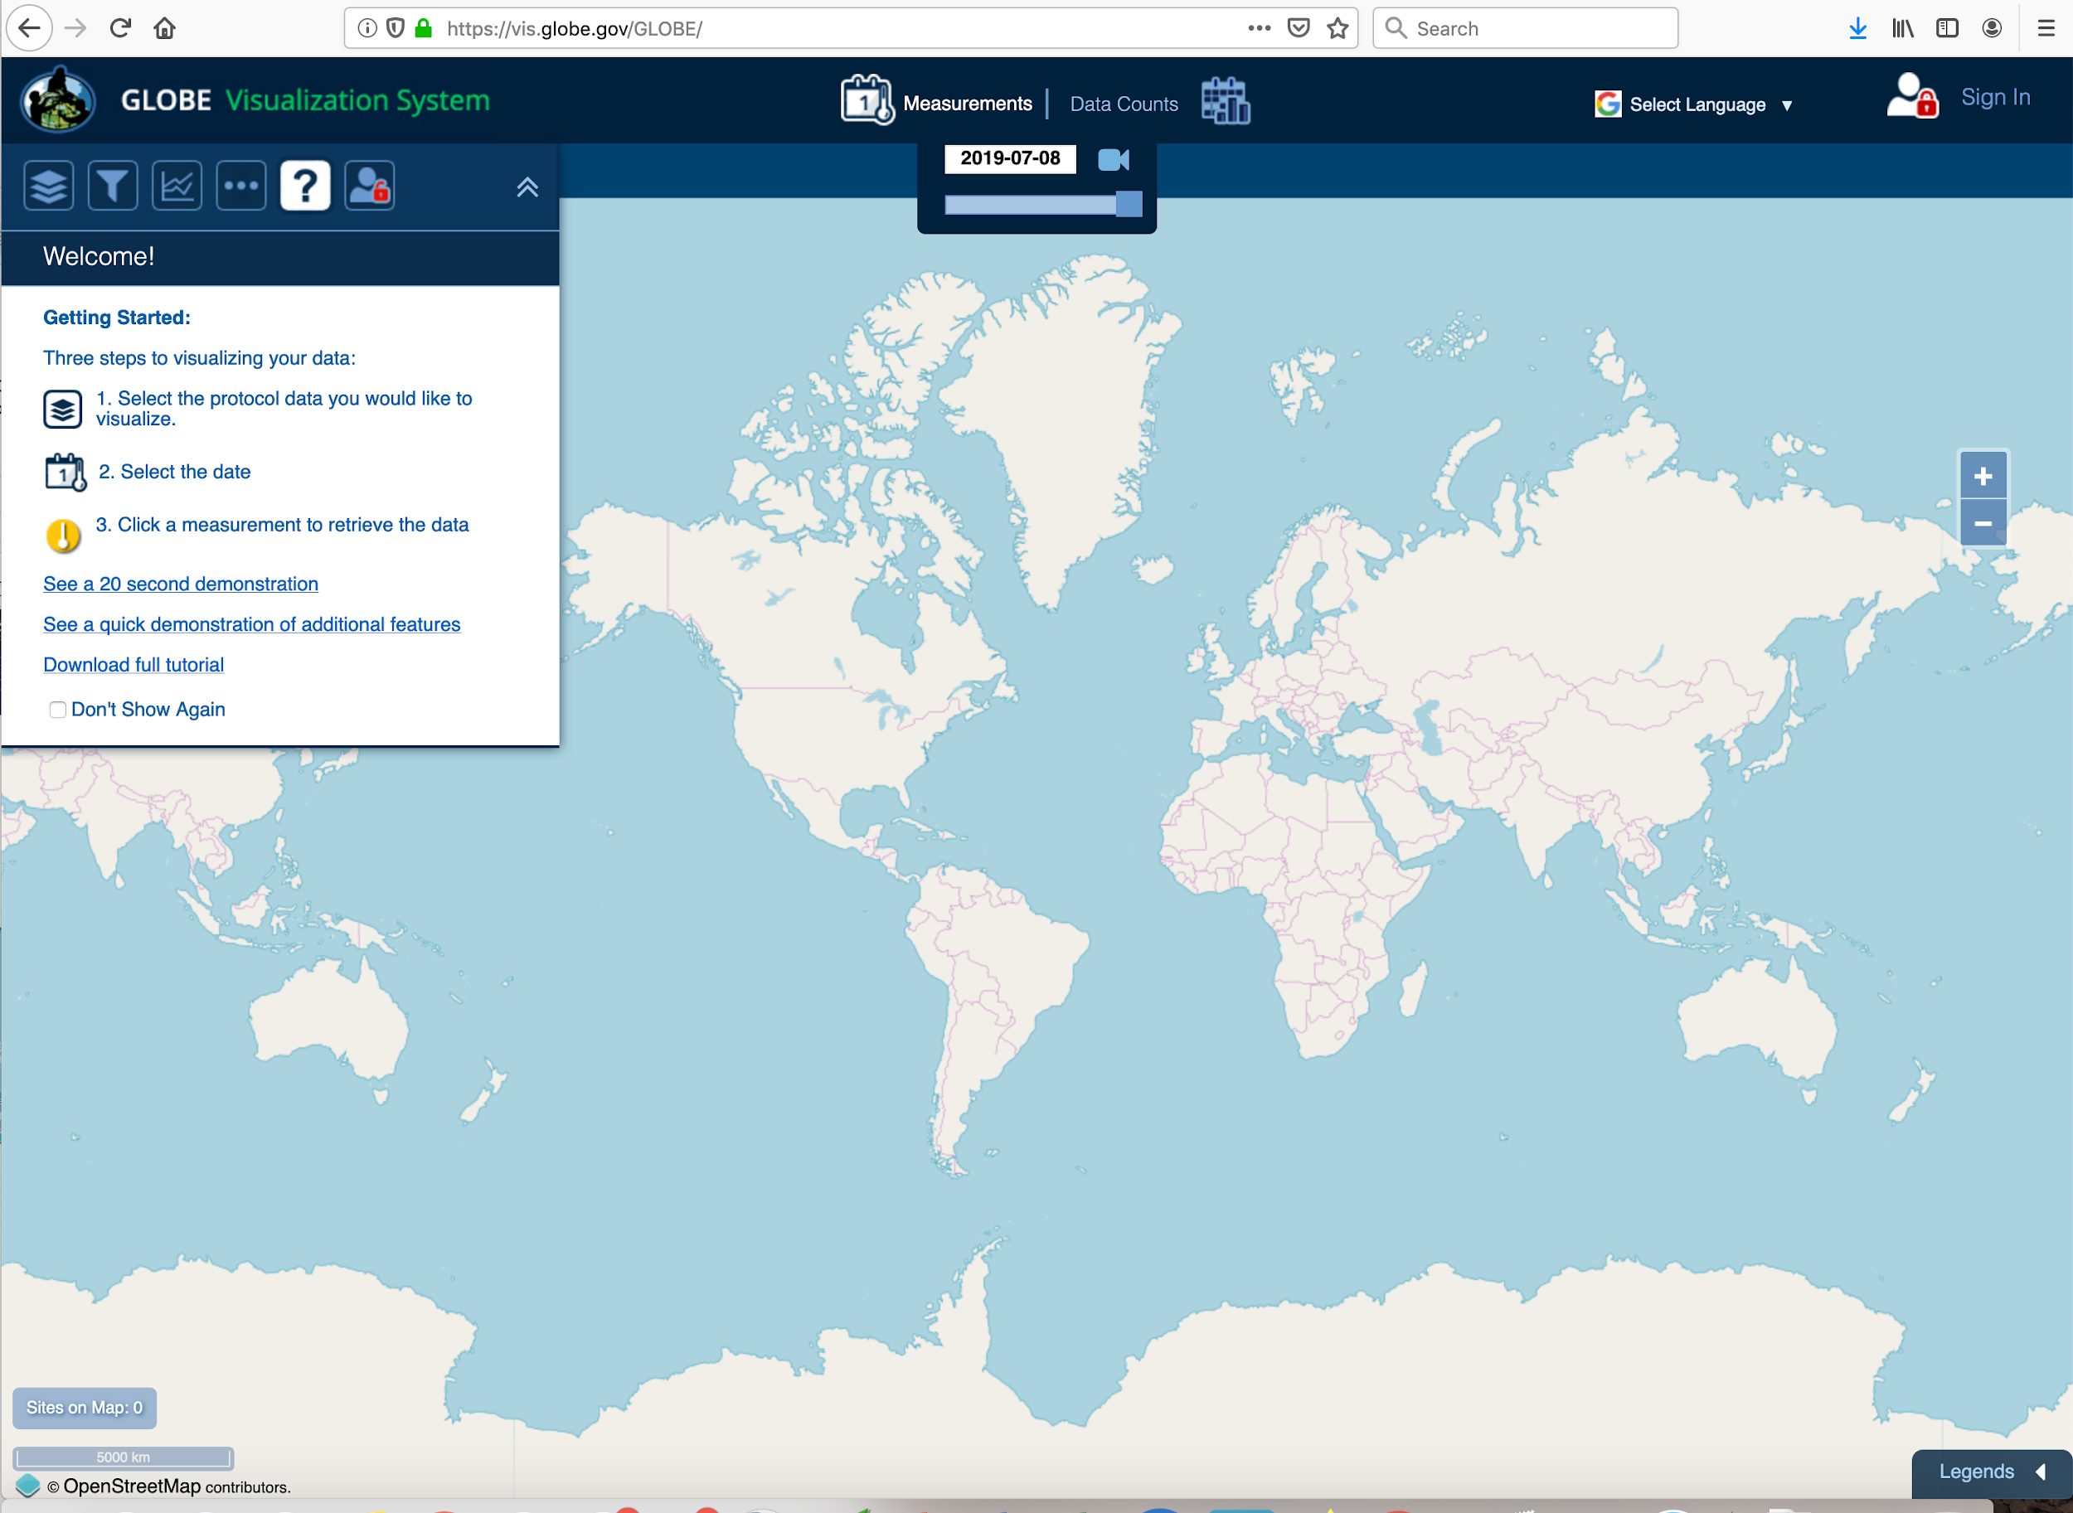
From Observations to maps and decisions

Slide 4
Overview - (Cloud Challenge)
What is the campaign focus?
why
How these campaigns engaging community science?
how are scientists using the data or informing the questions
-Examples of student investigations
-Examples from educators
-Examples from community scientists

Slide 5
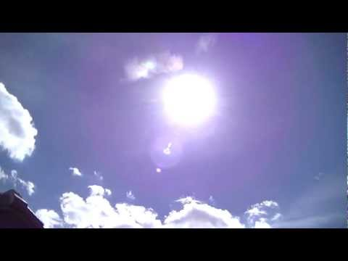
NASA GLOBE Clouds:
Not all clouds are created the same
Video: Which clouds block out the sun?

Slide 6
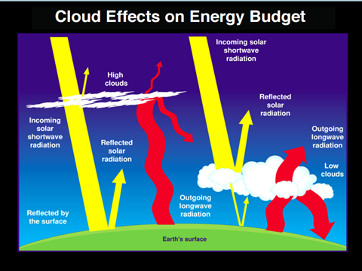

Slide 7
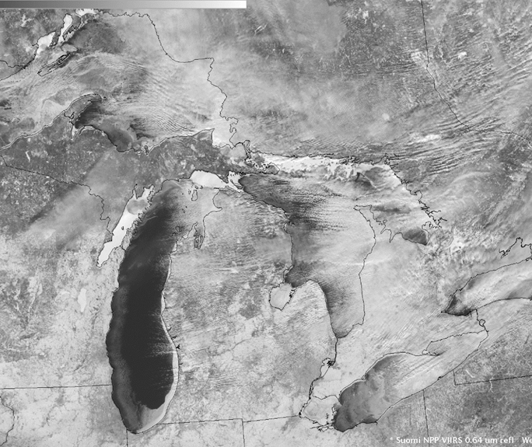
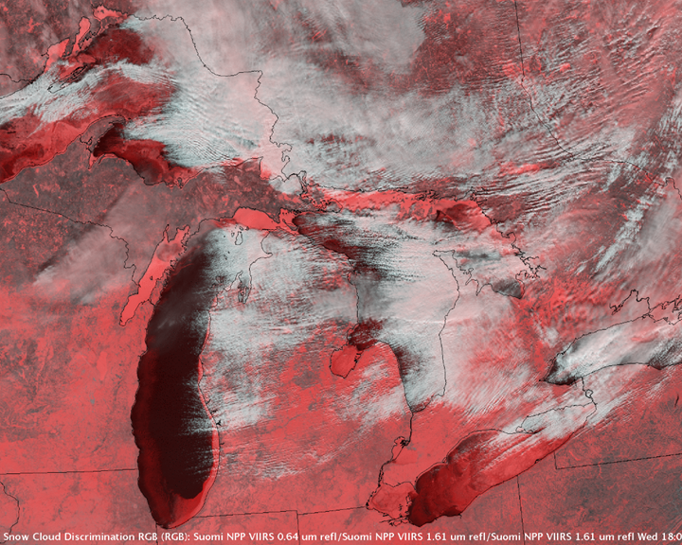
What do satellites see?
Not everything that is white is a cloud!

Slide 8
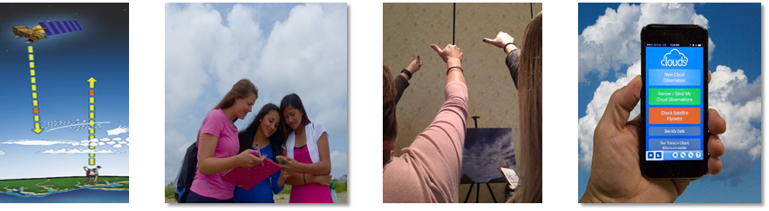
NASA GLOBE Clouds:
We need your observations
All observations, no matter how they are submitted to GLOBE, are matched to a satellite if one was overhead.
PLEASE SUBMIT DATA WITHIN A MONTH.

Slide 9
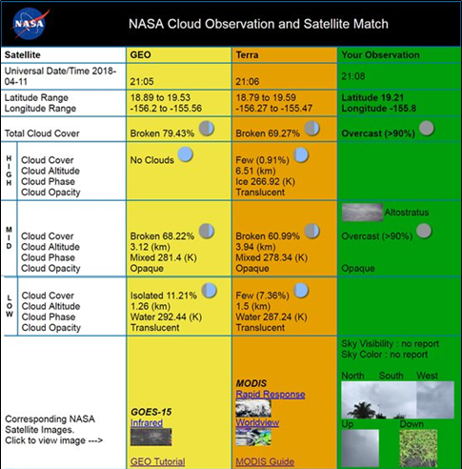
Your observations are in green.
Satellite observations are in yellow and orange with a photograph from the satellite’s point of view of your location.

Slide 10
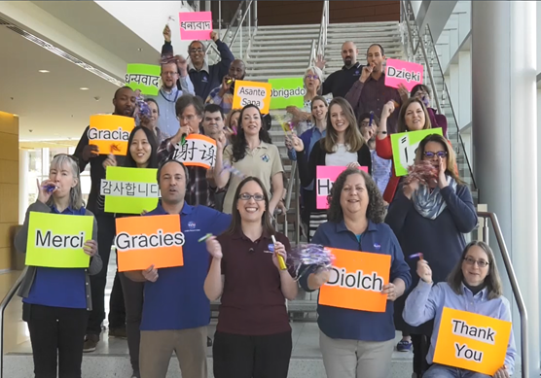
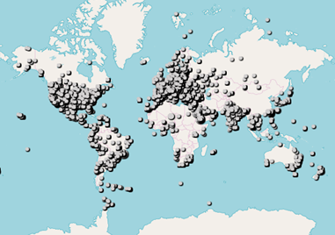
2018 GLOBE Clouds
Spring Data Challenge
The 2018 NASA GLOBE Clouds Spring Data Challenge received over 55,000 observations from more than 15,000 locations in 99 countries in every continent, including Antarctica!

Slide 11
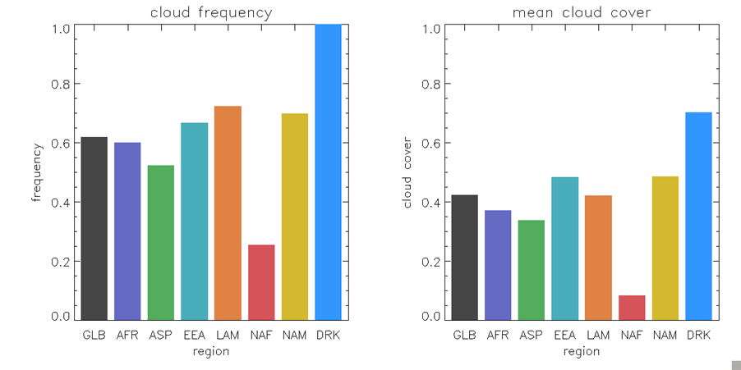
60% of GLOBE participants reported cloudy conditions in Spring 2018
Mean Total Cloud Cover Over the World was 40%

Slide 12
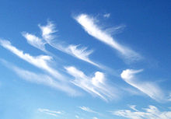
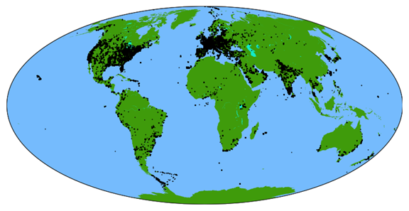
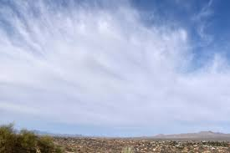
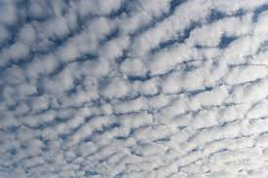
Most observed cloud type for 2018: Cumulus
cirrus
Stratocumulus
Altostratus
215,440 total cloud observations submitted in 2018, covering roughly 11% of Earth’s landmasses.

Slide 13
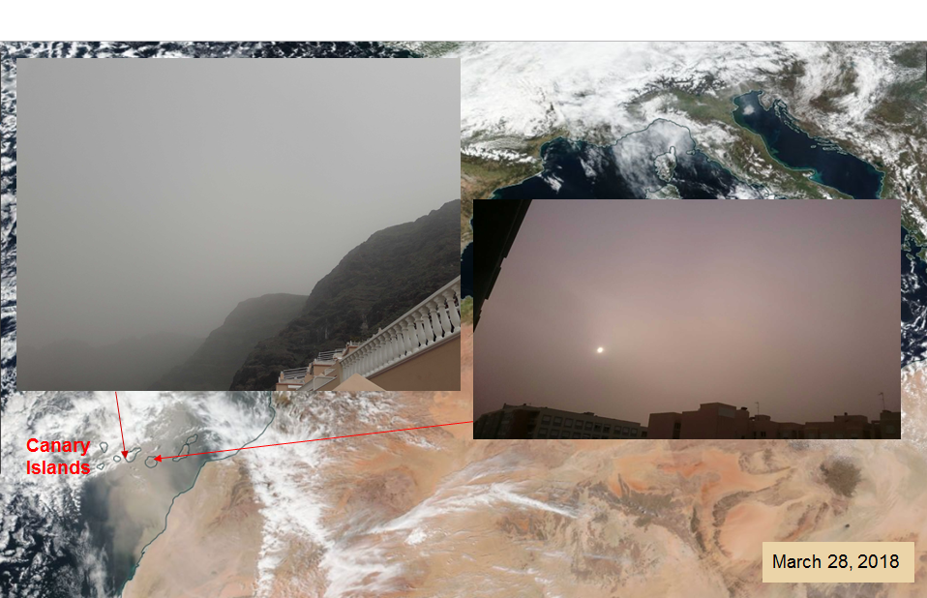
Unique Observations - Dust Storms
GLOBE Observers Caught in Saharan Dust Storm

Slide 14
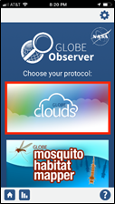
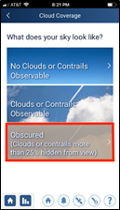
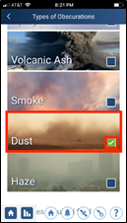
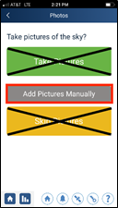
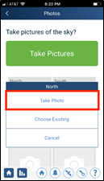
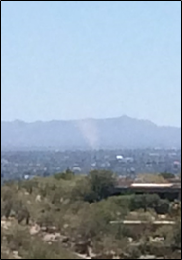
How to Report Dust Storms
Select clouds and choose obscurations
Choose to add pictures manually and submit your pictures of dust storms!

Slide 15
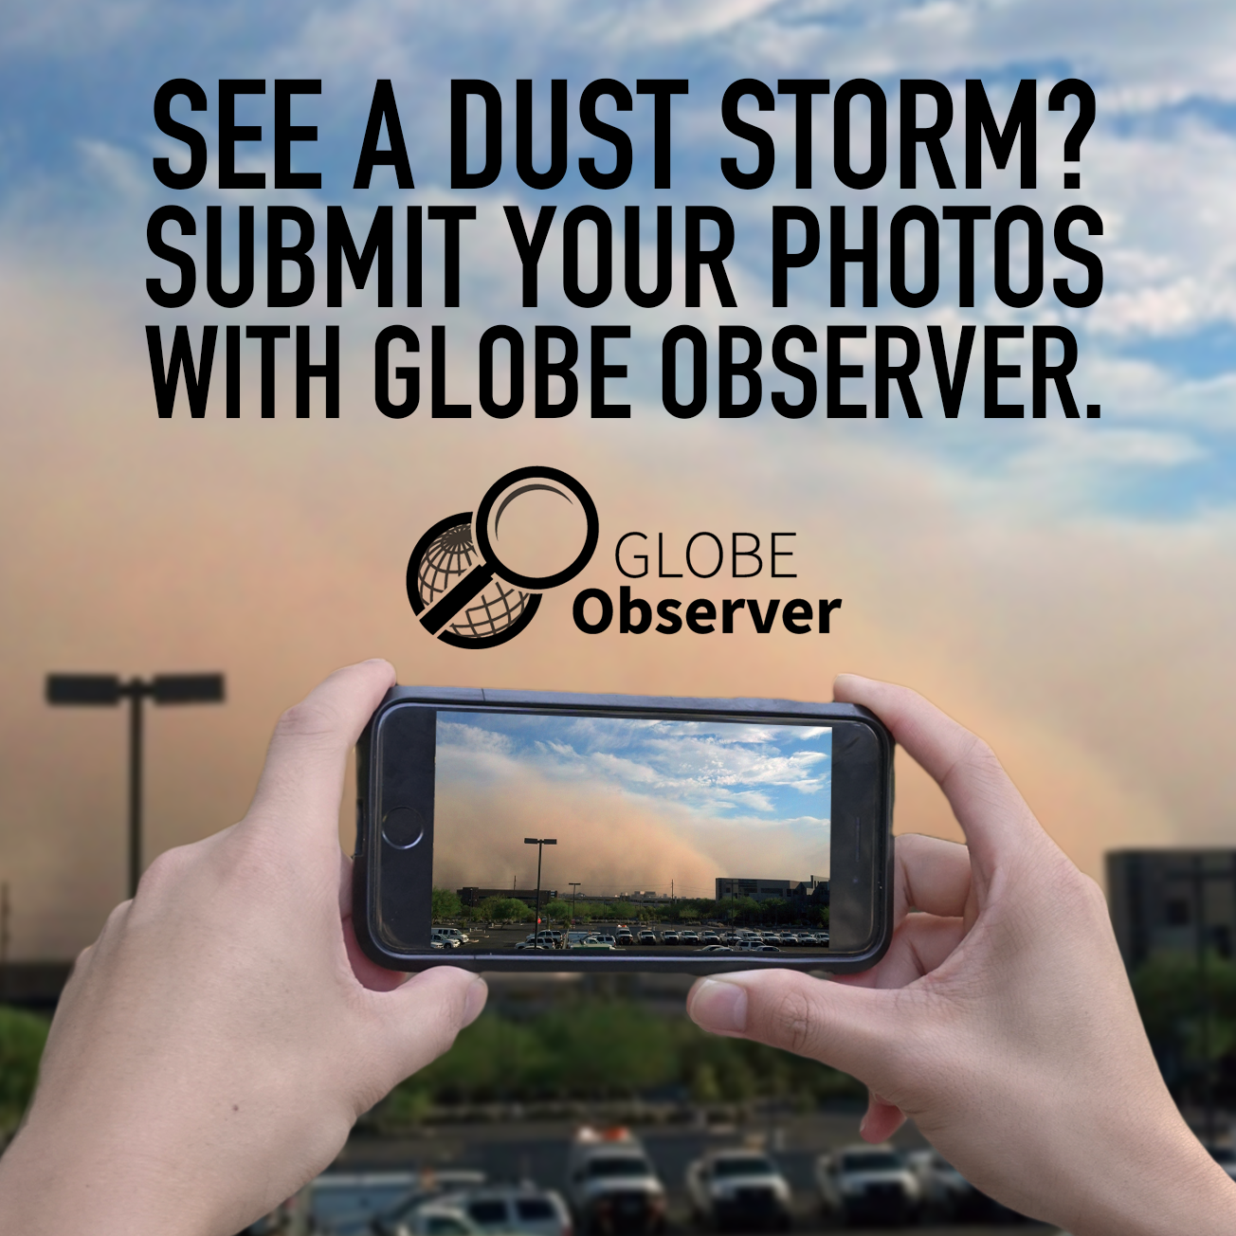
Question: What are the major cloud types worldwide per season?
NASA GLOBE Clouds Fall Data Challenge
October 2019!

Slide 16
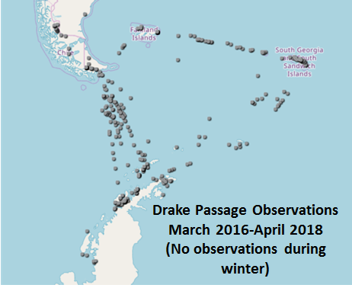
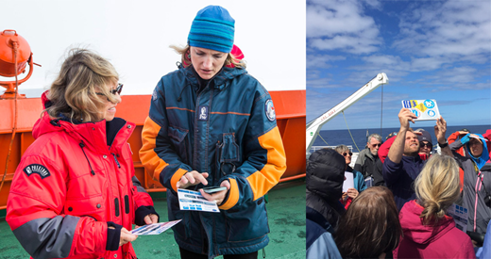
Unique Observations - Antarctica
Cloud and visibility observations over the ocean are being used to validate aerosol layers detected by satellites.

Slide 17
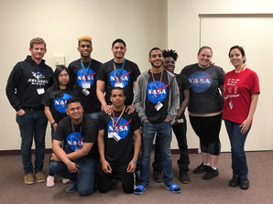
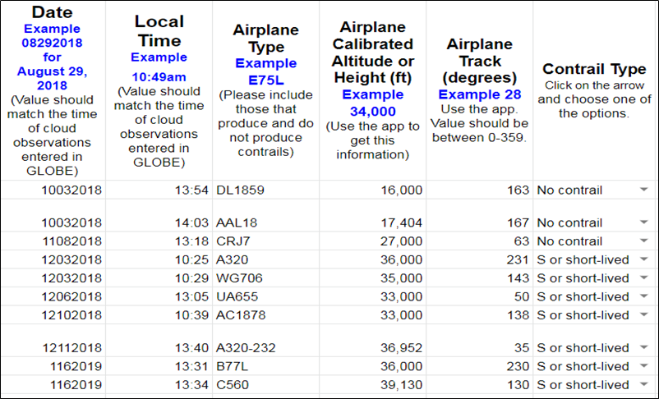
Unique Observations - Contrails
Lexington School for the Deaf has kept track of airplanes that create and those that do not create contrails.

Slide 18
Overview - (U.S. Air Quality)
What is the campaign focus?
why
How these campaigns engaging community science?
how are scientists using the data or informing the questions
-Examples of student investigations
-Examples from educators
-Examples from community scientists

Slide 19
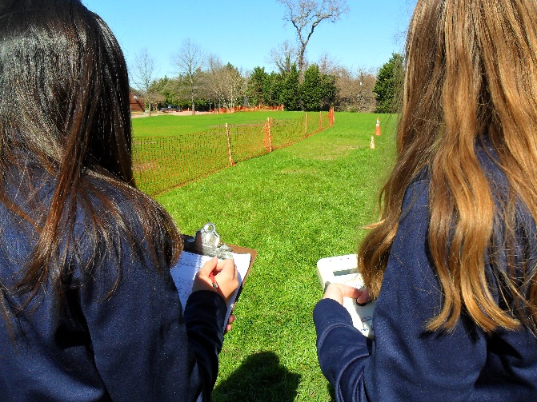
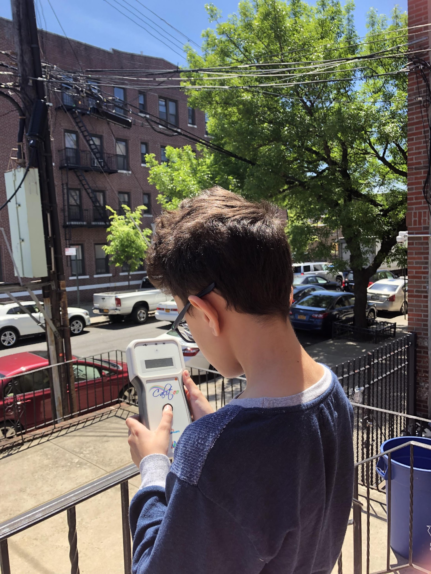
U.S. Air Quality Student Research Campaign
Objectives
  Learn about air quality
  Student Research Opportunities
  Build community of schools
  School network for TEMPO Validation
Protocols
  Aerosols (with supporting protocols)
Support
  Dr. Margaret Pippin m.pippin@nasa.gov
Notes:
TEMPO launch early 2022

Slide 20
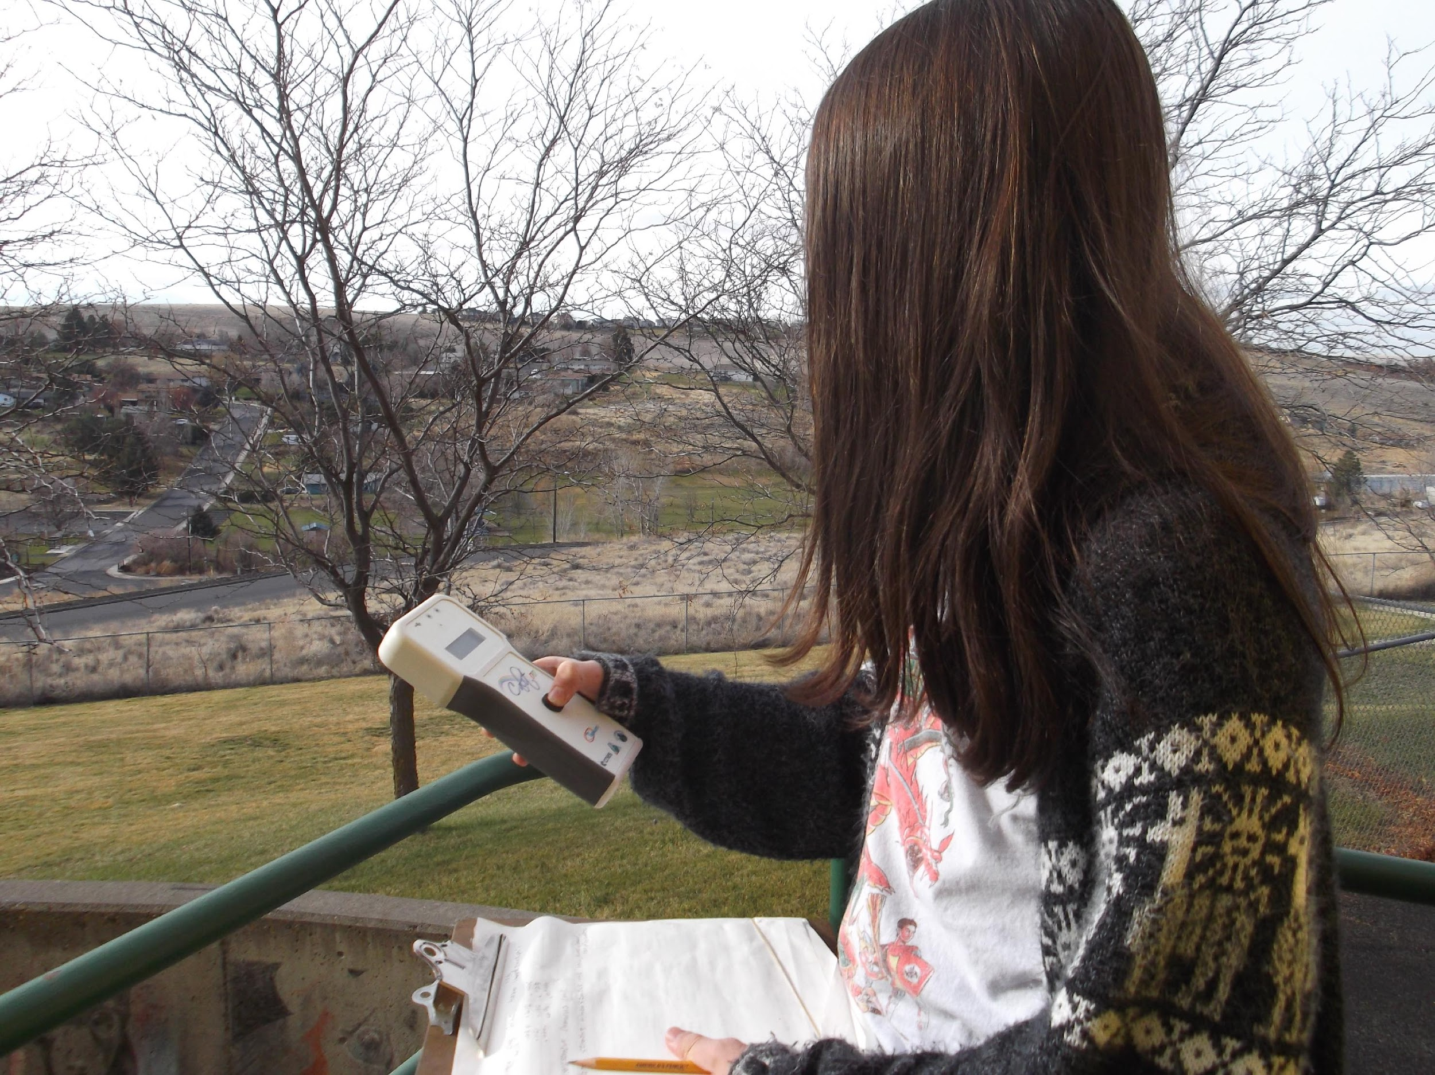
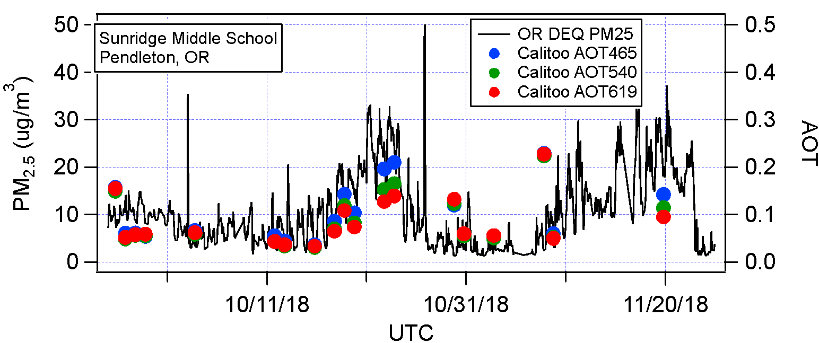
Why Your Aerosol Measurements Matter
- Improve your understanding of local air quality
- Impacts of weather system movement can be tracked
- Widespread measurements can detect movement of air quality
events such as fires
Fire Plume!

Slide 21
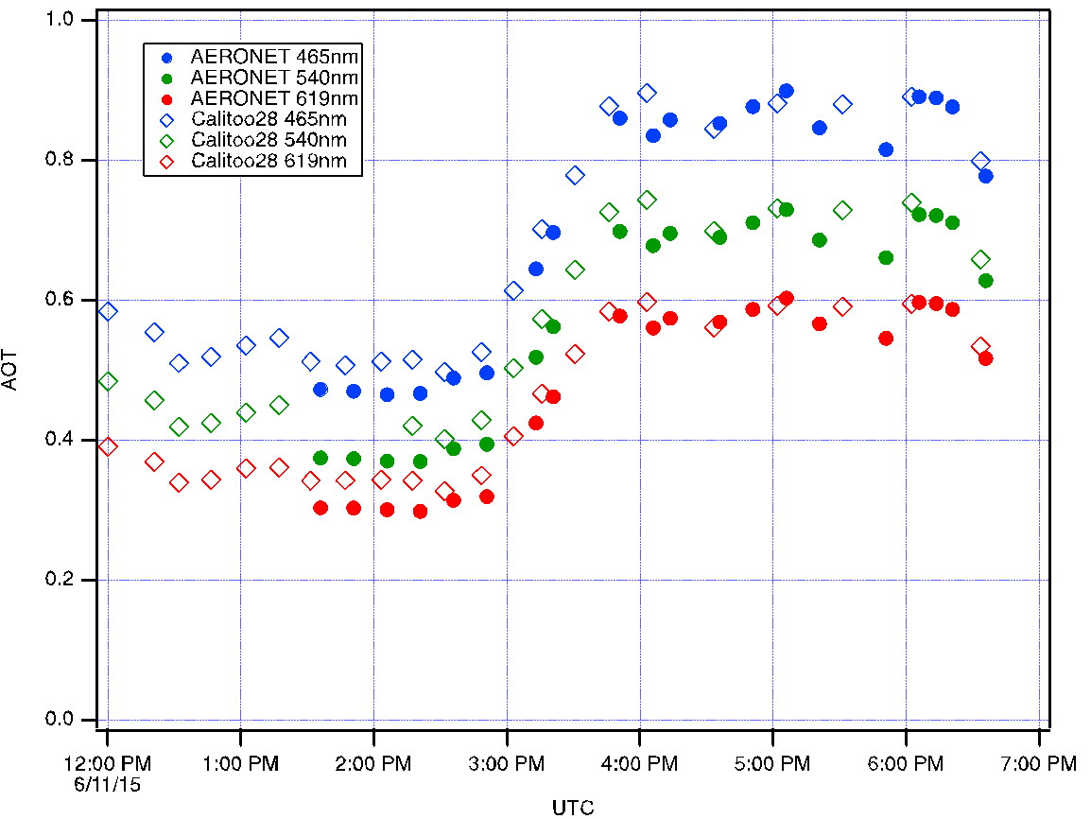
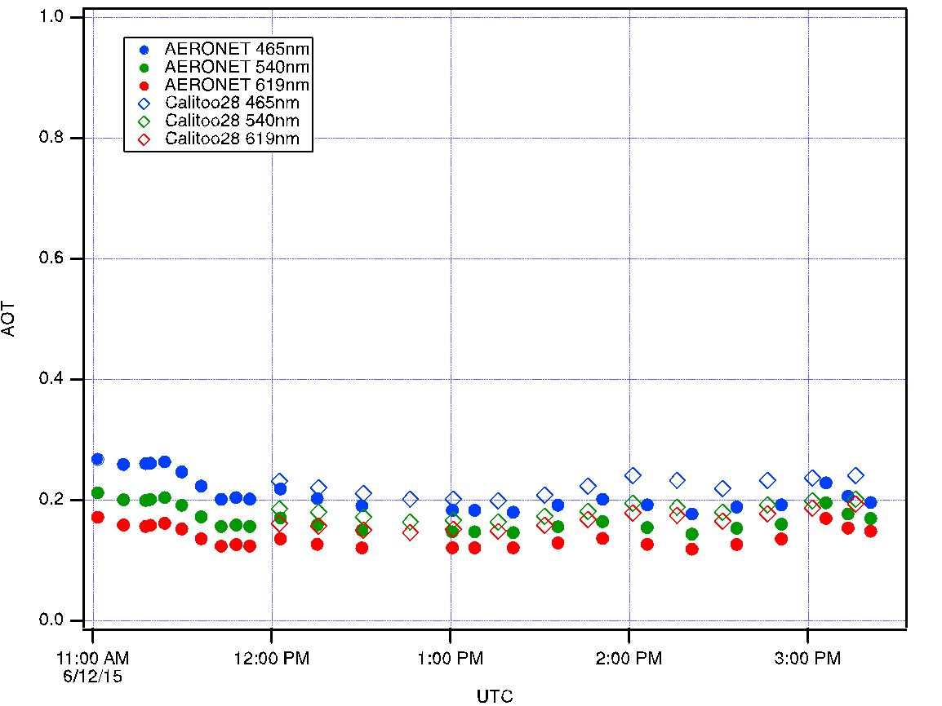
GLOBE School Data Correlates with Satellite Data
Cleaner air
the next day
Smoke
plume
Open markers - calitoo
Solid markers - aeronet
Scientists can use your data in their research to:
- validate satellite observations
- observe local pollution events in places where there are no other instruments
- explore remote locations where data is rare
Notes:
The GLOBE Air Quality campaigns in the US and Europe have been collaborating since 2016. (Danielle de Staerke at CNES leads the European AQ campaigns)
Aerosol is measured using a Calitoo sun photometer which was developed in France in collaboration with CNES and then evaluated at NASA Langley.
The Calitoo compares extremely well with NASA AERONET as shown.
The AERONET project is a federation of ground-based remote sensing aerosol networks established by NASA along with CNES and other partners
The student measurements show a wild fire smoke plume as it moved across the area.

Slide 22
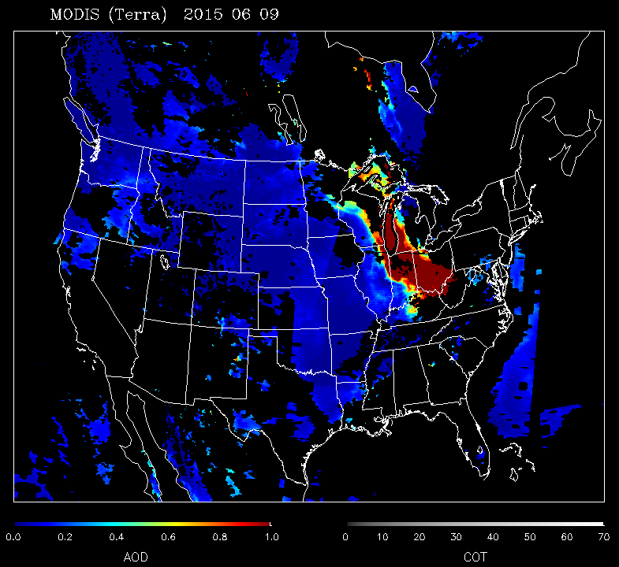
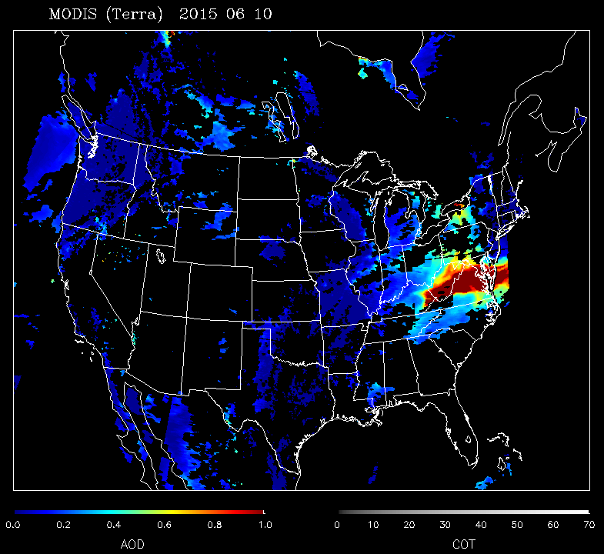
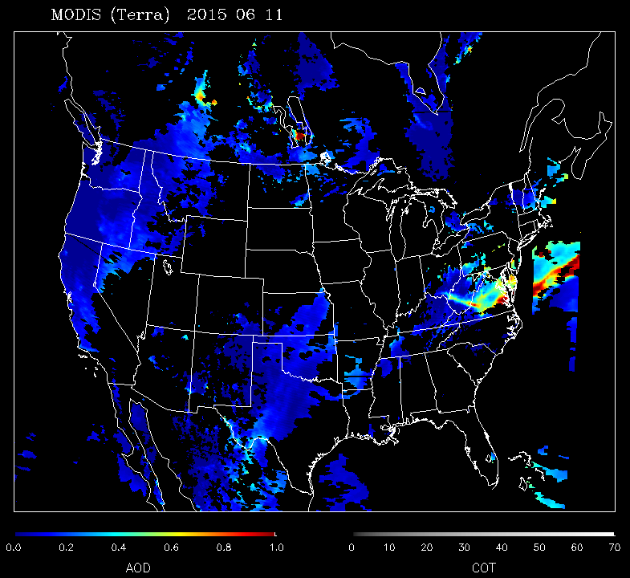
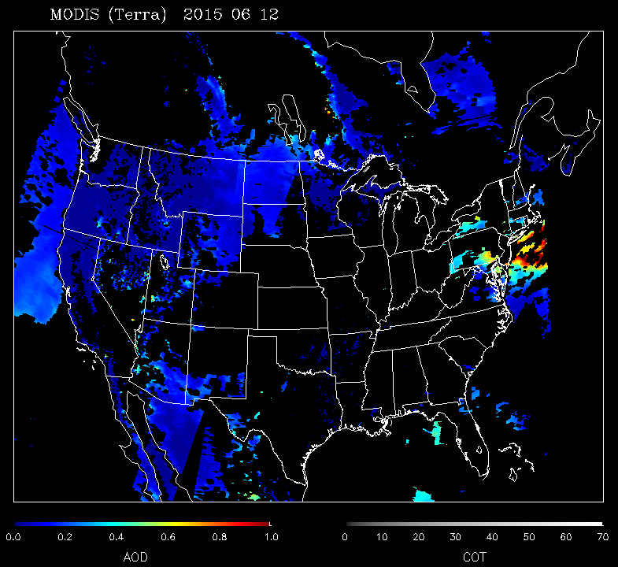
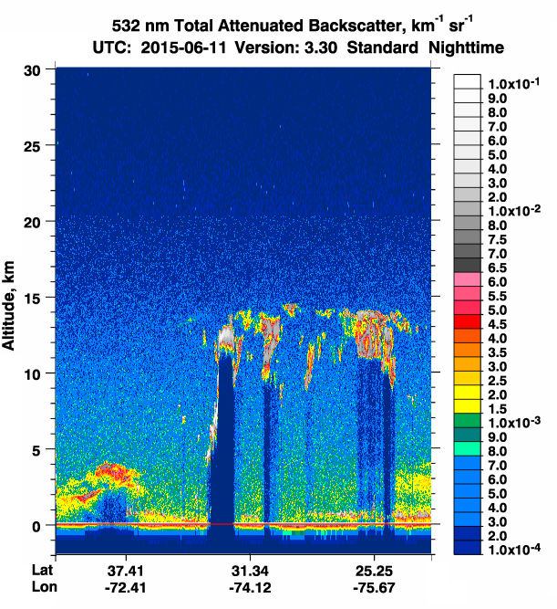
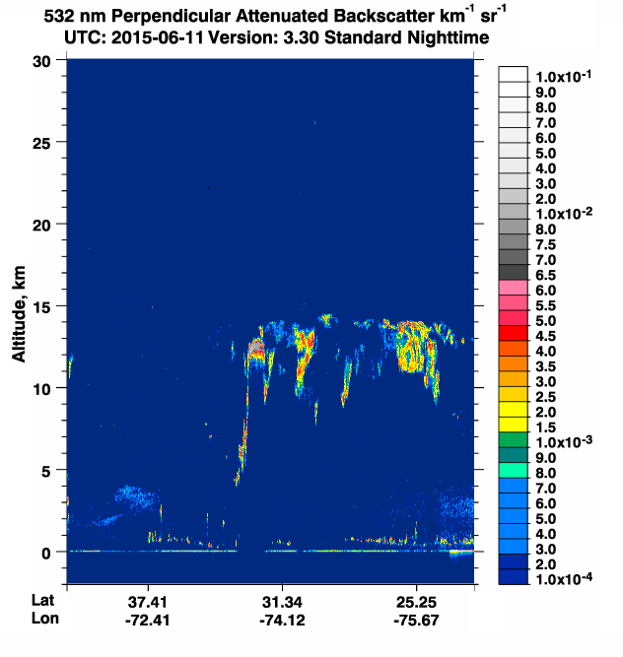
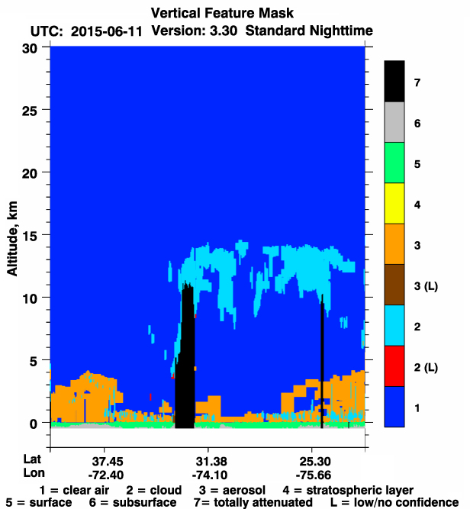
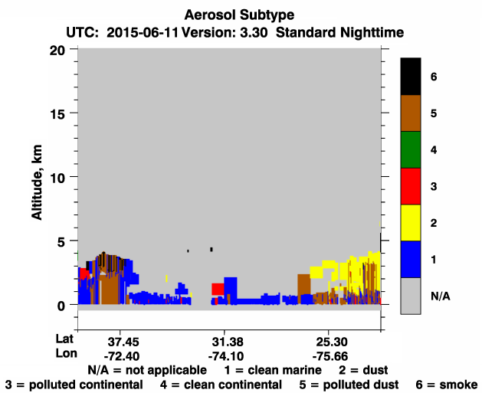
Analysis of Smoke Plume Episode using Satellite Data
MODIS images from Terra Satellite
Smoke plume
2015-6-9
2015-6-10
2015-6-11
2015-6-12
CALIOP images from CALIPSO Satellite show vertical profiles of aerosol
aerosol
smoke
Notes:
Globe schools use data from established NASA missions and projects such as CALIPSO, MODIS and AERONET.
along with their own data to help understand their data within the larger context of what is happening.
The increased aerosol is evident in the MODIS image.
CALIPSO identifies the aerosol as smoke aloft.
(CALIPSO is a joint mission between NASA and the French space agency, CNES)

Slide 23
Overview - GLOBE Mission Mosquito
What is the campaign focus?
why
How these campaigns engaging community science?
how are scientists using the data or informing the questions
-Examples of student investigations
-Examples from educators
-Examples from community scientists

Slide 24
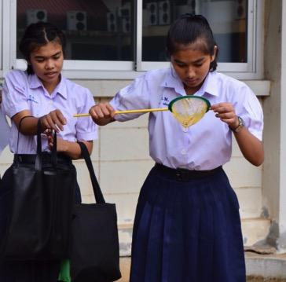
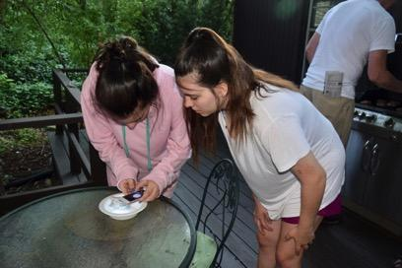
GLOBE
Mission Mosquito

Slide 25
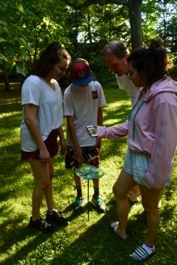
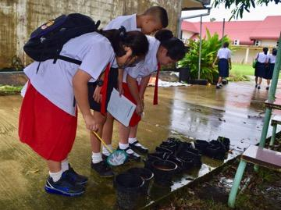
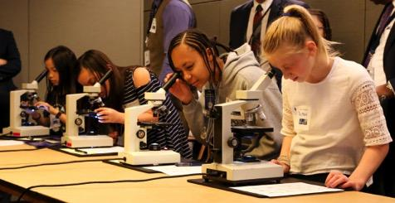
The goal of GLOBE Mission Mosquito is to create an organized citizen science community - primarily through formal education, with targeted outreach to informal education - that will conduct and report local observations using the MHM.

Slide 26
GLOBE “Mission Mosquito”
D
Campaign connecting citizen scientists of all ages to monitor changes in the frequency, range, and distribution of potential disease vector mosquitoes
Conduct research to explore how these vary in response to changes in environmental conditions
Fusion of the GLOBE and the GLOBE Observer programs

Slide 27
Key Scientific Questions
Identify baseline (2018-2021) for range and distribution of vectors such as Aedes aegypti and Aedes albopictus.
Identify seasonality of local mosquito vectors: first sighting, last sighting, period of greatest number of observations
Quantify change in mosquito frequency and distribution at local, regional, national and global scales with specific reference to prevailing environmental parameters, such as precipitation, land cover, surface temperature, and soil moisture.

Slide 28
Campaign Participants:
are identifying potential risks in their community
are mitigating mosquito breeding habitats
making communities safer from disease

Slide 29
Engaging Community Science
Creating a community of interested citizen scientists who are engaged in reducing the threat of mosquito transmitted disease:
dedicated website
bimonthly webinars
monthly newsletter
IVSS scientist and educator mentors
sharing Best Practices, examples, ideas, frustrations, etc.
regular outreach to data submitters

Slide 30
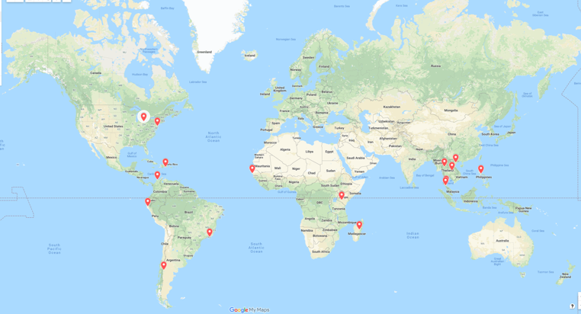
23 IVSS Projects using MHM
http://bit.ly/2MsQQxt
http://bit.ly/2MsQQxt

Slide 31
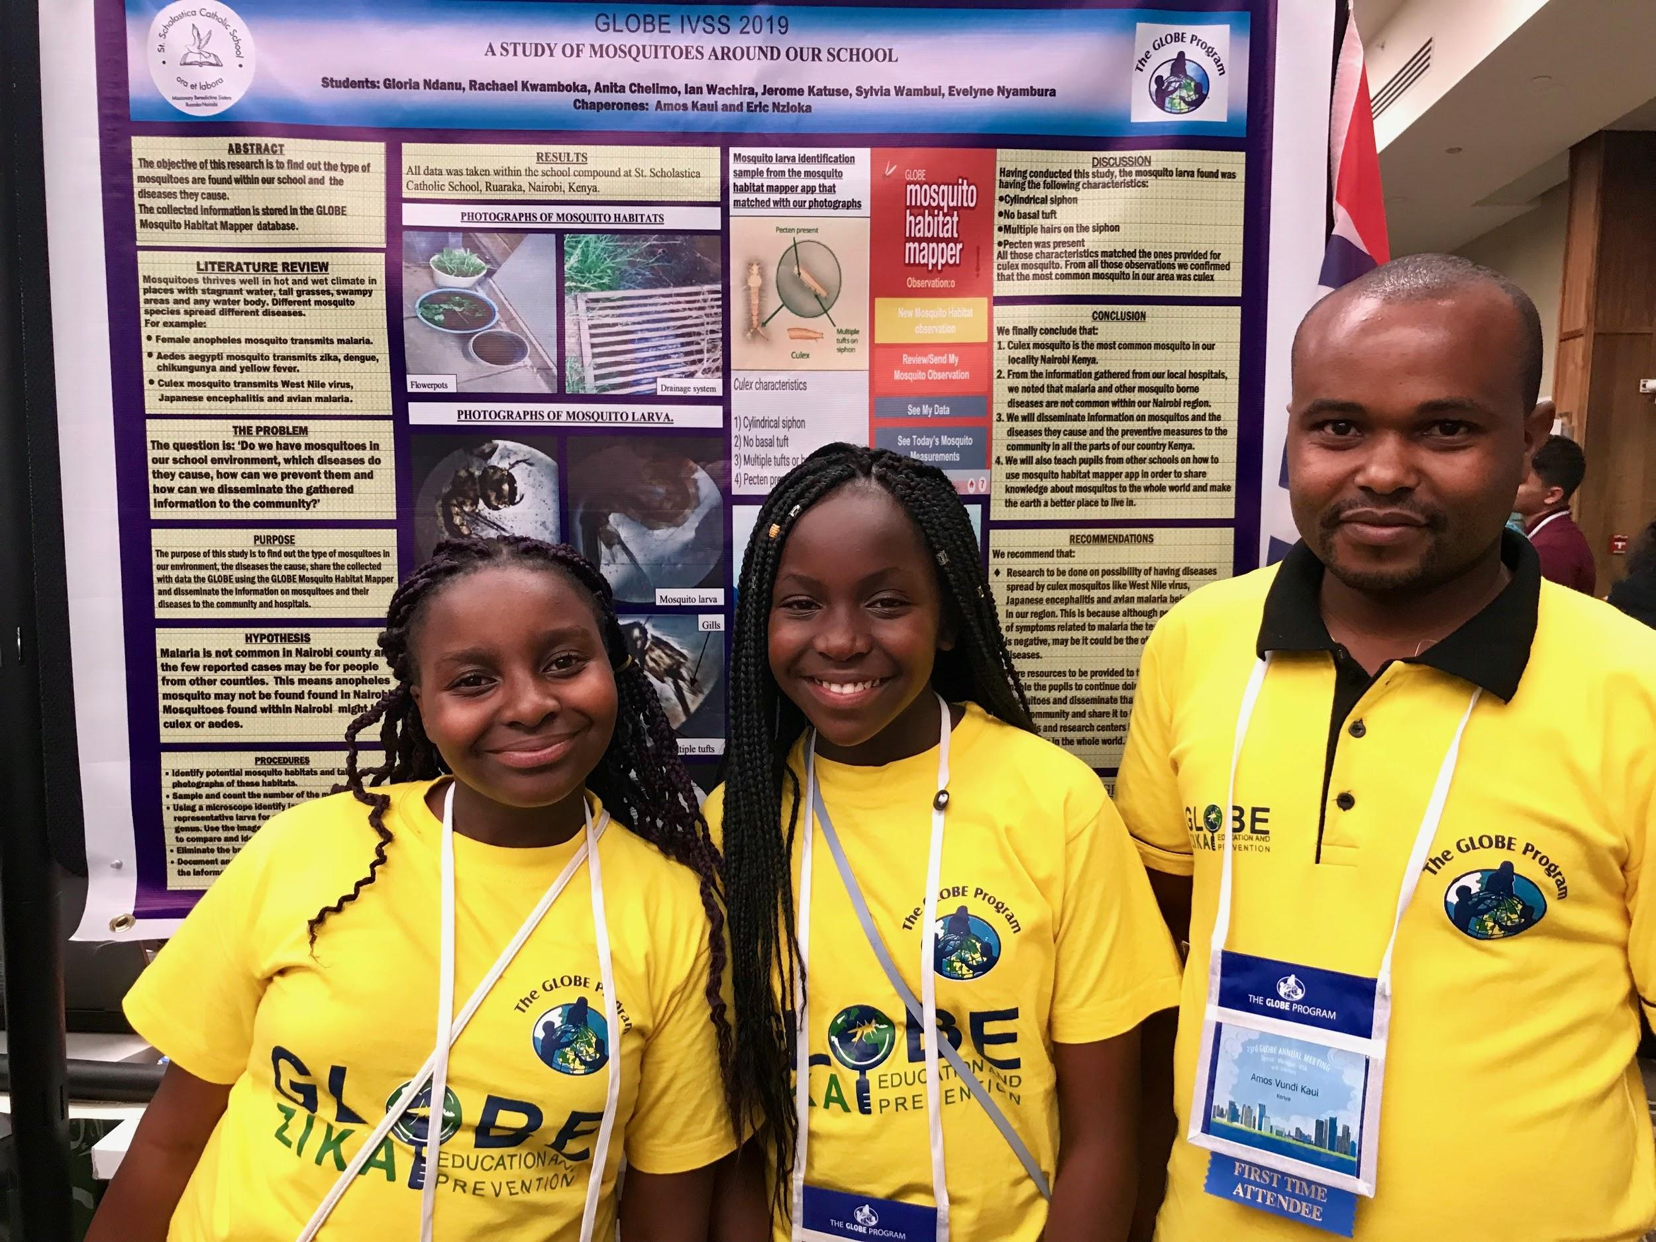

Slide 32
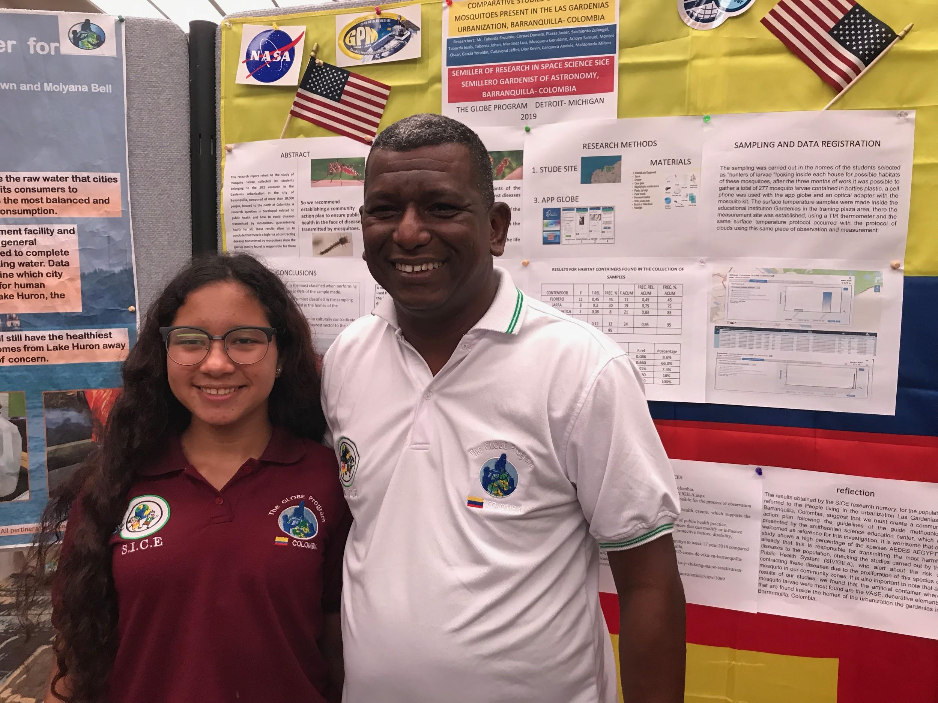

Slide 33
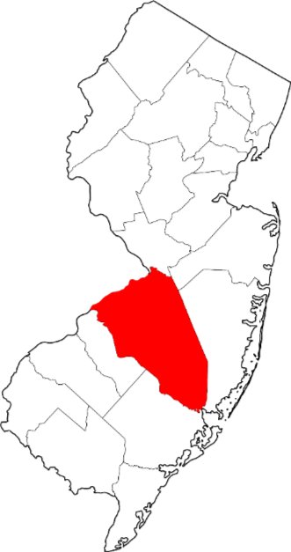
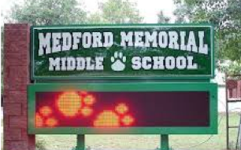



Slide 34

Student Investigations

Slide 35




Thailand

Slide 36

Informal Education settings:
Library programs
After School Clubs
Nature Centers
Environmental Outdoor Education programs
Summer Camps
High School students summer online program
Native American Youth Council

Slide 37


Columbia GLOBE v-School

Slide 38


Slide 39
Involving Scientists:
Involving scientists in conducting research that takes advantage of the MHM data and tool
GO Oklahoma Citizen Science Campaign
recruiting citizen scientists in greater Oklahoma City area, teaching them how to use the MHMN to explore the extended range of Aedes mosquitoes, taking place this summer

Slide 40

Metrics
MHM data submissions 5/17-10/18: 4,740
MHM data submissions as of 7/16: 14,164

Slide 41
Still have questions?
Dorian Janney, Education Lead and Campaign Organizer
dorian.w.janney@nasa.gov
Dr. Russanne Low, Science Lead, GLOBE Observer Mosquito Habitat Mapper, GLOBE Mission Mosquito Campaign Co-lead
rusty_low@strategies.org
Cassie Soeffing, Education Specialist
cassie_soeffing@strategies.org

Slide 42
Overview - GO on a Trail
What is the campaign focus?
why
How these campaigns engaging community science?
how are scientists using the data or informing the questions
-Examples of student investigations
-Examples from educators
-Examples from community scientists

Slide 43


Challenge!
June 1 – Sep 2
Map the land around you in the spirit of Lewis and Clark.
Winners will receive recognition and a prize package!

Slide 44

Lewis & Clark National Historic Trail is a near transect of the United States. It offers a nice sample of multiple kinds of ecosystems across the continent.

Slide 45

How to join the challenge
Take Land Cover observations on the Lewis and Clark Trail. Get points when you submit the data.
Observation Station:
4 points
Designated Historic Site: 2 points
Anywhere on the trail (Satellite Pixels on Trail): 1 point

Slide 46


Map at observer.globe.gov/go-on-a-trail

Slide 47

GO on a Trail International
Away from the trail, collect points by taking as many land cover observations at as many different locations as possible. Most area mapped wins.

Slide 48
But why does NASA care?

Slide 49



Slide 50
GO on a Trail Science
Observation stations: repeat data.
  How well does location services work across different phones?
  How do different people classify the land? What is the variability?
Historical sites: How has land cover changed independent of direct human land use? Park wanted a sample of land cover at each of 7 ecoregions
Satellite locations: How does GLOBE land cover compare to satellite-based land cover classification? What can you do to verify satellite land cover with GLOBE data?
International: baseline of measurements

Slide 51


Questions?
Holli Kohl holli.kohl@nasa.gov
@nasa.globeobserver
observer.globe.gov
@nasago

Slide 52



Slide 53




Slide 54



Slide 55


Slide 56


Slide 57


Slide 58


Slide 59



Slide 60


Slide 61


Slide 62


Slide 63

www.openaltimetry.org

Slide 64

CONTACT INFORMATION
Brian Campbell, Trees Around the GLOBE Student Research Campaign Lead
NASA Wallops Flight Facility, Wallops Island, Virginia, USA
Brian.A.Campbell@nasa.gov

Slide 65
Break: 10:15-10:30
10:30-12:00
Go to Grand A:
Station Activities and Tabletop Demos

