Slide 1

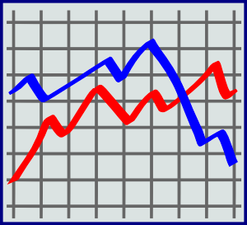
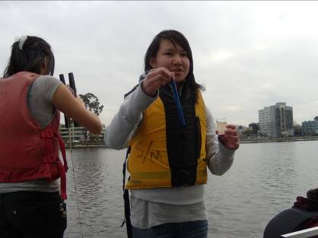
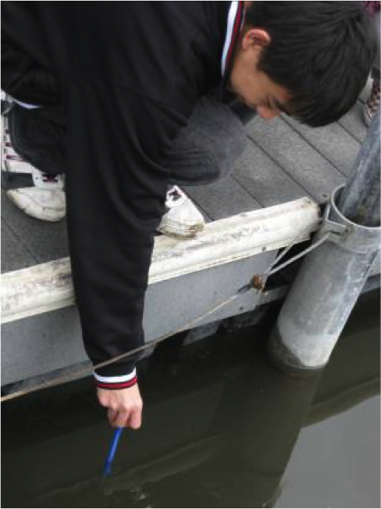
Concise Title of Less Than 15 Words That Summarizes the Study
Team Members
School Name
School Logo
Abstract
Research Methods
Results
  Write less than 200 words
  Describe the research context and objectives
  Ask the research question
  Describe the methods, state the results, and draw conclusions
  Our research is about _____ because ______
  Our research question is _______
  The GLOBE protocols we used were _______ to test _____
  The results of our research are ______
  We conclude that ______
  Planning Investigations
  Describes the planning process
  Write between 300 and 500 words
  Present the investigation plan
  Include a map and description of the study site with mention of:
  (1) the area of study, (2) climatic characteristics, and (3) basic aspects of land cover
  Describe the GLOBE protocols and NASA assets used
  Describe the process for data collection, including instrument calibration, preparation of materials, and tools and equipment used
  Include the planned data collection activities including: (1) how time of day of data collection was selected, (2) how frequently data was collected, and (3) the location of sample collection and measurement
  Include a Google Earth map and (if possible) a NASA satellite image
  Our plan for the investigation is _______
  Our plan will produce data to test ________
  The study site is located at _____
  Our study site looks like _____
  The GLOBE protocols we plan to use are_______
  We plan to collect ___ data, ___ times each day, ___ days each week
  We plan to collect data at _____ time of day.
  Carrying Out Investigations
  Describes what actually happened
  Write between 300 and 500 words
  Identify the GLOBE protocols, data, and NASA assets actually used
  Describe data collection activities that actually happened including
    Steps for data collection
    When and how often data was collected
    Types and amounts of data collected
    Locations at the study site where data collection happened
    Role each team member played in carrying out the investigation
Describe procedures for data analysis including mathematical calculations used
Explain how the methods used to carry out the investigation help to answer the research question
  The GLOBE protocols we used were _______
  When we collected data (this happened_______
  We collected a total of ______ data points for _______
  We collected a total of ______ data points ______
  We analyzed the data using ______ procedures
  Our methods help to answer the research questions because ______
  Analyzing Data
  Write between 400 and 600 words
  State the results
  Perform analysis to address the research question
  Show patterns and trends in the data using tables, figures, and graphs
  Our results show _______
  The analysis we conducted addressed the research question because _____
  As shown in our data table, _____ data was collected and _______ data points were entered into the GLOBE database. (See data table and graph)
  A summary of our results shows _______
  According to our data, _______(this happened)
Discussion
  Interpreting Data
  Restate the most important results
  Discuss the what the results mean
  Explain the importance, relevance, and impact of the research
  Compare results with similar studies
  Discuss how and why the results help answer the research question
  Answer the research question
  Support or refute the hypothesis
  Interpret the uncertainties and limitations of the research process including possible sources of error
  The most important results are _______
  The results mean that ________
  The data are important to science and our community because _____
  Comparing our results to similar studies by other researchers reveals _______
  The results (do or do not) help answer the research question because _______
  The results (do or do not) support our hypothesis because _______
  We had problems collecting and recording data because _______
  We had problems analyzing data because_________
  Uncertainties and limitations in our research process means ______
Question/Hypothesis
  Asking Questions
  Write between 250 and 400 words
  Ask the research question
  State the hypothesis
  Discuss the research by answering the following questions:
    How can the research question be answered with GLOBE data?
    Is the question important and of scientific interest?
    Does the question address a local or global community issue?
    Do the question and the hypothesis show in-depth content knowledge?
    How does the research expand on previous investigations?
  Our research question asks _____
  Our hypothesis is _____
  We are interested in researching this topic because _____
  In class we learned ______ and we wanted to find out more about _______
Figure #2
Introduction
  Content Knowledge
  Write between 300 and 500 words
  State the importance of the research
  Review what you know already about this research topic
  Describe the environmental or societal issue addressed by the research question
  Demonstrate knowledge of facts, scientific concepts, and fundamental principles covered in the GLOBE protocol
  Cite research from 3 or more scientific studies, including at least one primary source in a “peer-reviewed” journal
  Researching this topic is important because______
  This topic addresses _______ issue because _____
  For our research we used ________ GLOBE protocols or data to understand how ________
Conclusions
  Drawing Conclusions & Next Steps
  State conclusions
  Support conclusions with interpretations of the results
  Explain how conclusions were reached
  Discuss implications for future research including improvements in the methods and recommendations for follow-up research
  Our conclusion is (or is not) supported by the results because_____
  Improvements to our research can be_______
  We appreciated doing this research for GLOBE and NASA because_______
Figure #3
Figure #1
Map of Study Site(s)
Bibliography
  References
  Cite the GLOBE website and any other literature
  (See owl.english.purdue.edu for guidance and resources)
  List GLOBE materials and NASA assets used
  Provide sources beyond those provided by GLOBE
Field Photos (requires release forms)

