Slide 1

Concise Title of Less Than 15 Words That Summarizes the Study
Collaboration Team Names
School Name
School Logo

Slide 2
Abstract
  Our research is about _____ because ______
  Our research question is _______
  The GLOBE protocols we used were _______ to test _____
  The results of our research are ______
  We conclude that ______

Slide 3
Research Question
(Asking Questions)
  Our research question asks _____
  Our hypothesis is _____
  We are interested in researching this topic because _____
  In class we learned ______ and we wanted to find out more about _______

Slide 4
Introduction
(Content Knowledge)
  Researching this topic is important because______
  This topic addresses _______ issue because _____
  For our research we used ________ GLOBE protocols or data to understand how ________

Slide 5
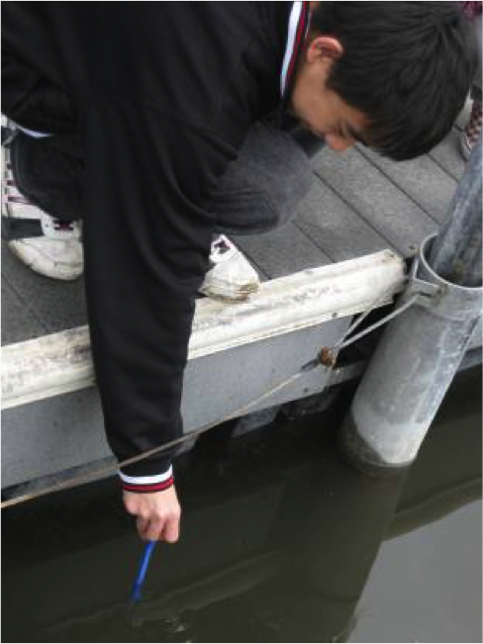
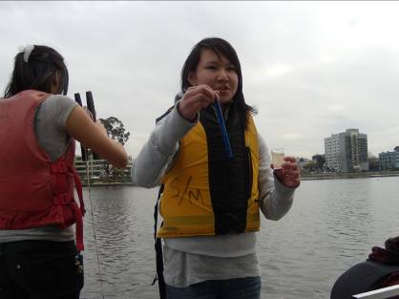
Introduction (continued)
(Content Knowledge)
Field Photos
(requires release forms)

Slide 6
Research Methods: Describing The Planning Process
(Planning Investigations)
  Our plan for the investigation is _______
  Our plan will produce data to test ________
  The study site is located at _____
  Our study site looks like _____
  The GLOBE protocols we plan to use are_______
  We plan to collect ___ data, ___ times each day, ___ days each week
  We plan to collect data at _____ time of day.

Slide 7
Map of Study Site

Slide 8
Research Methods: Describes What Happened
(Carrying Out Investigations)
  The GLOBE protocols we used were _______
  When we collected data (this happened_______
  We collected a total of ______ data points for _______
  We collected a total of ______ data points ______
  We analyzed the data using ______ procedures
  Our methods help to answer the research questions because ______

Slide 9
Results
Figure 1 Title

Slide 10
Results
Figure 2 Title

Slide 11
Discussion
(Interpreting Data)
  The most important results are _______
  The results mean that ________
  The data are important to science and our community because _____
  Comparing our results to similar studies by other researchers reveals _______
  The results (do or do not) help answer the research question because _______
  The results (do or do not) support our hypothesis because _______

Slide 12
Discussion (continued)
(Interpreting Data)
  We had problems collecting and recording data because _______
  We had problems analyzing data because_________
  Uncertainties and limitations in our research process means ______

Slide 13
Map of Study Site

Slide 14
Conclusions
(Drawing Conclusions)
  Our conclusion is (or is not) supported by the results because_____

Slide 15
Conclusions
(Next Steps)
  Improvements to our research can be_______
  We appreciated doing this research for GLOBE and NASA because_______

Slide 16
Bibliography
(References)
  Cite the GLOBE website and any other literature
  (See owl.english.purdue.edu for guidance and resources)
  List GLOBE materials and NASA assets used
  Provide sources beyond those provided by GLOBE

