Slide 1
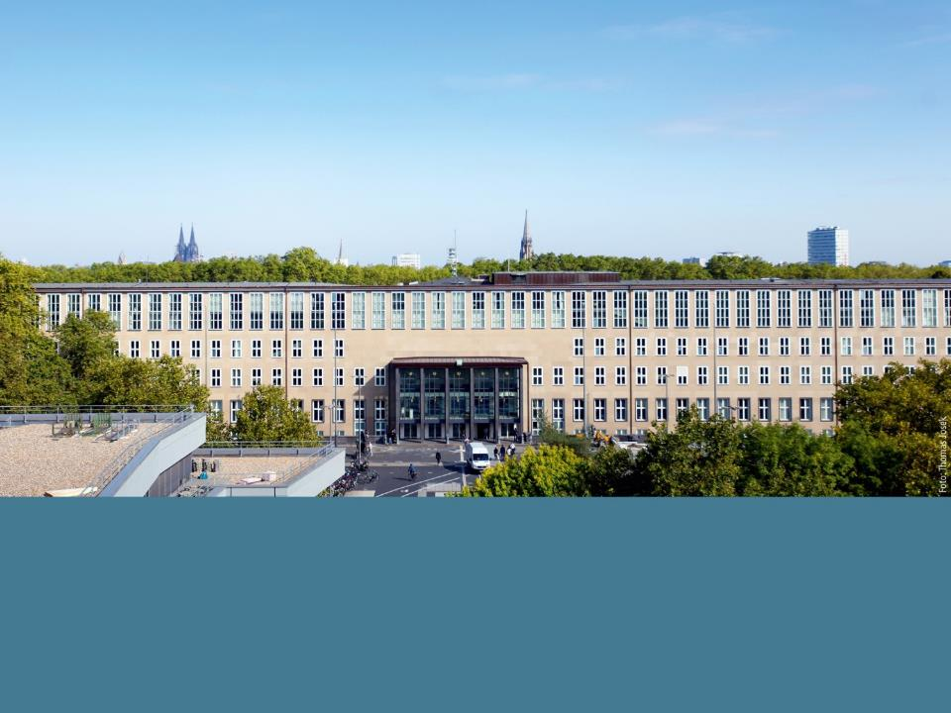

Dr. Andreas Thiemer University of Cologne Institute of Geography | GLOBE Europe and Eurasia Regional Meeting 2017 Highlights at University of Cologne

Slide 2
GLOBE Protocols
Translated protocols by DLR

Slide 3
GLOBE Tutorials
Translated Tutorials

Slide 4
Introduction to Atmosphere
Clouds
Precipitation – Rain / Snow
Air Temperature
Relative Humidity
Barometric Pressure
Surface Temperature
Introduction to Biosphere
Land Cover Classification
Canopy Cover and Ground Cover
Tree Circumference
Biomass
Tree and Shrub Height
Grass Green Up/Green Down
Tree and Shrub Green Up/Green Down
Atmosphere
Biosphere
Introduction to Hydrosphere
Water Temperature – Thermometer / Probe
Water Transparency – Secchi Disc / Secchi Tube
Electrical Conductivity
Water pH – pH-Paper / pH-Meter
Alkalinity
Mosquito Larva
Dissolved Oxygen – Commercial Kit / Probe
Salinity – Titration / Hydrometer
Nitrates
Introduction to Pedosphere
Soil Temperature
SMAP Soil Moisture
Soil Moisture Gravimetric
Soil Characterization
Selecting, Exposing and Defining a Soil Characterization Site
Soil Bulk Density
Soil Infiltration
Hydrosphere
Pedosphere

Slide 5
Introduction to GLOBE
GLOBE Visualization System

Slide 6
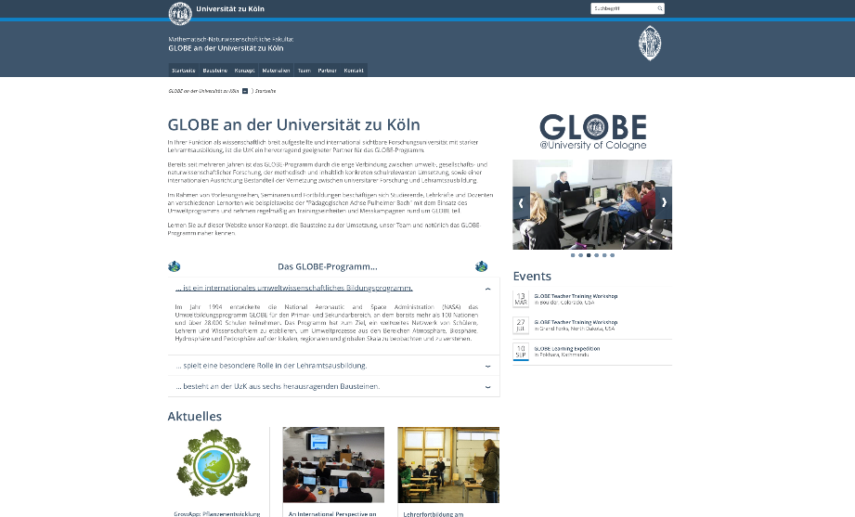
www.globe.uni-koeln.de

