Slide 1
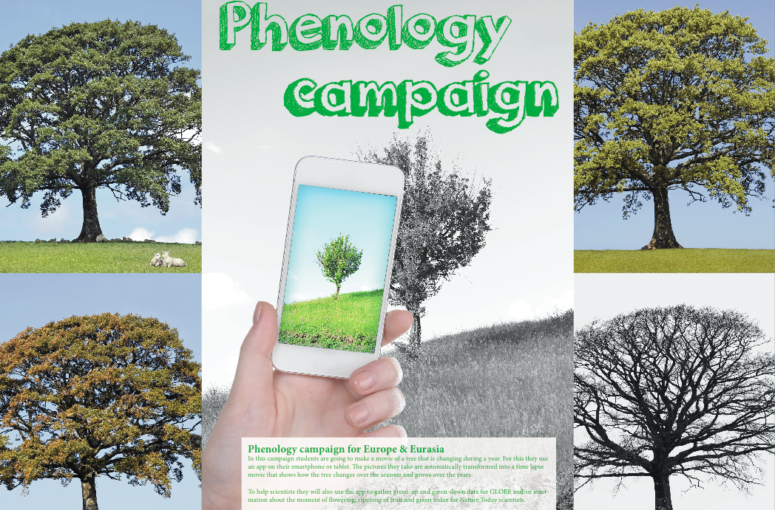
Phenology app
www.globe.gov/web/european-phenology-campaign

Slide 2
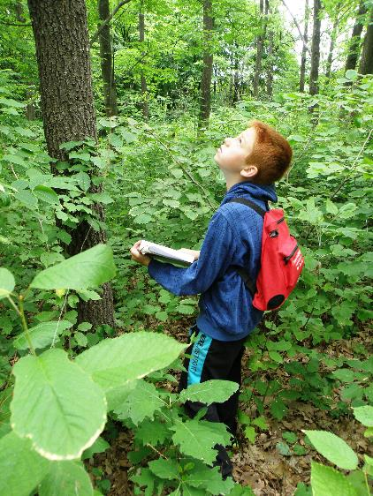
What we will learn today (about phenology)
WHAT tree species
WHEN to observe
HOW to do a research project
WHERE and how to enter and visualize data
WHY and how to use the GROW APP
Collaboration with other schools

Slide 3
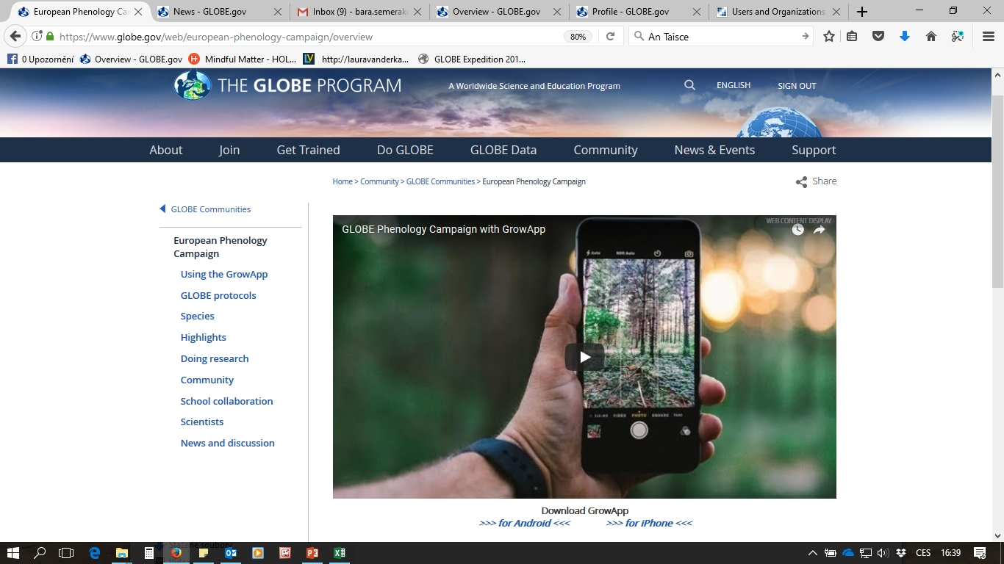
Website www.globe.gov/web/european-phenology-campaign

Slide 4
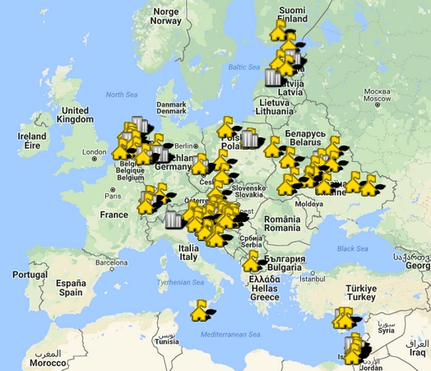
Community
Go to www.globe.gov/web/european-phenology-campaign
Sign in to your account
Click on Community
Join
You can post on the forum and stay
informed about what is going on in
the campaign.

Slide 5
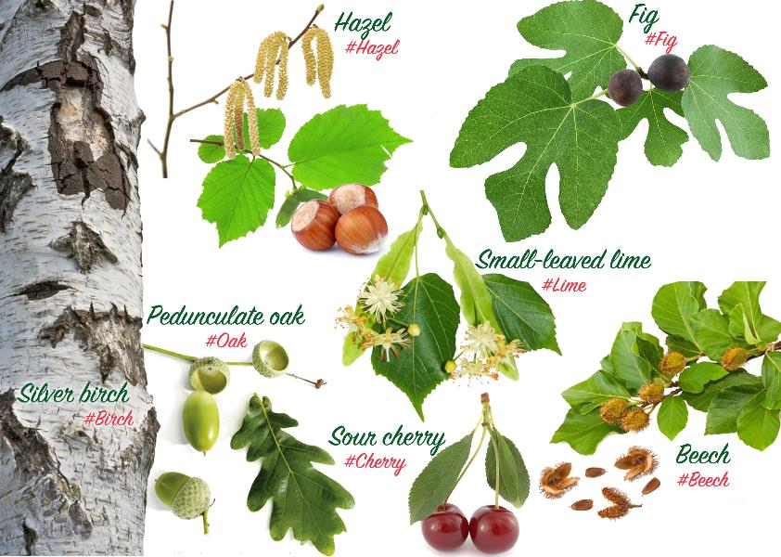
European campaign
Investigate 7 species with a Europe wide distribution

Slide 6
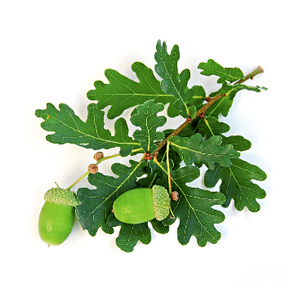
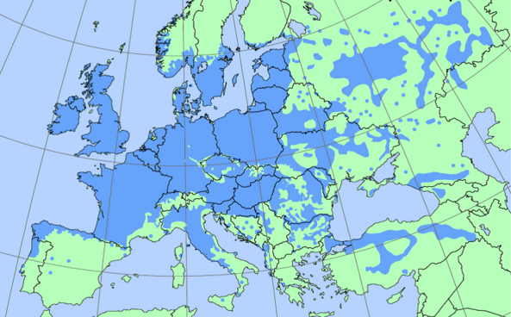
Oak (Quercus robur)
#Oak

Slide 7
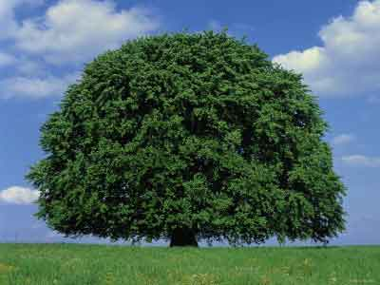
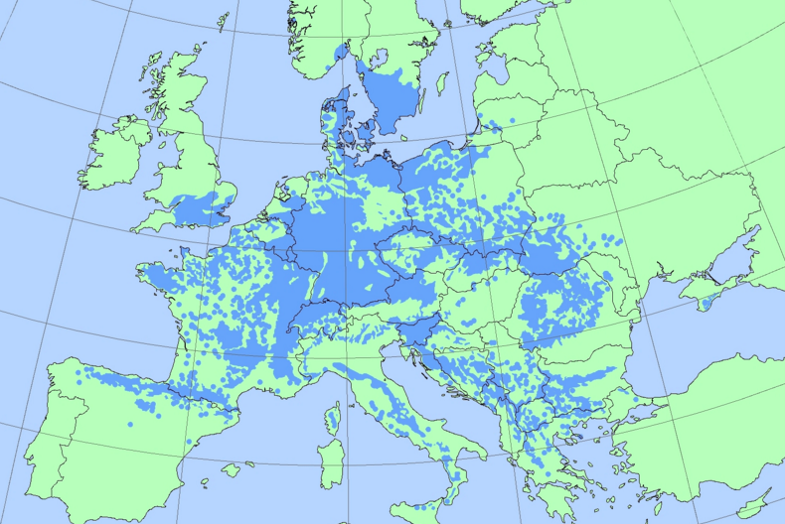
Beech (Fagus sylvatica)
#Beech

Slide 8
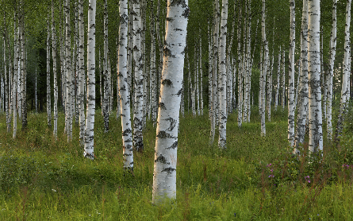
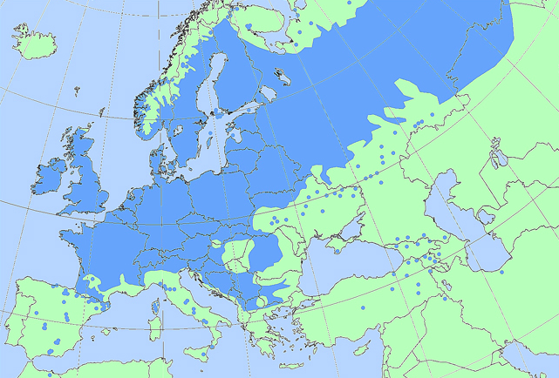
Birch (Betula pendula)
#Birch

Slide 9
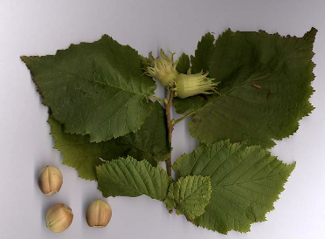
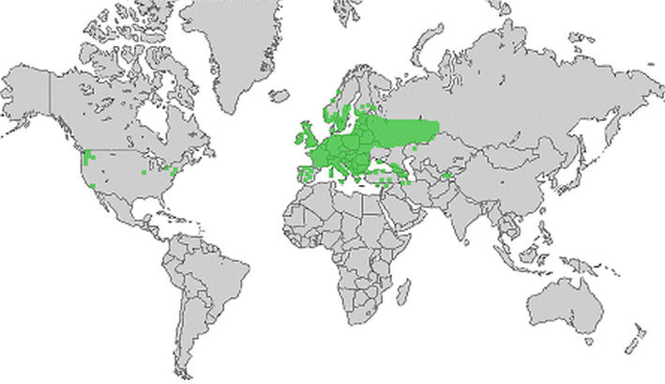
Hazel (Corylus avellana)
#Hazel

Slide 10
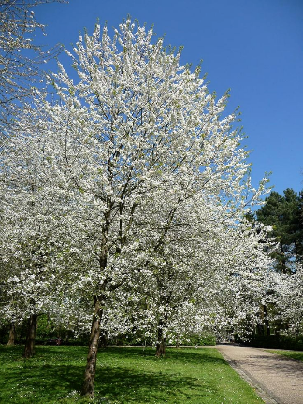
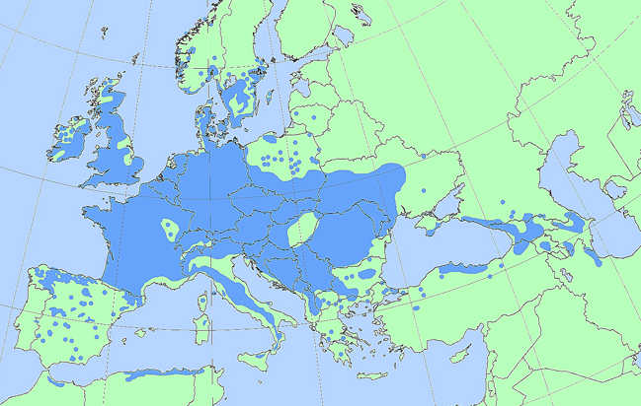
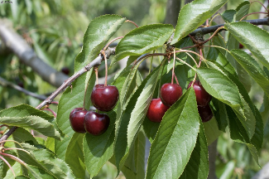
Sour cherry (Prunus cerasus)
#Cherry

Slide 11
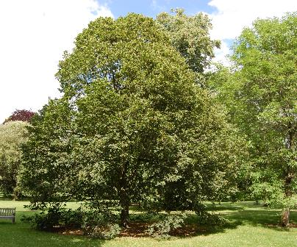
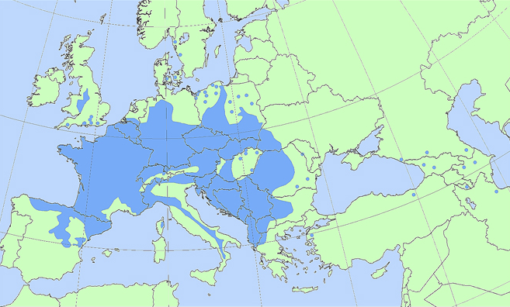
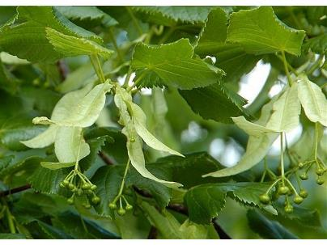
Small-leaved lime (Tilia cordata)
#Lime

Slide 12
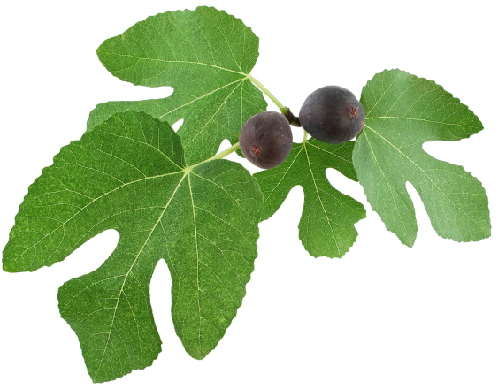
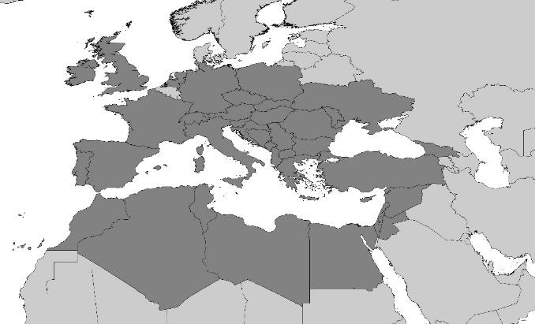
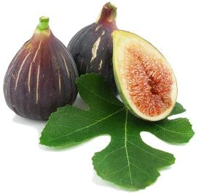
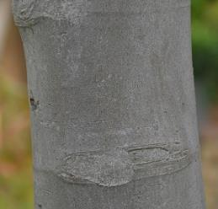
Fig (Ficus carica L.)
#Fig

Slide 13
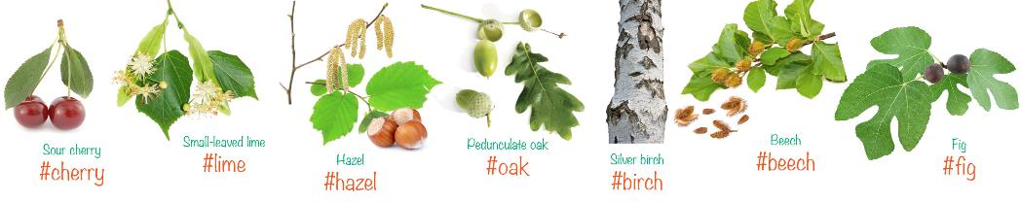
HOW and WHEN to observe
Pick one of the 7 species that is common in your area and consider:
  When is greening-up and greening-down to be expected
Find different trees in your area.
  Make sure that they are in a location you visit every day.
  Pick trees in different habitats. Think about:
    Shade/sun
    Dry/wet
    In the city / out of the city
    Temperature
    Soil type

Slide 14

HOW and WHEN to observe
The tree is bare: Take a first picture with GROWAPP. In the description field add following hashtags:
#species, #GLOBE, #Name of the school
The tree is starting to green-up:
  Collect the green up data - GLOBE GREEN UP protocol
  Take more photos of the tree by GROWAPP
The tree is completely green: Take a picture if you want, but it is not necessary, if it is not changing!
The tree is starting to green down:
  Follow the GLOBE GREEN DOWN
  Take pictures with the GrowApp
The tree is bare again: You don’t need to take so many pictures anymore.

Slide 15
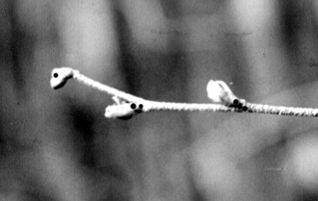

GLOBE protocols: Green-up
One or more than one green down cycles
Select a healthy and relatively large branch
  south side of the tree in the Northern Hemisphere
Mark the branch with tape (at least 2 weeks prior to the start of green-up)
Label 4 buds closest to the end of branch
Examine each bud and record (at least twice a week,):
  “dormant” if the bud is unchanged.
  “swelling” if the bud is getting bigger.
  “budburst” the first day you see the green tips of leaves.
  “lost” if something happens to the bud and you cannot continue observations.
After each budburst measure the length of the leaf or leaves.

Slide 16
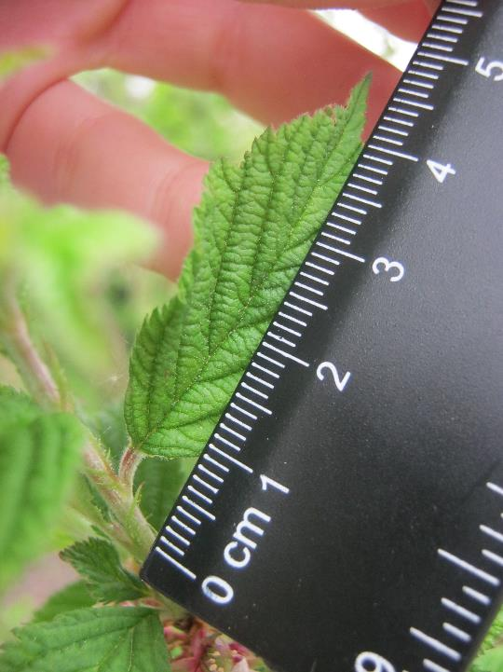
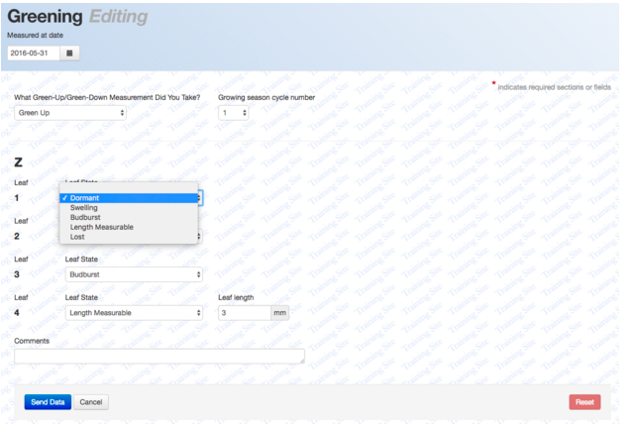
Data entry Green up

Slide 17
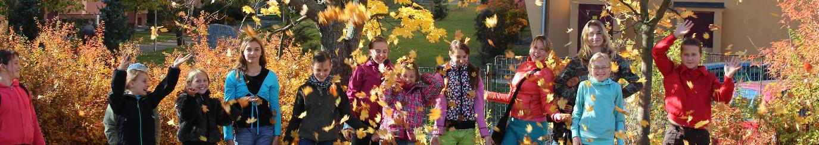
GLOBE protocol: Green down
Start at least 2 weeks prior to the expected start of green down
Tag a branch with flagging tape
Determine whether there are more than one green down cycles
Label the 4 leafs at the end of the branch with 1,2,3 or 4 dots
Check the colour of the leafs at least twice a week until they have fallen of
  = Use the GLOBE Plant Color Chart to estimate the dominant color of each leaf

Slide 18
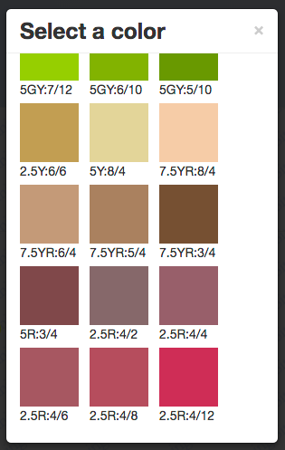
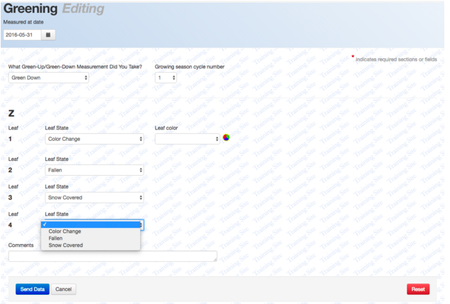
Data entry Green down

Slide 19
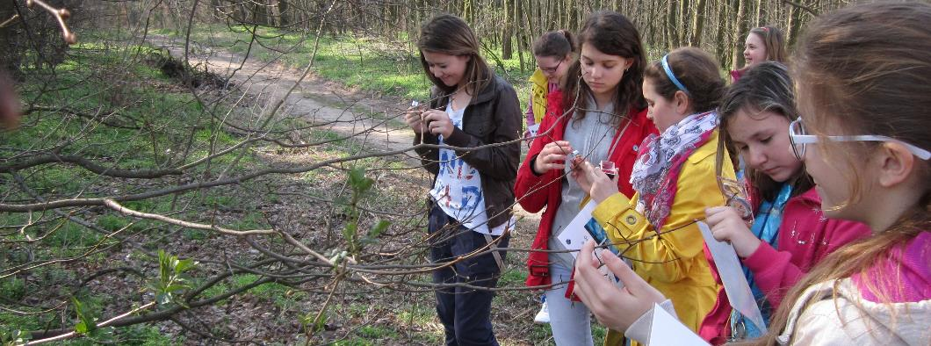
HOW to do student research
https://www.globe.gov/web/european-phenology-campaign/overview/doing-research
Examples of research questions on phenology
Good and bad research questions – how to evaluate
How to create a research report and Example research report

Slide 20
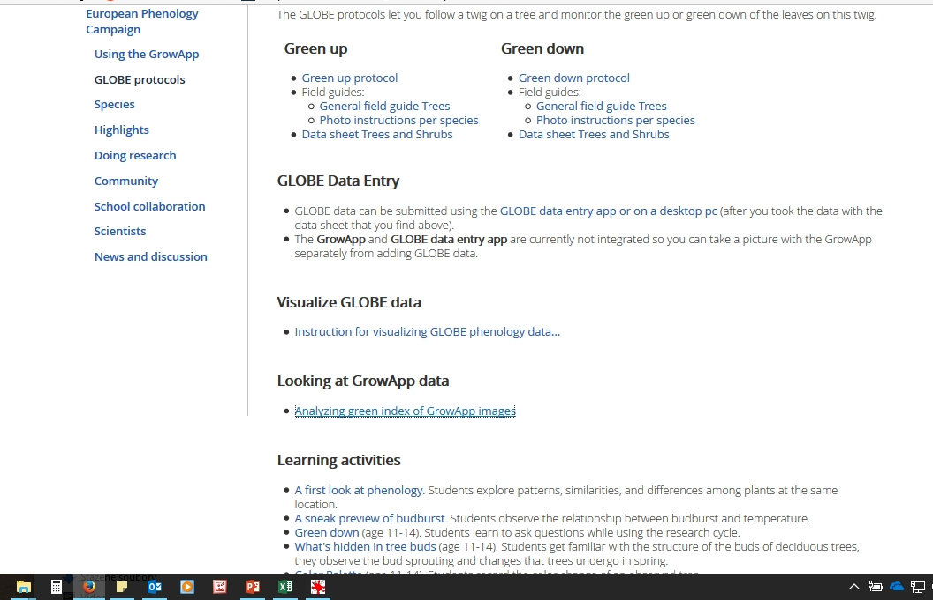
Learning activities https://www.globe.gov/web/european-phenology-campaign/overview/globe-protocols

Slide 21
Using the GrowApp
Explained at the video with scientists + link to download:
https://www.globe.gov/web/european-phenology-campaign/overview

Slide 22
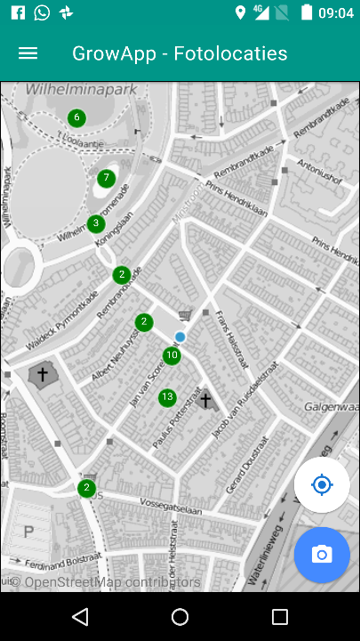
Open app
Put on GPS
Make sure you have internet connection
Take a picture of a tree
(everyone take another tree)

Slide 23
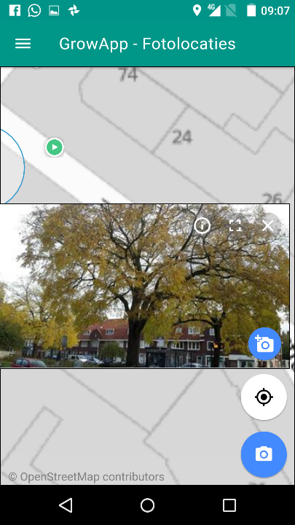
Add a picture to a picture location (of somebody else)
Add picture to existing picture location
Create new picture location (first picture in an animation)

Slide 24
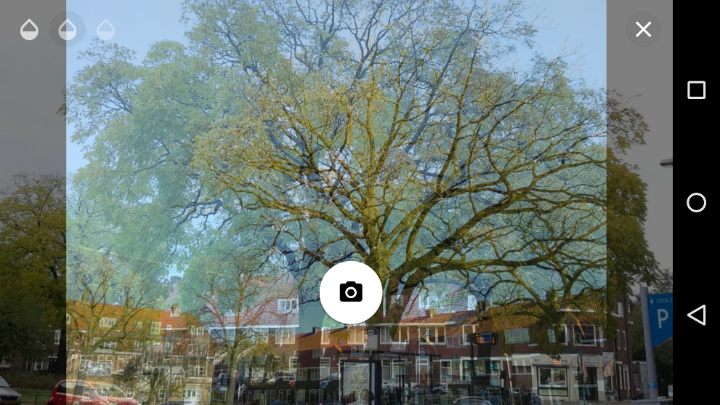
Show camera preview on top of picture
'Onion Skinning'
Adjust transparency
Close

Slide 25
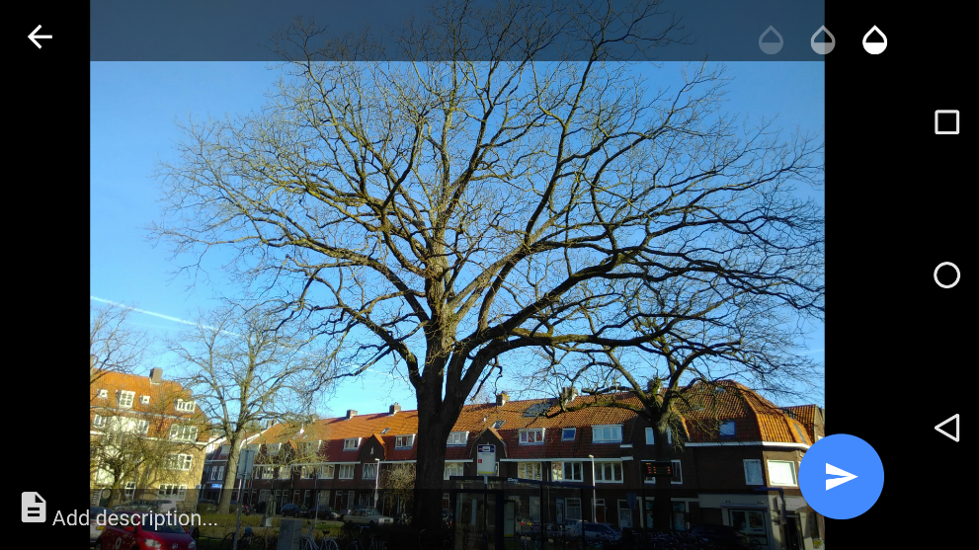
Picture taken!
Adjust transparency to check picture overlay
Cancel (try again)
Add description
Send picture to be shown publicly on the map

Slide 26
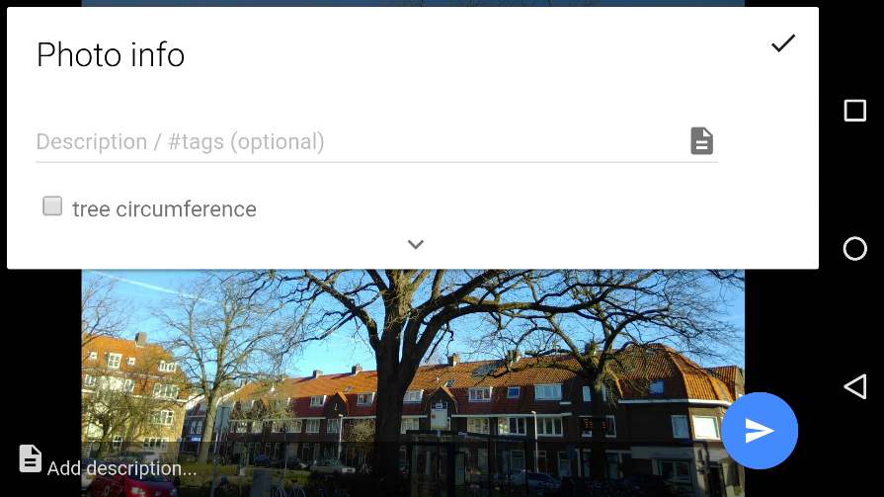
Add information and #tags
Tags make it possible to filter photo’s on www.growapp.today. In the European campaign use the # for the 7 species

Slide 27
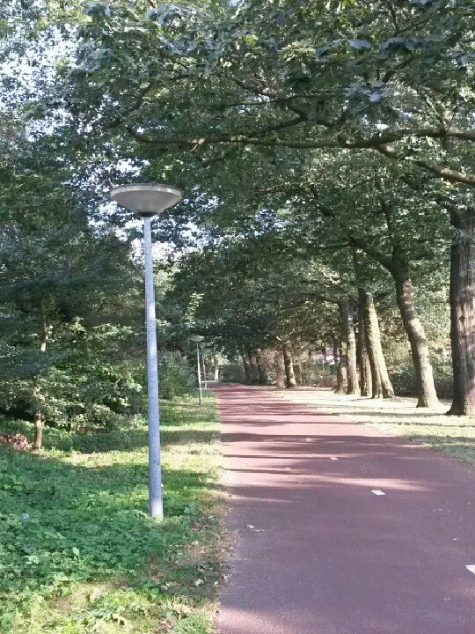
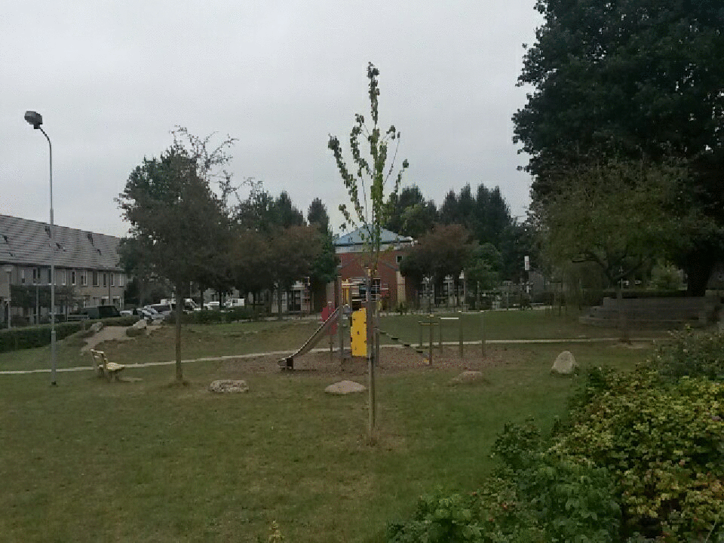
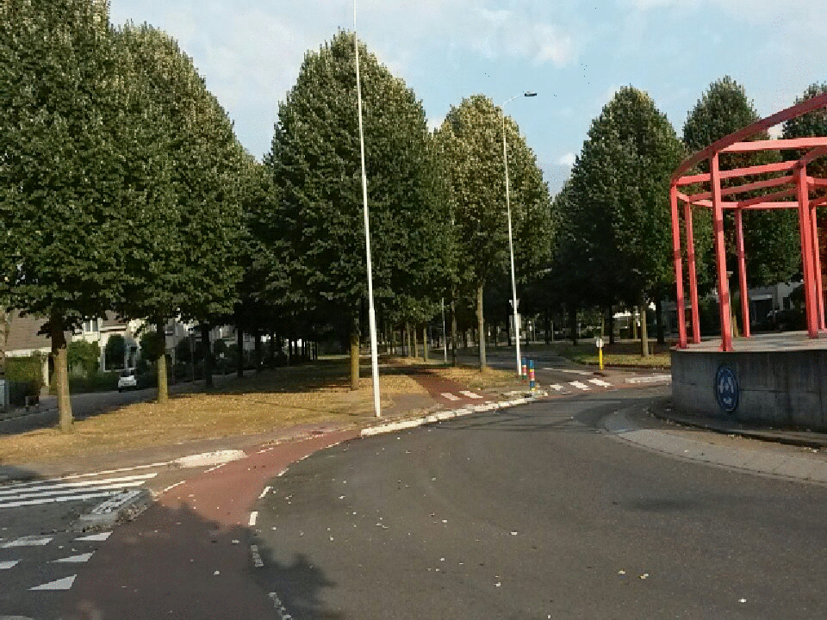
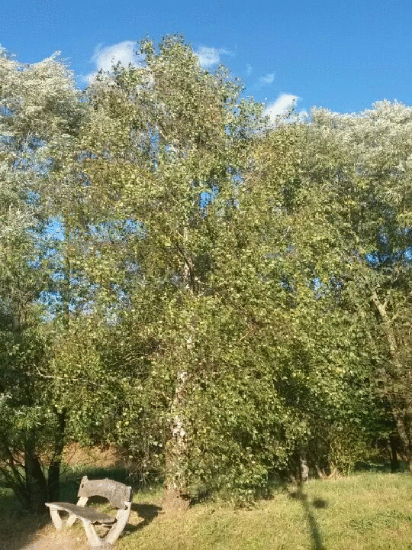
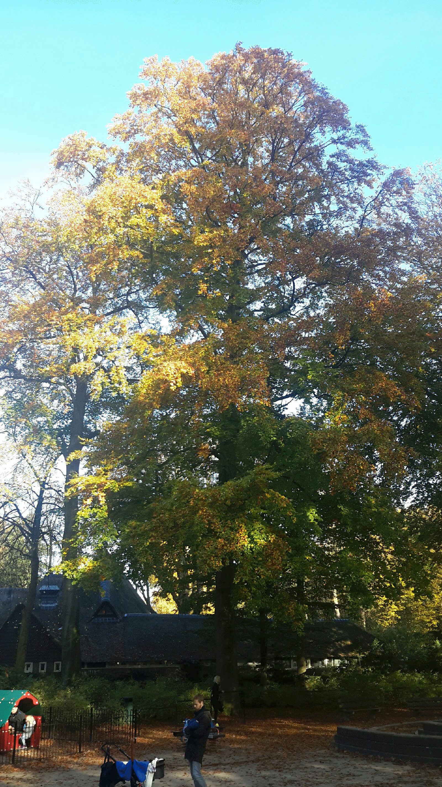
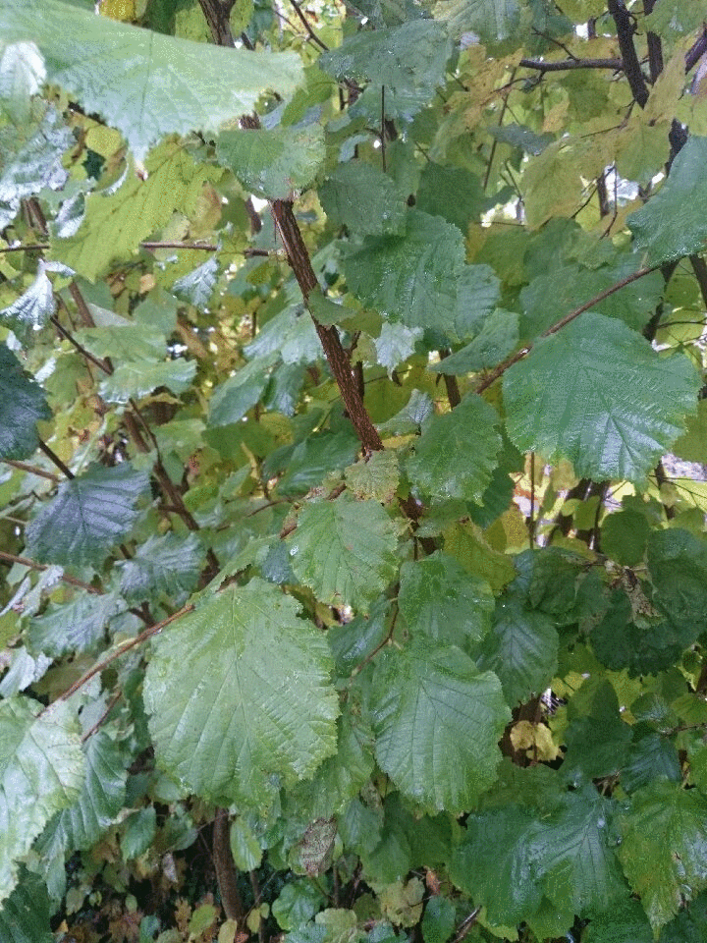
Animations of trees
Made with GrowApp

Slide 28
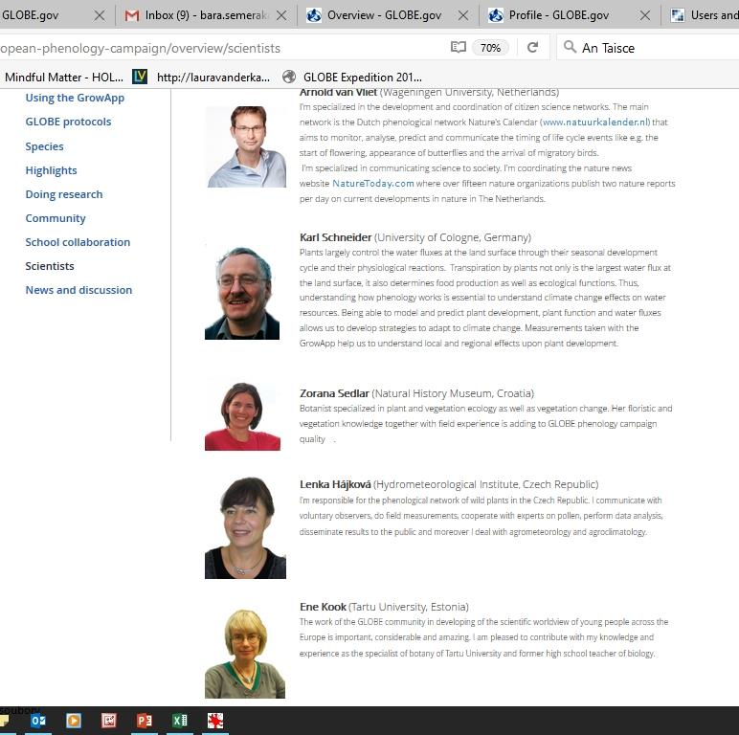
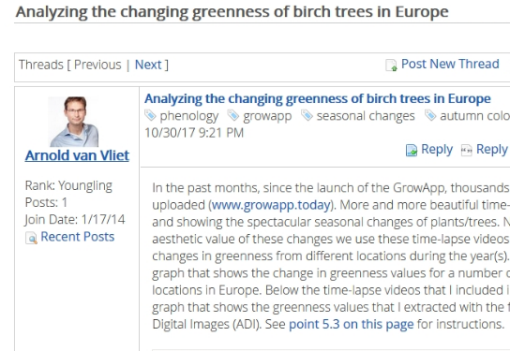
Scientists

Slide 29
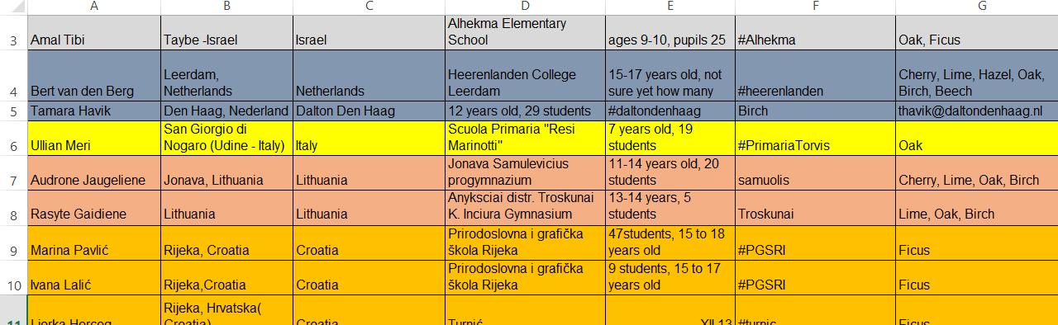
School Collaboration
https://www.globe.gov/web/european-phenology-campaign/overview/collaboration-group
More then 60 GLOBE schools joined the campaign (from Ukraine, Poland, Croatia, Czech Republic, Lithuania, Israel, Belgium or Netherlands)

Slide 30
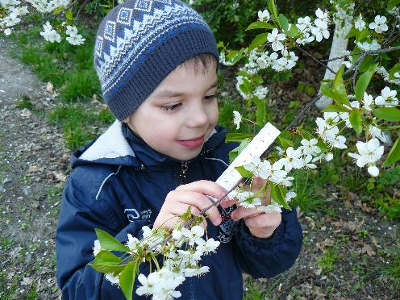
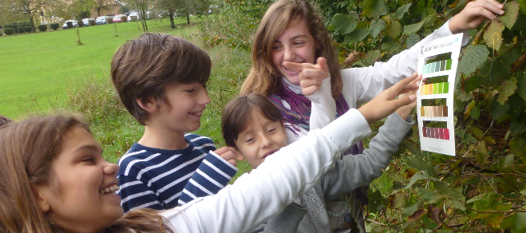
Plan for the school year 2017-2018
Students learn more about phenology, seasonal changes in their environment through using GrowApp
students create their own research project
school is twinned with another school to share the results with students from other country/region
4 lessons

Slide 31
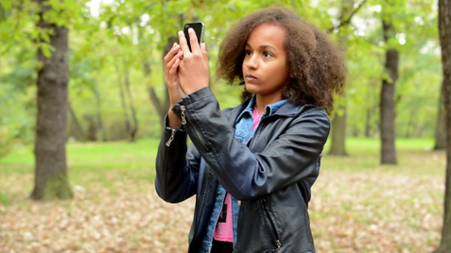
Let’s go outside!

Slide 32
Partners
EU (MYGEOSS)| funding building app
Ministry of environment Netherlands | funding learning materials & outreach
GLOBE Europe & Eurasia board | organisation and outreach
Wageningen University | science
Leiden University | strategy app development
Geodan | development app
GLOBE Program | connection to database (API) and visualisation
GLOBE Netherlands foundation | coordination
Forget the fish | website development

