Slide 1
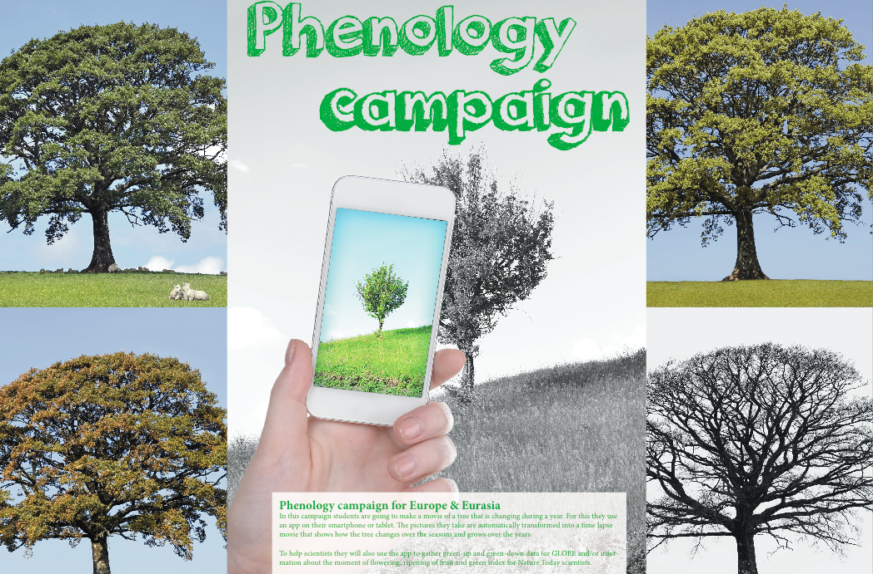
Phenology app
www.globe.gov/web/european-phenology-campaign

Slide 2
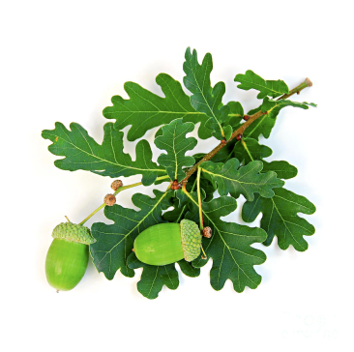
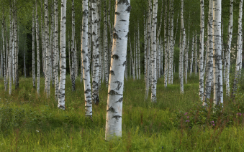
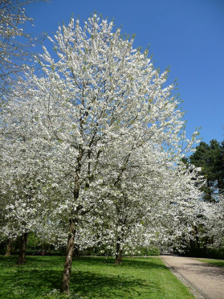
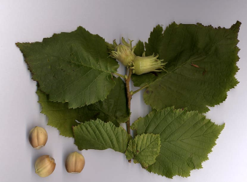
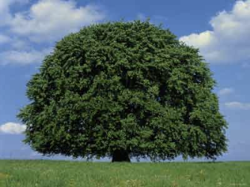
Oak (Quercus robur)
Europe & Eurasia campaign
Gather green-up and green-down data of 5 species that have a region wide distribution
Birch (Betula pendula)
Wild cherry (Prunus avium)
Hazel (Corylus avellana)
Beech (Fagus sylvatica)

Slide 3
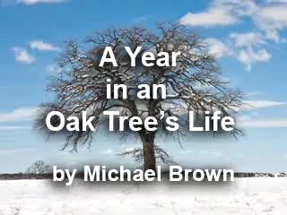
While gathering GLOBE data, make a time lapse movie

Slide 4
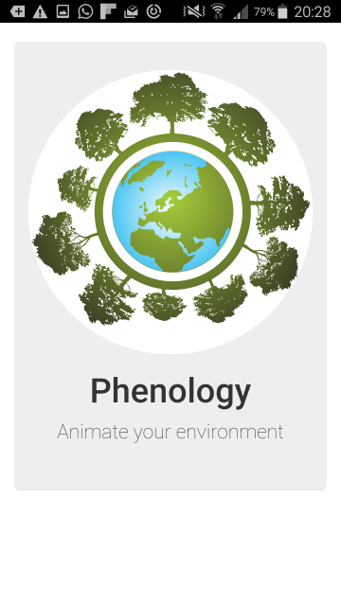
Splash

Slide 5
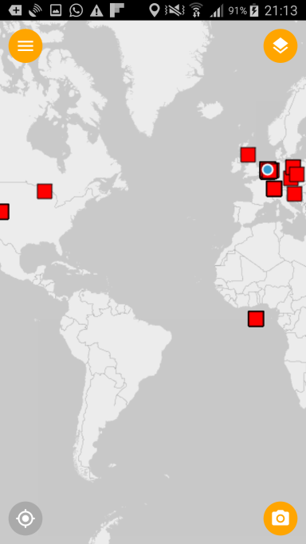
Map with photo locations

Slide 6
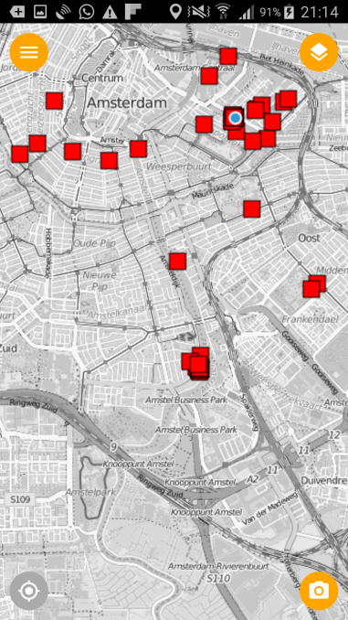
Zoom in

Slide 7
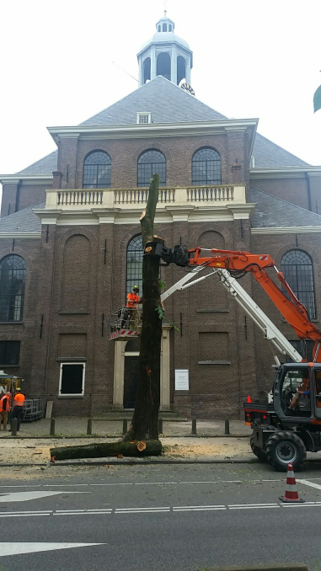
Create animation
step 1:
Existing photo from map

Slide 8
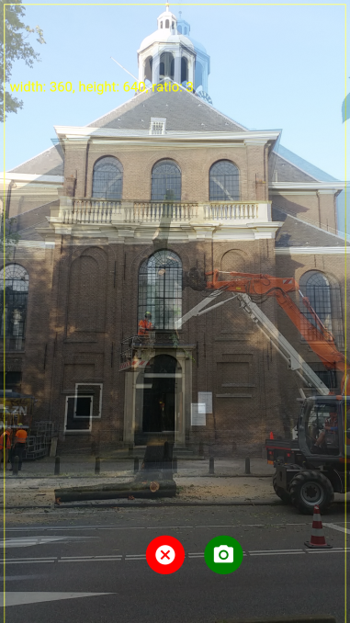
Create animation
step 2:
Add photo, using 'onion skinning'

Slide 9

New animation generated

Slide 10
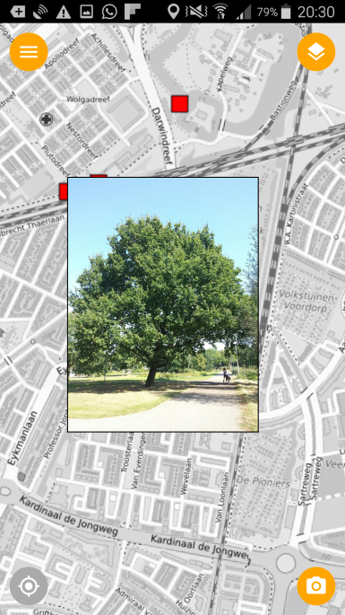
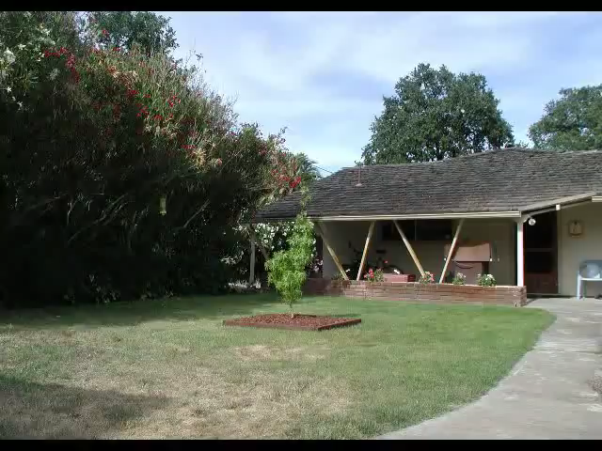
Click/Touch photo location
Photo displayed

Slide 11
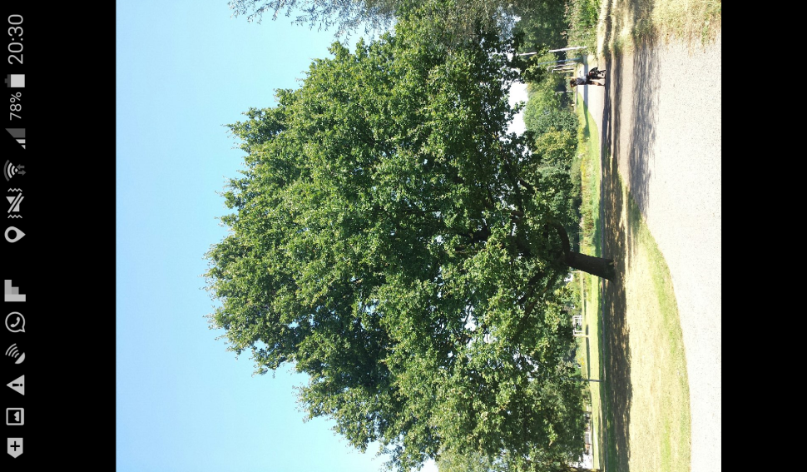
Click photo for full screen view

Slide 12
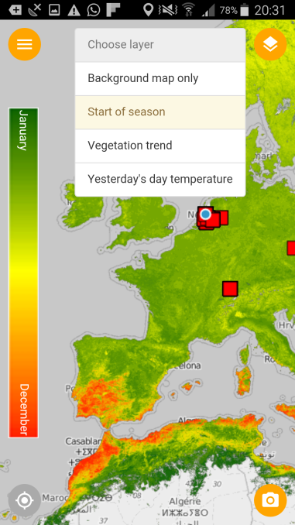
Extra reference map layers:
start of vegetation season

Slide 13
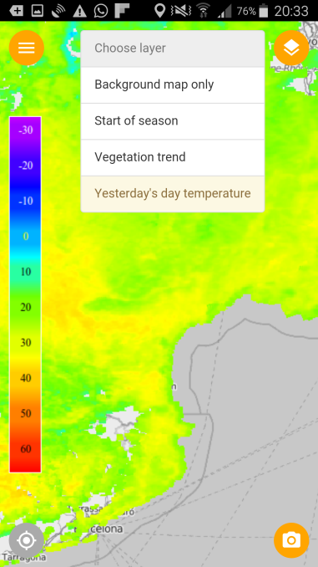
Extra reference map layers:
yesterday's surface temperature

Slide 14
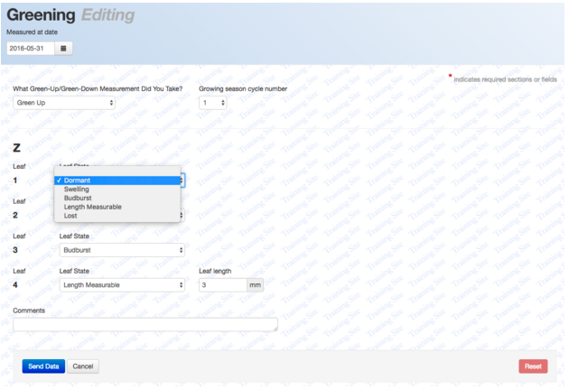
Submit data to GLOBE: Green up & down

Slide 15
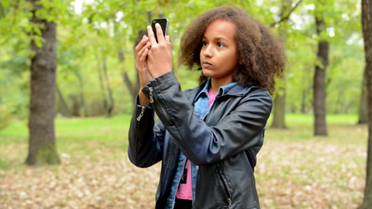
What will students investigate?
Students can investigate differences in green-up and green down within their own school surrounding and will look for patterns in the Europe & Eurasia region.

Slide 16

How to participate as a teacher?
Go to www.globe.gov/web/european-phenology-campaign
Sign in to your account and click on
Download learning materials and prepare the class
Let your students download the app and gather GLOBE data with it, while also taking pictures to make nice time lapse movies

Slide 17
How to prepare your national campaign?
Find national scientist to help you:
  Train teachers
  Use data for research
  Help students with their research and give feedback
  Be a judge during science fair
Inform your schools and prepare them for campaign in January
Translate learning materials and app
Find (outreach) partners (media, Disney, environmental education centres)
Let us know how we can help each other to make the campaign a success, by using the ‘participation form’ on the website
Come to our workshop tomorrow with scientist Arnold van Vliet!

Slide 18
How will we facilitate you?
  App (with translation module)
  Learning materials in English that you can translate
  PR materials (standard press releases, folder, website)
  Webpage with results and news:
  www.globe.gov/web/european-phenology-campaign
  News letters
  Training tomorrow (Tuesday 16:15 – 18:00)

Slide 19
Planning
September 27th 2016: workshop and discussion Cologne
October 2016: announce campaign to schools (in Europe & Eurasia)
Sept-Oct-Nov: test the app in autumn (green down)
November: Learning materials ready (for translation)
December 2016: app available for iPhone & Android (ready for translation)
January 2017: official start (exact date to be determined in Cologne)

Slide 20
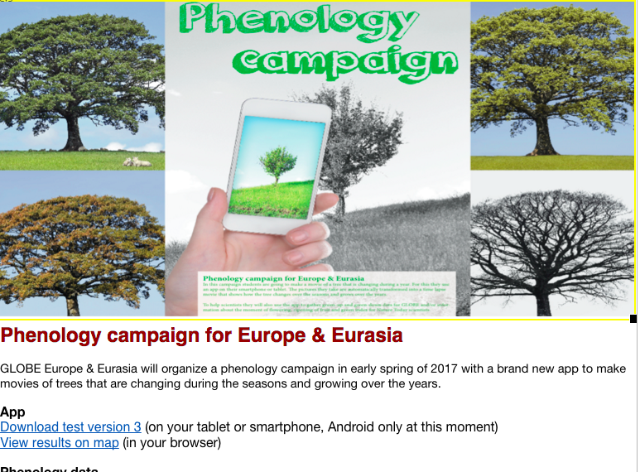
Join the campaign! www.globe.gov/web/european-phenology-campaign
Please already download the app

