Slide 1
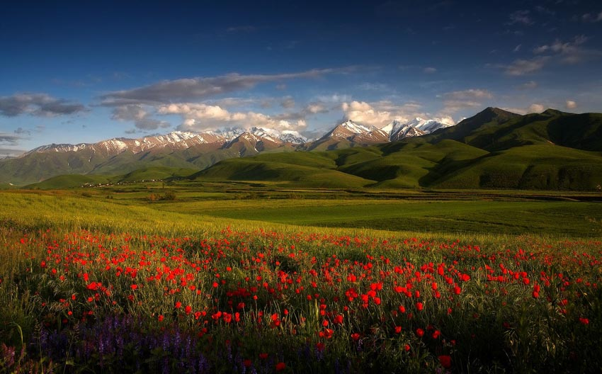

Globe in Kyrgyzstan
Venera Zhamanova

Slide 2
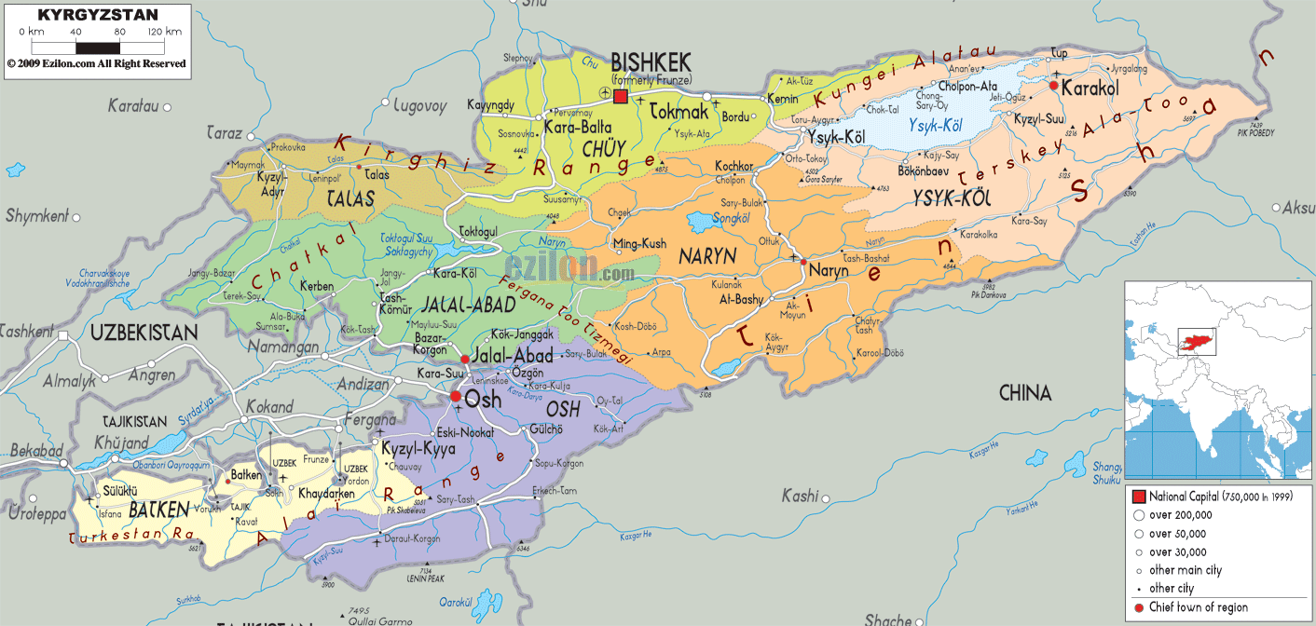
K y r g y z s t a n
    Geography
Neibouring countries:
Kazakhstan on the north and northwest
Uzbekistan in the southwest
Tajikistan in the south
China in the southeast.
Currency - Som (KGS)
ISO 3166 code – KG
Capital – Bishkek

Slide 3
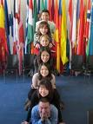



P e o p l e
Population: 6,000,421 -Density 27.4/km²
Population growth rate: 1.29%
Ethnic groups:
Kyrgyz 64.9%,
Uzbek 13.8%,
Russian 12.5%,
Dungan 1.1%,
Ukrainian 1%,
Uygur 1%, other 5.7%
Religions: Muslim 75%, Russian
Orthodox 20%, other 5%
Languages: Kyrgyz (state & official), Russian (official)
Literacy: definition: age 15 and over can read and write total population

Slide 4
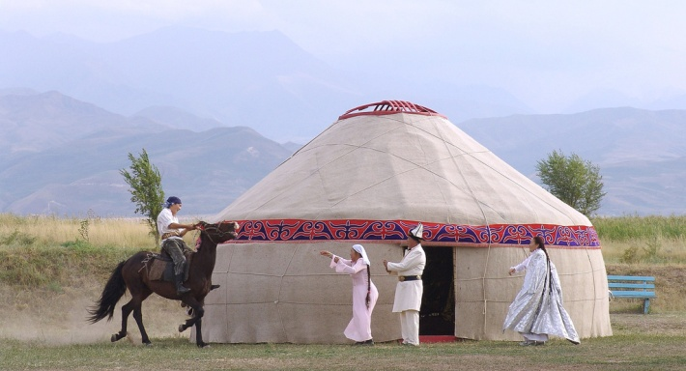
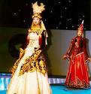
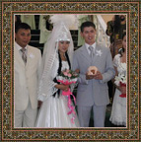
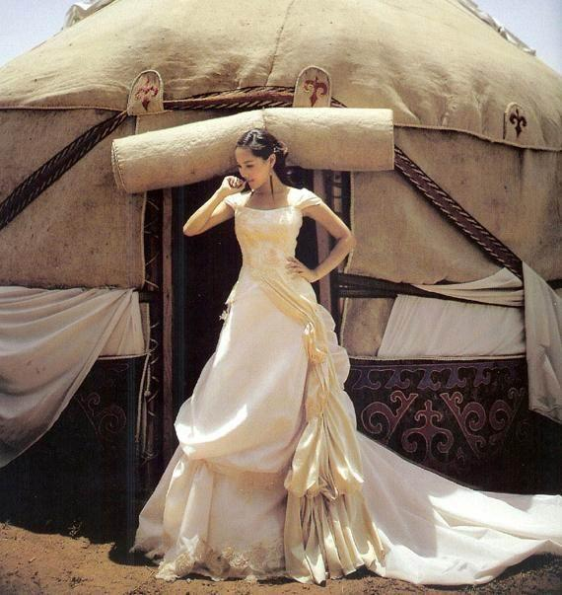
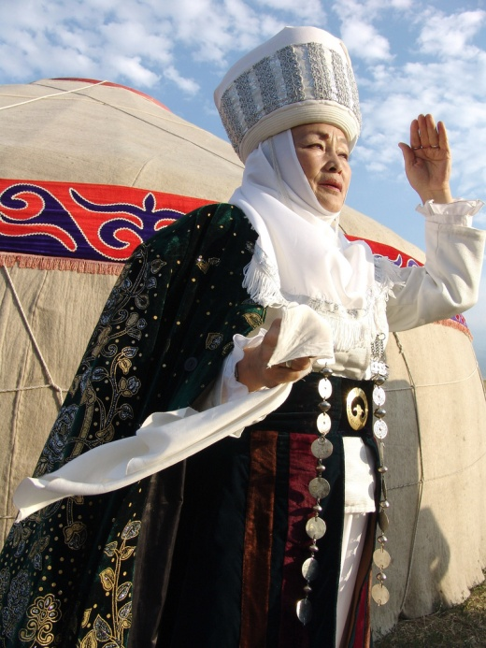


Custom and traditions

Slide 5
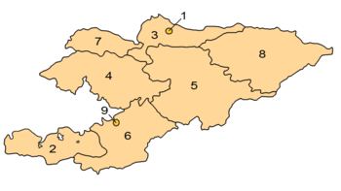
Ecology of Kyrgyzstan
Area: Total 199,900 km²
⁽Mountains–93.4%, Water 3.6 %, Plain– 3%)
Bishkek
Batken
Chuy
Jalal Abad
Naryn
Osh
Talas
Yssyk Kul

Slide 6
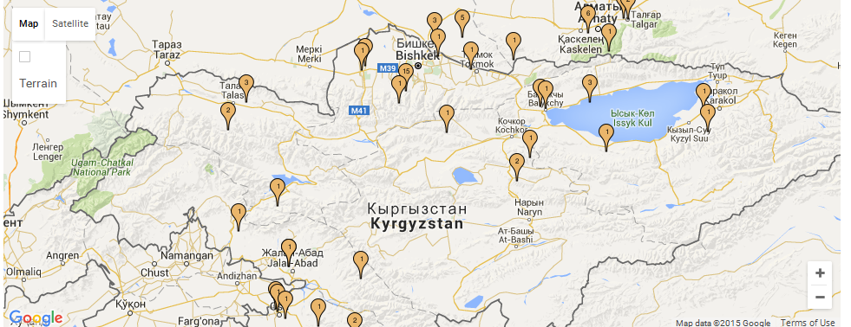
Globe Partner schools

Slide 7

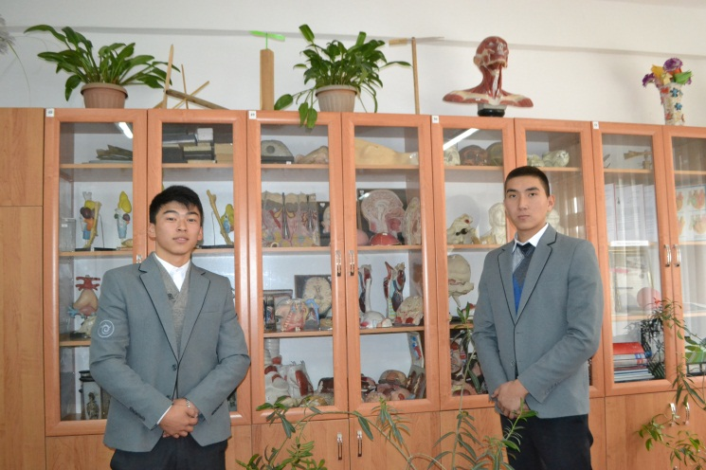
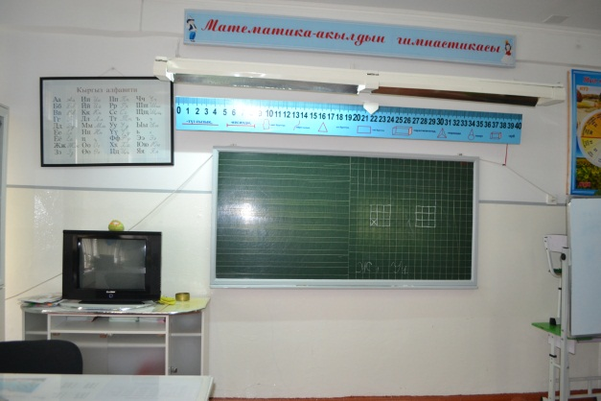
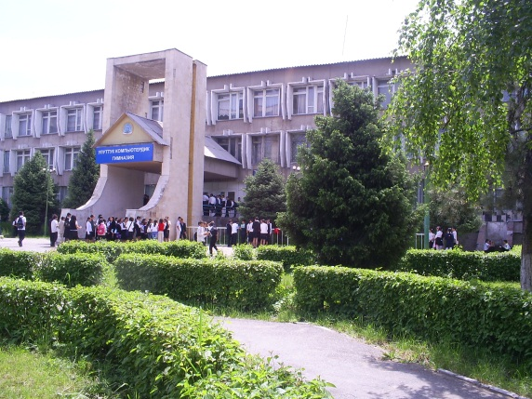
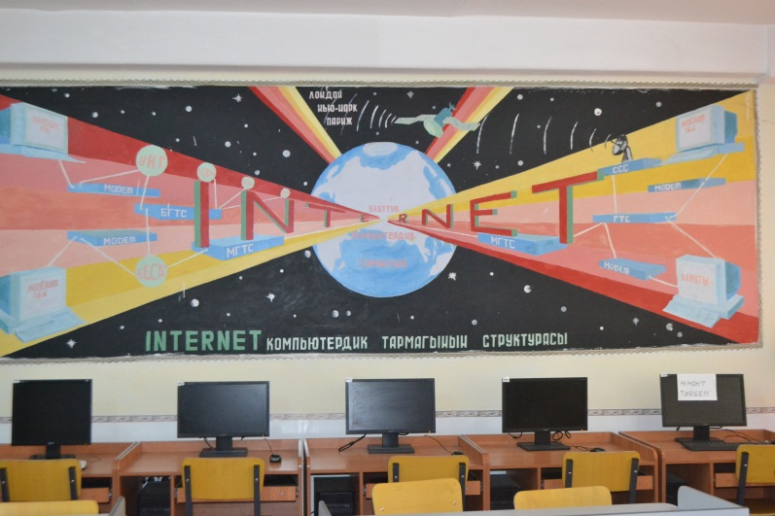
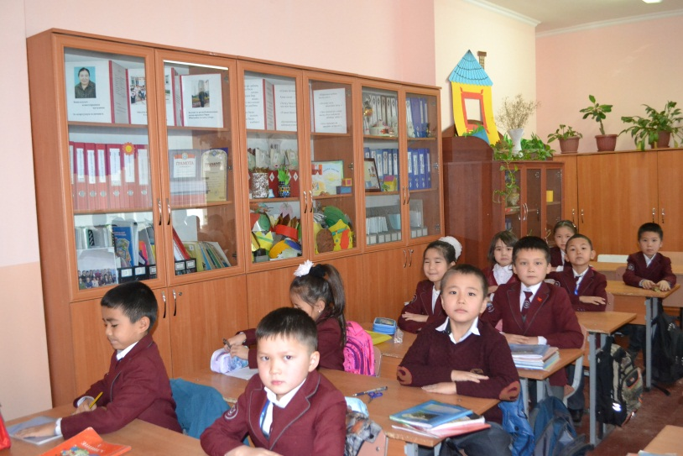
Kyrgyz National Computer Gymnasium

Slide 8
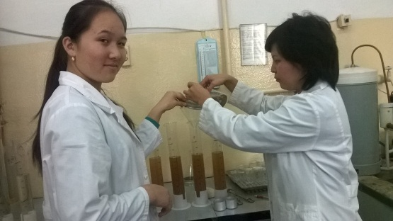
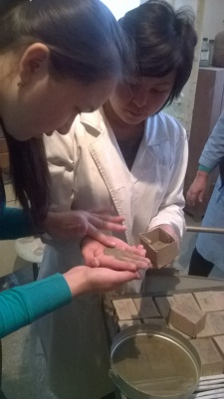
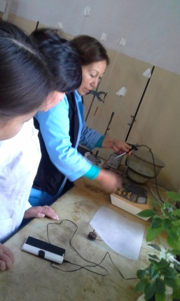
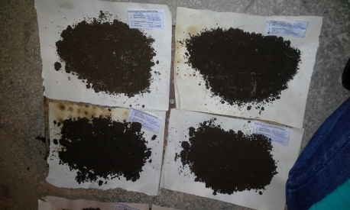
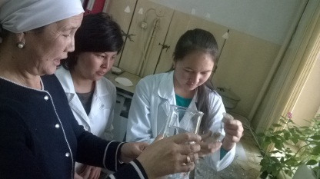
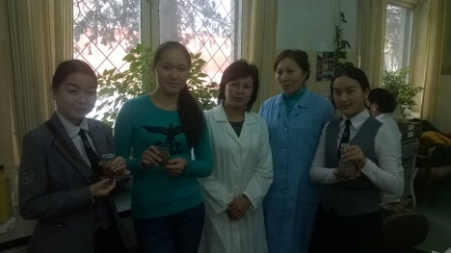
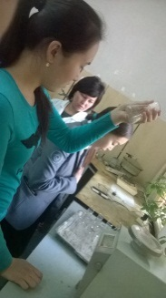
Students’ Soil Research Campaign
Students of the National computer gymnasium in the process of investigating and researching soil from the Chui valley and Bishkek city and defining process of soil’s PH and sharing with their expertise with friends from other schools.

Slide 9
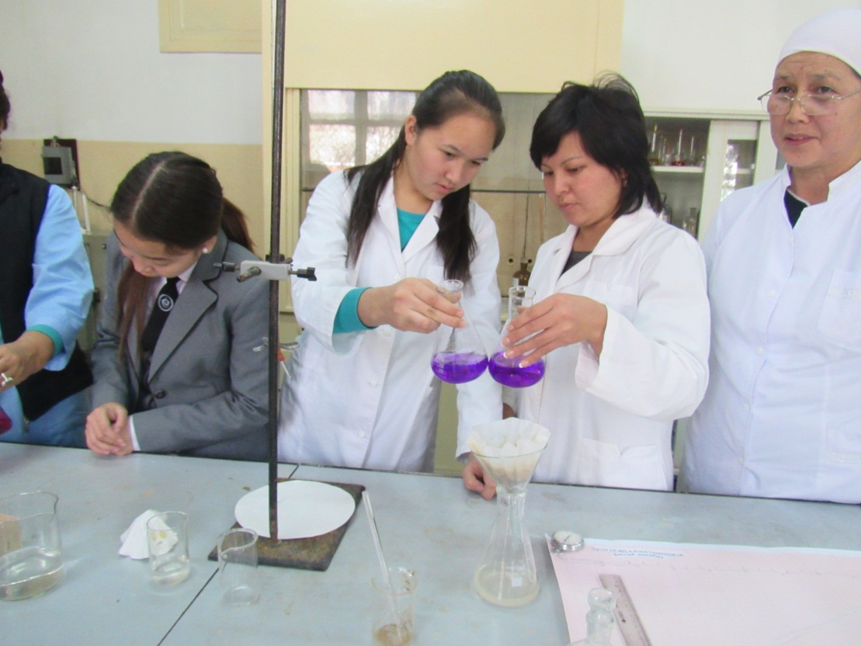
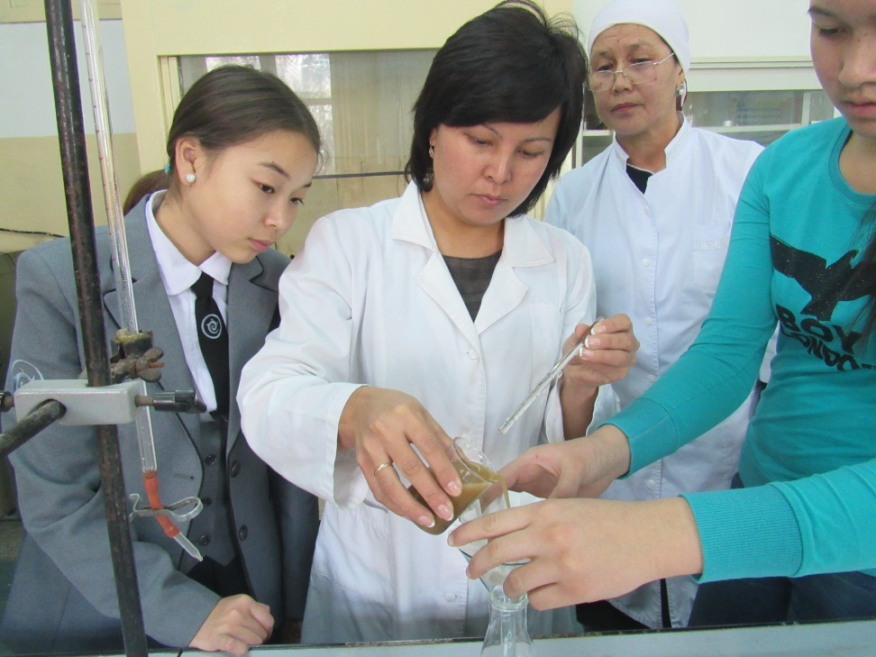
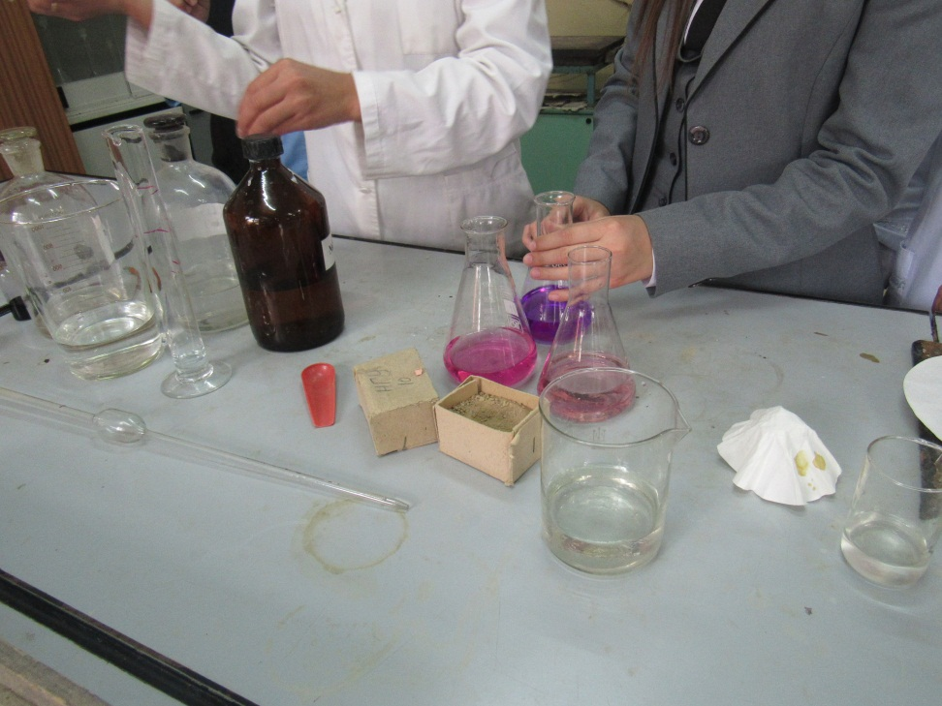
Student’s research

Slide 10
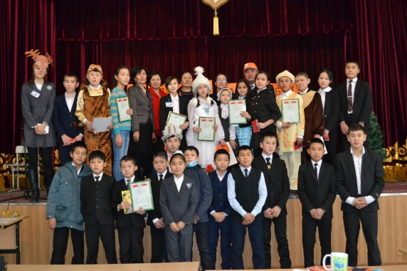
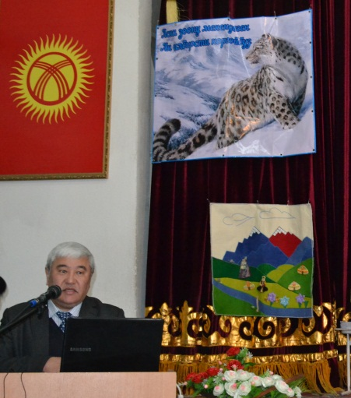
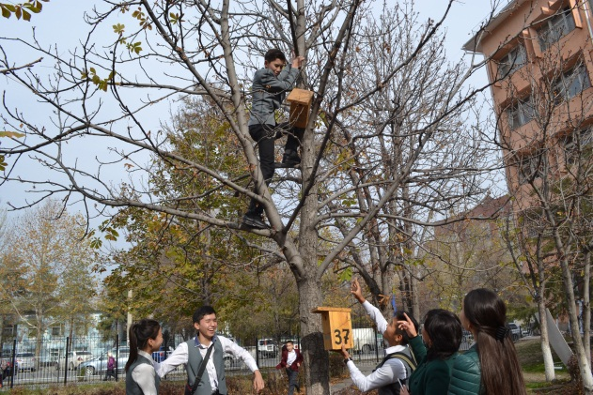
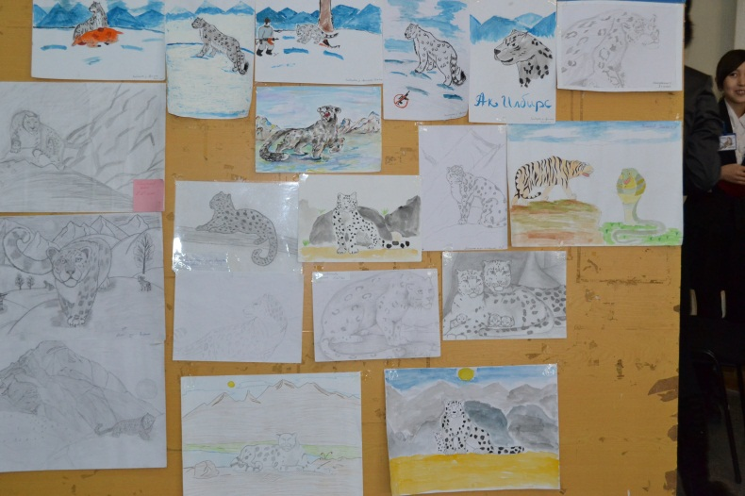
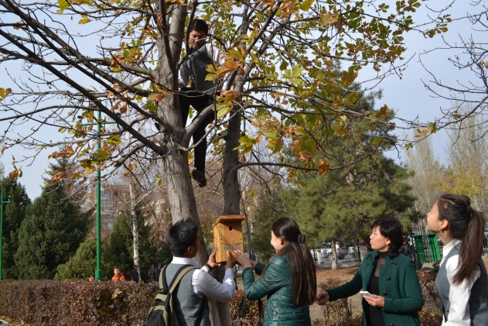
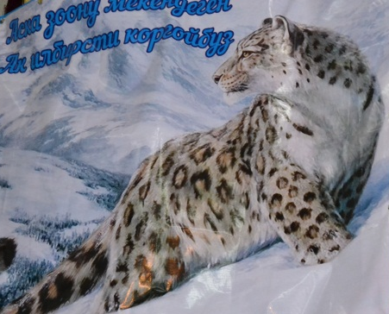
Projects: Ecological celebrations and action
Save mountain tigers
Care of birds

Slide 11

Kyrgyz Nature

Slide 12
Көңүл бурганыңыздарга чоң рахмат!
Thank you for your attention!

