Slide 1

Earth System Science/GLOBE
Partner Collaboratives
Collaborative Leadership Meeting
Amy Barfield
Tony Murphy
John Ristvey
Deanna TeBockhorst
August 21, 2020
This work is supported by the National Science Foundation, Division of Atmospheric and Geospace Sciences (AGS), # 2011518
Any opinions, findings, and conclusions or recommendations expressed in this material are those of the author(s) and do not necessarily reflect the views of the National Science Foundation.

Slide 2
Agenda
Introductions (John)
Review goals of the project (John)
Flipping the project (John)
Review Collective Impact Model (John)
Think about Vision/Mission based on Common Agenda (Deanna)
Review website and communication expectations (Amy)
  With project coordinators (John/Amy/Deanna)
  With your team
  With other collaborative teams
Homework with your team (Deanna)
Next meeting between project coordinators and collaborative teams

Slide 3
Introductions (John: Hit record please)
Describe your ESS/GLOBE Collaborative Team
  Who are the members/affiliations of your collaborative team?
  What are your thoughts about what you want to achieve by participating in this project?
Notes:
Popcorn
Valerie Williams will be working on the evaluation of this project.

Slide 4
Goals of Project
Expand your view of Earth System Science (ESS) Providers and GLOBE Partners to develop and implement a plan for sustaining collaboratives
Document promising practices and processes for building collaborative teams
Align our efforts with a Collective Impact Model

Slide 5
Flipping the project
Moving from
meeting in person at the beginning of the project with follow-up meetings/work
To
meeting online over the next year within and between teams with a meeting in person at the end of the project
Notes:
What does this look like for you, your team, and your project ideas?
Possible meeting sequence:
Leadership
Local meeting
Large group team meeting

Slide 6
Format and Structure of Meetings (with flex)
Team Lead Meetings (like today)
  Planning and direction
Local Meeting(s)
  You create the agenda and meet with your team
Large Group Meeting (with all team members)
  Reviewing progress/homework
  Sharing resources
  Q/A and next steps
Notes:
What are some other ideas?
Round Robin

Slide 7
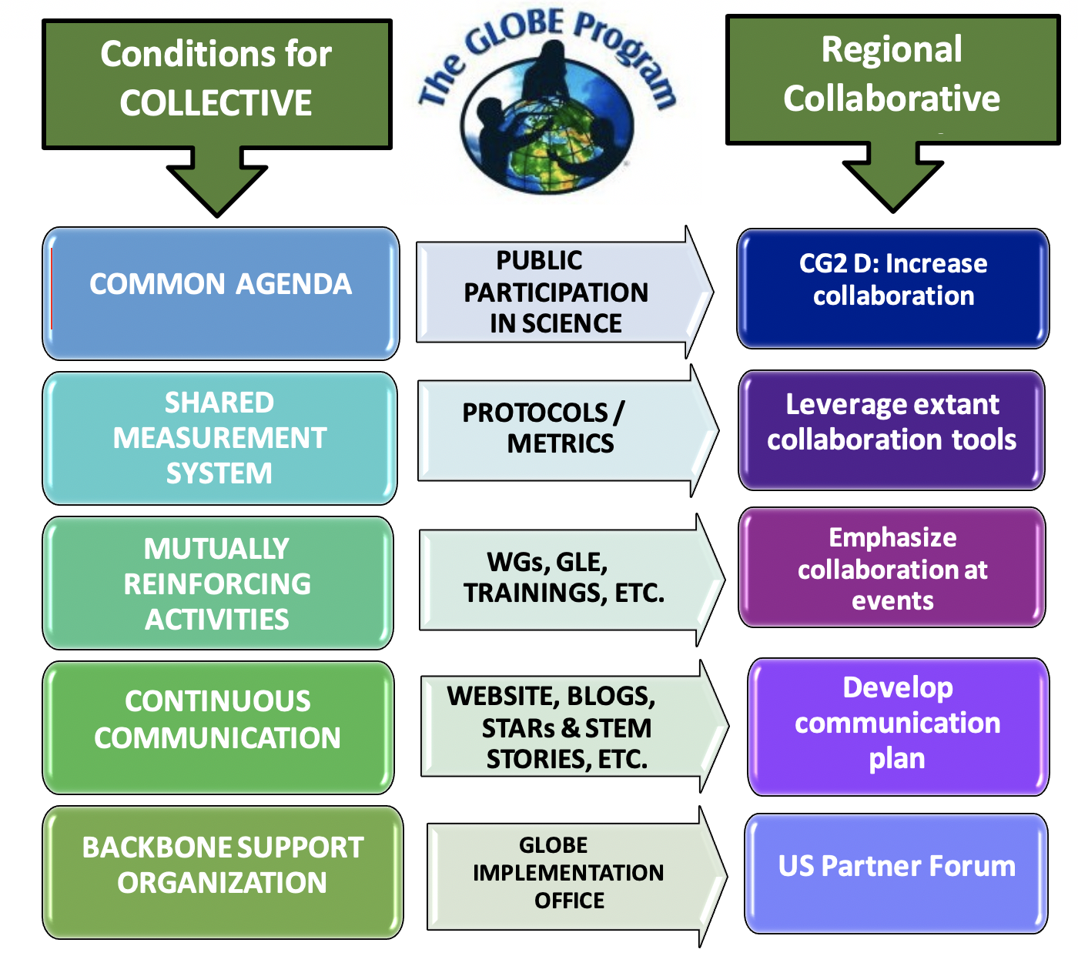

Slide 8
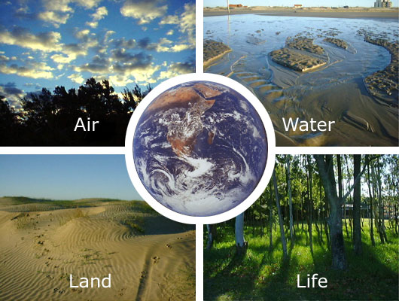
Make up of Partner Collaboratives
Formal and informal providers in Earth System Science (ESS) from:
  K-12 schools
  Community colleges
  Universities
  Minority serving institutions
  Informal science learning centers
  Nonprofit education organizations
Regional GLOBE representative
Active GLOBE Partners in a region

Slide 9

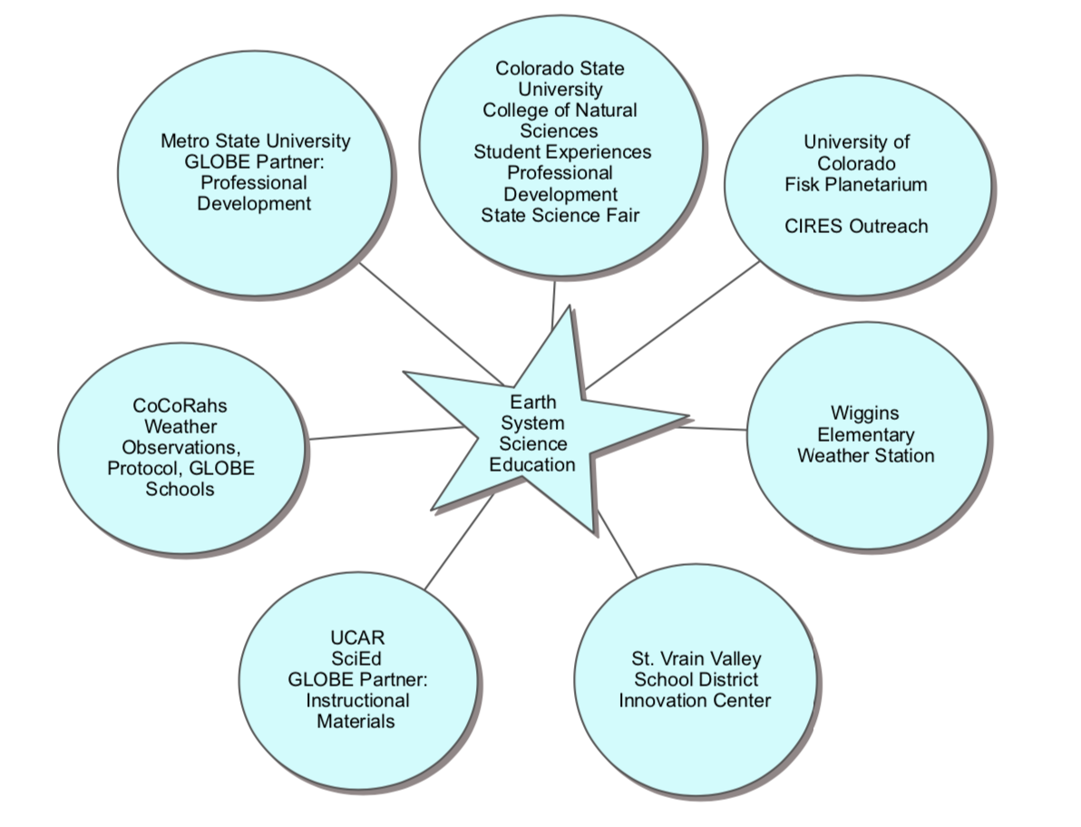
Colorado ESS Collaborative Example
Notes:
Vision:
GLOBE Partners in Colorado and Wyoming who collaborate to leverage GLOBE assets and organizational resources to improve Earth system science education
What would this look like for your collaborative?

Slide 10
Mission/Vision Statements
Vision: long-term desired state of the world due to our (and others’)
work
Mission: why we’re here and how we’ll contribute to achieving the
vision
Notes:
https://topnonprofits.com/examples/vision-statements/
Example vision: Teach for America: One day, all children in this nation will
have the opportunity to attain an excellent education.
https://topnonprofits.com/examples/nonprofit-mission-statements/
Example Mission: Teach for America is growing the movement of leaders who
work to ensure that kids growing up in poverty get an
excellent education.

Slide 11
Developing a Vision/Goals
Purpose
Example from Colorado
Vision:
•GLOBE Partners in Colorado and Wyoming who collaborate to leverage GLOBE assets and organizational resources to improve Earth system science education
Goals:
•Determine how GLOBE can be instrumental in leveraging networks and partnerships
•Determine range of process definitions to integrate GLOBE in collaboration with organizations for sustainable programming and professional development

Slide 12
Review Website
GLOBE Collaborative Website
Adding to content to contact pages for your collaborative team
Adding child pages for Vision/Mission Statement
A place for sharing resources
Notes:
https://www.globe.gov/web/united-states-of-america/home/ess-collaborative?p_p_id=56_INSTANCE_zGqAuBUCI7uY&p_p_lifecycle=0&p_p_state=normal&p_p_mode=view&p_p_col_id=column-1&p_p_col_pos=2&p_p_col_count=3

Slide 13
Homework and Next Meeting
Homework:
  Meet with your team to develop vision/mission and identify some needs from your collaborative team mates that we could help each other with to accomplish the vision/mission.
  Fill in bio page template with collaborative team member information for the project website
  Team name, Location/Region, Team members-short biography/contact information
  Talk with team about days/times for large group meetings
Next meeting (large group):
  Short presentations from teams on vision/needs
  Timing of meeting with collaborative teams
Notes:
Homework: Meet with your team to develop vision/mission and identify some needs from your collaborative team mates that we could help each other with to accomplish the vision/mission. TBD on Padlet
Svetalana to briefly share resources about research based best practices around collaboration???
Next meeting: Short presentations from teams on vision/needs

Slide 14
Questions for us?
jristvey@ucar.edu
Notes:
Round Robin

