Slide 1
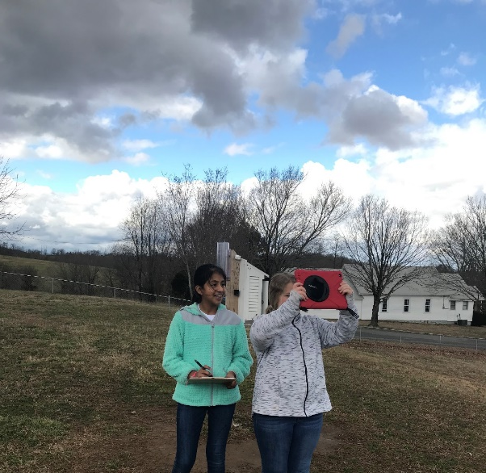
“A GLOBEal Window of Opportunity”
(A study conducted using GLOBE protocols to analyze how the weather changes during the two-hour solar noon window for data collection).
Bayleigh Jettton & Elizabeth Hernandez - 6th grade - Alpena Elementary/Middle School
  Have you ever noticed how the clouds in the sky changes continuously? No matter what type of clouds are in the sky they are constantly changing shapes and moving around. And, even if there aren't any clouds in the sky, the components of the atmosphere are constantly changing as the sun heats up the air causing it to rise and then cooler air moves into its place. The air temperature, barometric pressure, humidity, particles in the air are constantly changing even if we can't see it. The international network called GLOBE "Global Learning and Observations to Benefit the Environment" is a science and education program that is made up of scientist, teachers, and students from more than 122 countries. The GLOBE program offers participants the opportunity to collect data that can be used by scientist to study and better understand the interactions between earth's systems. The GLOBE program is anchored by protocols that are used to make observations and collect data about the world that we live in. Many of the GLOBE atmospheric observations and data collections are conducted during a two-hour window centered around local solar noon for the observer's area. According to GLOBE, "Solar noon is the time during the day when the sun appears to have reached its highest point in the sky. Astronomers refer to this time as local apparent noon. Usually, this is not the same time as "clock noon". The relationship between clock noon and solar noon depends on your location within your time zone and the time of year. Solar noon always occurs half-way between local sunrise and sunset."
­

Slide 2
RESEARCH QUESTION
The GLOBE atmospheric observations and data collections for Aerosols, Surface Temperature, and Cloud Cover, are centered around the two-hour window around local solar noon. The research question being addressed in this investigation is, "How do the components of the atmosphere, Aerosols, Surface Temperature, and Cloud Cover change during the two-hour solar noon window for GLOBE observations and data collection?"
HYPOTHESIS
Based on the researcher's previous experience in making solar noon observations for GLOBE, it was predicted that the air and surface temperatures would increase and the barometric pressure, relative humidity, and cloud cover would decrease as the window progresses from the beginning of the solar noon window to the close. It was predicted that there would be a significant difference in the AOT readings from the beginning to the end of the solar non window. It was also predicted that 40% of the days, (2 out of every 5), would show a significant difference in cloud cover.
Bayleigh Jettton & Elizabeth Hernandez

Slide 3
PROCEDURE
For the past year, the researchers have been making observations and collecting data using the GLOBE protocols for Aerosols, Surface Temperature, and Cloud Cover. Over a period of 15 days, the observers followed the GLOBE protocols for making observations and collecting data for Aerosols, Surface Temperature, and Cloud Cover. The first set of observations and data collections were conducted during the beginning of the solar noon window that occurred during the noon recess right after lunch. The researchers collected the solar noon and ending of solar noon window data during their science classes over the next two hours. A Calitoo meter was used to collect Aerosol Optical Thickness (AOT). AOT data was only available on the days when clouds were not blocking the sun. GLOBE Cloud charts were used to analyze the types of clouds and cloud cover. A digital infrared thermometer was used to collect the surface temperature. An iPad was used to record the cloud observations. All data collected was recorded on GLOBE data sheets and then entered into the GLOBE website data base according to the GLOBE protocols for each type of observation.
Bayleigh Jettton & Elizabeth Hernandez

Slide 4
AEROSOL RESULTS
Aerosol data was collected on 8 different days when the sun was not covered by clouds. The Calitoo meter measures AOT in three wavelengths, Blue-465 nanometers, Green-540 nanometers, and Red-619 nanometers.
The beginning of solar noon: averaged blue=0.080, Green=0.064, and red=0.077, for an overall average of 0.073.
The solar noon: averaged blue=0.123, Green=0.113, and red=0.110, for an overall average of 0.115.
The end of solar noon: averaged blue=0.068, Green=0.053, and red=0.066, for an overall average of 0.073.
SURFACE TEMPERATURE RESULTS
Surface Temperature results were collected on all 15 days. According to the GLOBE protocols, 9 temperatures were recorded for each observation for a total of 405 total surface temperatures recorded and analyzed.
The average surface temperature at the beginning of the solar noon window was 18.5˚C.
The average surface temperature at solar noon was 18.7˚C.
The average surface temperature at the ending of the solar noon window was 20.3˚C.
Bayleigh Jettton & Elizabeth Hernandez

Slide 5
CLOUD OBSERVATION RESULTS
The average cloud cover at the beginning = 45.3%, at solar noon = 45.3%, at the ending of the window = 43.3%, resulting in a 2% decrease in the last hour.
The average air temperature at the beginning = 14.6˚C, at solar noon = 15.5˚C, at the ending of the window = 16.4˚C. The air temperature increased by 0.9˚C each hour resulting in a 6% per hour increase in temperature.
The average relative humidity at the beginning = 14.6˚C, at solar noon = 15.5˚C, at the ending of the window = 16.4˚C. Relative humidity decreased 3.8% the first hour and decreased by 1.4% the last hour of the solar noon window.
The average barometric pressure at the beginning = 974.3mb, at solar noon = 973.5mb, at the ending of the window = 972.9mb. Barometric pressure decreased by 0.8mb the first hour and then only by 0.6mb the last hour.
Bayleigh Jettton & Elizabeth Hernandez

Slide 6
CONCLUSION
The hypothesis was mostly supported by the data. As predicted, the air and surface temperatures increased and the barometric pressure, and relative humidity decreased as the window progresses from the beginning of the solar noon window to the close. However, the cloud over did not change very much during the solar noon window. Sometimes it increased slightly and sometimes it decreased slightly resulting in only a 2% change in cloud cover. The most significant differences recorded during the solar noon window were the readings for AOT. The solar noon AOT readings were 58% higher than the beginning of the window and 85% higher than the readings recorded at the end of the solar noon window. After reviewing all of the data, the researchers have concluded that the overall weather conditions change only slightly during the solar noon window of opportunity for data collection. The researchers recommend that when collecting the solar noon weather data, it would be best to always try and collect it during the same part of the solar noon window in order to make the observations more consistent.
Bayleigh Jettton & Elizabeth Hernandez

Slide 7
Bayleigh Jettton & Elizabeth Hernandez
Aerosol Data Collection Results (Recorded in three different wavelength with a CALITOO meter as AOT (Aerosol Optical Thickness)
 | Beginning of the Solar Noon Window |  |  | Solar Noon |  |  | End of the Solar Noon Window
 | Channel Wavelength |  |  | Channel Wavelength |  |  | Channel Wavelength
Test Date | Blue 465 | Green 540 | Red 619 | Blue 465 | Green 540 | Red 619 | Blue 465 | Green 540 | Red 619
10/16 | 0.091 | 0.071 | 0.081 | 0.084 | 0.065 | 0.077 | 0.084 | 0.064 | 0.074
10/17 | 0.075 | 0.059 | 0.075 | 0.078 | 0.061 | 0.075 | 0.080 | 0.062 | 0.077
10/18 | 0.088 | 0.072 | 0.088 | 0.151 | 0.136 | 0.155 | 0.060 | 0.045 | 0.058
10/21 | 0.072 | 0.060 | 0.077 | 0.208 | 0.169 | 0.174 | 0.064 | 0.052 | 0.064
10/22 | 0.073 | 0.059 | 0.072 | 0.204 | 0.246 | 0.191 | 0.068 | 0.055 | 0.068
10/23 | 0.071 | 0.056 | 0.072 | 0.074 | 0.059 | 0.075 | 0.076 | 0.061 | 0.076
10/31 | 0.134 | 0.112 | 0.113 | 0.150 | 0.139 | 0.124 | 0.069 | 0.056 | 0.065
11/01 | 0.040 | 0.030 | 0.045 | 0.042 | 0.032 | 0.048 | 0.041 | 0.032 | 0.048
Total | 0.644 | 0.519 | 0.623 | 0.991 | 0.907 | 0.879 | 0.542 | 0.427 | 0.530
Mean | 0.080 | 0.064 | 0.077 | 0.123 | 0.113 | 0.110 | 0.068 | 0.053 | 0.066
Overall Mean AOT | 0.073 AOT Beginning of the Solar Noon Window |  |  | 0.115 AOT Solar Noon |  |  | 0.062 AOT End of the Solar Noon Window
Air Temperature Data Collection Results (recorded as average °C during Cloud Observations)
Test Date | Beginning of the Solar Noon Window | Solar Noon | End of the Solar Noon Window
10/15 | 23.5 | 22.9 | 23.1
10/16 | 12.5 | 13.8 | 15.0
10/17 | 18.8 | 19.4 | 22.2
10/18 | 21.8 | 23.1 | 23.6
10/19 | 17.8 | 19.7 | 21.9
10/21 | 16.3 | 17.3 | 19.3
10/22 | 16.4 | 17.6 | 18.2
10/23 | 22.7 | 23.8 | 23.9
10/24 | 10.5 | 10.8 | 10.0
10/25 | 808 | 9.7 | 10.2
10/28 | 18.2 | 20.2 | 19.6
10/29 | 8.0 | 8.0 | 8.6
10/30 | 7.3 | 7.7 | 7.7
10/31 | 3.6 | 4.8 | 6.1
11/01 | 12.4 | 14.8 | 15.8
Total | 218.6 | 233.0 | 245.3
Mean Air Temperature | 14.6°C | 15.5°C | 16.4°C
Barometric Pressure Data Collection Results (recorded as average mb during Cloud Observations)
Test Date | Beginning of the Solar Noon Window | Solar Noon | End of the Solar Noon Window
10/15 | 969 | 969 | 968
10/16 | 977 | 977 | 977
10/17 | 976 | 973 | 974
10/18 | 970 | 969 | 968
10/19 | 966 | 965 | 964
10/21 | 964 | 964 | 964
10/22 | 975 | 974 | 972
10/23 | 973 | 972 | 972
10/24 | 980 | 979 | 979
10/25 | 980 | 978 | 977
10/28 | 973 | 972 | 971
10/29 | 977 | 977 | 976
10/30 | 973 | 972 | 971
10/31 | 981 | 982 | 980
11/01 | 981 | 980 | 981
Total | 14,615 | 14,603 | 14,594
Mean Barometric Pressure | 974.3mb | 973.5mb | 972.9mb

Slide 8
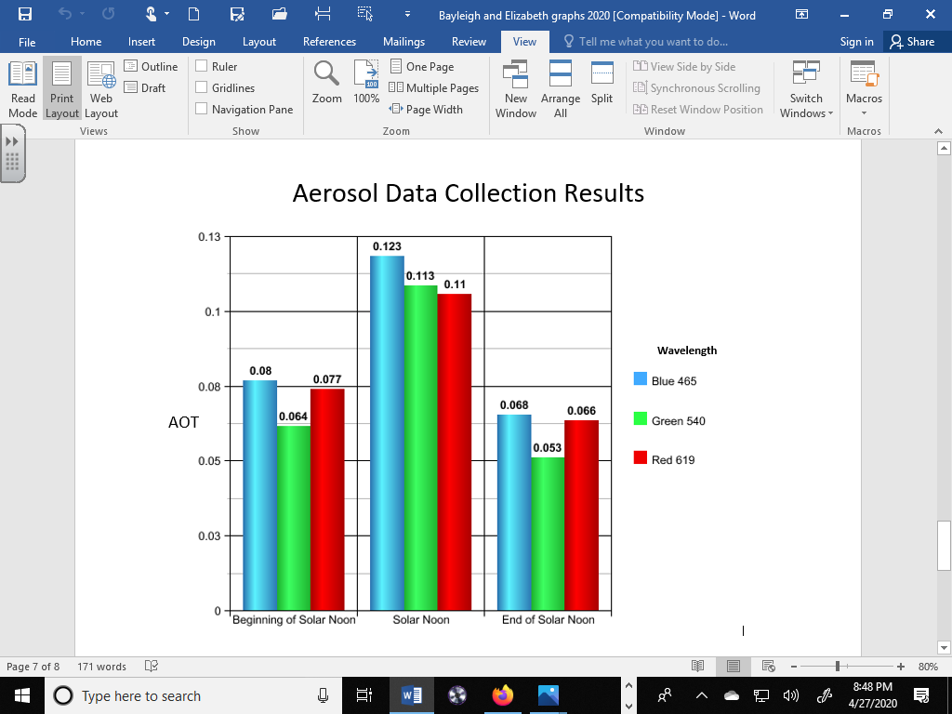
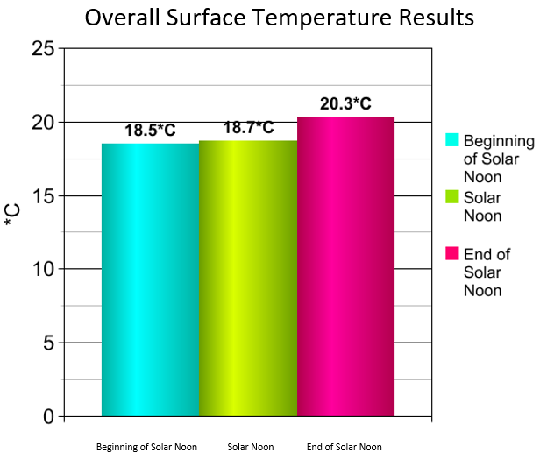
Bayleigh Jettton & Elizabeth Hernandez

Slide 9
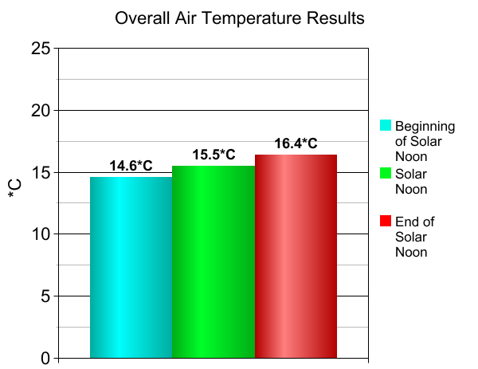
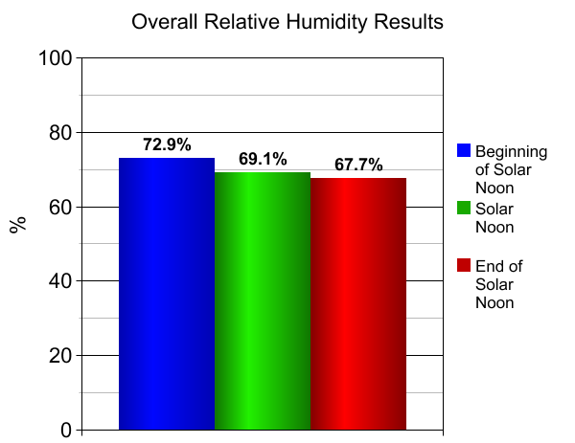
Air Temperature Results Relative Humidity Results
Bayleigh Jettton & Elizabeth Hernandez

Slide 10
Bayleigh Jettton & Elizabeth Hernandez
Surface Temperature Data Collection Results (recorded as average °C)
Test Date | Beginning of the Solar Noon Window | Solar Noon | End of the Solar Noon Window
10/15 | 21.6 | 21.1 | 26.7
10/16 | 21.8 | 22.5 | 25.6
10/17 | 27.5 | 27.6 | 26.0
10/18 | 26.9 | 30.6 | 35.7
10/19 | 18.7 | 20.6 | 25.9
10/21 | 24.6 | 23.6 | 23.5
10/22 | 23.0 | 22.6 | 23.4
10/23 | 25.3 | 27.7 | 24.3
10/24 | 12.6 | 10.6 | 3.6
10/25 | 9.3 | 8.6 | 9.1
10/28 | 20.3 | 19.6 | 29.8
10/29 | 8.6 | 9.6 | 9.6
10/30 | 10.2 | 7.1 | 10.1
10/31 | 9.3 | 10.2 | 10.5
11/01 | 18.2 | 18.8 | 20.3
Total | 277.9 | 280.8 | 304.1
Mean Surface Temperature | 18.5°C | 18.7°C | 20.3°C
Cloud Coverage Data Collection Results (recorded as average % of Cloud Cover)
Scale used for calculating Cloud Cover: None = 0, Few = 10%, Isolated = 20%, Scattered = 40%, Broken = 70%, Overcast = 90%
Test Date | Beginning of the Solar Noon Window | Solar Noon | End of the Solar Noon Window
10/15 | 90 | 90 | 70
10/16 | 0 | 0 | 10
10/17 | 0 | 0 | 10
10/18 | 40 | 40 | 20
10/19 | 70 | 90 | 70
10/21 | 10 | 0 | 0
10/22 | 10 | 10 | 10
10/23 | 10 | 10 | 10
10/24 | 90 | 90 | 90
10/25 | 90 | 90 | 90
10/28 | 70 | 70 | 70
10/29 | 90 | 90 | 90
10/30 | 90 | 90 | 90
10/31 | 20 | 10 | 20
11/01 | 0 | 0 | 0
Total | 680 | 680 | 650
Mean Cloud Cover | 45.3% | 45.3% | 43.3%
Relative Humidity Data Collection Results (recorded as % Relative Humidity during Cloud Observations)
Test Date | Beginning of the Solar Noon Window | Solar Noon | End of the Solar Noon Window
10/15 | 95 | 95 | 95
10/16 | 69 | 64 | 57
10/17 | 59 | 63 | 63
10/18 | 63 | 59 | 54
10/19 | 95 | 85 | 73
10/21 | 56 | 51 | 50
10/22 | 43 | 38 | 34
10/23 | 37 | 30 | 52
10/24 | 95 | 95 | 95
10/25 | 95 | 95 | 95
10/28 | 95 | 84 | 72
10/29 | 95 | 95 | 95
10/30 | 95 | 95 | 95
10/31 | 64 | 58 | 56
11/01 | 37 | 30 | 29
Total | 1,093 | 1,037 | 1,019
Mean Relative Humidity | 72.9% | 69.1% | 67.7%

