Slide 1




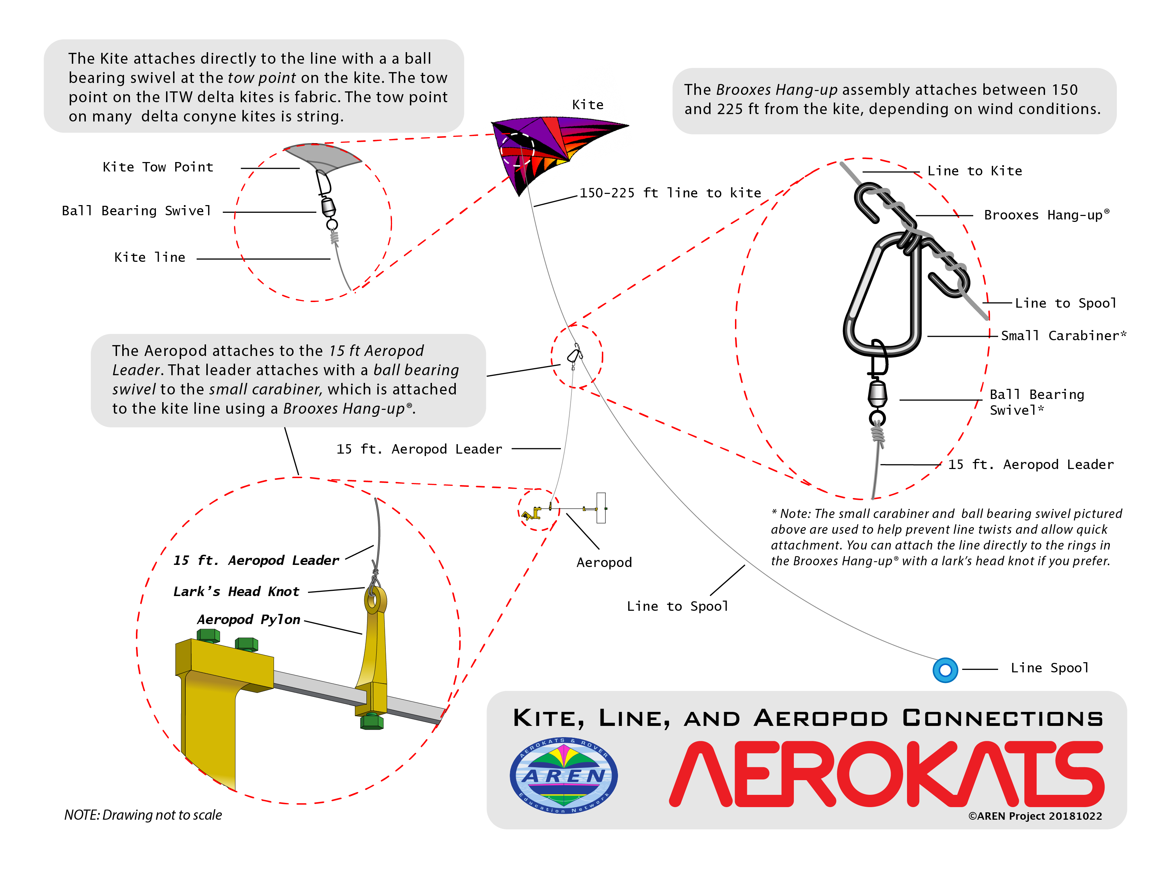
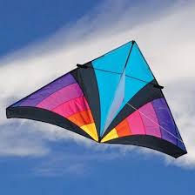





Using Aeropod Technology to Interpret Select Microscale Weather Parameters Using Vertical Profiling
Nazih Baydoun, Hassan Berry, and Belal Beydoun
Crestwood High School – Dearborn Heights, Michigan

Slide 2
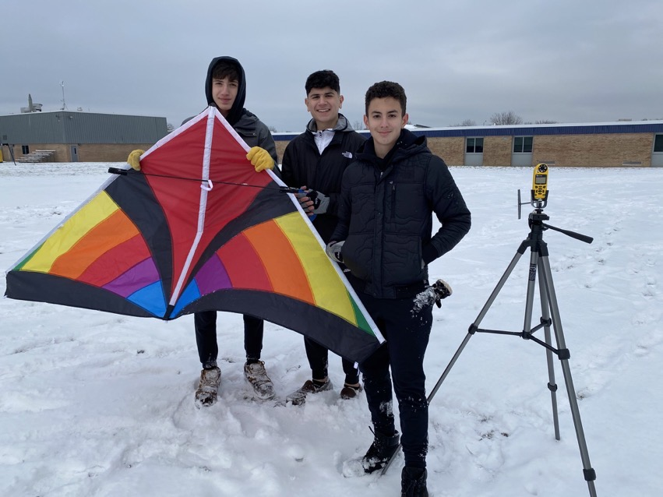
Research Questions
Nazih Baydoun, Hassan Berry, and Belal Beydoun
Do near surface weather parameters such as air temperature, humidity, and dew point predict the altitude and types of clouds that form?
How do select weather parameters measured at ground level compare with the same weather parameters at approximately 122 meters or 400 ft above the surface during the winter?
How does vertical profiling using AREN/NASA technology compare at northern latitudes as compared with warmer latitudes like those found in Thailand in the future?
Belal Beydoun
Nazih Baydoun

Slide 3
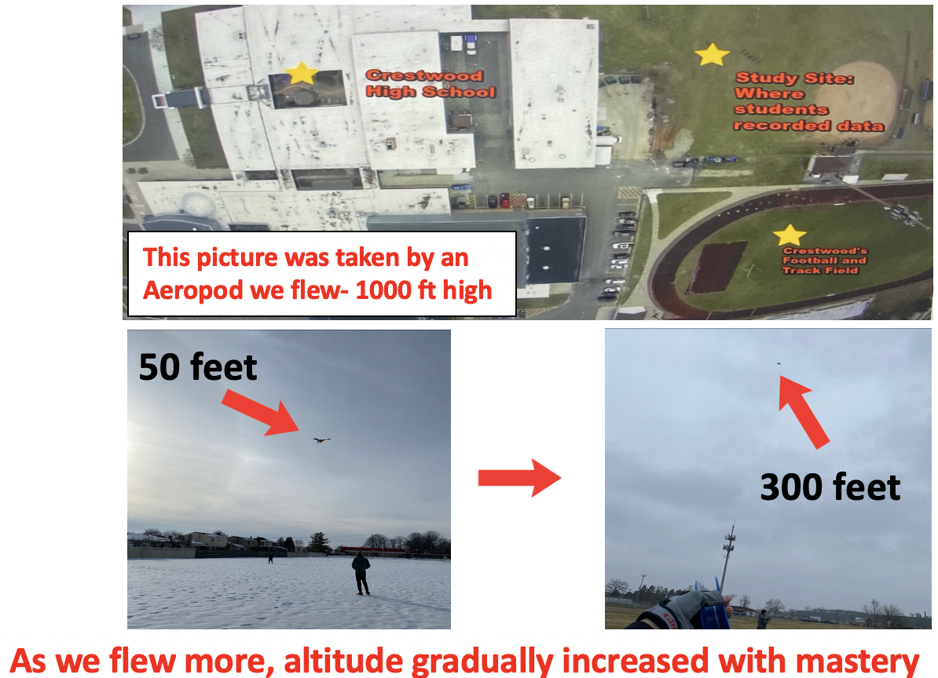
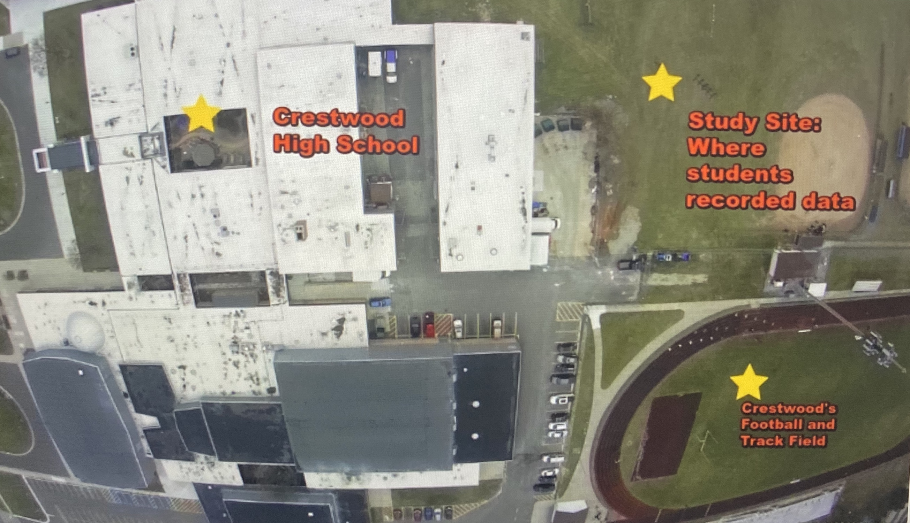
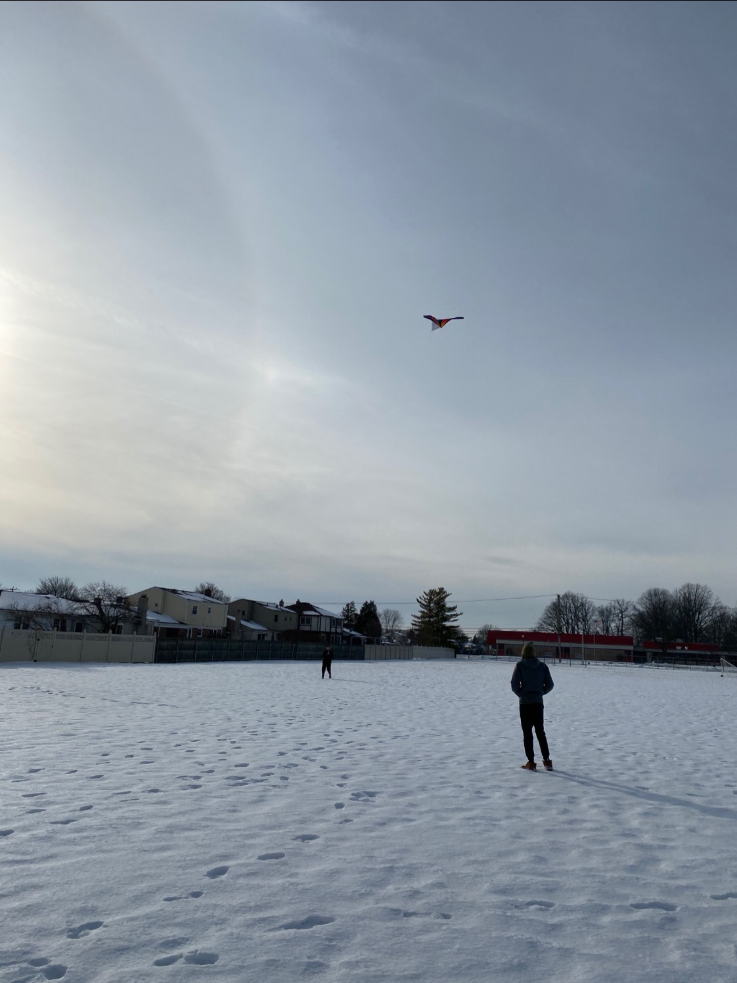
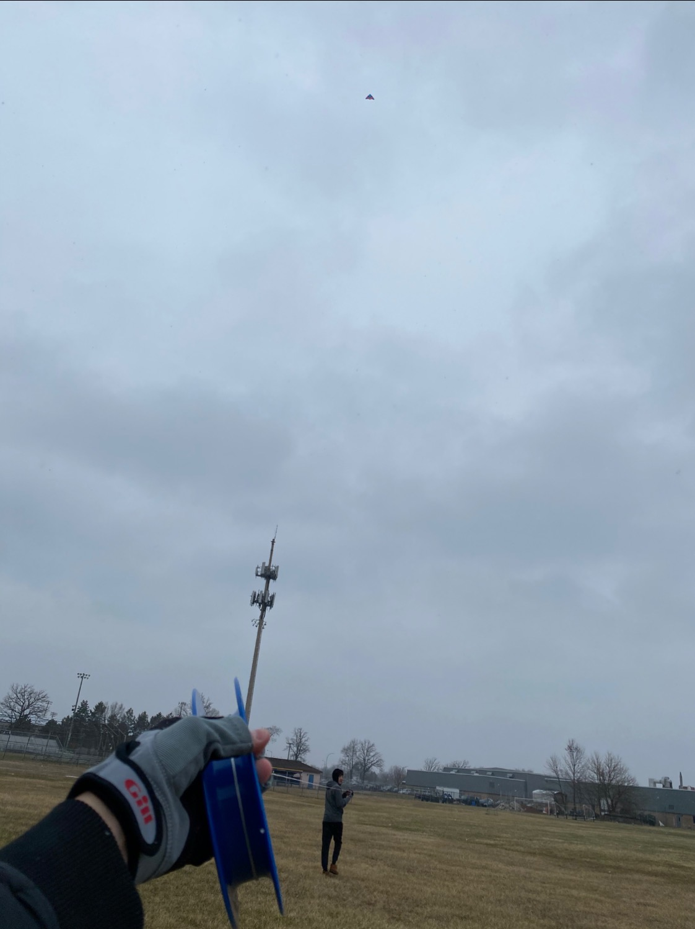

Research Site and Duration of Research
Nazih Baydoun, Hassan Berry, and Belal Beydoun
The data was recorded at Crestwood High School’s Soccer/ Football field.
Short grass
The climate of this site is cold and temperate
Lots of precipitation constantly.
Very muddy due to large amounts of snow that have melted over the course of the months the researchers took data.
Many areas of standing water, ice, and snow
Hassan Berry
Belal Beydoun
This picture was taken by an Aeropod we flew- 1000 ft high
Nazih Baydoun
50 feet
Days of data collected=7
Through January to March of 2020, we flew kites.
However, for a large portion, we conducted practice flights to learn how to assemble kites, fly, attach weather devices to kites, record data, learn how to use the Kestrel, etc.
300 feet
As we flew more, altitude gradually increased with mastery

Slide 4
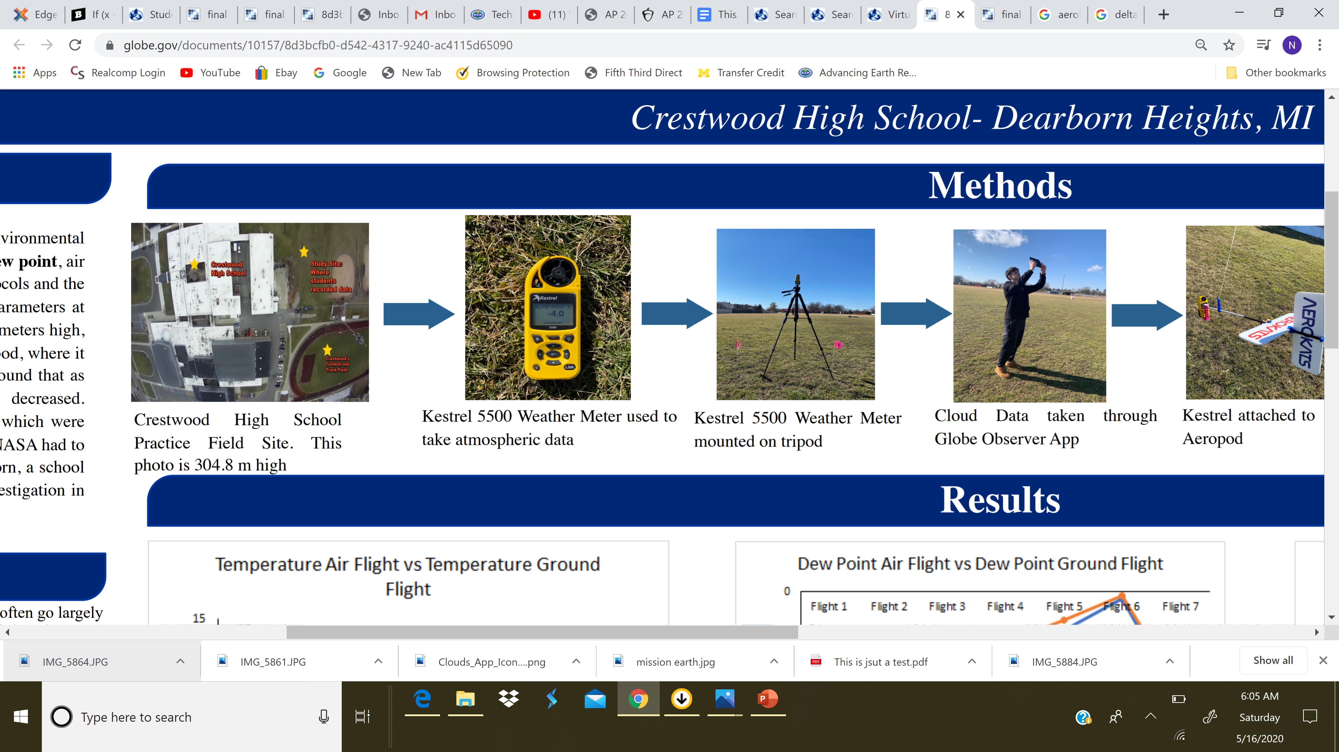


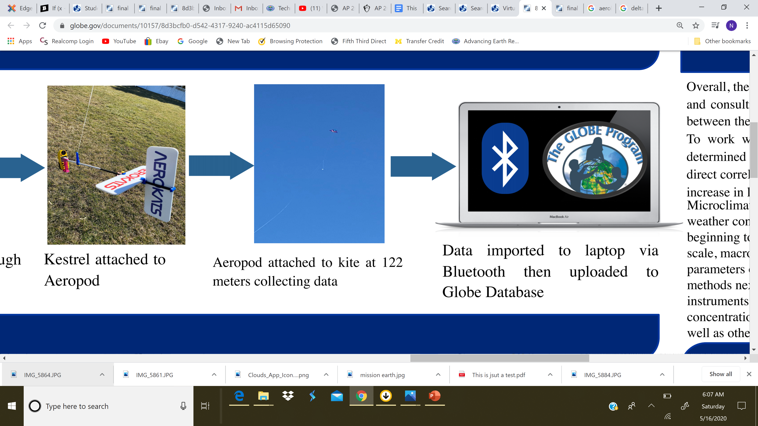
Methodology
Nazih Baydoun, Hassan Berry, and Belal Beydoun
Hassan Berry
Belal Beydoun
Nazih Baydoun

Slide 5
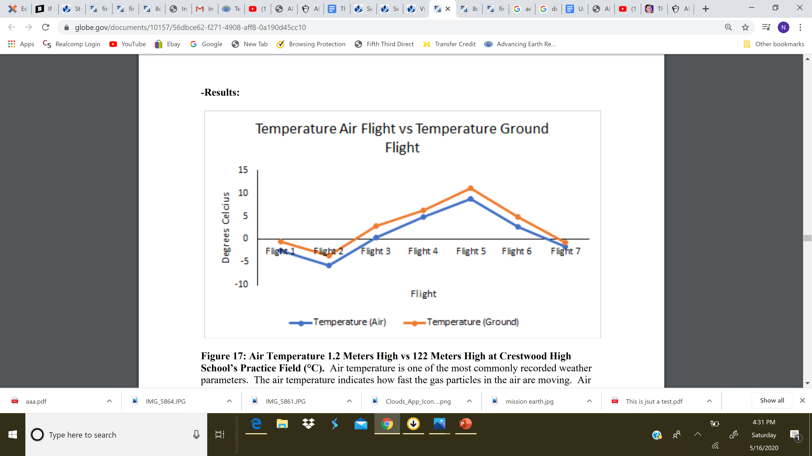
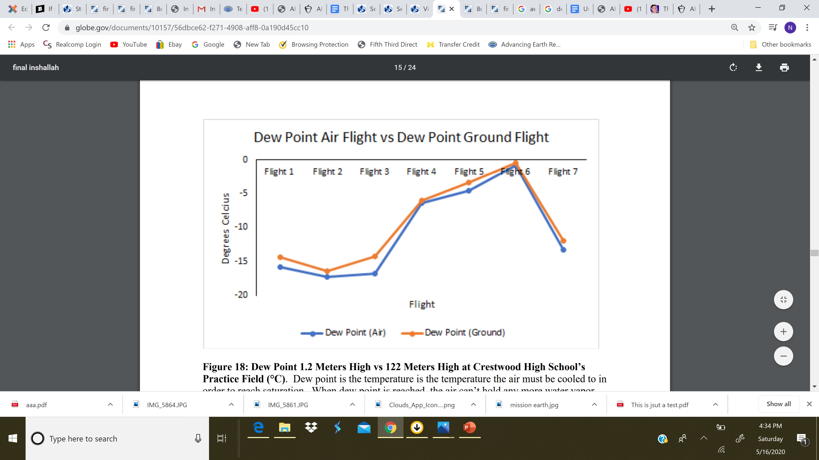
Results
Nazih Baydoun, Hassan Berry, and Belal Beydoun
The air temperature indicates how fast the gas particles in the air are moving.
Air temperature 1.2 meters high and 122 meters high seems to be very correlated.
As altitude increases, air temperature decreases. This is clearly shown here; there seems to be a 2°C differential all the way through. As altitude increases about 120 meters, the air temperature decreases by about 2°C constantly
Directly correlated
Hassan Berry
Belal Beydoun
Dew point is the point when air cannot hold any more water vapor, so the water vapor must condense to form clouds. Dew point is directly linked w/ cloud formation.
Dew point in the air seems to always be lower than on the ground. If the dew point in the air and dew point on the ground became very similar, fog would begin to form.
Directly correlated

Slide 6
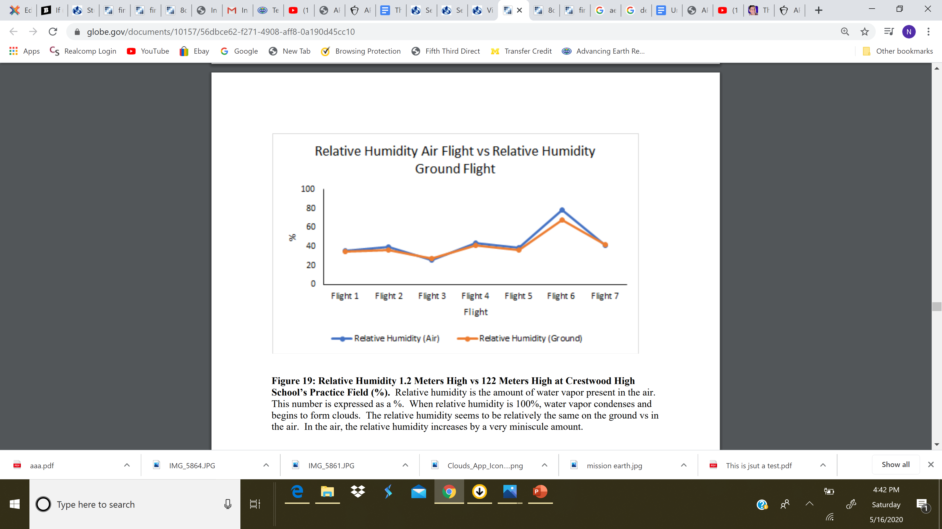
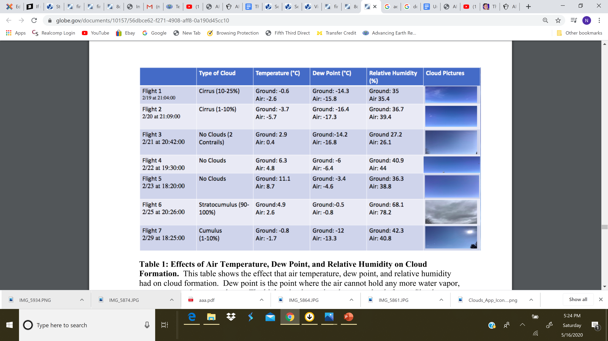
Results
Nazih Baydoun, Hassan Berry, and Belal Beydoun
Relative humidity is the amount of water vapor present in the air. (Expressed as %)
When relative humidity is 100%, water vapor condenses and begins to form clouds.
The relative humidity seems to be relatively the same on the ground vs in the air.
In the air, the relative humidity increases by a very miniscule amount.
Belal Beydoun
Hassan Berry
Seems diff. by a small amt.
Flight 6’s relative humidity and dew point was significantly higher than the rest of the flights
This led to stratocumulus clouds that day.
However, the other flights had much lower percentages of relative humidity and dew point, which lead to higher clouds such as cirrus, cirrocumulus, etc.
Nazih Baydoun

Slide 7
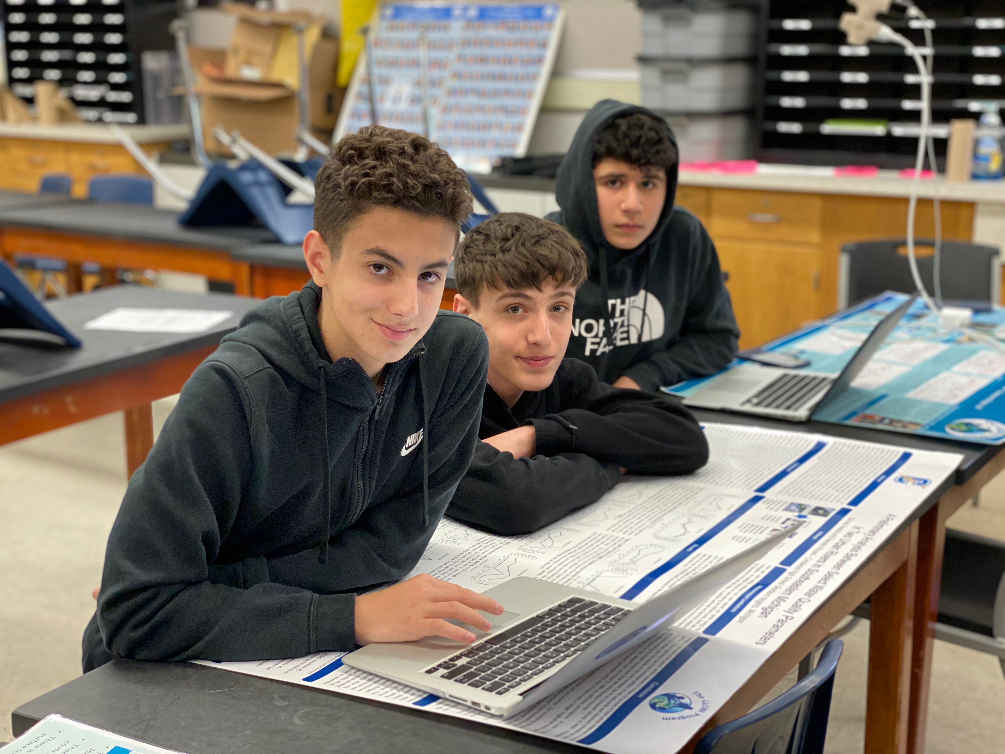
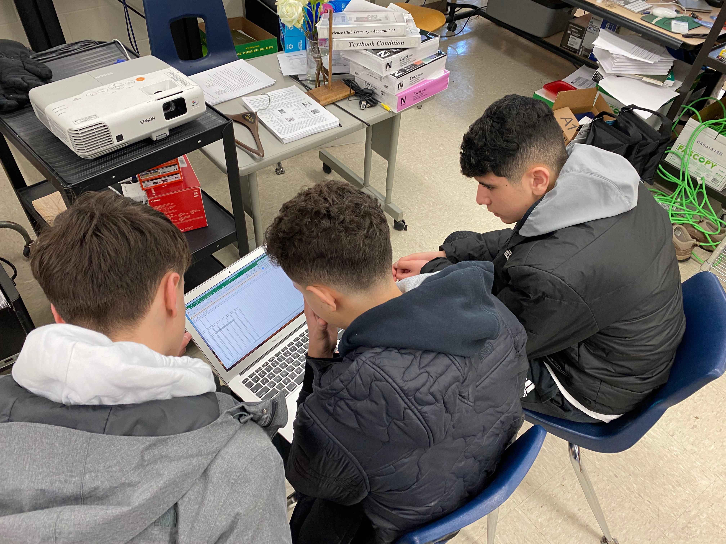
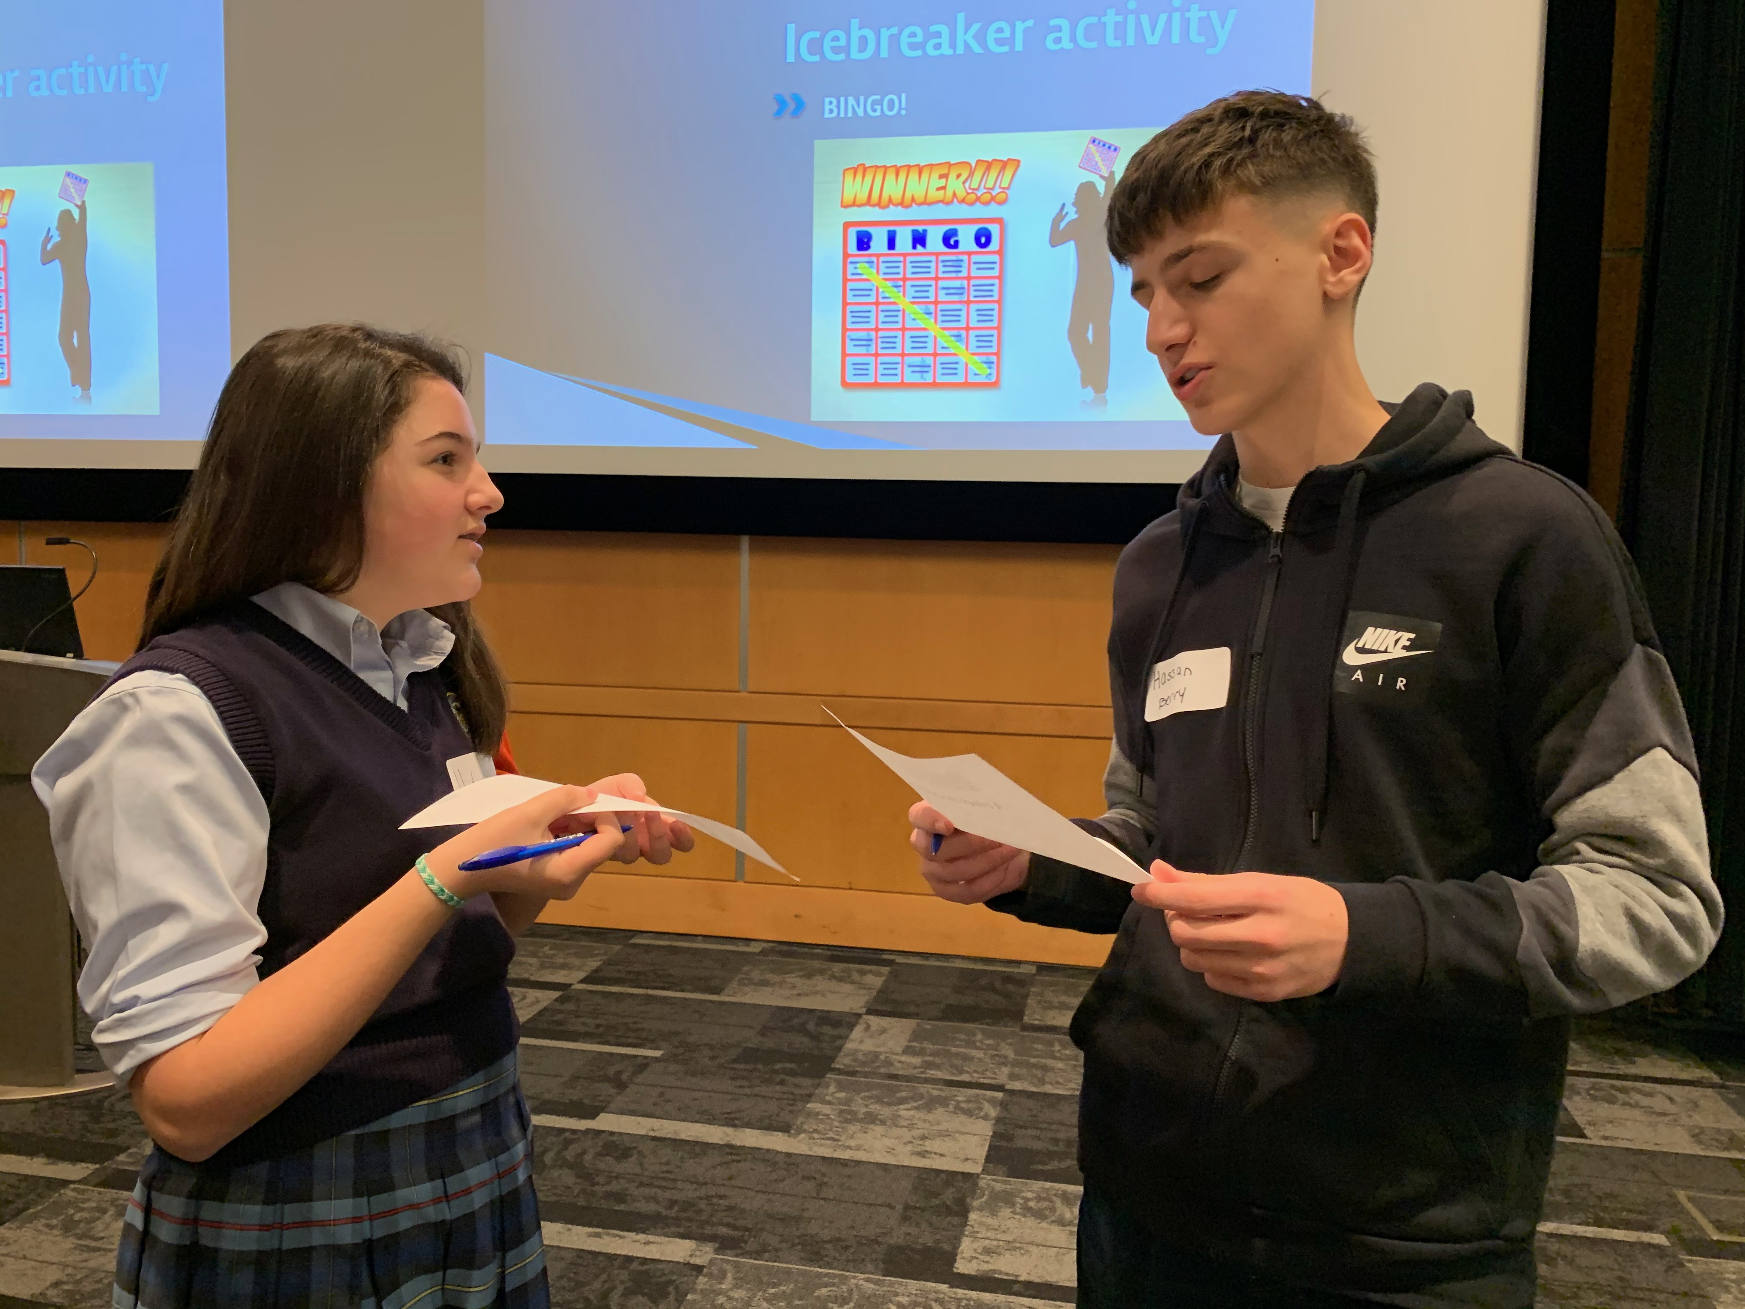
Discussion
Nazih Baydoun, Hassan Berry, and Belal Beydoun
Significant correlations found between select surface weather parameters on the ground vs 122 meters high
Rejection of first and second null hypothesis, unfortunate acceptance of the third
Some possible sources of errors include the Kestrel having the inability to be a barometer and an altimeter simultaneously, so there was no definitive way of obtaining the exact altitude.
A plethora of research exists on vertical profiling using radiosonde technology and weather balloons. Much data is also collected today using airplanes and drones outfitted with weather sensors. There is a current void in published data using Aeropod technology with the equipment the researchers are using. This and subsequent research seek to fill this gap. However, Mr. David Bydlowski of the NASA GLOBE AREN Project helped us interpret all the results, and the researchers came to a strong conclusion that there was a strong correlation present between relative humidity, dew point, and temperature at ground level and 122 meters high.

Slide 8
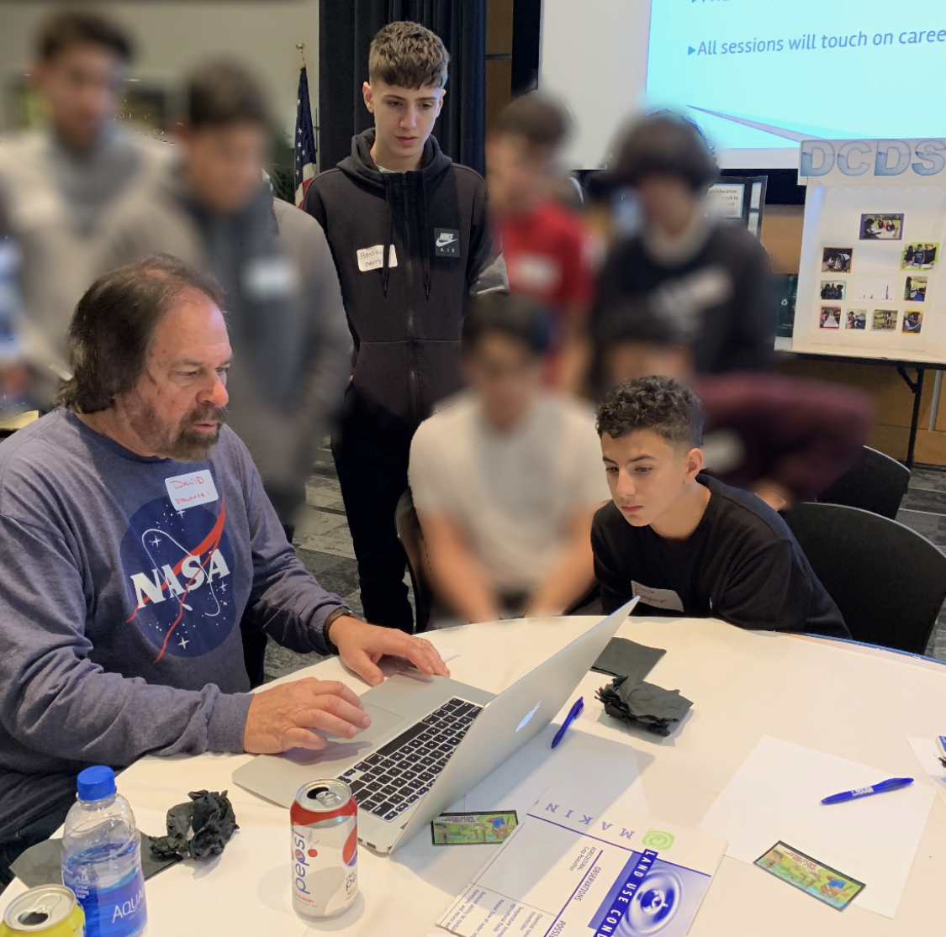
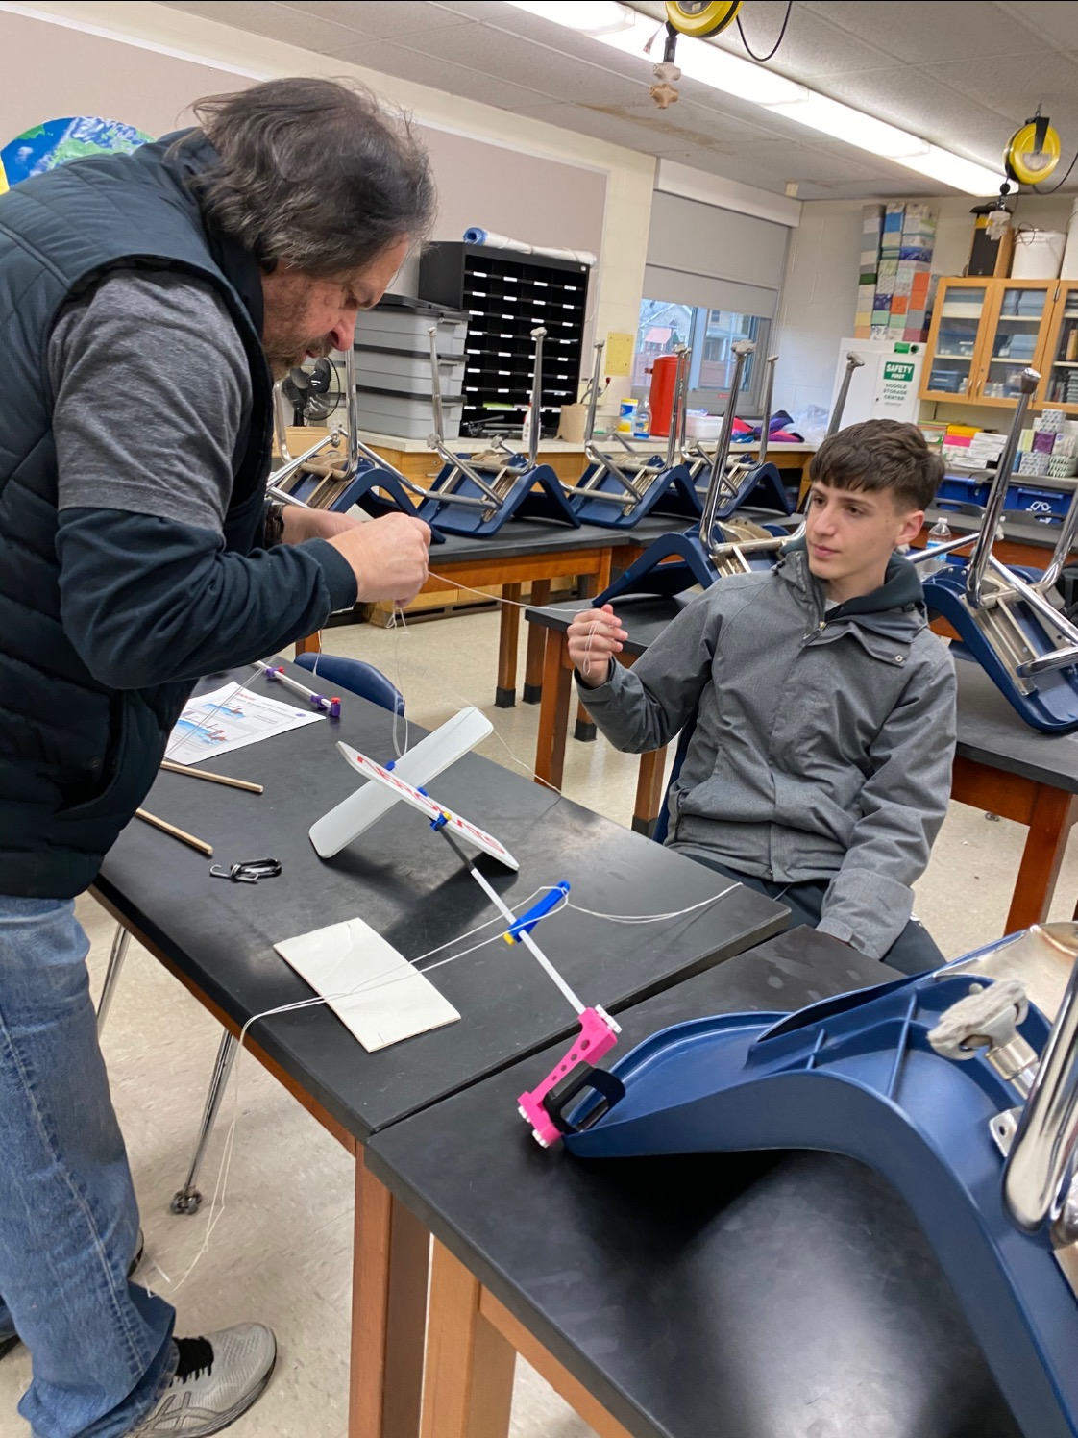
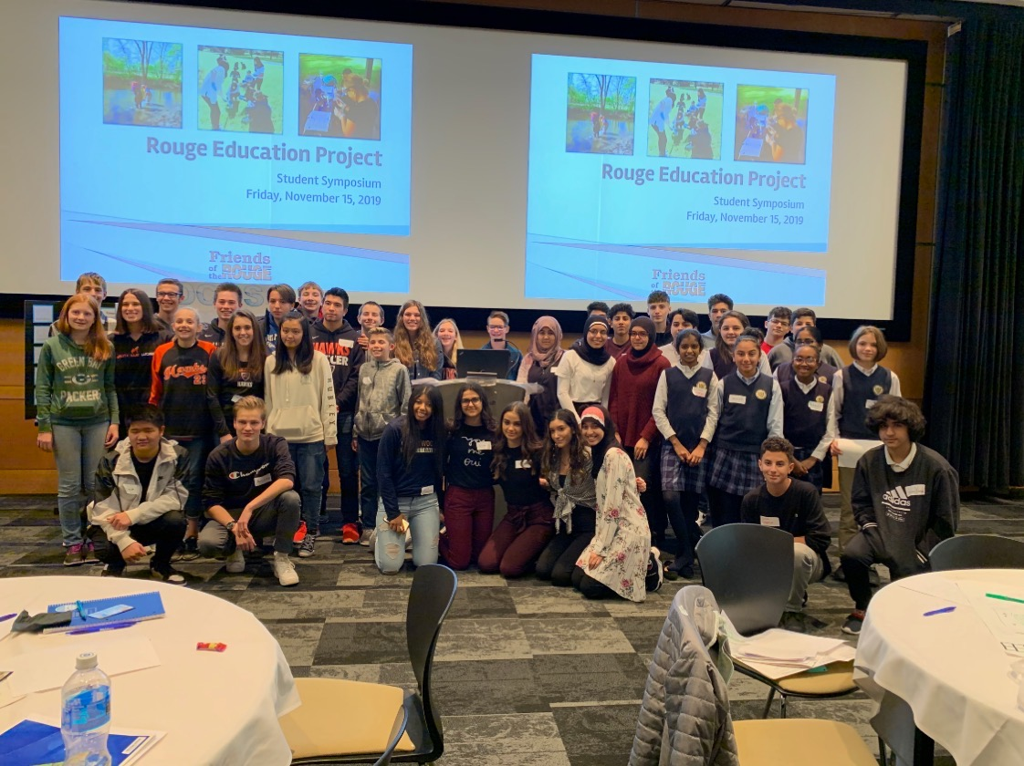
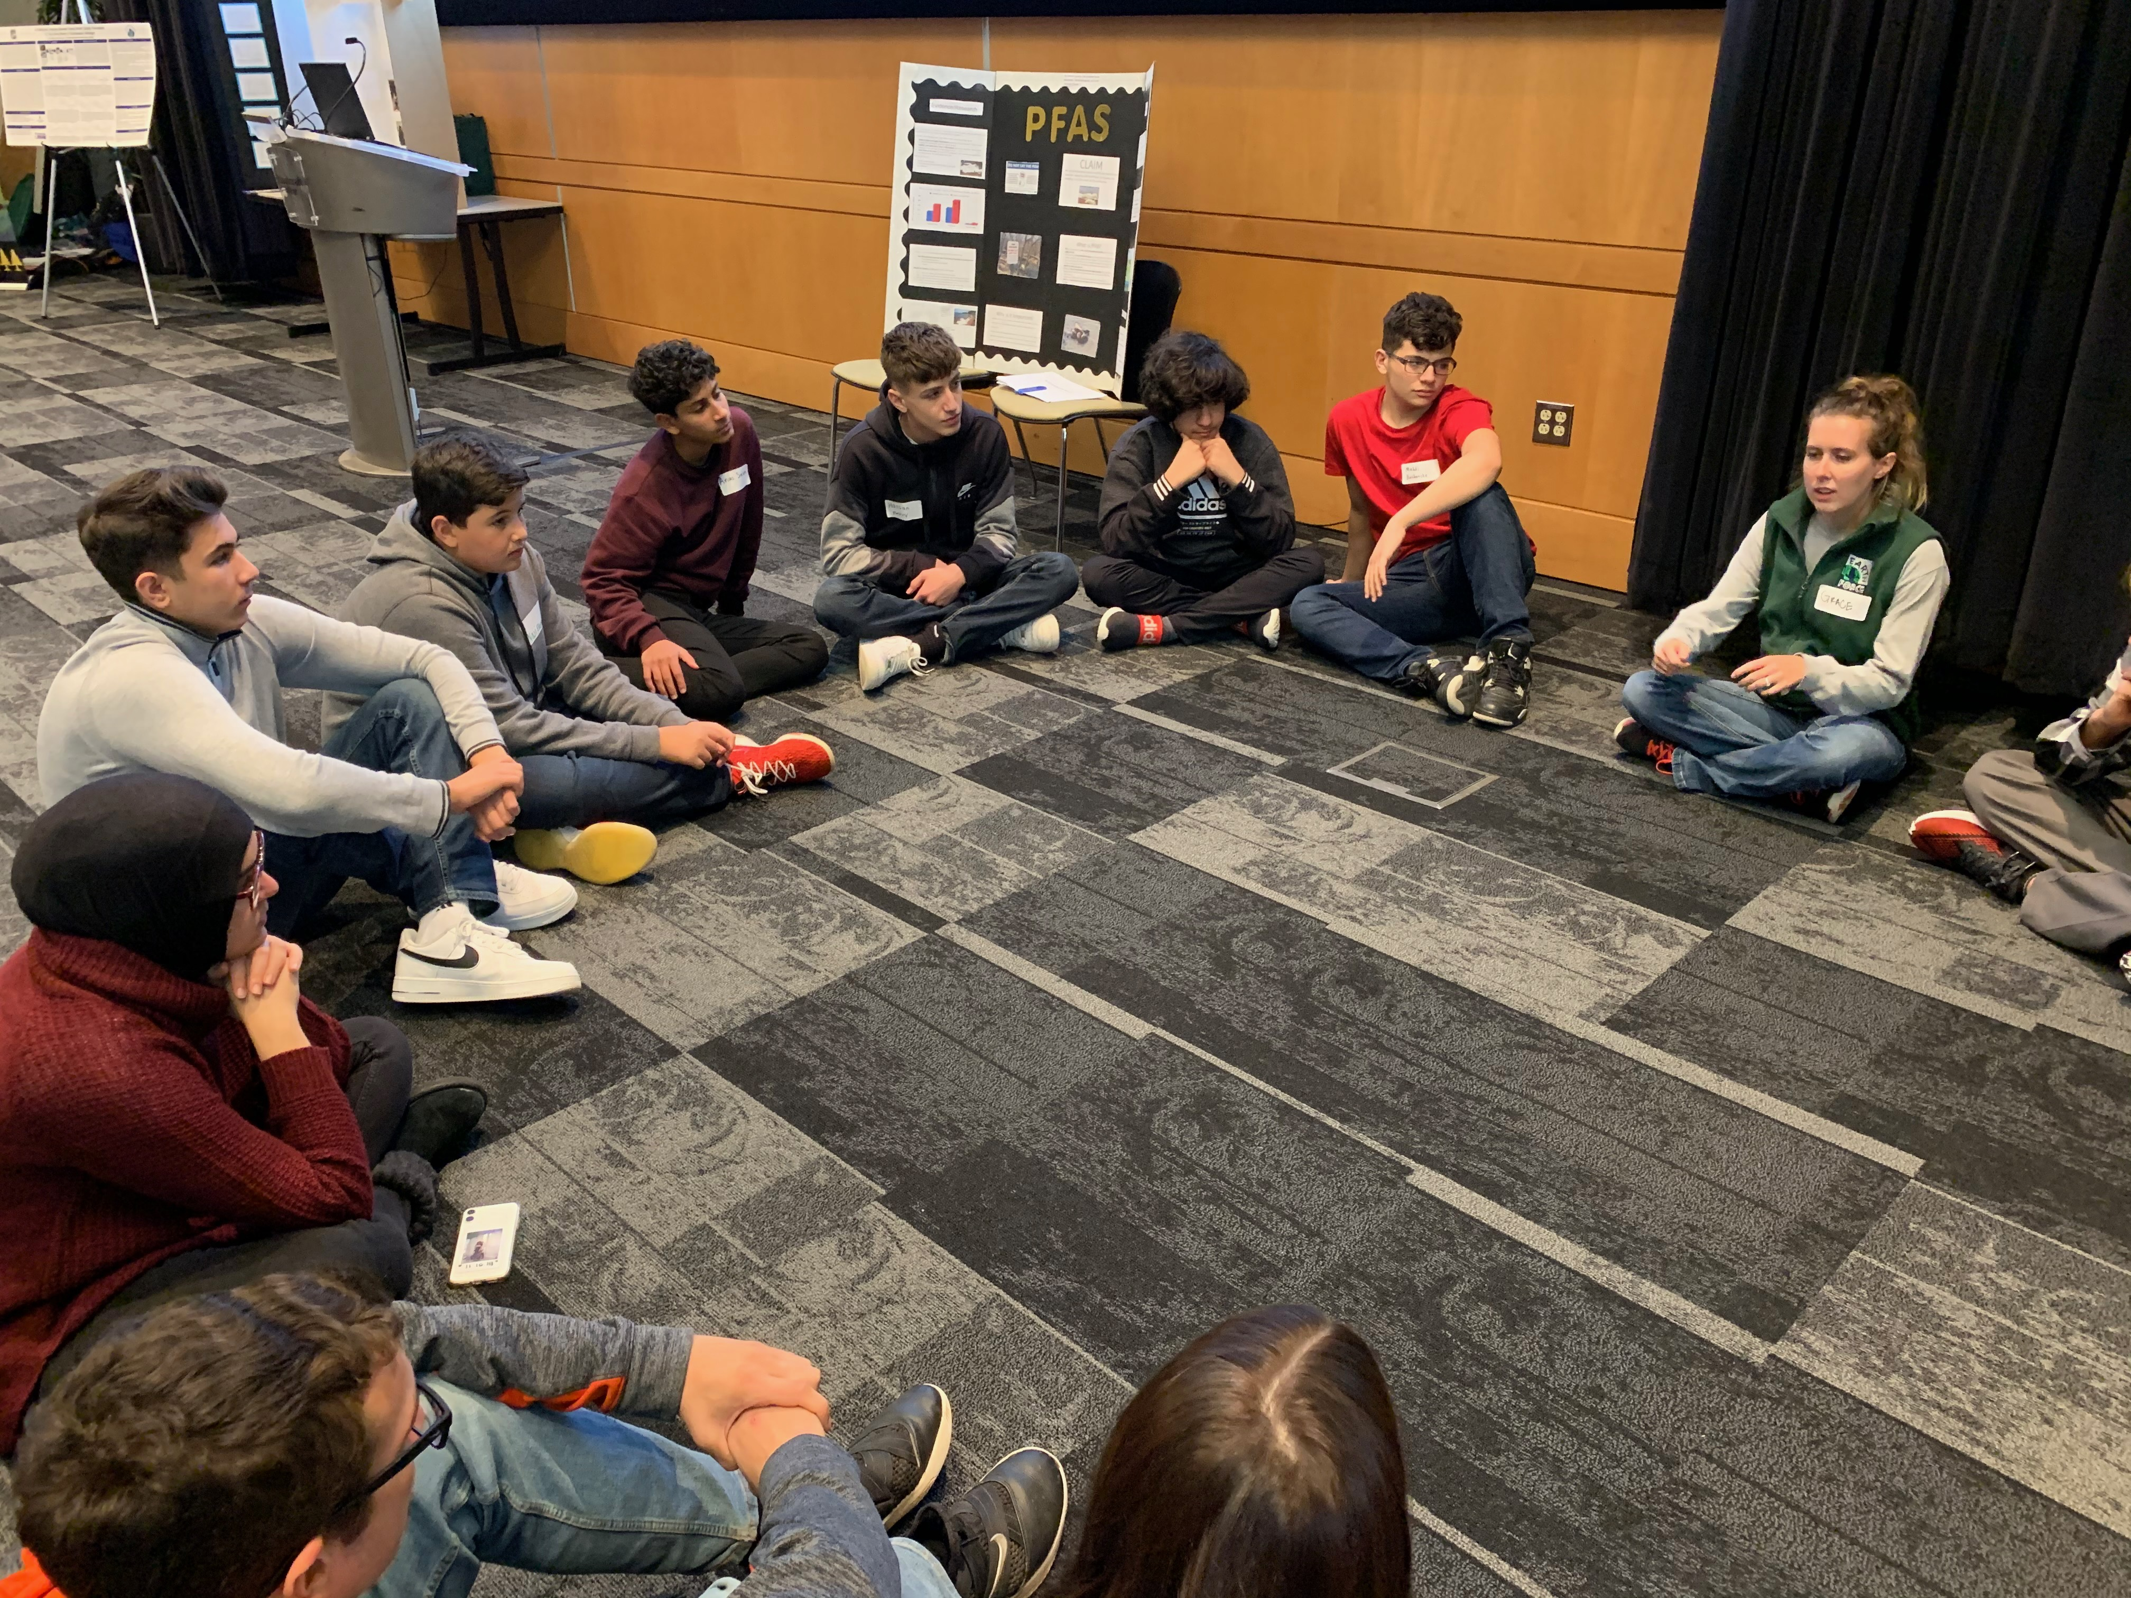
Working with a STEM Professional and Significance of Research
Relatively inexpensive
The effects of microclimates
Our school campus is its own microclimate within a neighborhood of many homes and businesses
Studying microclimates is also important as to it can shed possible insight into phenomena such as fog formation, urban heat island effect and other small-scale weather events.
Mr. David Bydlowski of the NASA/AREN Program was very inspirational to us as young scientists
He also helped us interpret results of our research, as well as provide tools and troubleshoot issues when necessary
Nazih Baydoun

Slide 9
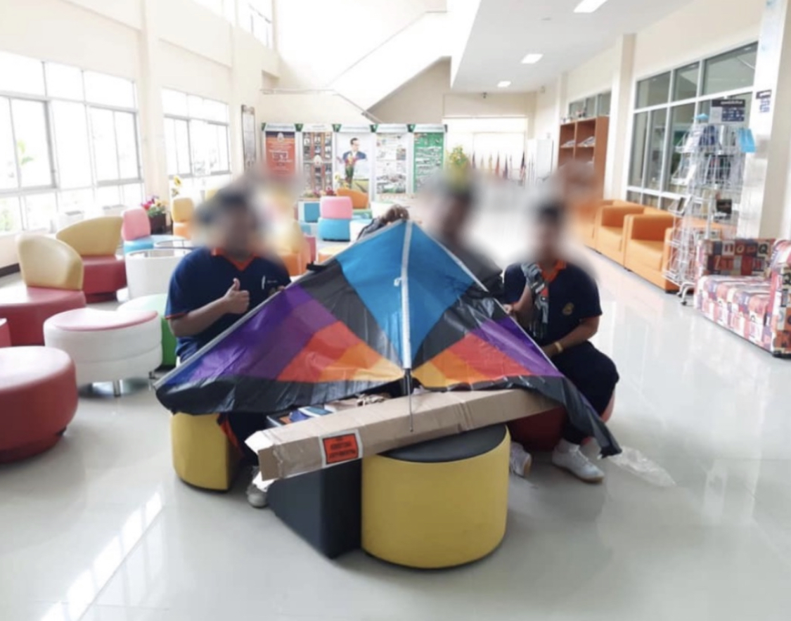
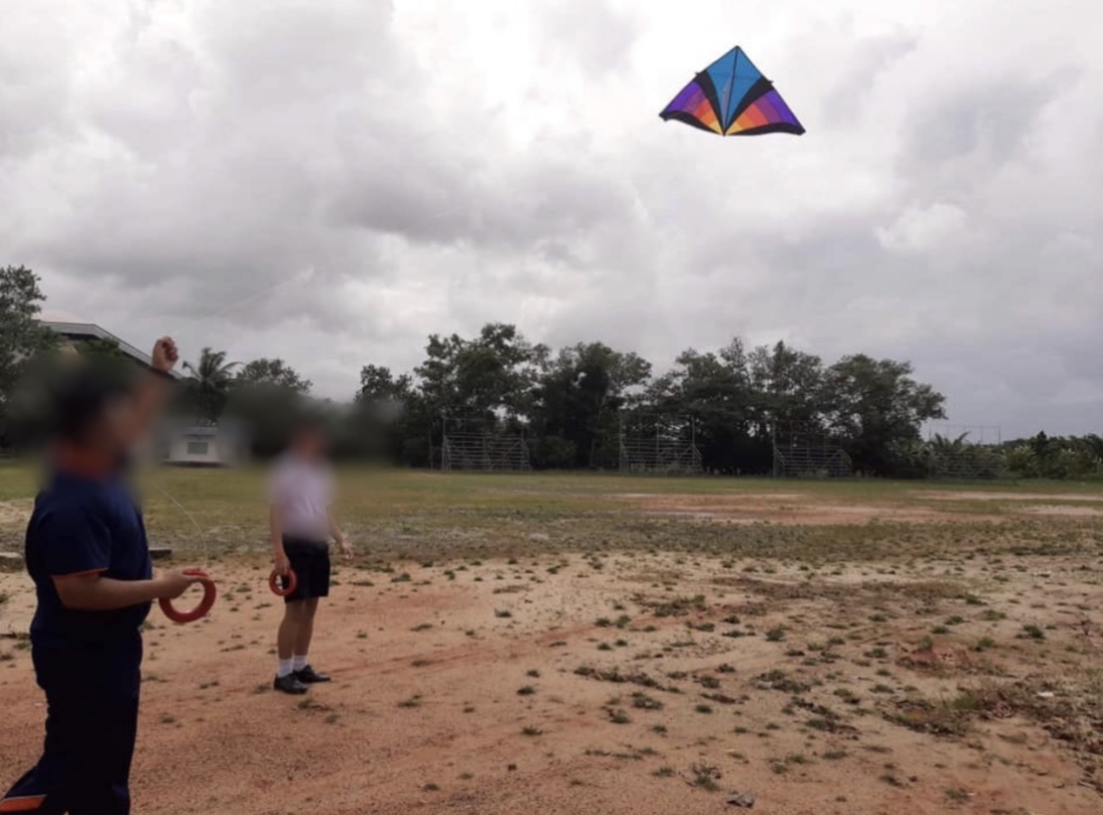
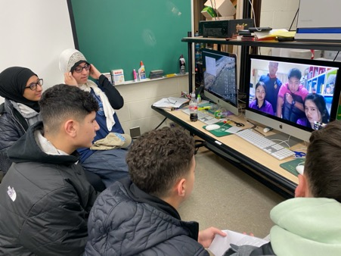
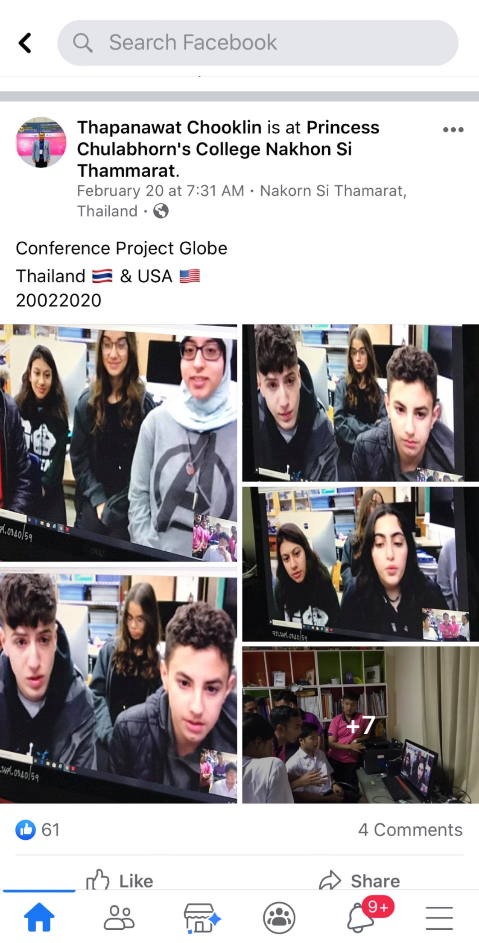
Collaboration with Thailand
Nazih Baydoun, Hassan Berry, and Belal Beydoun
The picture on the top left shows the Thailand students receiving the kite we sent them. The picture on the top right shows their first time flying it.
Our group has had strong ties with students at Princess Chulabhorn, as we communicated with them on a weekly basis (before the Coronavirus) on furthering our joint project. We communicate with each other through Facebook video chats (pictures on bottom).
Hassan Berry
Nazih Baydoun

Slide 10
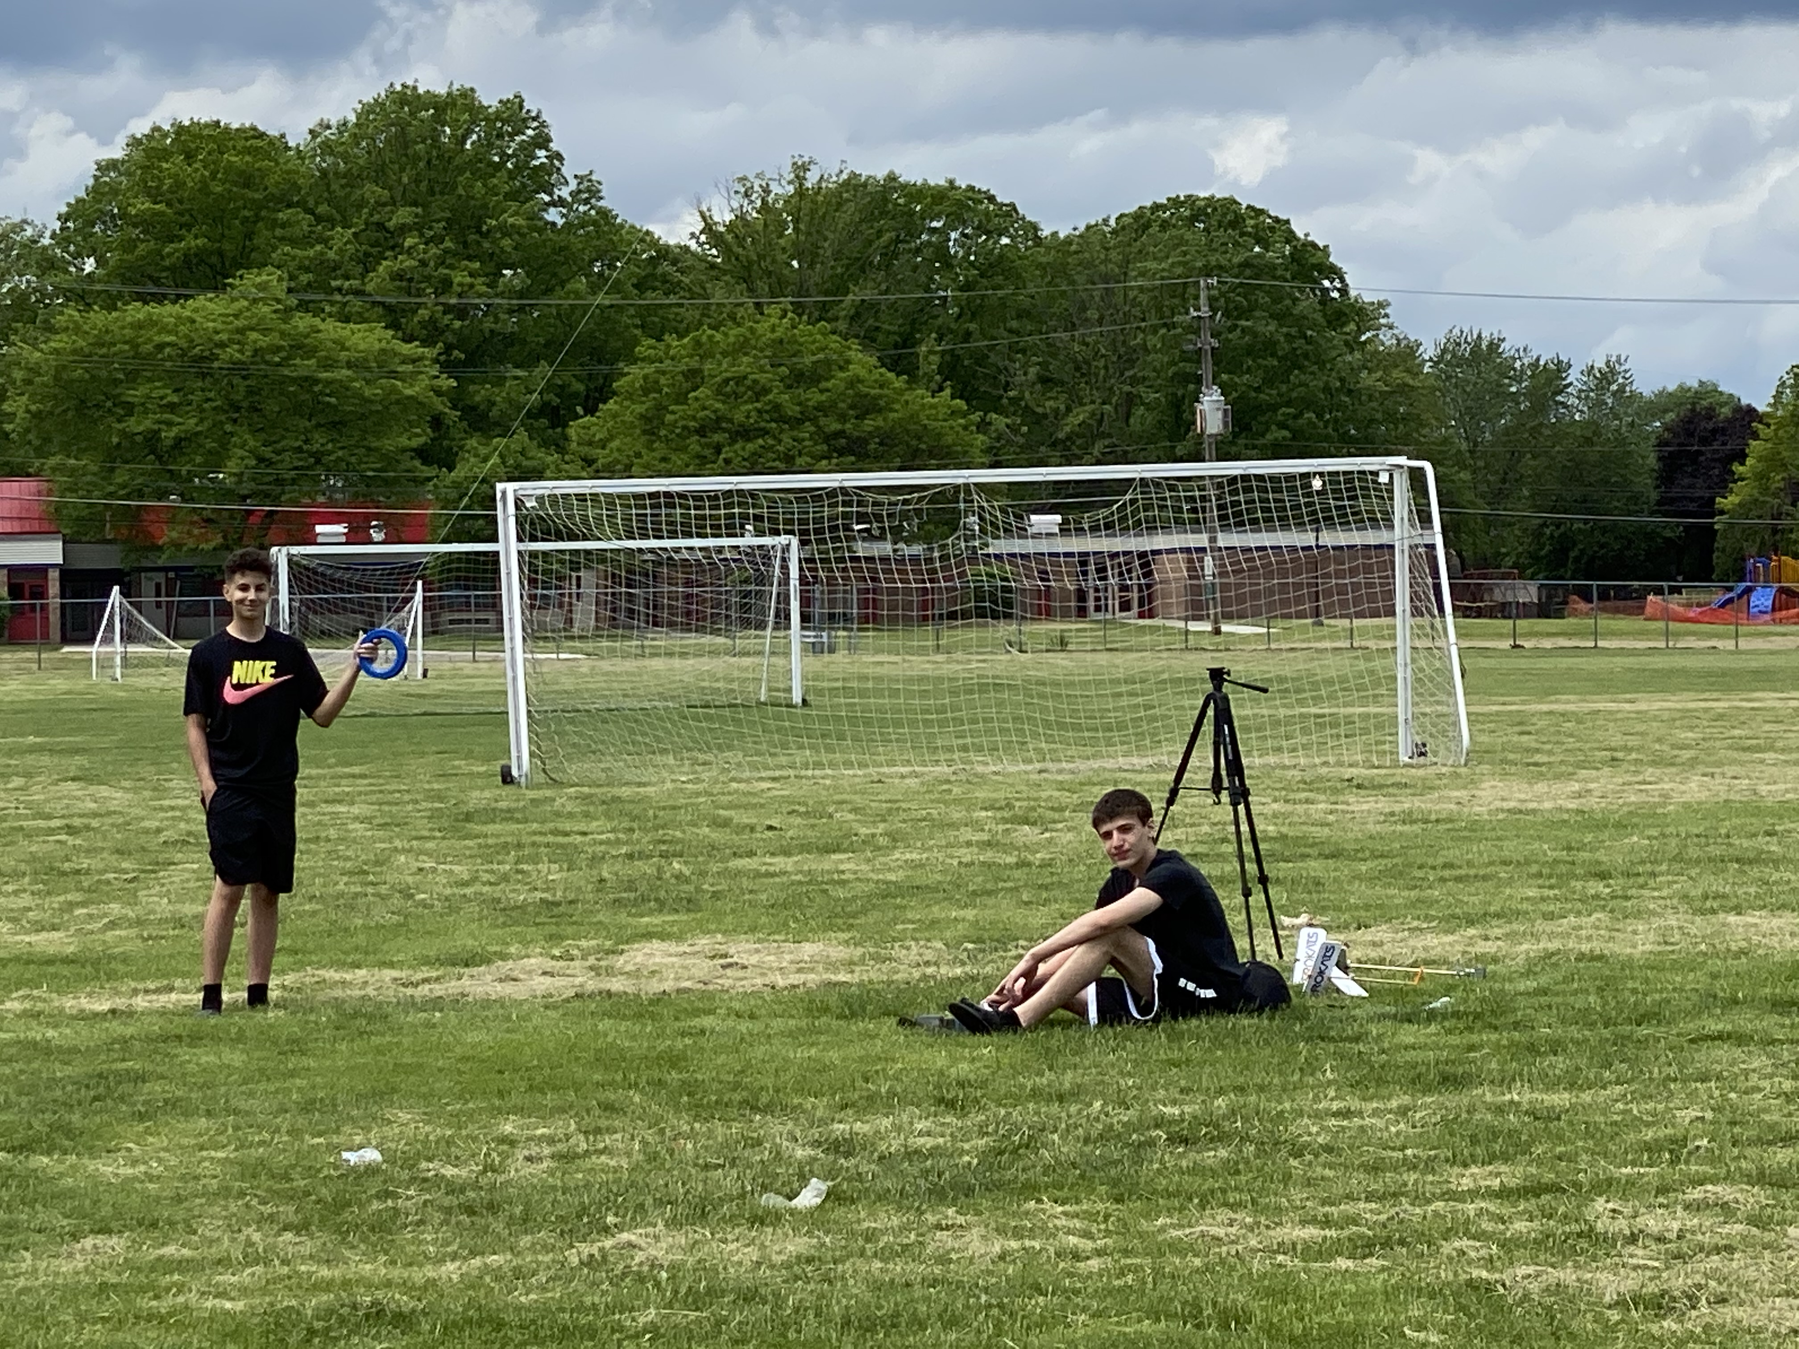
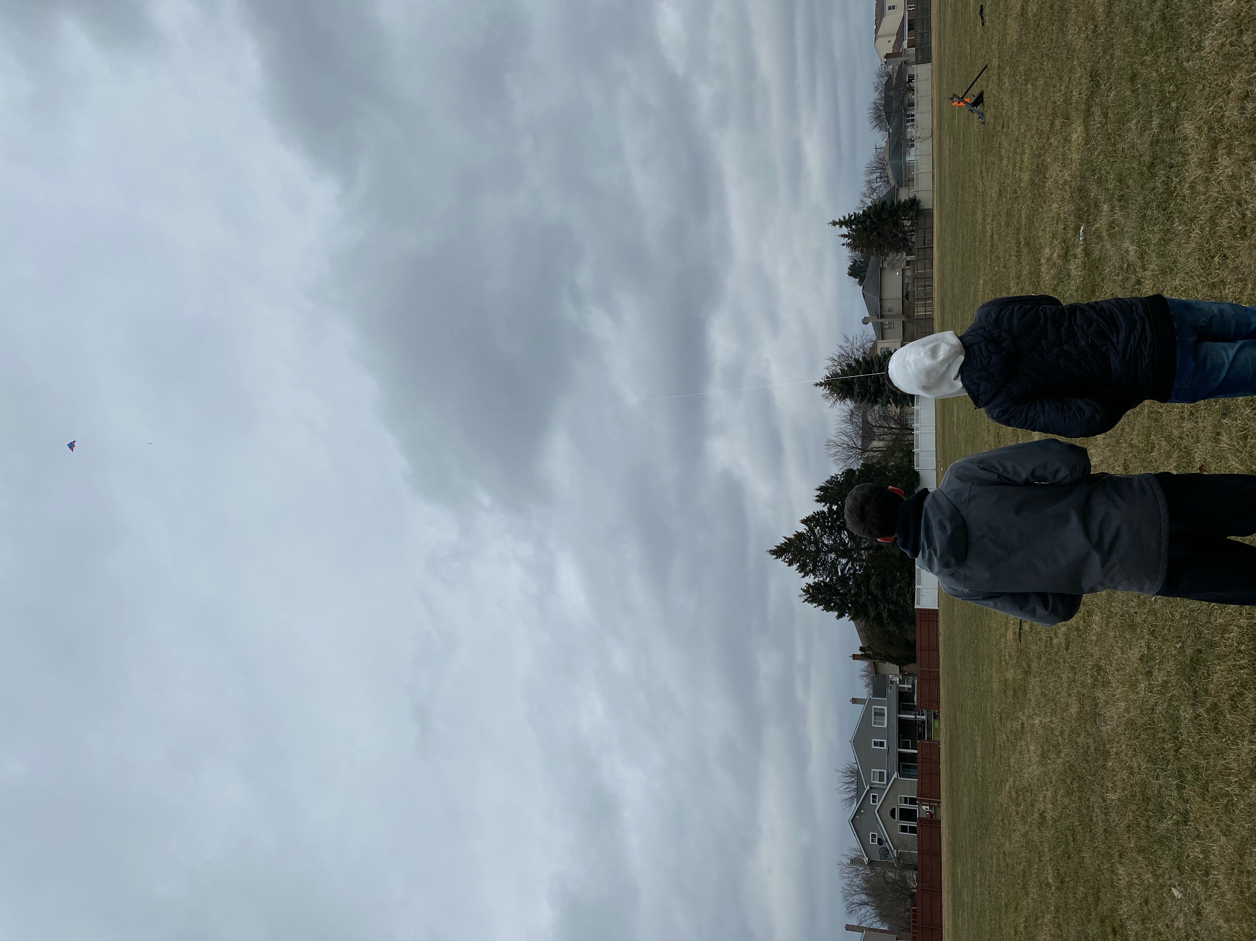
Conclusion and Future Plans
Nazih Baydoun, Hassan Berry, and Belal Beydoun
Microclimate weather parameters are important to analyze because microclimates and their associated weather conditions are poorly understood and how they affect larger scale weather conditions is just beginning to be studied in greater detail. It is important to study the effects of microclimates on large scale, macroclimate trends. This project helped the researchers determine the effect of various weather parameters on cloud formation, and the overall effects on the macroclimate.
In the future, we hope to continue our research in microclimates and studying the relationship between surface weather parameters and altitude. We also hope to continue to hold our strong ties with our friends in Thailand and continue to fly kites and compare our data collected together. We also are collecting data throughout this summer and will continue to do so!
Nazih Baydoun

