Slide 1


2020 GLOBE VIRTUAL MEETING STUDENT SHOWCASE
Assessing the Water Quality
of Lake Norconian
By Cody Zanoria Garcia

Slide 2

Introduction
Presenter: Cody Z. Garcia
City: Carson, CA
Grade: Rising Junior
School: Damien High School
Abstract
Lake Norconian is a 60-acre artificial lake in the city of Norco, California. A few years back, a few dead fish were observed floating in Lake Norconian, but none has been observed since then. This research project investigated what essential qualities a lake must have in order for fish and wildlife to flourish in Lake Norconian.

Slide 3
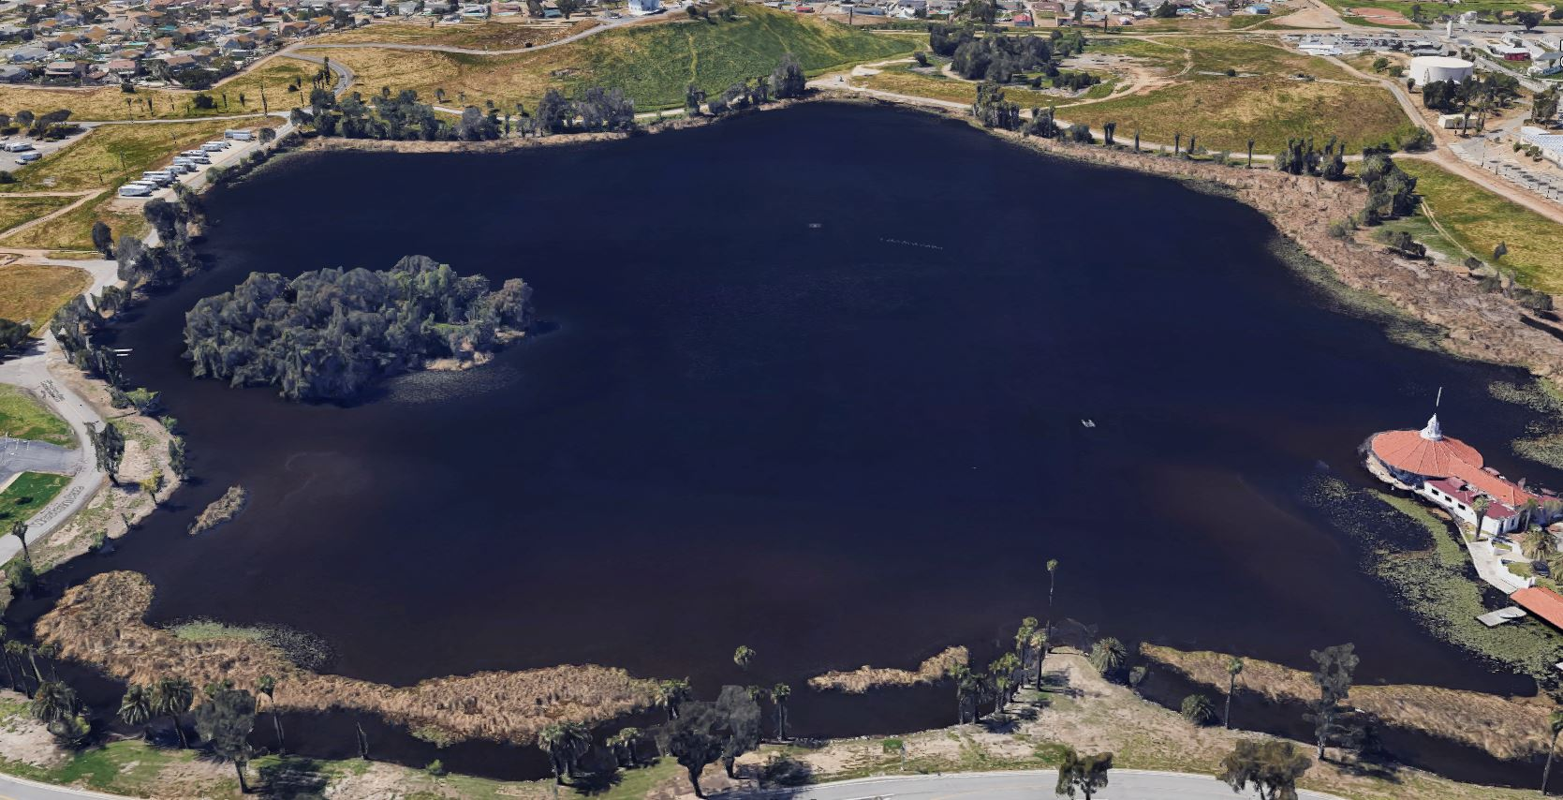
What essential qualities does Lake Norconian need to have in order for fish and wildlife to flourish there?
Research
Question
Cody Z. Garcia

Slide 4

Research Methods
Instruments Used
Alcohol-filled thermometers were calibrated by using an ice bath and by following the procedures from the GLOBE protocol.
The lake’s pH level was collected using pH paper.
A Dissolved Oxygen (DO) test kit was used to measure the lake’s DO level.
Data Gathered
Water was sampled at Lake Norconian almost every week from August 2019 to March 2020.
Water Parameters Measured
Water samples were analyzed for Temperature, pH levels, and Dissolved Oxygen levels using the GLOBE protocols.
Cody Z. Garcia

Slide 5
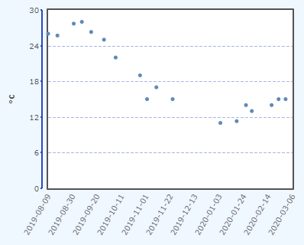
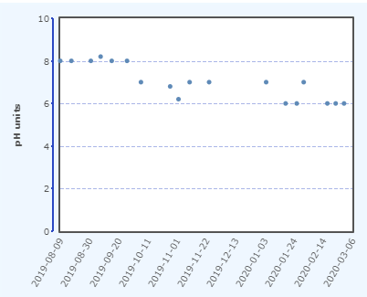
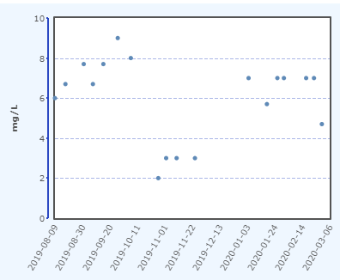
Data / Results
Figure 1. Water temperature data taken at Lake Norconian from August 2019 to March 2020.
Figure 2. pH level data
taken at Lake Norconian from August 2019 to March 2020.
Figure 3. Dissolved oxygen data taken at Lake Norconian from August 2019 to March 2020.
Cody Z. Garcia

Slide 6

As expected, the water temperature of the lake rose and dropped in accordance with the seasons. The lake’s water temperature peaked at 28°C in August 2019 and reached a low of 11°C in January 2020.
The lake’s pH level were consistently between 6 and 8 pH units from August 2019 to March 2020. Those pH levels are within the optimum levels for fish to survive, and is one of the reasons fish are thriving at the lake.
The Dissolved Oxygen (DO) level needs to be above 4 mg/L in order for fish to survive. The data shows this reading until November 2019, when the data collected were showing below 4 mg/L. After analyzing the data, it was suggested that there may be a bad batch of ampoules in the DO Kit. After measurements were made with a new batch of ampoules, the DO level readings were back to normal levels.
Discussion
Cody Z. Garcia

Slide 7

Conclusion
Fish and wildlife are able to flourish at Lake Norconian because the lake has the following essential qualities:
Water temperature is between 11°C and 28°C
pH Level is between 6 to 8 pH units
Dissolved Oxygen Level is above 4 mg/L
Cody Z. Garcia

Slide 8
Citations/ References
“Water Temperature.” Environmental Measurement Systems, www.fondriest.com/environmental-measurements/parameters/water-quality/water-temperature/
“PH of Water.” Environmental Measurement Systems, www.fondriest.com/environmental-measurements/parameters/water-quality/ph/.
Oram, Brian. “Mr. Brian Oram, PG.” Pennsylvania Well Water Testing Private Wellowners Drinking Water Pennsylvania Ground Water Education Program, www.water-research.net/index.php/dissovled-oxygen-in-water.
Dissolved Oxygen and Water, www.usgs.gov/special-topic/water-science-school/science/dissolved-oxygen-and-water?qt-science_center_objects=0#qt-science_center_objects.
“Indicators: Dissolved Oxygen.” EPA, Environmental Protection Agency, 16 Aug. 2016, www.epa.gov/national-aquatic-resource-surveys/indicators-dissolved-oxygen
“Dissolved Oxygen.” Environmental Measurement Systems, www.fondriest.com/environmental-measurements/parameters/water-quality/dissolved-oxygen/.
Cody Z. Garcia

Slide 9
Questions?
Cody Z. Garcia

