Slide 1

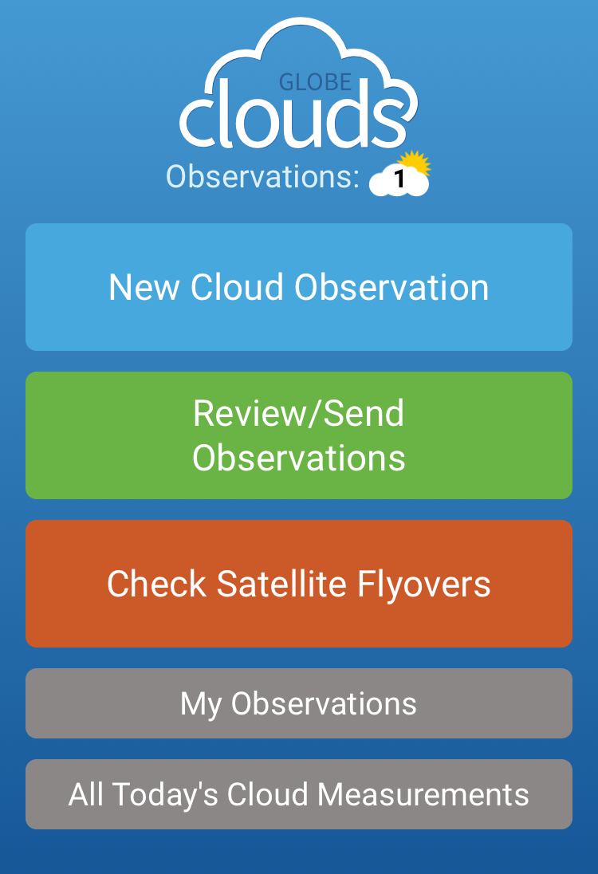
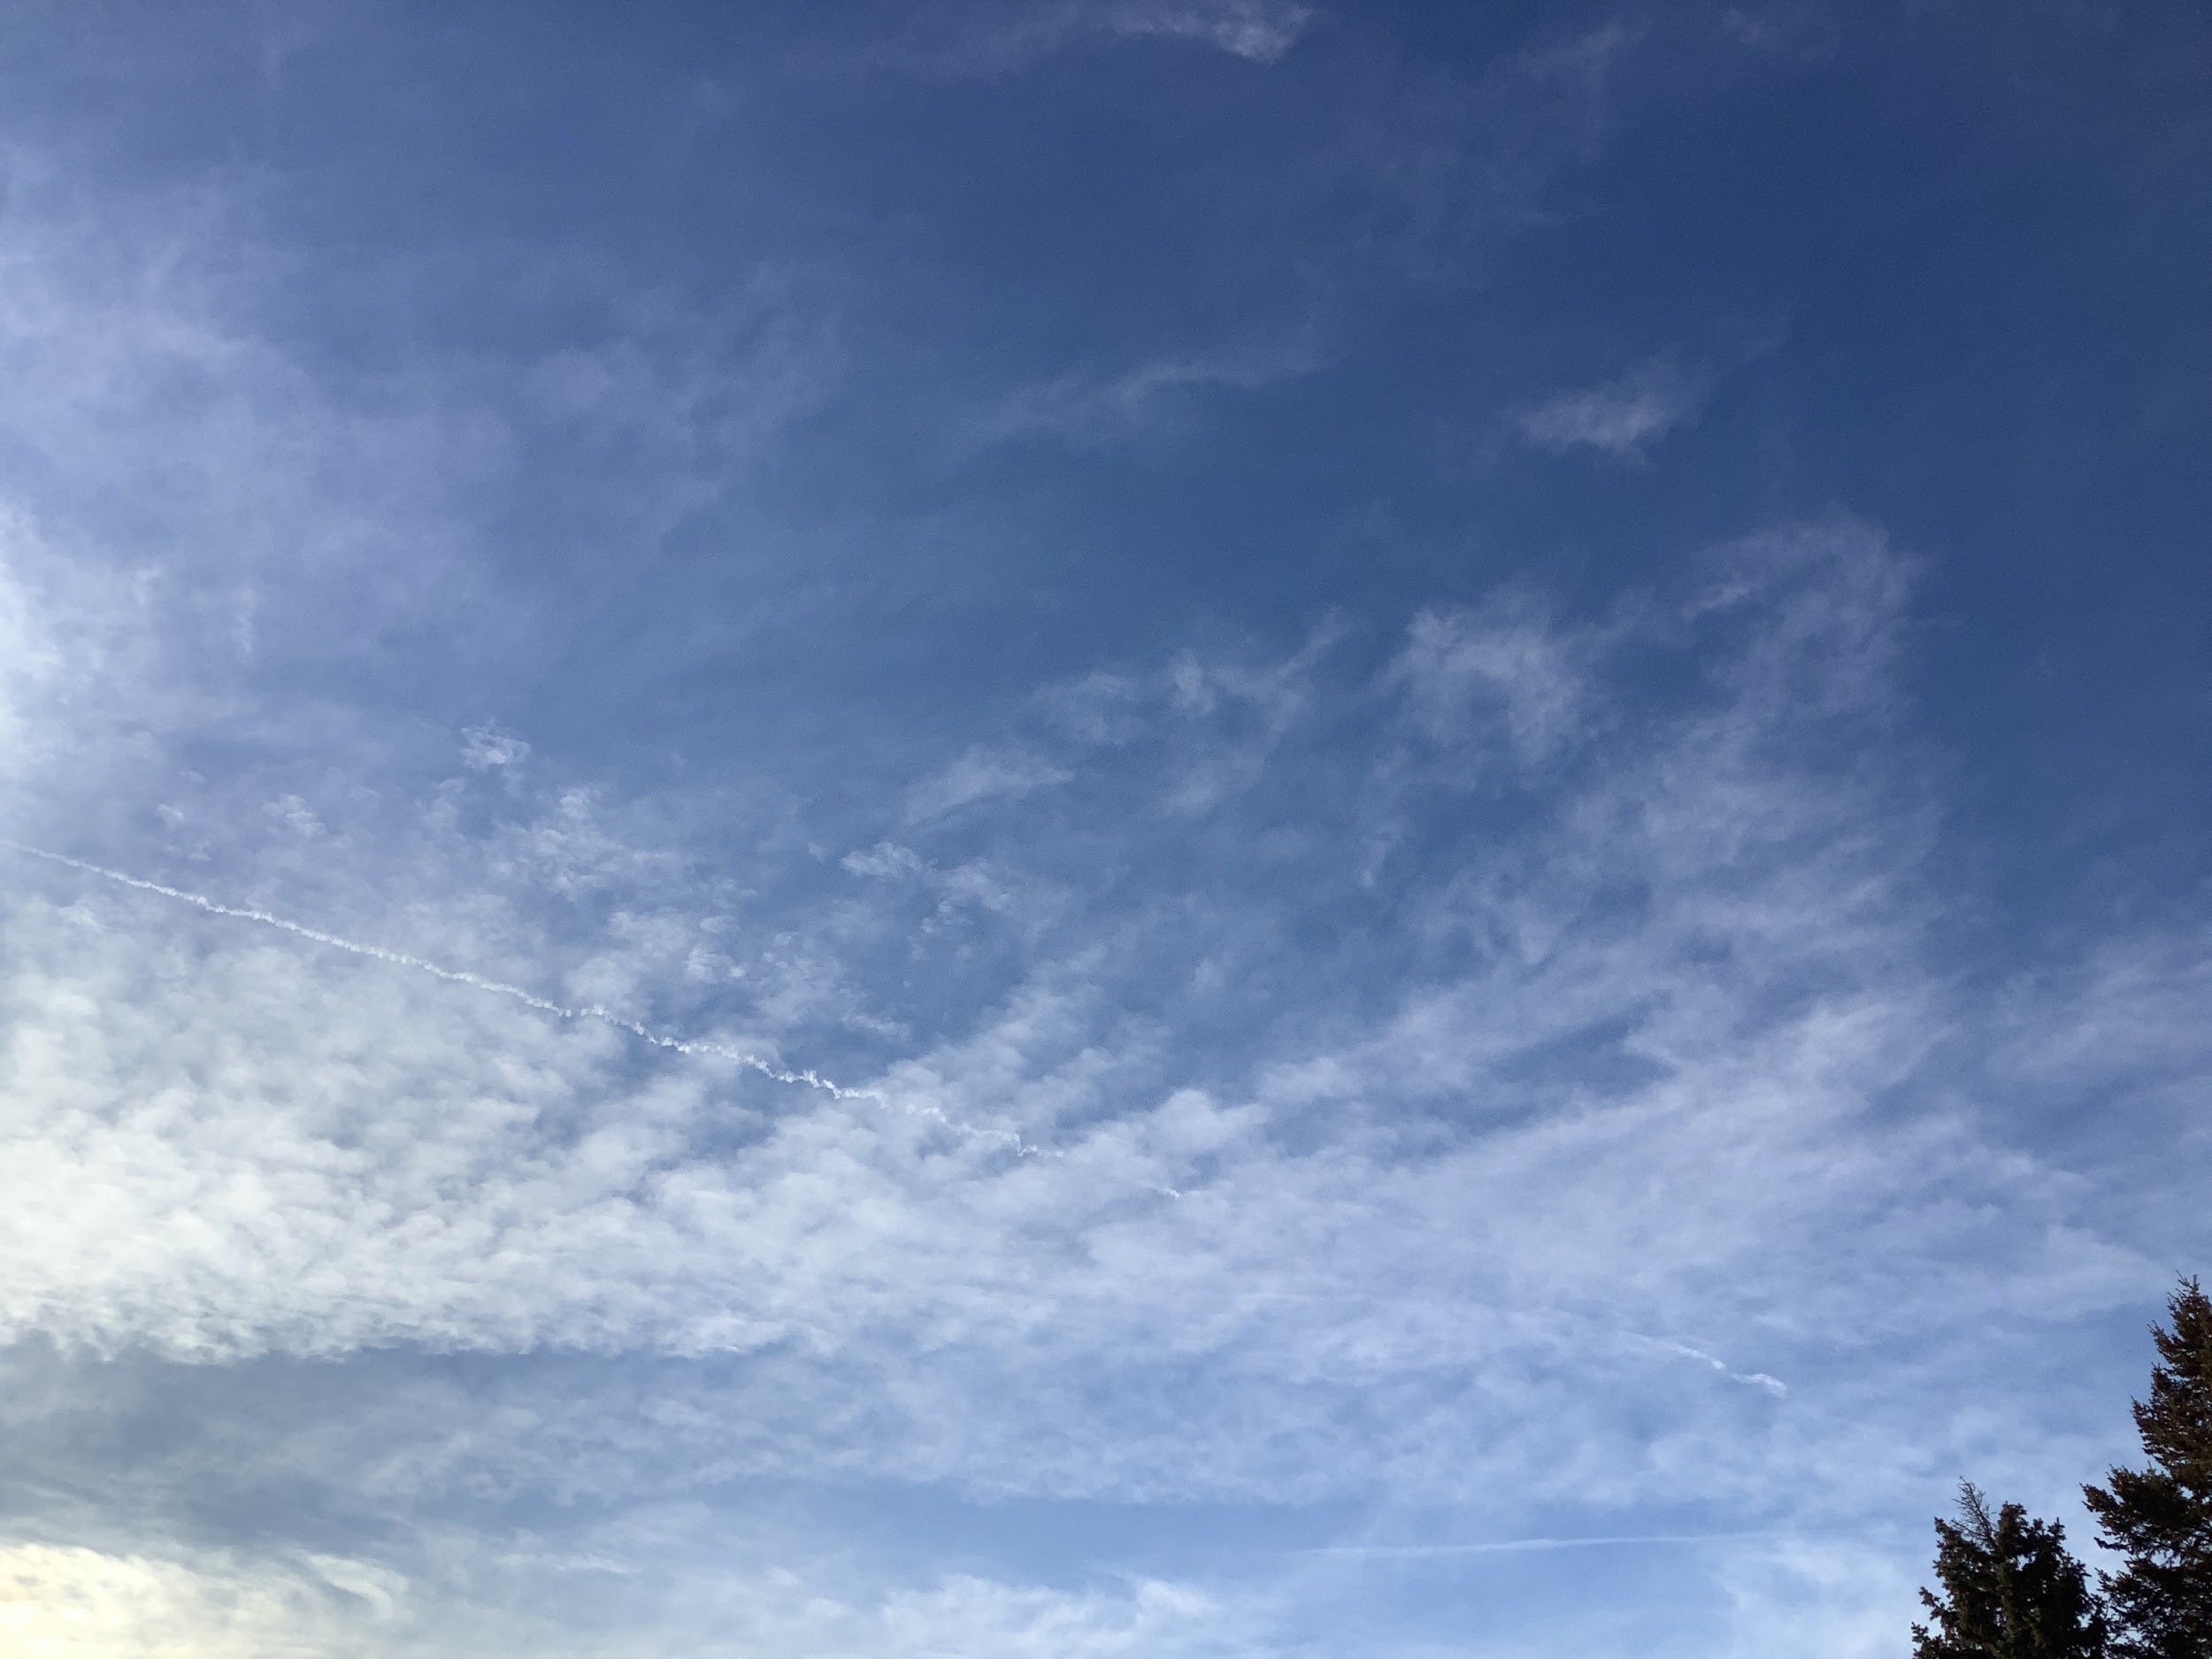









Contrail Formation in Southeastern Michigan
with Potential Regional and Global Impacts
Crestwood High School - Dearborn Heights, Michigan

Slide 2
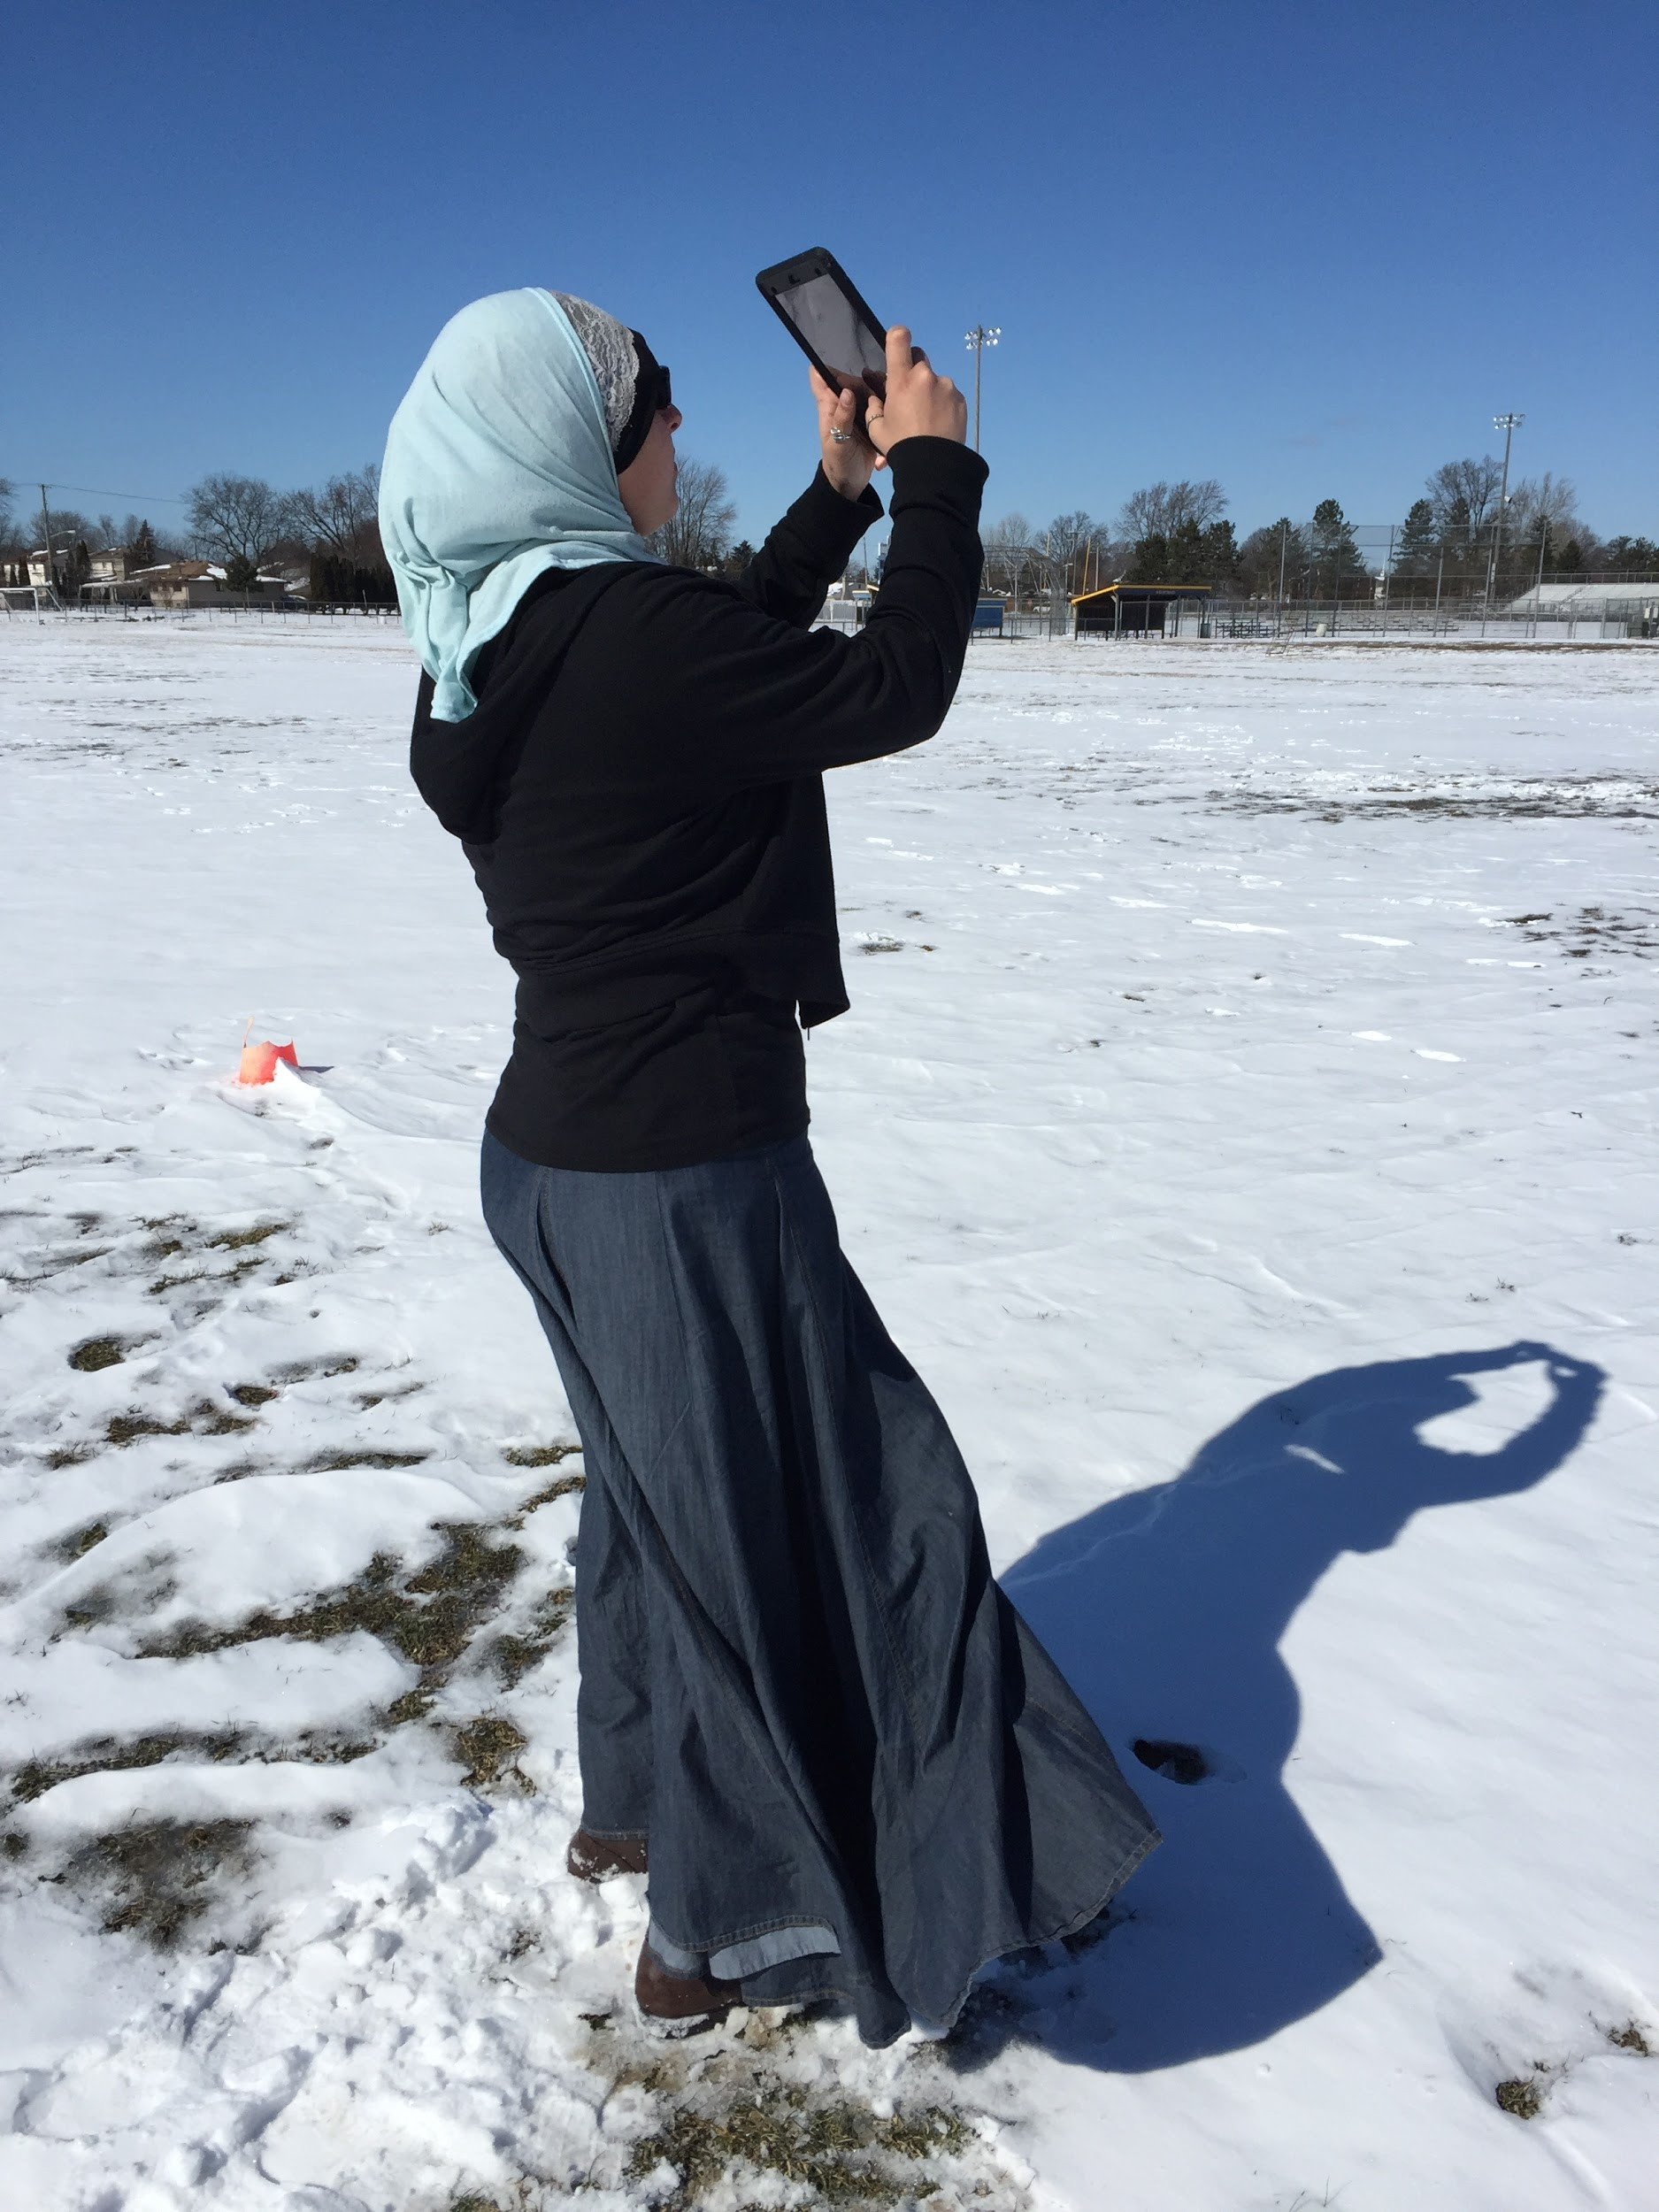

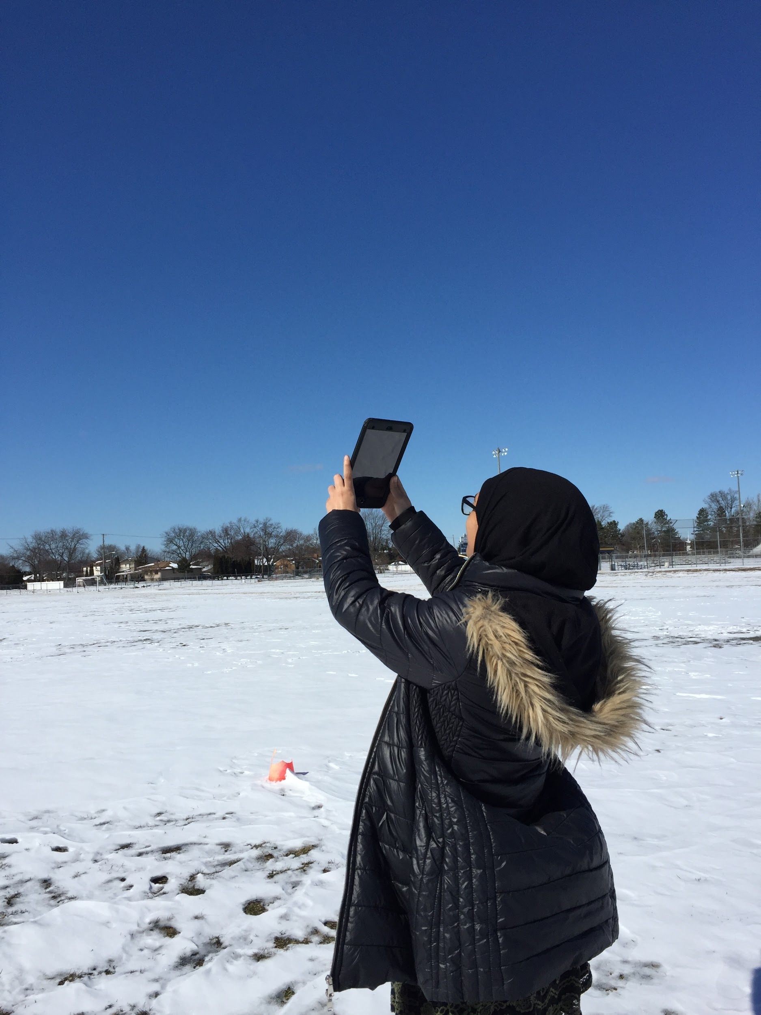
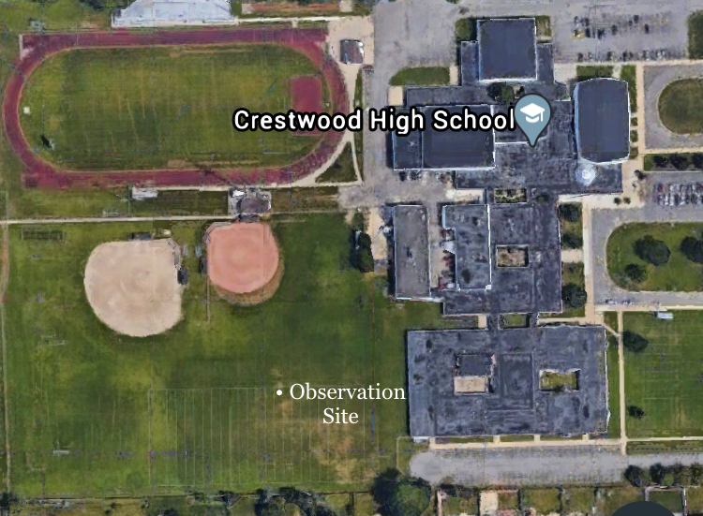
About The Team
Noor
Zaharaa
☁ Rising Seniors at Crestwood High School
☁ Located in Metro Detroit, Michigan

Slide 3
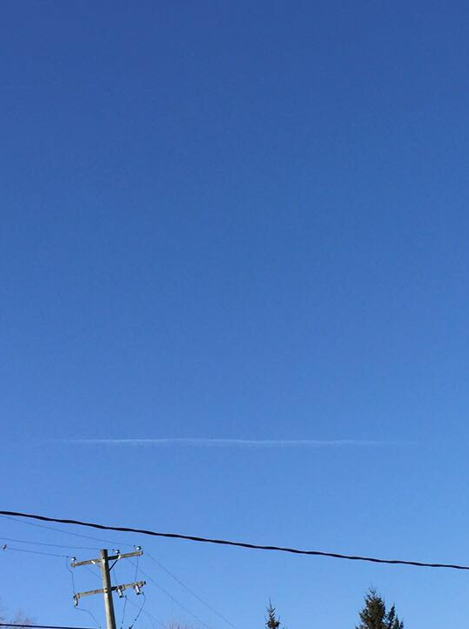
Research Questions
☁ Can ground-level observations of contrails be used to verify contrails seen in photos from the NASA GOES-16 and MODIS Terra and Aqua satellites?
☁ How does contrail formation vary by upper atmosphere temperatures at different locations?
☁ Do the locations of nearby large bodies of water contribute to any extent of contrail formation?
☁ How do contrail observations made in warm, moist tropical climates like Thailand compare with contrail observations made in the Great Lakes region of the United States?

Slide 4

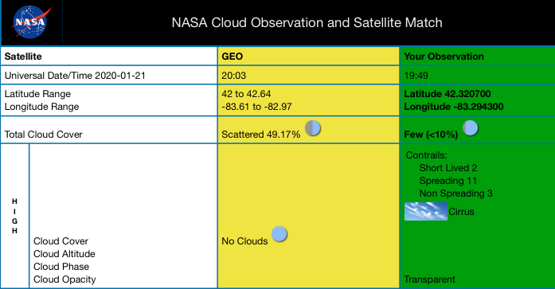
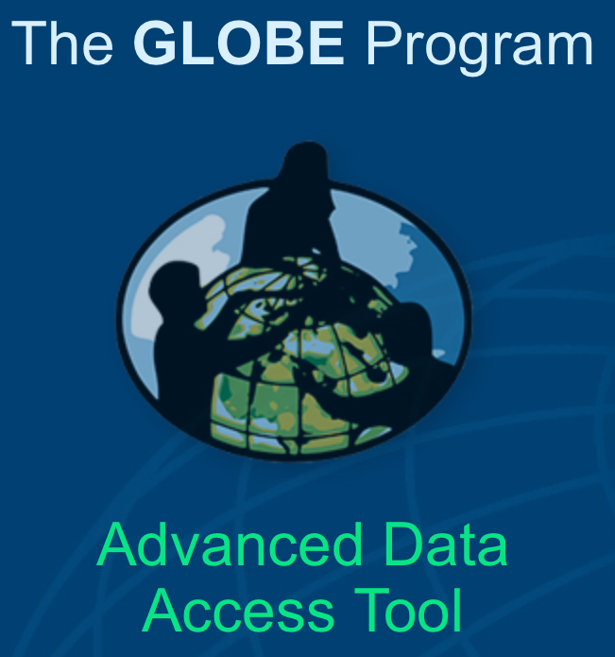
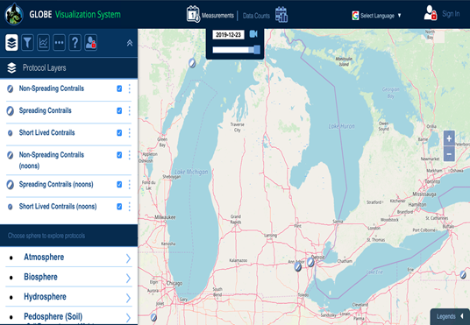
Methods Used
☁ Cloud observations in GLOBE Observer Cloud App
☁ GLOBE Advanced Data Access Tool’s (ADAT) for latitude and longitude
☁ Langley Research Center’s NASA Cloud Observation and Satellite Match
☁ GLOBE Visualization System for observation site comparisons

Slide 5
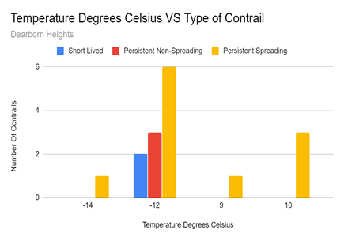
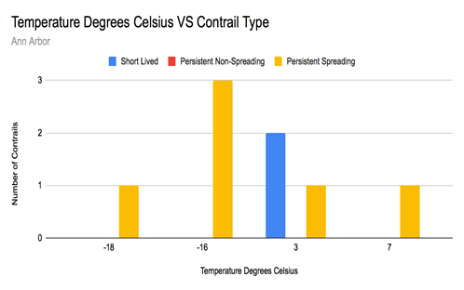
Results
The pictures above show the temperatures of the data along the x-axis on particular dates. Figure on the right is the data obtained from the researchers’ site at Dearborn Heights. The temperature was obtained from the NASA infrared satellites. Figure on the left represents the data of the contrails and the temperature from Ann Arbor both retrieved through the Visualization System.

Slide 6
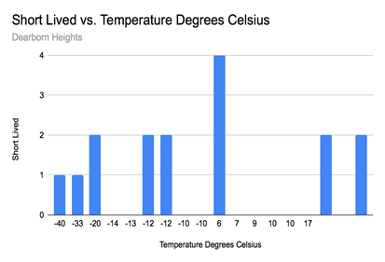
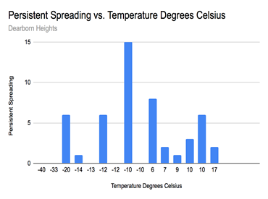
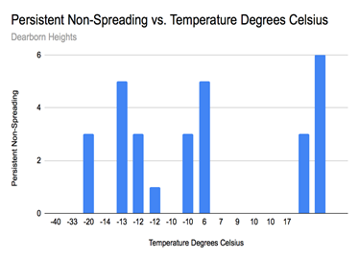
Results
Pictures above show the data comparison of temperature to the type of contrails in Dearborn Heights. Figure on the left shows the number of short-lived contrails as compared to temperature. Figure in the middle shows the number of persistent contrails graphed with temperature. Figure on the right shows the number of persistent non-spreading contrails against temperature.

Slide 7
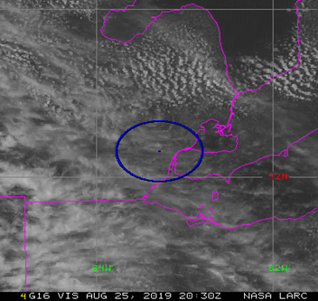
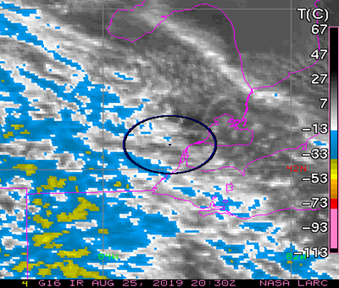
Discussion and Conclusion
☁ The consistency of contrails’ appearance and type correlate with the temperatures and locations of the sites.
☁ The GLOBE Visualization System is the best way to find the sites where contrails are spotted and to see if their locations are close to bodies of water, helping researchers analyze data and see the correlation between them.
☁ The separate locations of Dearborn Heights and Ann Arbor resulted in different types of contrails shown.
☁ As shown in the MODIS Worldview, bodies of water affect the amount of contrail and cloud cover shown, with more prevalent amounts recorded directly above the Great Lakes.

Slide 8
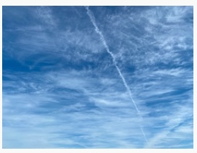
Significance of Research
☁ Further explains how anthropogenic actions affect climate change.
☁ Different locations affect types of contrails formed.
☁ Help to form a solid database that NASA and other scientists can use to help unravel the potential implications and effects of contrails on climate change.

Slide 9
Acknowledgements
☁ Thank you to the GLOBE Program for access to both online and print resources to make this project feasible. Thank you also to the staff of NASA LaRC for the emails showing satellite comparisons with our data.
☁ We also are thankful for the individual student contacts we were able to make at the Princess Chulabhorn Science High School in Nakhon Si Thammarat.
☁ This project could not have been possible without the crucial assistance of the project mentor, Mrs. Diana Johns, who introduced the researchers to the foreign students and provided unfaltering encouragement and support throughout the entire process.

Slide 10
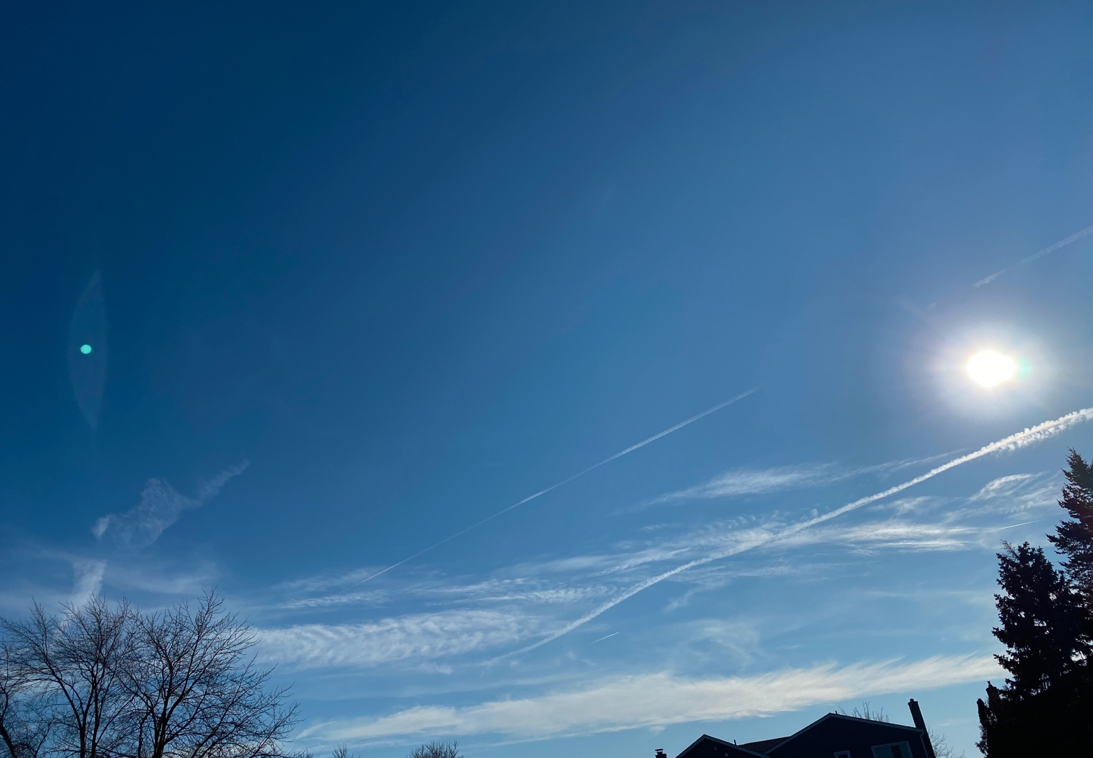
References
Bock, Lisa & Burkhardt, Ulrike. (2019). “Contrail cirrus radiative forcing for future air traffic.” Atmospheric Chemistry and Physics. 19. 8163-8174. 10.5194/acp-19-8163-2019.
Burkhardt, U., Bock, L. & Bier, A. “Mitigating the contrail cirrus climate impact by reducing aircraft soot number emissions.” npj Clim Atmos Sci 1, 37 (2018). https://doi.org/10.1038/s41612-018-0046-4. Accessed 7 Mar. 2020.
Changnon, Stanley A. “Climate Fluctuations and Record-High Levels of Lake Michigan.” Bulletin of the American Meteorological Society, vol. 68, no. 11, 1987, pp. 1394–1402. JSTOR, www.jstor.org/stable/26226085. Accessed 7 Mar. 2020.
“Clouds Protocol Featuring Satellite Comparison.” The Globe Program, www.globe.gov/documents/348614/7b79ee82-ebd6-4382-9283-181a412f063f. “Contrail Education.” NASA, NASA, 2020, science-edu.larc.nasa.gov/contrail-edu/.
Duda, David & Minnis, Patrick & Nguyen, Louis & Palikonda, Rabindra. (2004). “A Case Study of the Development of Contrail Clusters over the Great Lakes.” Journal of The Atmospheric Sciences - J ATMOS SCI. 61. pp. 1132-1146. 10.1175/1520-0469(2004)061<1132:ACSOTD>2.0.CO;2.
Dunbar, Brian. “National Aeronautics and Space Administration NASA Official.” NASA, NASA, 2020, www.nasa.gov “NESDIS News & Articles.” NOAA National Environmental Satellite, Data, and Information Service (NESDIS), 27 July 2016, www.nesdis.noaa.gov/content/do-contrails-affect-conditions-surface.
Federal Aviation Administration. “Contrails 101.” FAA Seal, 3 Oct. 2014, www.faa.gov/about/office_org/headquarters_offices/apl/noise_emissions/contrails/. “GLOBE Science Data Visualization.” GLOBE Visualization, vis.globe.gov/GLOBE/.
“Google Earth.” Google Earth, Google, 2020, earth.google.com/web/@42.32171697,-83.2947219,189.52068184a,666.80224309d,35y,0h,0t,0r.
Pearce, Fred. “How Airplane Contrails Are Helping Make the Planet Warmer.” YaleEnvironment360, 18 July 2019, www.e360.yale.edu/features/how-airplane-contrails-are-helping-make-the-planet-warmer.
“Rapid Response - LANCE - Terra/MODIS 2019/357 15:50 UTC.” NASA, NASA, lance.modaps.eosdis.nasa.gov/cgi-bin/imagery/single.cgi?image=band311.A2019357155000-2019357155500.2km.jpg.
“Visualize Data.” NASA, NASA, 8 Mar. 2020, earthdata.nasa.gov/earth-observation-data/visualize-data. “Worldview: Explore Your Dynamic Planet.” NASA, NASA, worldview.earthdata.nasa.gov/?v=-85.6653086419753,41.24,-81.7146913580247,43.24&t=2019-08-25-T00:00:00Z&l=Reference_Labels,Reference_Features,MODIS_Terra_CorrectedReflectance_TrueColor.

