Slide 1
The Effects of Aerosols on Water
Quality
By: Anna Willard
2020 GLOBE VIRTUAL MEETING STUDENT SHOWCASE

Slide 2
Introduction
This project focuses on the question; what is the effect of aerosols on water quality at the SFX pond? The hypothesis states if there are higher levels of aerosols, then the DO levels will be lower, and the temperature, electrical conductivity, and pH levels will all be higher. Aerosols are tiny particles in the air directly linked with the Air Quality Index (AQI). Data was collected outside by observing the cloud coverage, observing which way the wind was blowing, and measuring the Aerosol Optical Thickness. The pond water was then collected and tested for temperature, DO, pH, and conductivity, along with a protected bucket of water added as a control.
Anna Willard

Slide 3
Introduction
Aerosols enter the water through the water cycle. Rain is formed around a molecule in the atmosphere such as an aerosol molecule. When it rains, the aerosol molecule, now part of the raindrop, enters bodies of water directly (through rain) or through runoff once the rain hits the ground. Aerosols could have many effects on the water body. They could cause fluctuation in temperature, conductivity, pH, and DO. They could affect aquatic life (access to oxygen and clean water, their habitat (destruction do too to much sun or too little sun) , or their source of food (could be another aquatic life organism or plants that are affected the same way habitat is) (NASA, 2005).
The independent variable for this project is the level of aerosols. The dependent variable for this project is water temperature, DO, electrical conductivity, and water pH. The controlled variable for this project is the bucket of pond water that was covered by an umbrella in order to protect it from the weather and the aerosols.
Anna Willard

Slide 4
Methods
GLOBE Protocols Used
To test the hypothesis measurements were taken once a week for three months on Tuesdays or Thursdays if the clouds were permitting. Measurements were collected at the pond across from SFXC School. There were a total of eight dates of collection, with 3 trials for DO due to kit contents and 5 trials for all other parameters collected in the allotted data collection time. Data collection was dependent on the sun because aerosols cannot be measured if there are clouds blocking the sun, it is not possible to determine if the measurement is reflecting the cloud particles or actual aerosols.
Aerosols
Dissolved Oxygen
Water Temperature
Electrical Conductivity
Water pH
Anna Willard

Slide 5
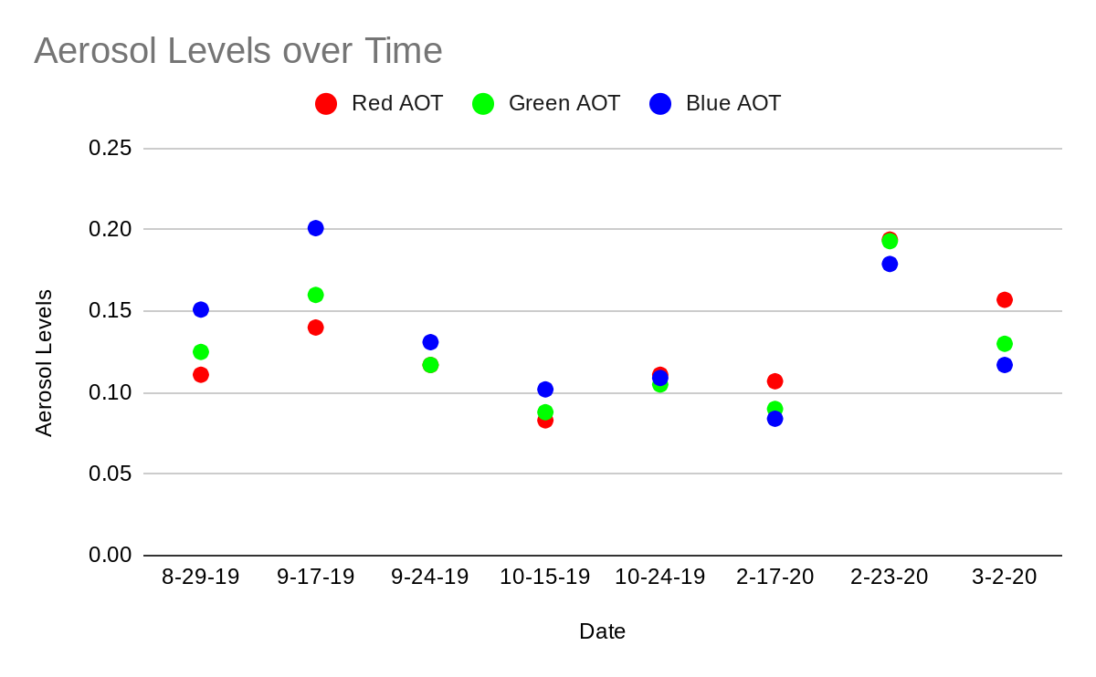
Results
It seemed that when aerosols were higher, the temperature of the water was also higher.
A correlation also appeared between pH levels and aerosols. It seemed that when the aerosol levels were higher, pH levels were lower.
Aerosols did not seem to affect DO or conductivity at all during the testing period, but further data will be collected to see if a pattern appears.
Anna Willard

Slide 6
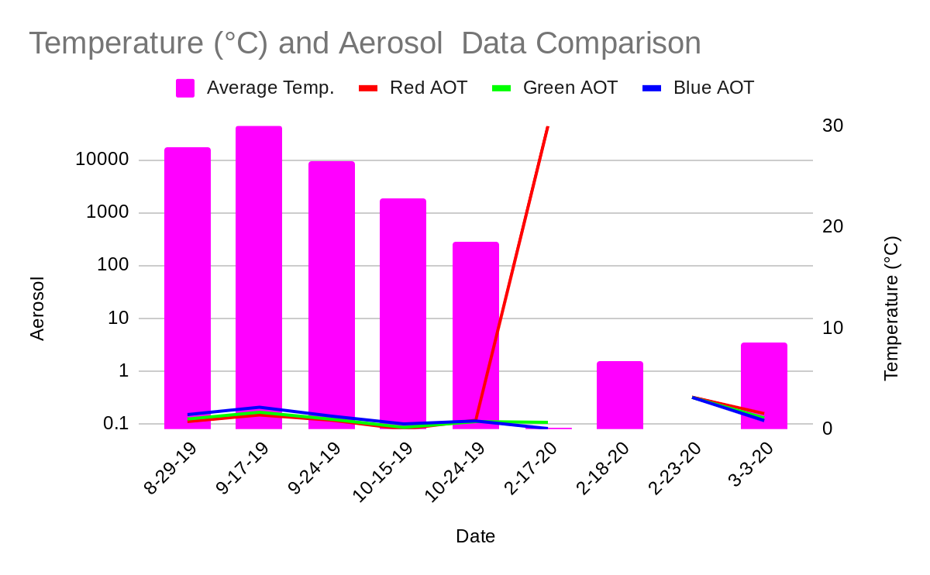
Discussion on Temperature
Based off of past research projects I believe the temperature outcome was the way it was because when the Earth cools down, the surface water remains warm. This warm surface water mixes with other cooler water at the bottom of the body of water and keeps it at a more consistent temperature unlike Earth going from hot to cold in a few hours because water retains and loses heat slower than land. In the atmosphere, when there are a lot of aerosols, the outside temperature is generally cooler because the aerosols prevent the Sun’s energy rays from reaching Earth’s surface, thereby heating the air closest to the ground, which then travels upward.
Anna Willard

Slide 7
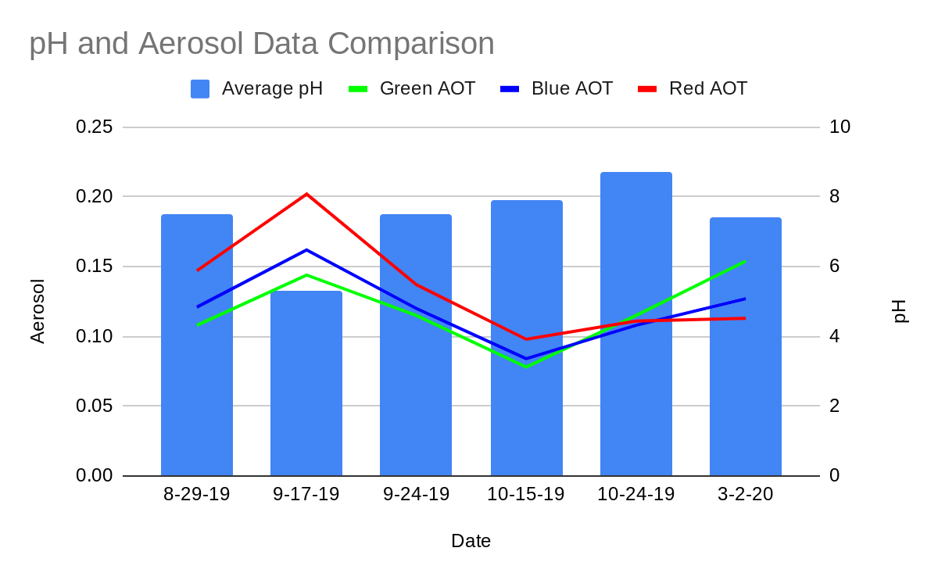
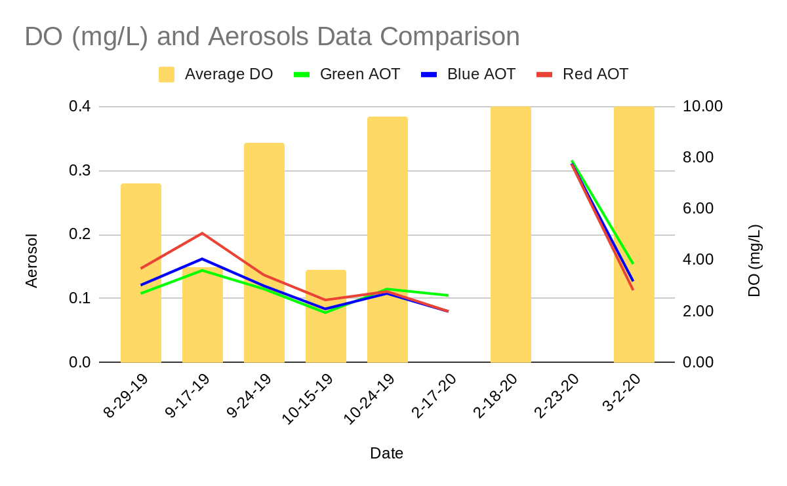
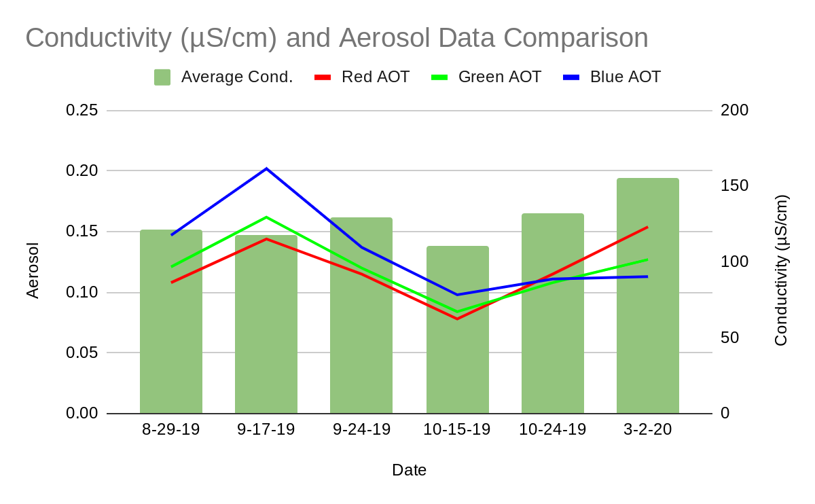
Discussion on pH, DO, and Conductivity
In order to see if there is an explanation as to why the pH reacted in that way it did future research needs to be taken. As for the DO and Conductivity, since they didn’t show any real correlation with the Aerosols future data will need to be collected in order to come up with a conclusion for them.
Anna Willard

Slide 8

Conclusion
The hypothesis was slightly supported by the data as no significant change happened with dissolved oxygen and conductivity. The pH did the opposite of what was hypothesized but the temperature followed the pattern that was hypothesized. The dissolved oxygen and conductivity did not seem affected by the aerosols so further data collection will be done to see if there is a correlation between the two. When the aerosols were high, pH was low for an unknown reason and the temperature was high most likely because of warm surface water mixing with cold bottom water evening out the temperature. When aerosols were low, pH was high and the temperature was low.
Anna Willard

Slide 9


Conclusion
In conclusion, the hypothesis of this experiment was not supported by the data, but further data collection will take place to see if patterns or correlations appear. For further data collection purposes a revised hypothesis was made. It states; When aerosol levels are higher, temperature levels will be higher, pH levels will be lower, and DO and conductivity will not really be affected though a correlation is still possible.
In future data collecting PM2.5 and AQI will be added in to see how they may or may not affect DO, temperature, conductivity, and pH.
The badges I received are, I am a Student Researcher, I am a Data Scientist, I am a STEM Professional, and I am a STEM Storyteller.
Anna Willard

Slide 10
Thank You for Learning About my Project!
Anna Willard

