Slide 1
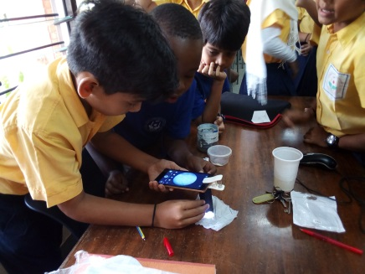


IDENTIFICATION OF MOSQUITO LARVAL SPECIES IN MOMBASA, KENYA.
ERIC KINYANJUI WAMBUGU
KHUSHI TRUSHARBHAI PATEL
KEVIN PAUL KETTERER

Slide 2
INTRODUCTION
There have been reports of mosquito bites at our school’s kindergarten section. The children are bitten by mosquitoes while playing outside and in the classrooms.
Fifteen cases of chikungunya were reported between February and March, 2018. Despite spraying with insecticide, the problem still persists.
The aim of this project was to identify the mosquito larval species in artificial breeding places within our school’s kindergarten section.
ERIC KINYANJUI WAMBUGU
KHUSHI TRUSHARBHAI PATEL
KEVIN PAUL KETTERER

Slide 3
HYPOTHESIS
There are different species of mosquitoes in the Kindergarten section at Shree Swaminarayan Academy.
Aedes mosquito is the species that would be found commonly in school due to cases of dengue fever and chikungunya recorded in the school.
ERIC KINYANJUI WAMBUGU
KHUSHI TRUSHARBHAI PATEL
KEVIN PAUL KETTERER

Slide 4
PROCEDURE
Equipment and material
Artificial breeding site
Dropper
250ml Beaker
Magnifier lens – X60 and X100/
Macro lens
Petri Dish
Paper towel
Globe Observer Application
Smart phone
ERIC KINYANJUI WAMBUGU
KHUSHI TRUSHARBHAI PATEL
KEVIN PAUL KETTERER

Slide 5
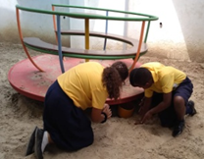
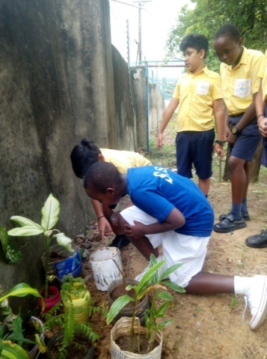
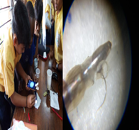
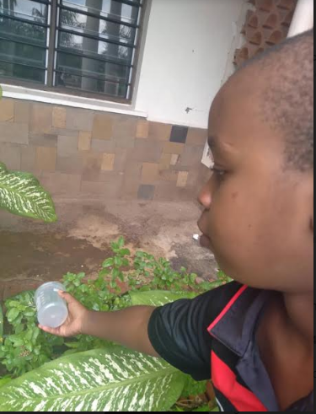
ERIC KINYANJUI WAMBUGU
KHUSHI TRUSHARBHAI PATEL
KEVIN PAUL KETTERER
Step 1 : Artificial breeding sites were identified and set up.
Step 2: Mosquito breeding sites were observed regularly.
Step 3: Mosquito larvae were identified using their morphological features.
Step 4: Breeding sites were eliminated by pouring the water out.

Slide 6
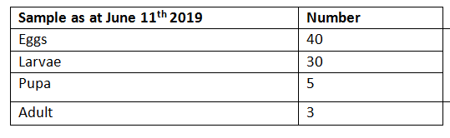
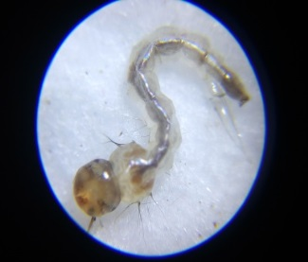
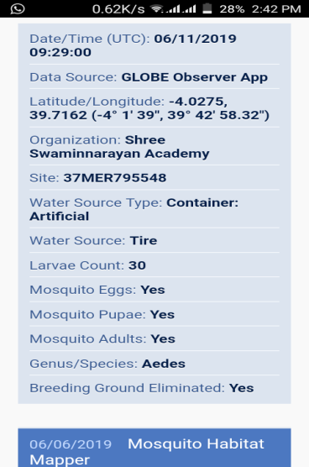
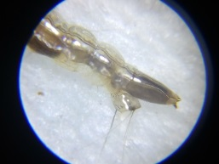

RESULTS
.
From the larvae identification protocol followed using the mosquito habitat mapper, we concluded that the type of mosquitoes that breed in the school’s Kindergarten section is the Aedes mosquito.
Full view of the larvae from X100 macro lens
View of lower abdomen showing siphon, siphon hair, saddle, and comb scale
Presence of strong, dark hooks on thorax setae.
ERIC KINYANJUI WAMBUGU
KHUSHI TRUSHARBHAI PATEL
KEVIN PAUL KETTERER

Slide 7
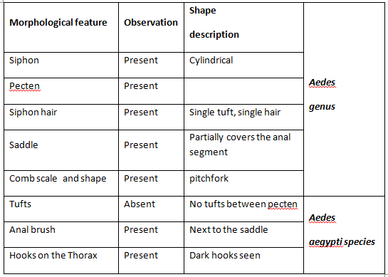
SUMMARY OF THE OBSERVATION
ERIC KINYANJUI WAMBUGU
KHUSHI TRUSHARBHAI PATEL
KEVIN PAUL KETTERER

Slide 8
CONCLUSION
Our research findings ruled out our first hypothesis in that only one species, Aedes, was identified in our school compound.
However, our findings were in agreement with our second hypotheses, that Aedes species would be commonly found at our school due to the reported cases of dengue fever and chikungunya at the Kindergarten
We did not find any Anopheles larvae during the study. The type of mosquito that breeds in Nyali area is Aedes mosquito
This may explain the low incidence of malaria within the Nyali sub-county as malaria is caused by the Anopheles mosquito. It is therefore important to educate the community on the importance of destroying breeding sites.
.
ERIC KINYANJUI WAMBUGU
KHUSHI TRUSHARBHAI PATEL
KEVIN PAUL KETTERER

Slide 9
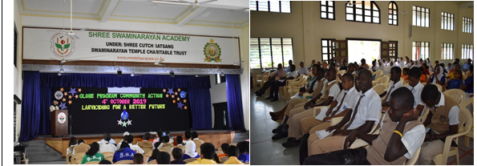
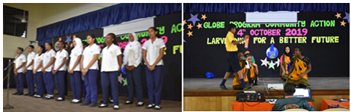
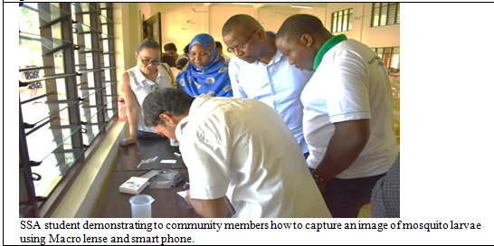
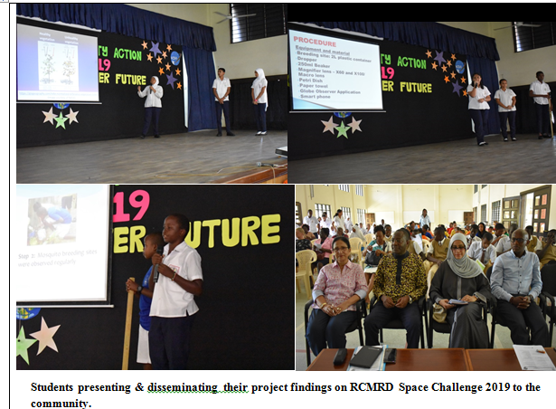
COMMUNITY INVOLVEMENT
THEME: LARVICIDING FOR BETTER FUTURE 4th OCTOBER, 2019.
Chief Guest’s opening remarks
Edutainment items
Student demonstrating to a community member how to capture mosquito larvae using macro lens.
Students presenting their project research findings to the community

Slide 10
REFERENCES
Interviewmania, 2018. https://interviewmania.com/discussion/48705-biology-biology-
miscellaneoushttps://interviewmania.com/discussion/48705-biology-biology-miscellaneous
Tian de Jager and Taneshka Kruger, 2019. Killing mosquito larvae can contribute towards malaria elimination. The Conversation, May 29, 2019. http://theconversation.com/killing-
mosquito-larvae-can-contribute-towards-malaria-elimination-115998
ERIC KINYANJUI WAMBUGU
KHUSHI TRUSHARBHAI PATEL
KEVIN PAUL KETTERER

Slide 11





THANK YOU
ERIC KINYANJUI WAMBUGU
KHUSHI TRUSHARBHAI PATEL
KEVIN PAUL KETTERER

