Slide 1




2020 GLOBE VIRTUAL MEETING
STUDENT SHOWCASE
THE SPREAD AND BIODIVERSITY OF MOSQUITOES IN SPUSSA COMMUNITY,
AKURE, ONDO STATE, NIGERIA
Grade Level: Secondary School (grades 9 -12, ages 14-18)
Report Type: International Virtual Science Symposium Report
PRESENTERS:
Paul Eke, Kemisola Akomolafe and Temitope Akinsunmade
School Name
St. Peter’s Unity Secondary School, Akure (SPUSSA)
Country
Nigeria

Slide 2
INTRODUCTION
Malaria is one of the most severe global health challenges facing humanity (WHO, 2014)
In Nigeria, it has been shown that abundance of various Mosquitoes species include the genera Anopheles, Culex and Aedes (Nwoke et al., 1993)
St. Peter’s Unity Secondary School, Akure (SPUSSA) is a co-educational institution with domestic wastes, water run-off and farmlands. The school compound has possible places for breeding common Mosquitoes.
The study seeks to identify the different species of Mosquito larvae, the physico-chemical attributes and the distribution of larvae species in SPUSSA community.
ABSTRACT
The project was aimed at observing the spread and bio-diversity of mosquitoes in St. Peter’s Unity Secondary School, Akure (SPUSSA) community, Ondo State, Nigeria. The objectives are to identify potential habitats of mosquito larvae, different species found in the study area and evaluate the physico-chemical properties of the habitat. Two habitat sites were investigated in two locations (hydrosphere sites A and B). Samples of mosquito larvae from the sites were taken to the science laboratory. Clip-on macro lens was used to count the mosquito larvae. The properties that support the breeding of mosquitoes in the area of study include air temperature range of 32ºC – 39ºC, water temperature range of 26ºC – 35ºC, relative humidity range of 10% - 42% and pH range of 3.5 – 8.0. Site A has less larvae than site B. The genera found in site A are Anopheles (58) and Aedes (19) while that found in site B are Aedes (112) and Anopheles (12). There is need to develop control strategies that will target the vector species.
Keywords: Mosquito larvae, Anopheles, Aedes, SPUSSA, Hydrosphere sites
Paul Eke, Kemisola Akomolafe and Temitope Akinsunmade

Slide 3
RESEARCH QUESTIONS
1. Where are the typical breeding habitats of mosquito larva in SPUSSA community?
2. What are the different genera of mosquitoes found in SPUSSA community?
3. What are physico-chemical properties that are favorable for breeding mosquito larvae in the study area?
4. What is the spread/distribution of biodiversity of mosquitoes in SPUSSA community?
Paul Eke, Kemisola Akomolafe and Temitope Akinsunmade

Slide 4
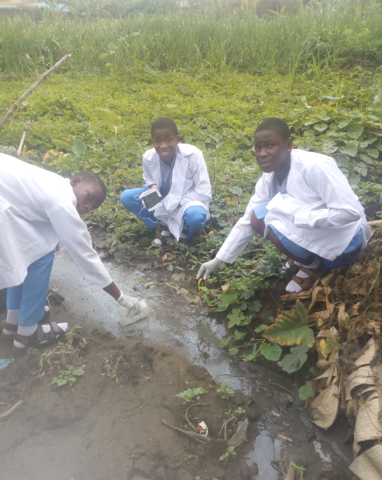
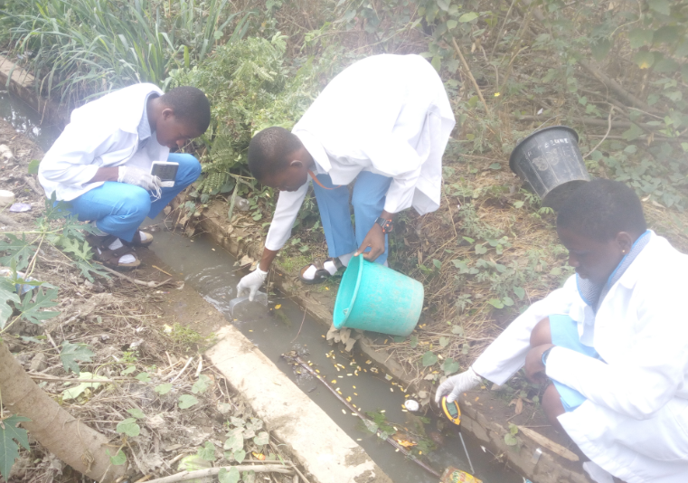
RESEARCH METHODS
The GLOBE protocols included in this study are Hydrology Protocols - Water temperature and Water pH; Atmosphere Protocols - Air temperature and Relative Humidity. We collected mosquito larvae from hydrosphere site B (a gutter with standing water) by scooping water and from hydrosphere site A (a shallow pool of flowing water with bushy environment). Water samples from the selected sites (A and B) were analyzed for physico-chemical properties such as pH and temperature. The water pH and water temperature were measured using the digital soil meter and digital hygro-thermometer respectively. Counting was done with clip-on macro lens.
Collection of Mosquito Larvae and physico-chemical properties from Hydrosphere Site A
Collection of Mosquito Larvae and physico-chemical properties from Hydrosphere Site B
Paul Eke, Kemisola Akomolafe and Temitope Akinsunmade

Slide 5
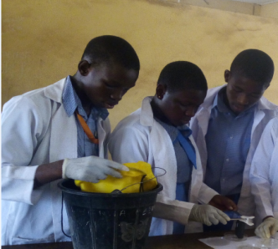
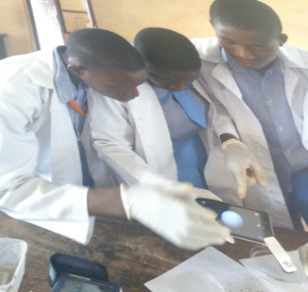
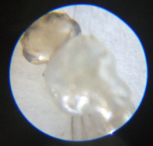
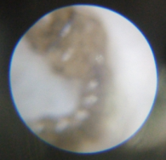
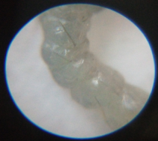
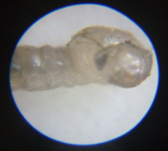
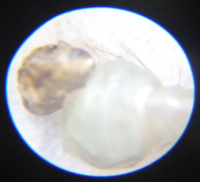
DATA/RESULTS
The diagrams below are samples of Anopheles and Aedes mosquito larvae we observed with the clip-on macro lens from the investigated hydro-sites A and B.
Table 1
Table 2
 | Atmos Temp (°C) | Water Temp (°C) | Relative Humidity (%) | pH | No. of Aedes Larvae | No. of Anopheles Larvae
Week 1 | 39 | 34 | 10 | 6.0 | 3 | 7
Week 2 | 37 | 32 | 11 | 6.5 | 5 | 7
Week 3 | 38 | 35 | 13 | 5.5 | 2 | 12
Week 4 | 36 | 31 | 16 | 6.0 | 0 | 13
Week 5 | 35 | 31 | 22 | 4.5 | 2 | 10
Week 6 | 33 | 28 | 34 | 3.5 | 4 | 5
Week 7 | 32 | 27 | 42 | 4.0 | 3 | 4
 | Atmos Temp (°C) | Water Temp (°C) | Relative Humidity (%) | pH | No. of Aedes Larvae | No. of Anopheles Larvae
Week 1 | 38 | 29 | 10 | 8.0 | 20 | 1
Week 2 | 37 | 30 | 12 | 7.5 | 23 | 4
Week 3 | 35 | 28 | 12 | 6.5 | 14 | 2
Week 4 | 34 | 26 | 17 | 6.0 | 12 | 0
Week 5 | 35 | 26 | 21 | 5.0 | 16 | 1
Week 6 | 32 | 31 | 35 | 5.5 | 8 | 3
Week 7 | 33 | 28 | 39 | 4.0 | 19 | 1
The physico-chemical parameters of the breeding sites as presented in the two tables (Tables 1 and 2) reveal that the atmospheric temperature ranges between 32 – 39°C , water temperature ranges between 26 – 35°C, relative humidity ranges between 10 – 42% and a pH range of 3.5 – 8.0.
Paul Eke, Kemisola Akomolafe and Temitope Akinsunmade

Slide 6
DISCUSSION
The abundance of Anopheles species in hydrosphere site A is due to human activities like, pool of stagnant water, domestic runoffs, disposal of household and kitchen wastes which provide numerous breeding sites.
The study has revealed that the number of anopheles genera is abundant in hydrosphere site A compared to hydrosphere site B. In SPUSSA community, the Anopheles genera and Aedes genera are the most common species in the study area and are listed among the most effective and efficient dominant vector species of human malaria.
It was further observed that physico-chemical parameters of the mosquito habitat determine mosquito oviposition and abundance. The optimal pH recorded in this study has also been reported by other authors (Adebote et al., 2006). The authors reported that pH range of 6.8–7.2 and 7.0–7.4 were suitable for the weakening of the mosquito egg shells for the emergence of its first larvae and that pH less than 5.0 and higher than 7.4 have fatal effects on survival of mosquito species. Optimal temperature suitable for breeding (28.6 °C) in Akure metropolis also concurred with the reports of Clement (1992).
In this study the temperatures we observed are keen factors which affect the abundance and distribution of mosquito in the identified habitats. A research study conducted by Afolabi and Aladesanmi (2018) also shows that the optimal temperature that favored breeding in Akure is 28 °C while mosquito breeding is not likely to be found in temperature below 25 °C.
Paul Eke, Kemisola Akomolafe and Temitope Akinsunmade

Slide 7
CONCLUSION
  The abundance and distribution of the mosquito species in the study area may be related to the availability of breeding sites.
  The Anopheles genera and Aedes genera encountered in the study are potential vectors of malaria and Zika respectively. Lack of good drainage could lead to the abundance of mosquitoes in the study area.
  Increasing temperature and relative humidity are potentially providing suitable conditions and habitats for mosquitoes to spread pathogens.
  Therefore, effective vector control programmes and public enlightenment especially on human activities that encourage mosquito breeding are recommended. There is need to develop control strategies that will target the vector species.
Paul Eke, Kemisola Akomolafe and Temitope Akinsunmade

Slide 8
CITATIONS/REFERENCES
Adebote, D.A., Oniye, S.J., Ndams, I.S. & Nache, K.M. (2006). The Breeding of Mosquitoes (Diptera: Culicidae) in Peridomestic Containers and Implication in Yellow Fever Transmission in Villages around Zaria, Northern Nigeria. Journal of Entomology, 3, 180–188.
Afolabi, O.J. & Aladesanmi, C.O. (2018). Seasonal Variation in Distribution and Abundance of Mosquitoes (Diptera: Culidae) in Akure North Local Government Area, Ondo State, Nigeria. Uttar Pradesh Journal of Zoology, 38, 149–159.
Clement, A.N. (1992). Development, Nutrition and Reproduction of Mosquitoes. In The Biology of Mosquitoes, London: Chapman and Hall.
Nwoke, B.E.B., Nduka, F.O., Okereke, O.M. & Ehighibe, O.C. (1993). Sustainable Urban Development and Human Health Septic Tanks As A Major Breeding Habitat Of Mosquito Vectors Of Human Disease in South Eastern Nigeria. Appl. Parasitol. 34, 1-10.
WHO (2014). World Malaria Report 2014. Geneva: World Health Organization
Paul Eke, Kemisola Akomolafe and Temitope Akinsunmade

Slide 9

thank You
Questions?
Paul Eke, Kemisola Akomolafe and Temitope Akinsunmade

