Slide 1
Looking to the Future….
The Year Ahead
2021

Slide 2
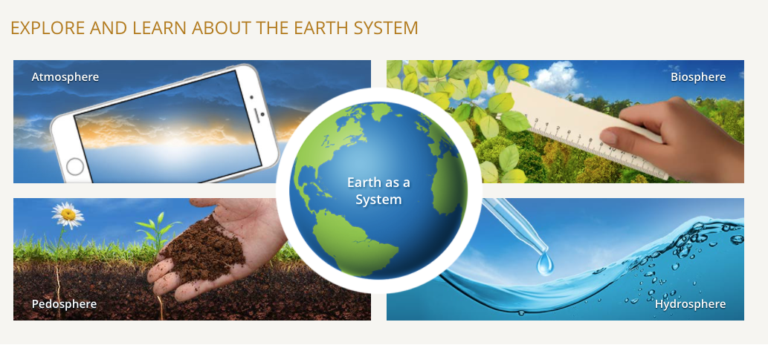
Science
Science Working Group
has created a set of
criteria for evaluating and
proposing protocols to be
dropped from the program. This process should be ready for
final clearance by GIO and NASA by the end of 2020.

Slide 3
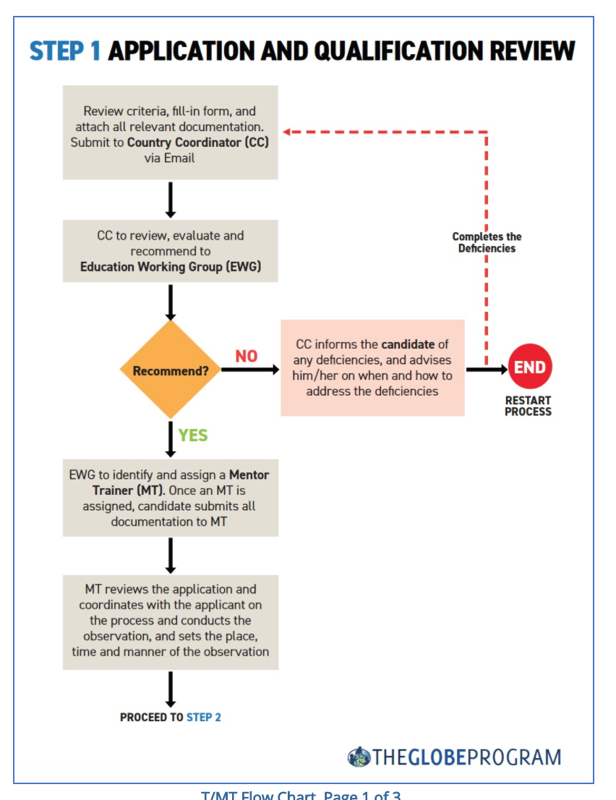
Education
Education Working Group has created a
revised trainer and mentor trainer
process. This process is being communicated
to the community and should be ready
for final implementation in 2021.

Slide 4

Alumni
Evaluation Working Group will prepare report on the GLOBE Alumni Interviews pilot project
Upload the Alumni set of questions on the GLOBE website (in a Survey Monkey or Google form format) to collect more responses
Collaborate with the GIO to update the Alumni page and to identify a mechanism to keep Alumni records so that this important group can remain engaged in the Program

Slide 5

Community
The Community Diversity,
Equity, and Inclusion Task
Force will provide
recommendations in the
fall of 2020 to the GIO
and NASA.

Slide 6

Technology
Technology Working Group continues
to work with and give feedback to
SSAI on the new GO app and the
website.

Slide 7

Campaigns
Campaigns will continue with all safety precautions followed wherever students and others collect data.
Cloud Challenge begins this week for a month.
New combined GO app may increase data entry

Slide 8
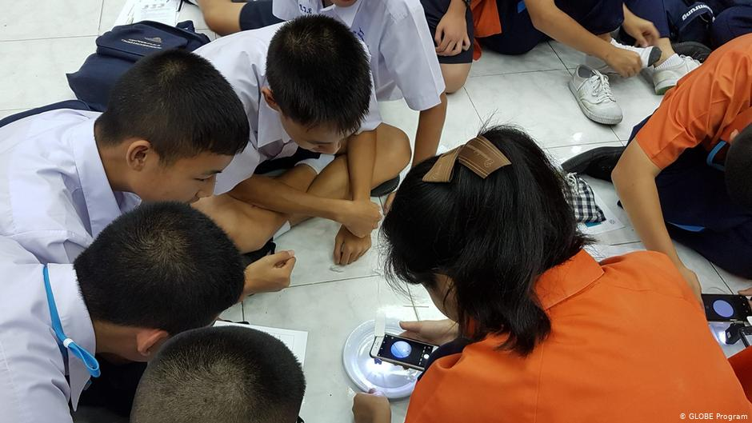
International Virtual Science Symposium 2021
International Virtual Science Symposium will be launched in September
Informational webinar to be held in October
We look forward to receiving reports from students/teachers in the spring of 2021

Slide 9

Strategic Plan
GIO uses the strategic plan with WGs, and other groups to move the program forward.
As a community, we continue to work toward the performance measures.
These measures will be revised and updated in fall 2020 with the WGs and Dr. Valerie Williams, UCP Evaluator.
Here are 2 examples of 2019 data

Slide 10
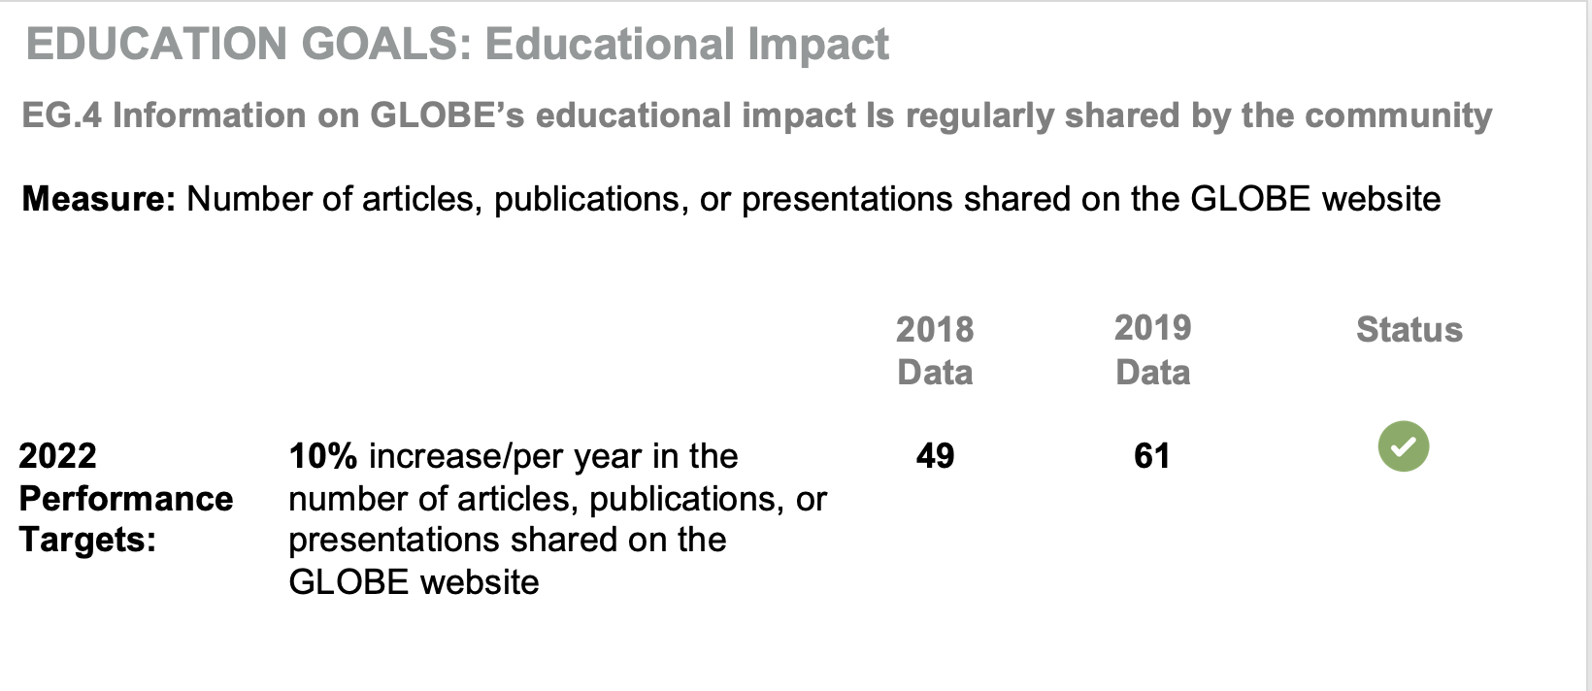
Strategic Plan

Slide 11
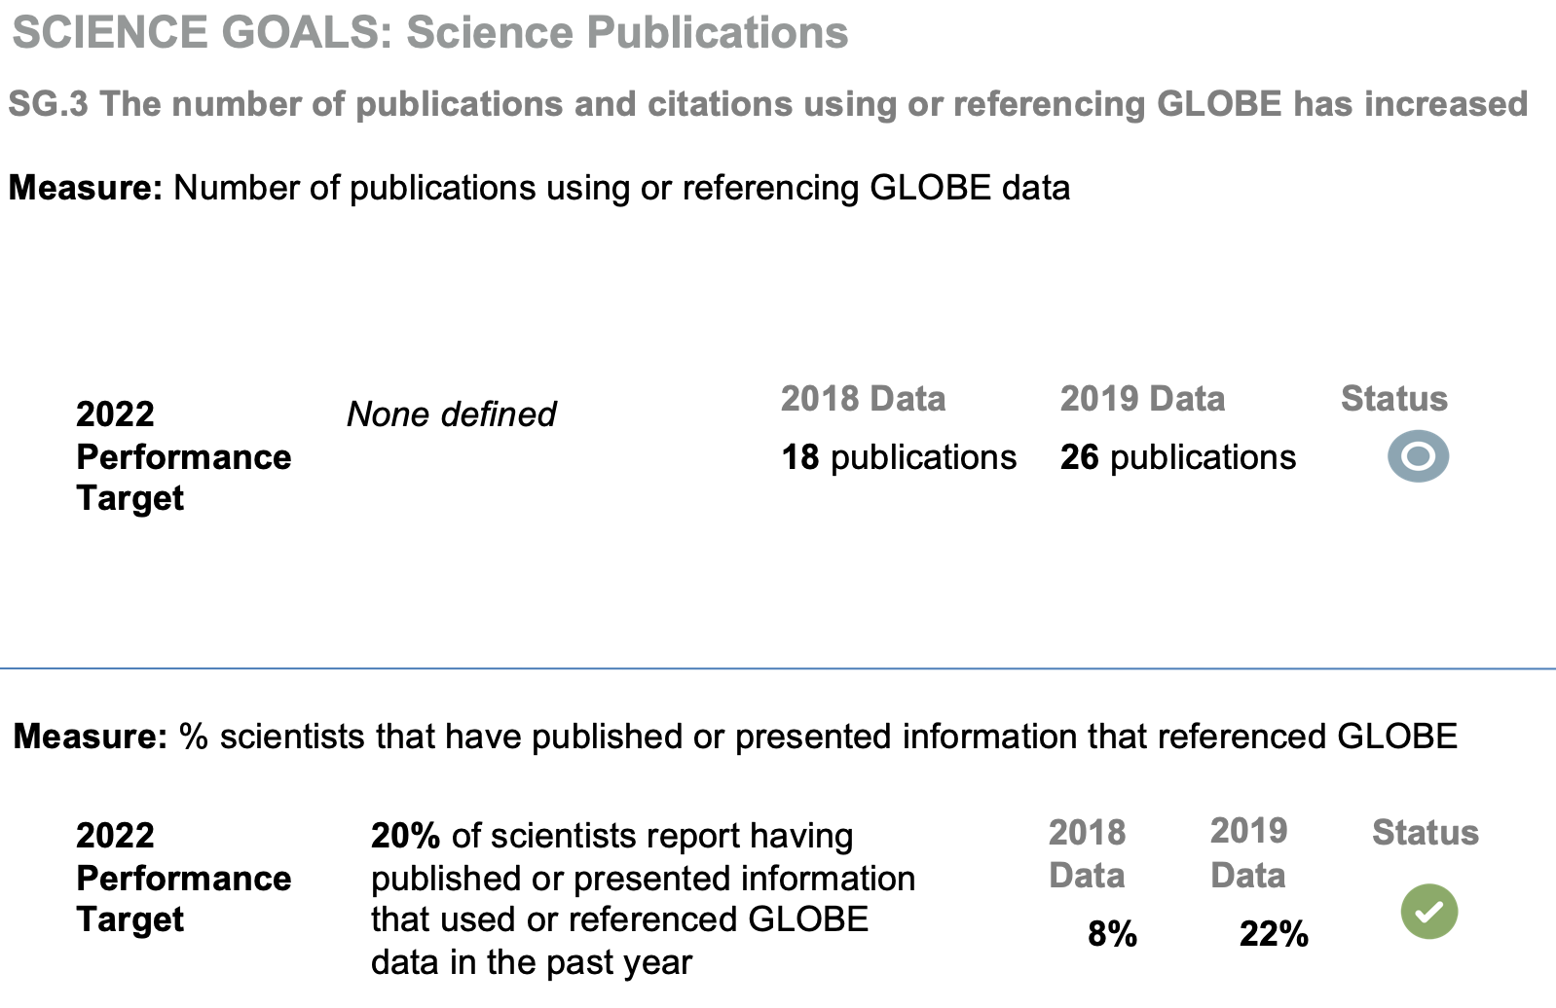
Strategic Plan

Slide 13
GLOBE Implementation Office
UCAR
BOULDER
USA help@globe.gov

