Slide 1
Welcome to the
2020 GLOBE Virtual
Annual Meeting
Theme: Reflecting on the Past,
Looking to the Future

Slide 2
Reflecting on the Past……Year
Community Achievements with GLOBE Implementation Office
support
  Regional Meetings
  International Virtual Science Symposium
  Earth Day celebrating 25 Years of GLOBE
  GLOBE Observer
  Zika Education and Prevention Project
  GLOBE welcomes new countries

Slide 3
Region Meetings (supported by RCOs)
Latin America and Caribbean Meeting, Brazil.
  August 27-30, 2019
  CC meeting and protocol training for teachers
North America Meeting, Berkeley, California
  October 15-17, 2019
  Teacher Professional Development and US Partner Meeting
Europe and Eurasia Meeting, Italy
  October 21-25, 2019
  CC Meeting and Teacher Professional Development
Notes:
RCO: Regional Coordination Office

Slide 4
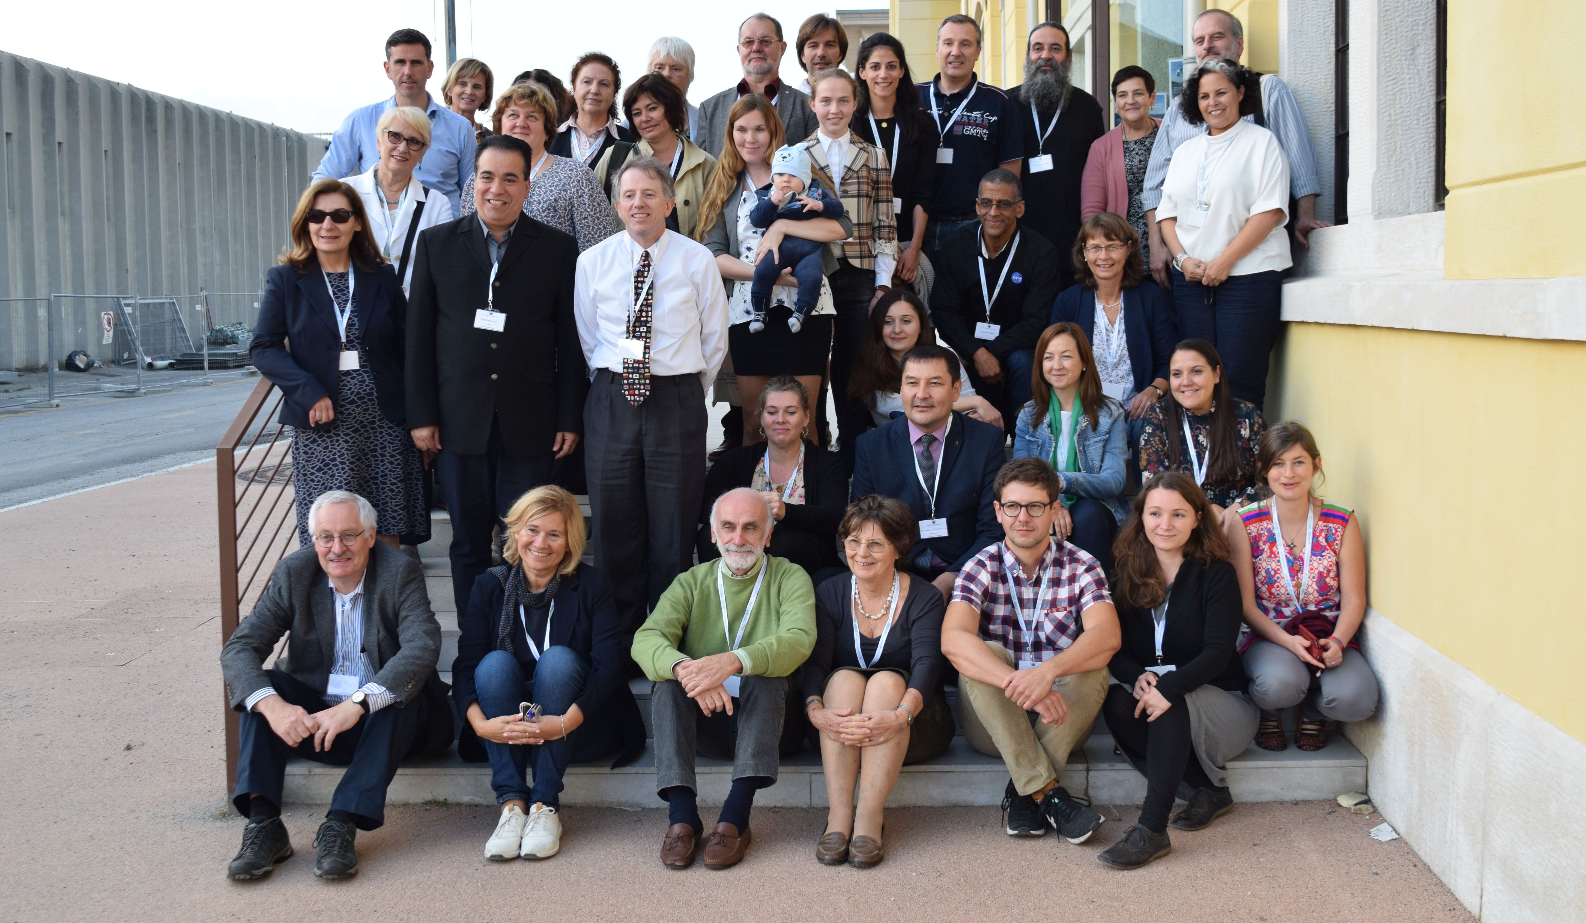
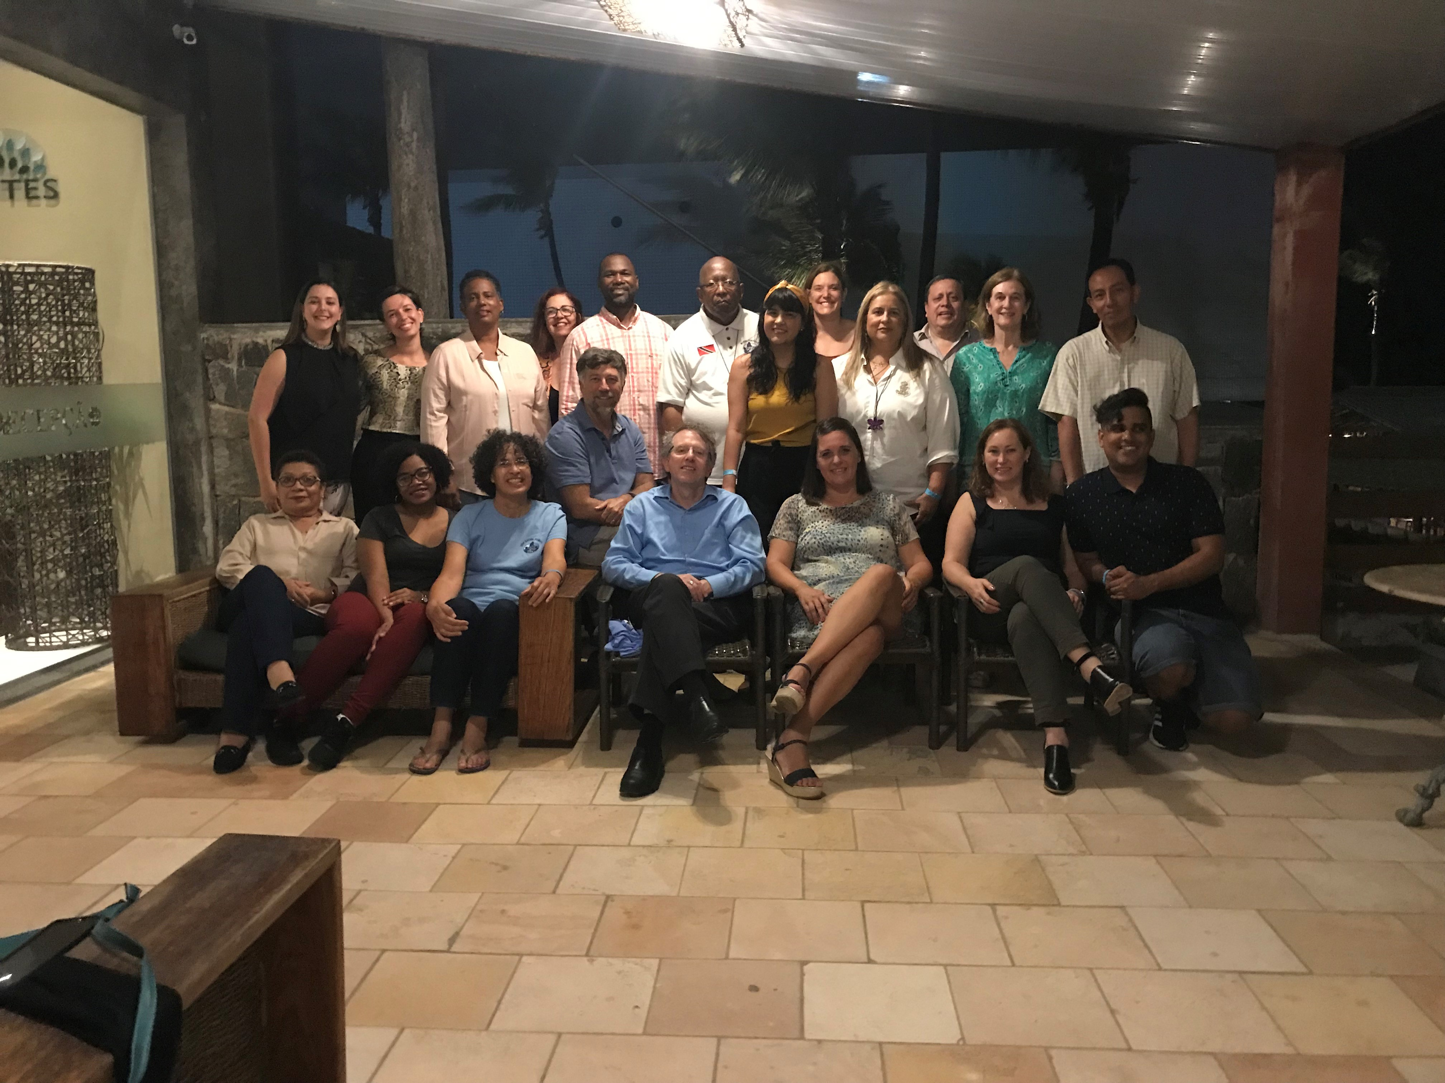
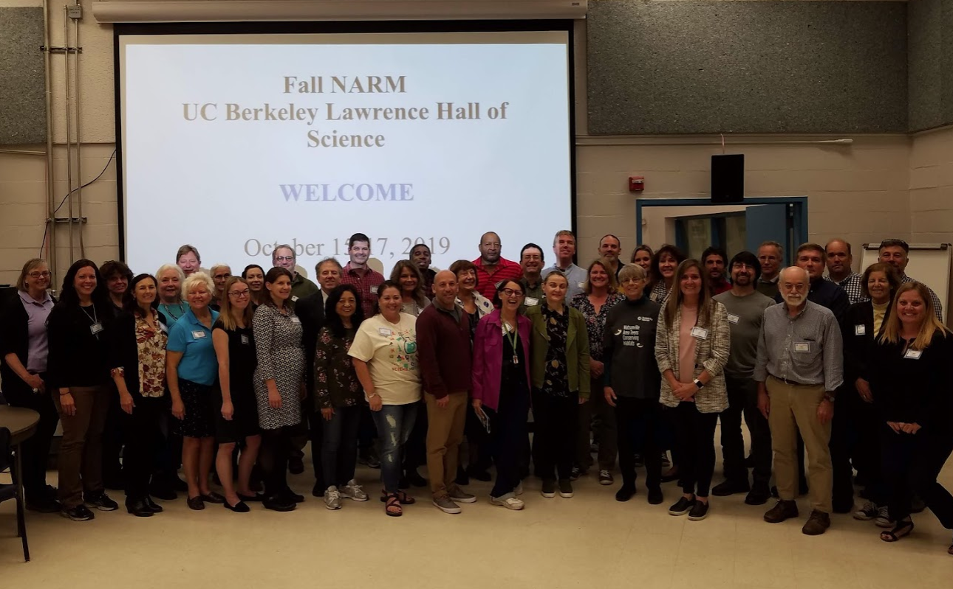
Region Meetings (supported by RCOs)
Latin America and
Caribbean
North America
Europe and Eurasia

Slide 5
Region Meetings (supported by RCOs)
Near East and North Africa Meeting, Kuwait
  November 11-17, 2019
  CC meeting and protocol training for master teachers
Asia and Pacific Meeting, India
  January 15-18, 2020
  CC meeting and mosquito training/meeting
Africa Meeting, South Africa
  Cancelled due to COVID-19
  Zoom calls held in lieu

Slide 6
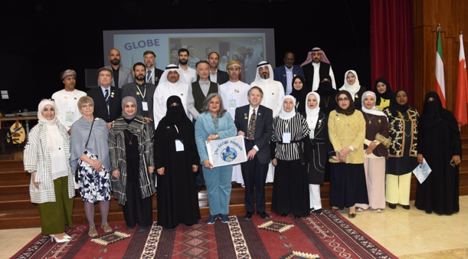
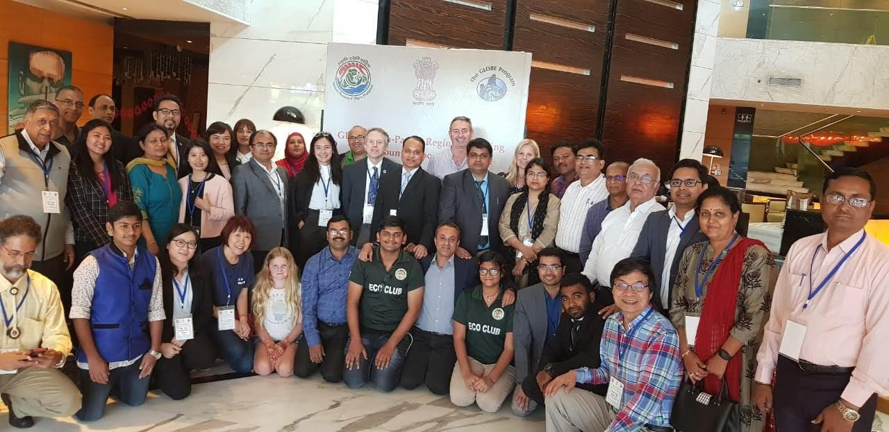
Region Meetings (supported by RCOs)
Near East and North Africa
Asia and Pacific Meeting

Slide 7

International Virtual Science Symposium (IVSS) 2020
2020 GLOBE International Virtual Science Symposium (IVSS):
  A record 265 projects were uploaded.
  Reports were received from 29 countries (eight countries new to the IVSS).
  There were 135 judges from 42 countries participating.
  Virtual badges were posted on all school pages.
  Feedback and certificates were sent to teachers. Certificates and virtual badges were provided to all judges.
  Projects were submitted in: English (206), Arabic: (36), Spanish (20), French (01), and Croatian (08).

Slide 8
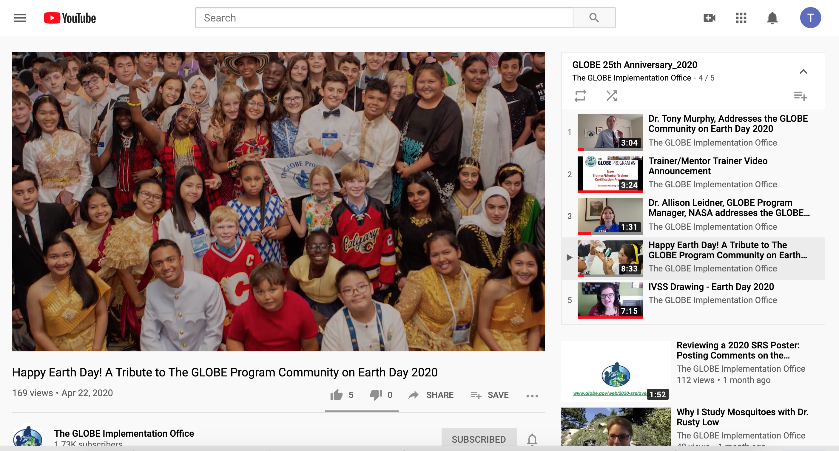
Earth Day 2020
A time for the community to celebrate 25 years of the program. GLOBE Implementation Office created a video address that included
  Opening words from the director,
  A collection of images from 25 years,
  An update on the trainer certification
  A drawing for the IVSS and Zika
  Education and Prevention Project
  Closing remarks from the NASA
  GLOBE Program Manager

Slide 9
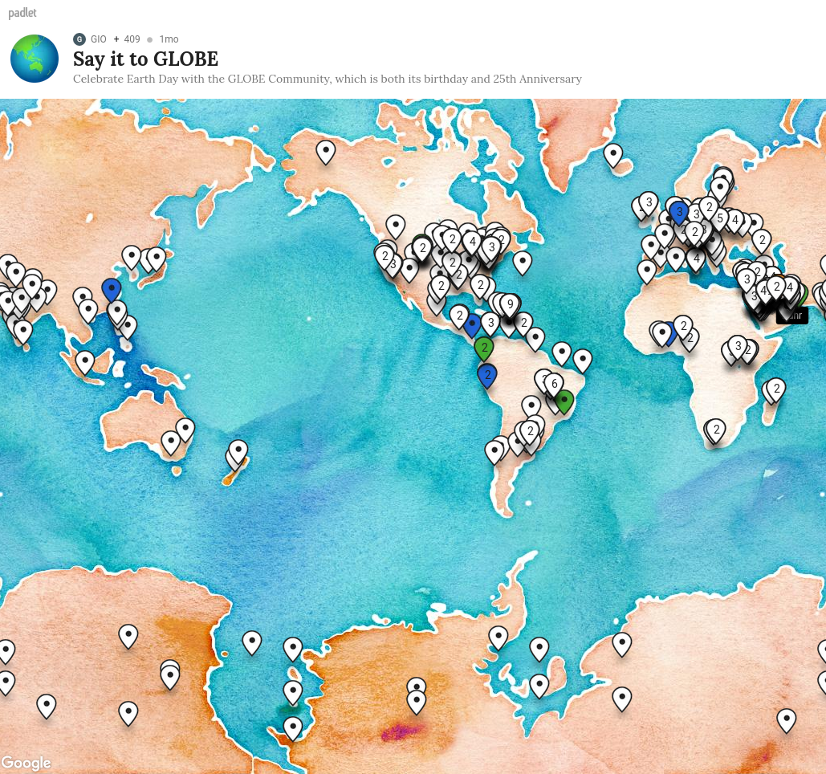
Earth Day 2020
GIO created a padlet “Say it to GLOBE” so that GLOBE members could write Happy Birthday/Happy 25th anniversary messages
Image shows distribution of messages from around the GLOBE Community

Slide 10
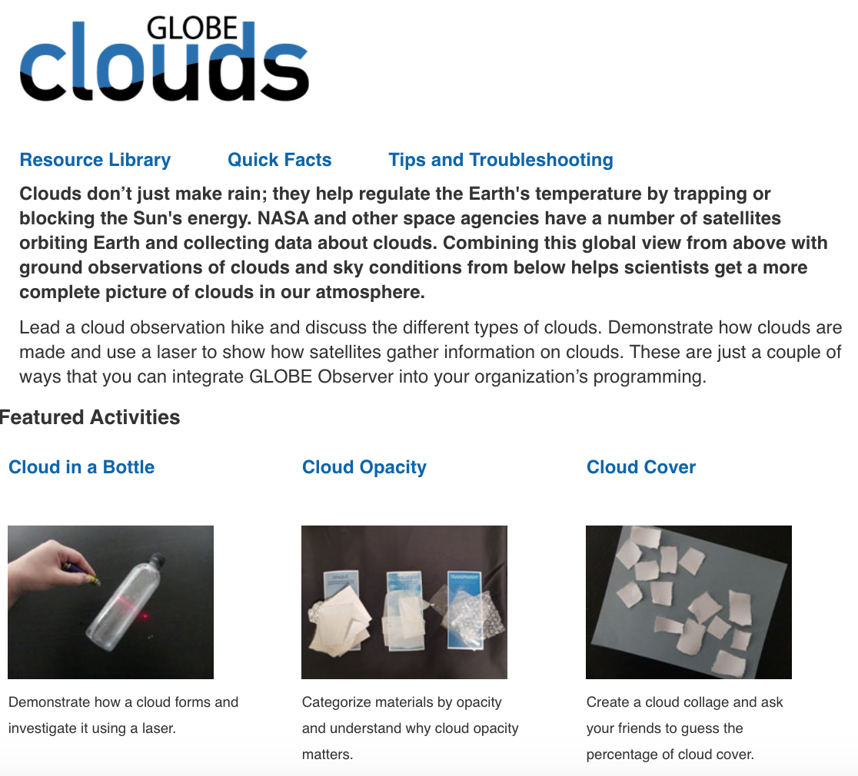
GLOBE Observer
Prior to COVID, a number of campaigns had operated by encouraging people to collect and enter data about trees, clouds, mosquitoes.
Once COVID arrived, the campaigns pivoted to doing webinars about indoor activities, data analysis, and recommended that people not collect data if it would require them to disobey local movement rules.

Slide 11
Zika Education and Prevention Project
As of June 30, 2020, more than 178,000 data points have been entered into the GLOBE database, resulting in about 10,000 new observations in this quarter, even with the COVID-19 disruptions.
These reports are from all GLOBE countries
Project supported by Dept. of State

Slide 12


Welcome to the GLOBE Family
Georgia
The Slovak Republic

Slide 14
Even in tough times,
The GLOBE Community stays strong and engaged doing the best for all of its members

