Slide 1
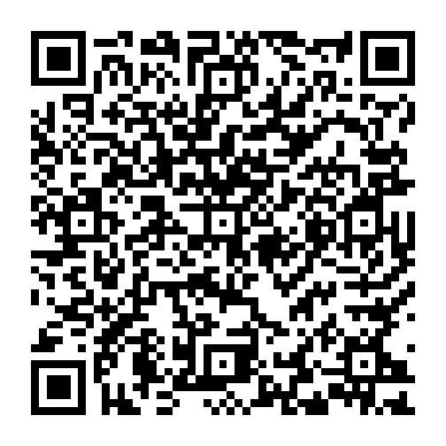
Participate live through our Mobile App!
Login to the mobile app NOW to participate live during this presentation.
You can get to the website version of our Mobile Application using the following link: https://crowd.cc/2020virtualmeeting
Or use this quick link for getting to the CrowdCompass AttendeeHub app in the app store on a mobile or tablet device: https://crowd.cc/s/3RKlm
Scan this QR code using your iOS or Android device to be taken to the website version of our Mobile Application.

Slide 2
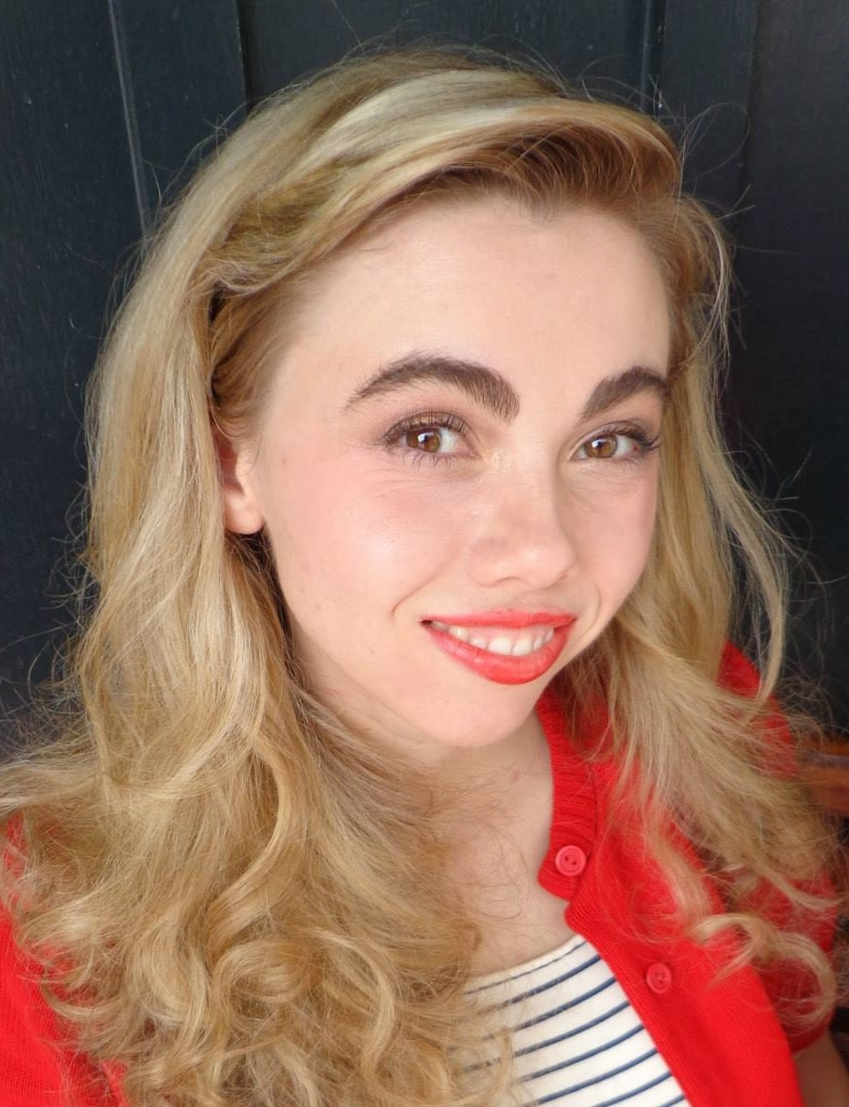


GLOBE Social Media
Social Media Lead
for
The GLOBE Program
and
Communications Director
for
NASA GLOBE Observer
With
Autumn Burdick

Slide 3

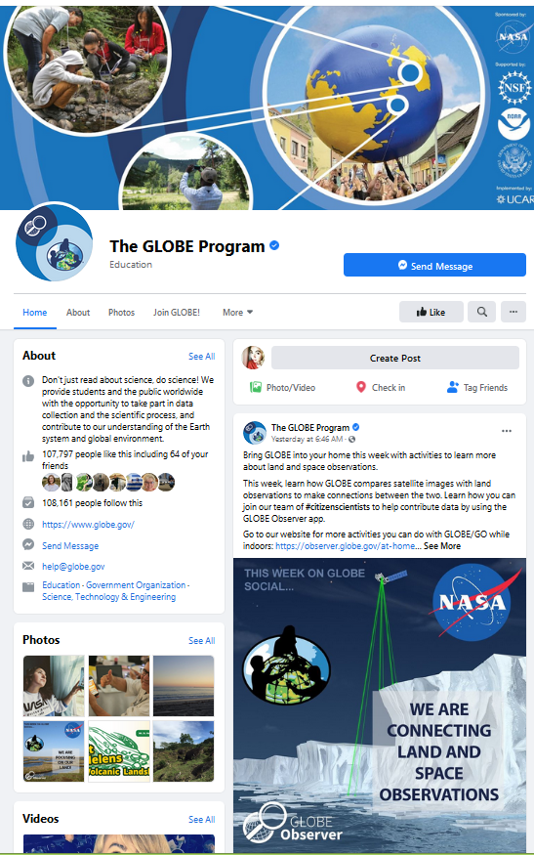
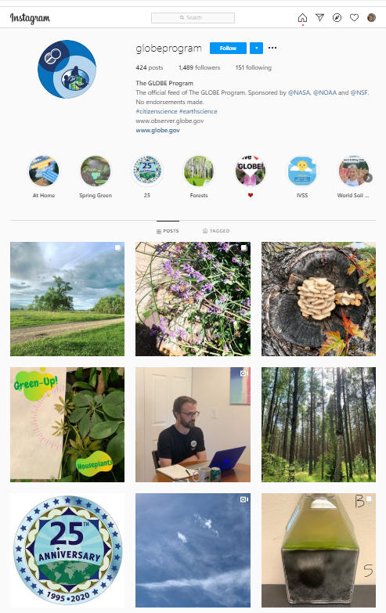
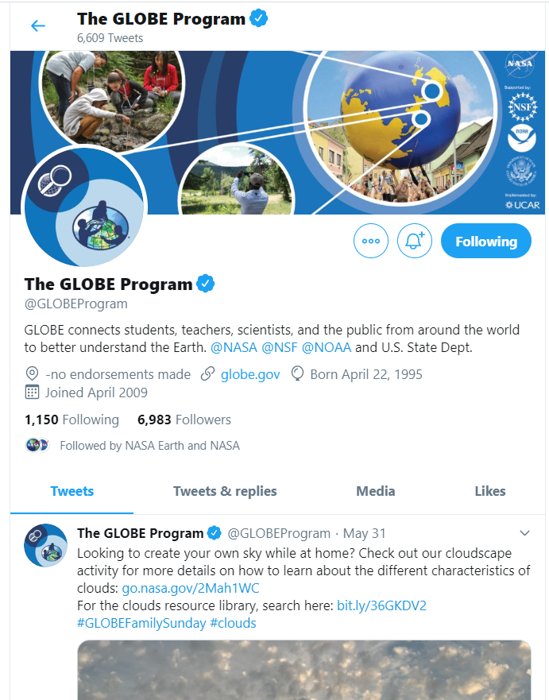
Follow Us!
Just search up: The GLOBE Program on any of these platforms.
Poll Alert!
Have you followed GLOBE yet?
Notes:
Before we get into the bulk of my presentation today, I want to first direct you to follow us on any or all of these social media platforms.

Slide 4

What’s New
Poll Alert!
Had you noticed the social consolidation?
Notes:
You might have noticed, especially if you have been with the GLOBE Program for a while, that I did not ask you to also follow NASA GLOBE Observer on social media. And that is because The GLOBE Program and the NASA GLOBE Observer social media accounts are now combined. This went into affect on March 1, 2020.
It came about because in January NASA HQ asked us to combine our social media accounts. This mandate was one taking affect across the board with accounts associated with NASA.

Slide 5
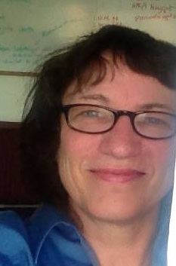
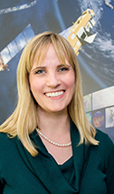
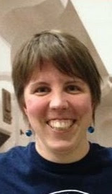
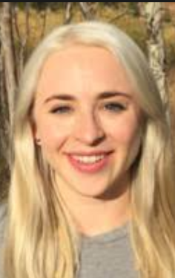
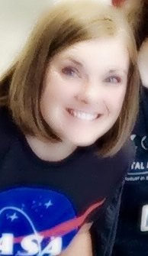
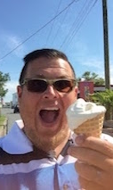
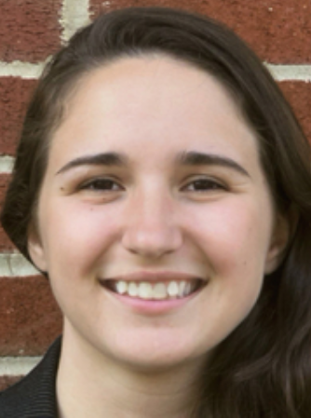

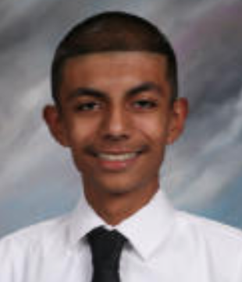
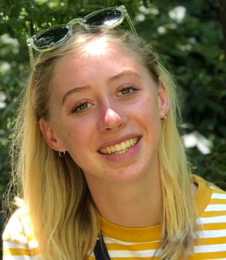
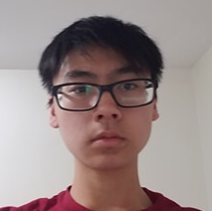
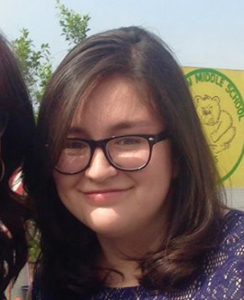
Get to Know the GLOBE Social Team
Kristen
Weaver
– NASA GO -
Amy
Barfield
– GLOBE/Instagram -
Heather
Mortimer
– NASA GO -
Sarah Parsons
– GLOBE -
Jan Heiderer
- GLOBE -
Holli Kohl
– NASA GO -
Tassia Owen
– NASA GO -
Brian Campbell
– NASA GO -
Poll Alert!
Since March 2019: Eve Terrill (ongoing) and Richard Tirado (through September 2019). And since March 2020, Nathan Hong and Shelby Carreon. These interns have provided GLOBE-focused posts on both Facebook and Twitter, as well as stories on the GLOBE Instagram – now weekly (since the pandemic began).
Which type of posts this past year have been your favorites?
Interns Working with Autumn.
Notes:
And so too our team is now combined and also has grown. Please meet the GLOBE social team. Here they are with their specific content focus roles since we do communicate to a broad audience. Many ages and associations, everything from being a GLOBE Student to an interested member of the public who wants to be a citizen scientist with The GLOBE Program and uses the NASA GLOBE Observer App to do so.
Really a big thank you to the entire GLOBE social media team. This team provides a great deal of content – as you will see. Custom visuals, like sharables. Great photography to illustrate our posts. Creating, building, and supporting wonderful social videos. We also write the words and information you read and learn from – information that is provided to the GLOBE community and the general public, daily, weekly, monthly, and annually. And it is a ton of content. This team is a joy to work with – and it really takes a team, so thank you!

Slide 6

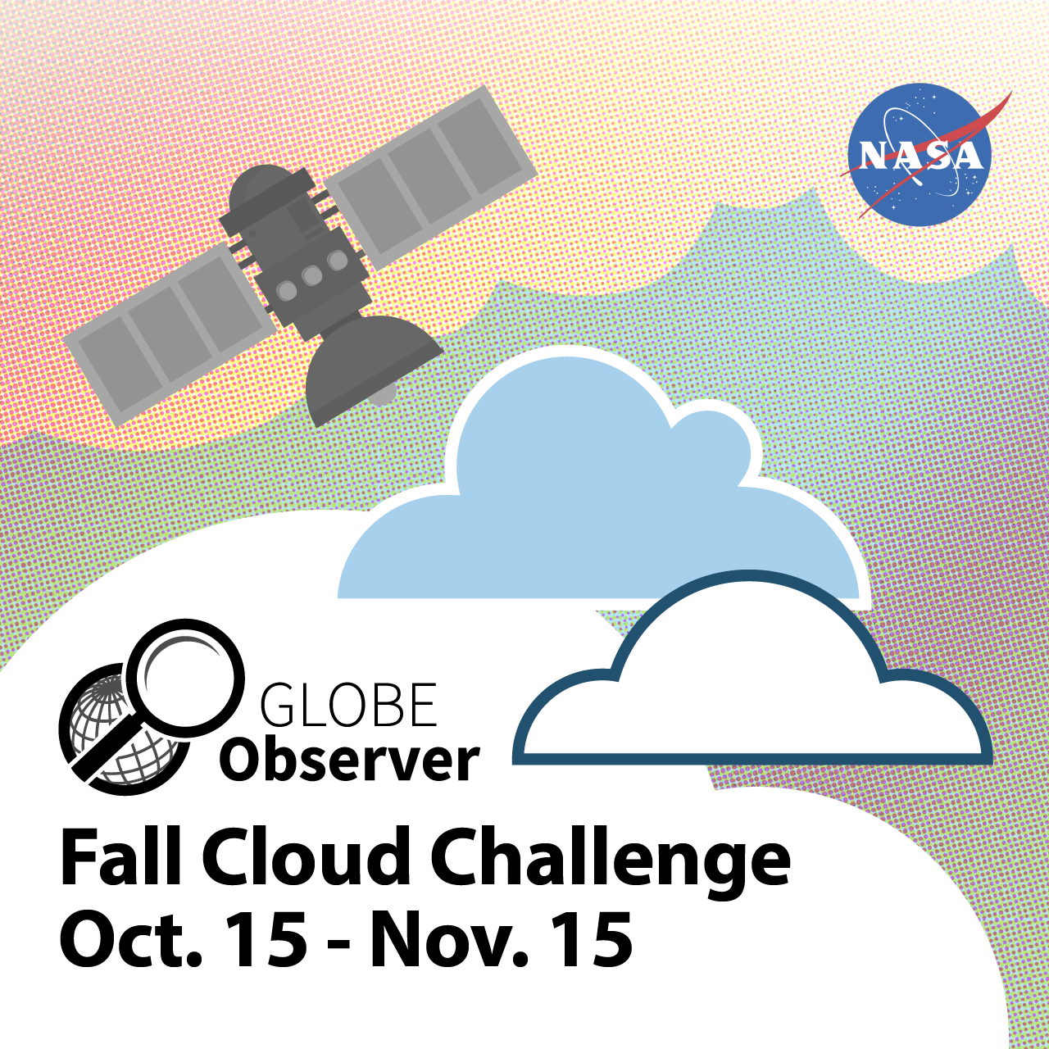

We have covered and supported the following and more!
  Research Contributions by the GLOBE Community
  Community Blogs
  GLOBE Zika, Mission Mosquito, Mosquito Habitat Mapper
  Trees Around the GLOBE, the GO Trees tool
  Land Cover
  UHI
  IOPs
  The IVSS
  And more!
  GLOBE Annual Meeting Coverage
  GO on a Trail Challenge (Concluded on Sept. 2, 2019)
  2019 Fall Cloud Challenge – MAJOR EFFORT!
  Consolidation Messaging –MAJOR EFFORT!
  Trees Challenge –--MAJOR EFFORT -- ULTIMATELY POSTPONED DUE TO THE PANDEMIC --
  NASA at Home and GLOBE at Home – MAJOR EFFORT!
  Prep for the 2020 Cloud Challenge –KICKS OFF WEDNESDAY -
  Tuesday Tips
  Thursday Thoughts
  Friday Recap Videos
  GLOBE Country Anniversaries
  National Days/Weeks
  Science Community Support
Notes:
As a team we supported and communicated about the following this past year. And we follow a schedule with weekly themes to convey all that GLOBE is and wishes to communicate.

Slide 7
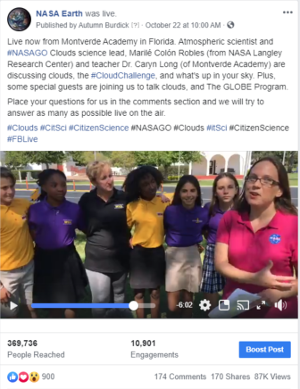
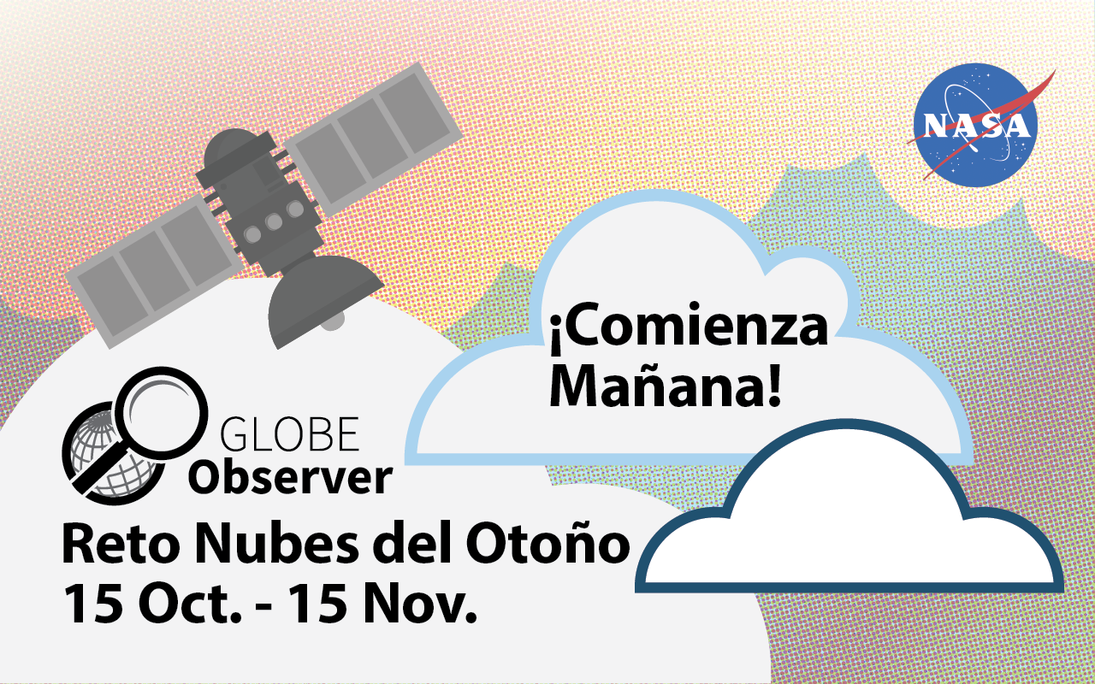
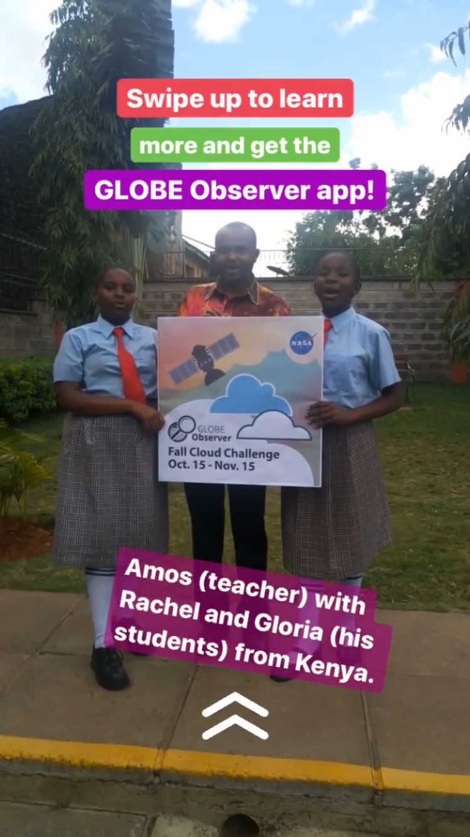
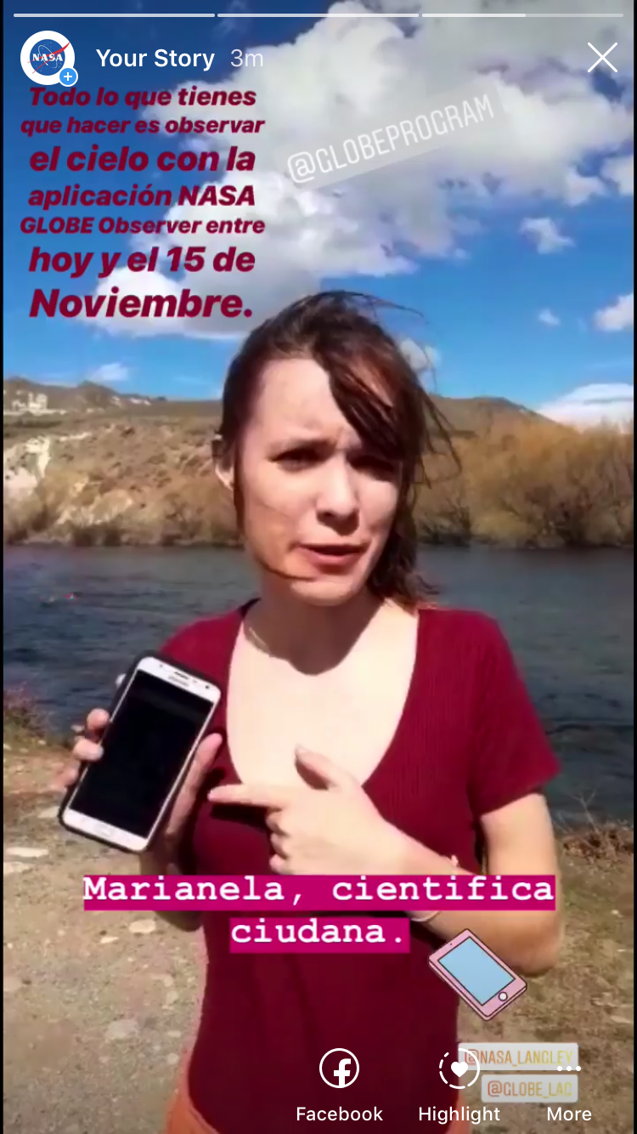
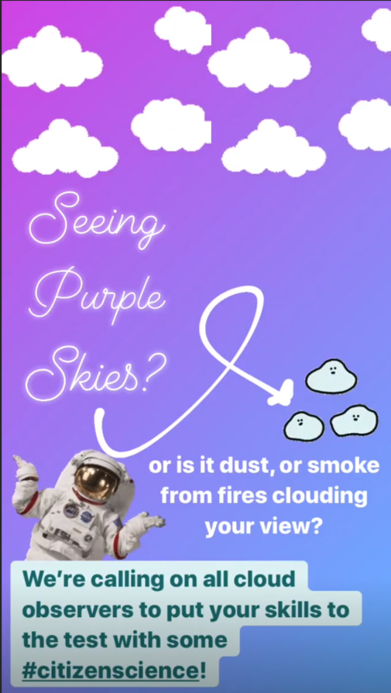
Fall Cloud Challenge
We reached nearly 5 million with our Cloud Challenge posts and products!
Cloud Challenge English and Spanish
- reached 2.3 million
Cloud Challenge Reminder
- reached 1.6 million
Notes:
One of our major pushes this past year was our Fall Cloud Challenge in October and November 2019. Our products resulted in a reach of nearly 5 million and has to date been our most successful social media campaign.

Slide 8
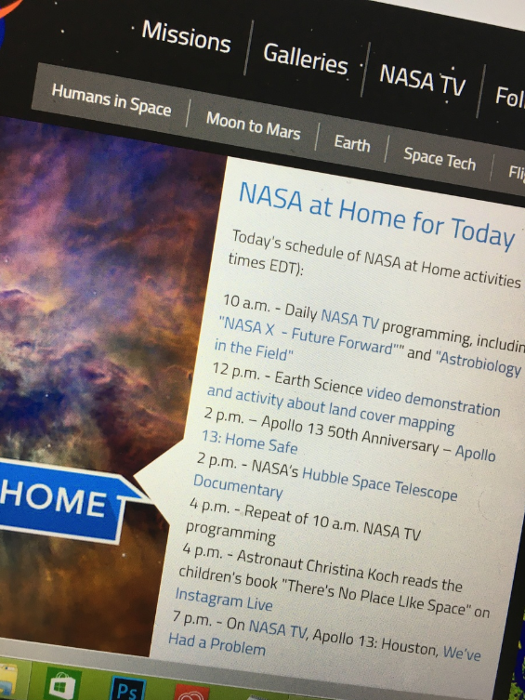
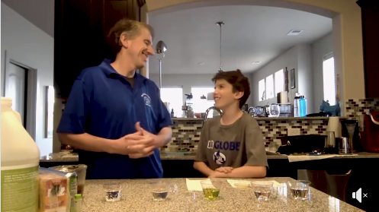
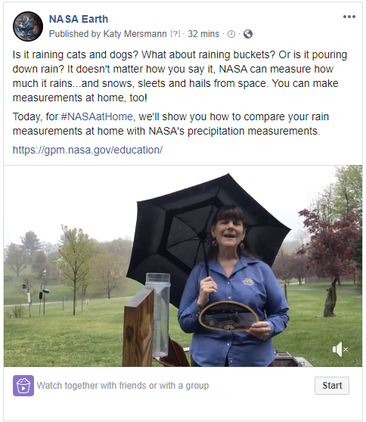
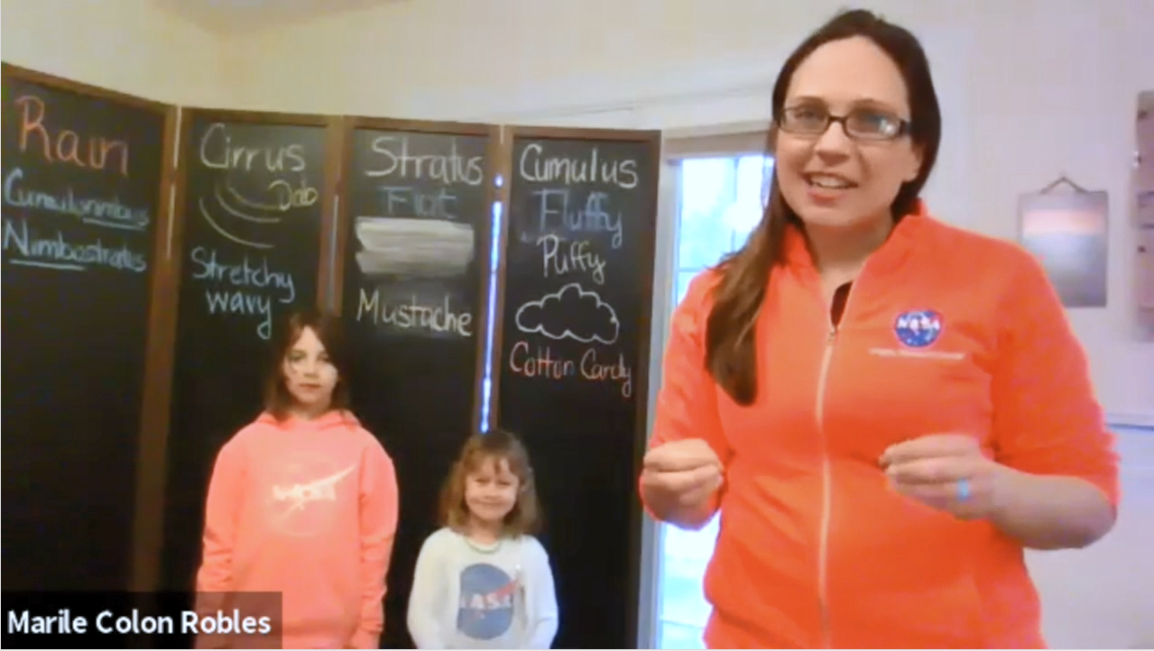
#NASAatHome with GLOBE and GO
Poll Alert!
Did you find our At Home content and weekly videos helpful?
9 videos released on NASA Earth since April 2nd. .
We have reached over 6.2 million people with these videos!
Notes:
Another major effort this past year has been our “At Home” support. When the pandemic came into full affect across the world we needed to switch gears. We postponed the Trees Challenge that was about to begin and which we had prepared for a great deal – it is ready to go and will in the future. But we needed to adjust, so we did. We adjusted to gather and provide at home resources to the public. We worked with NASA HQ social and NASA Earth to get on the schedule for at home video content and began producing videos under the #NASAatHome branding weekly. These were received very well by the public and GLOBE and NASA’s EO Kids really became the main video content offered by NASA during this period. With this video content we have reached over 6.2 million people.

Slide 9
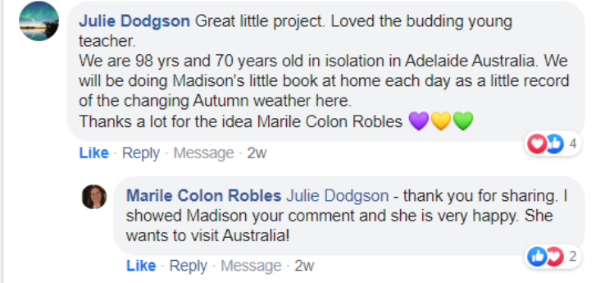
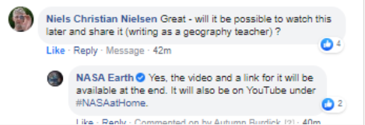
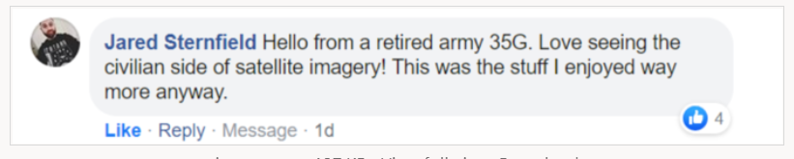
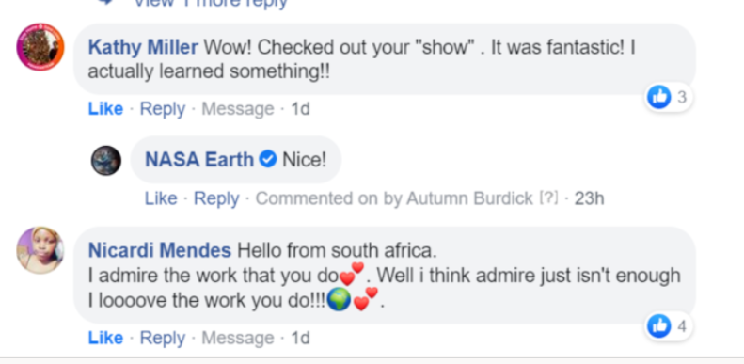

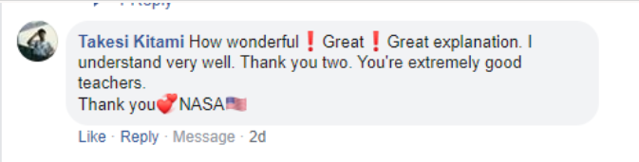
Positive Feedback
Notes:
People from all around the world joined us live each week on Thursdays. This is just a very small sampling of the hundreds of comments we received on these. Such as:
#NASA at Home Video content really has been a major effort since this past spring

Slide 10
In Summary,
Gained over 7.6K Followers
2,211 Tweets/Posts Created
Reached/Impressed Over 13.6 million!
since July 2019, we have:
Notes:
But, besides the two big ticket items I just mentioned we have been creating content for the everyday on both the GLOBE and GLOBE Observer accounts before consolidation took effect and since. Here is a short summary of all out combined efforts (this includes the Cloud Challenge and our NASA at Home Efforts) on social media since we last met in July 2019 in Michigan. As you can see quite a lot of content with good results.

Slide 11



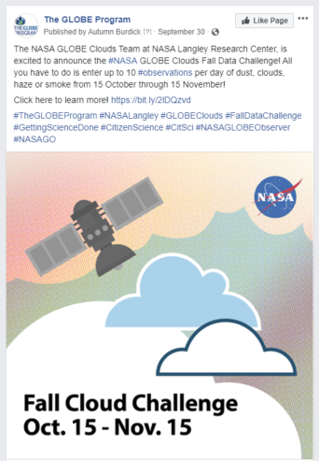
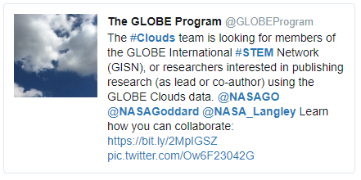
GLOBE Social -- July 2019 to February 2020
Gained 1,912 followers on Facebook
226 posts written/shared.
Our posts reached over 120K
  The top post reached 7.5K
Gained 1,007 followers on Twitter
323 tweets written/shared
Our tweets impressed over 272.6K
  The top tweet impressed 7.5K
Notes:
And here are just some further details from each account. This is GLOBE FB and Twitter for the period pre-consolidation. Top post and Tweet here were clouds related.

Slide 12

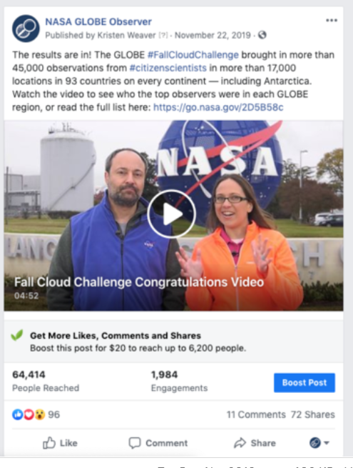
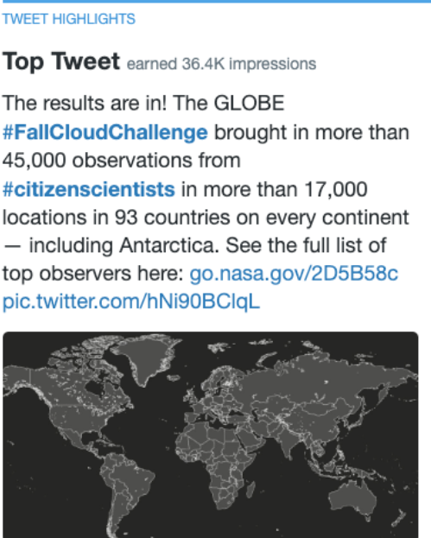
Social -- July 2019 to February 2020
Gained 1,679 followers on Facebook
450 posts written/shared
Our posts reached over 302.6 K
  The top post reached over 64K
Gained 1,148 followers on Twitter
507 tweets written/shared
Our tweets impressed over 935.3K
  The top tweet impressed 36.4K
Notes:
And GLOBE Observer social, pre consolidation. Our Fall Cloud Challenge of course was our top post on FB and our Top Tweet on Twitter for this period.

Slide 13
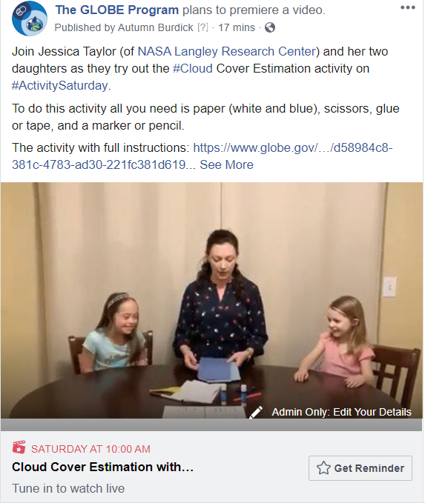
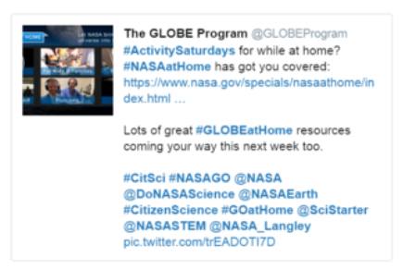
Post Consolidation – March to June 2020
Gained 425 followers on Twitter
389 tweets written/shared since the last annual meeting
Our tweets impressed over 688.8K
  The top tweet impressed 139.4K
Gained 1,467 followers on Facebook
229 posts written/shared since consolidating
Our posts reached over 94.4K
  The top post reached 9.3K
Notes:
And since consolidation we have been seeing good numbers and growth. Our top posts and tweets since March have been an at home cloud estimation video with Jessica Taylor and her two daughters and a tweet directing our followers to the then new NASA at Home content available on nasa.gov..

Slide 14

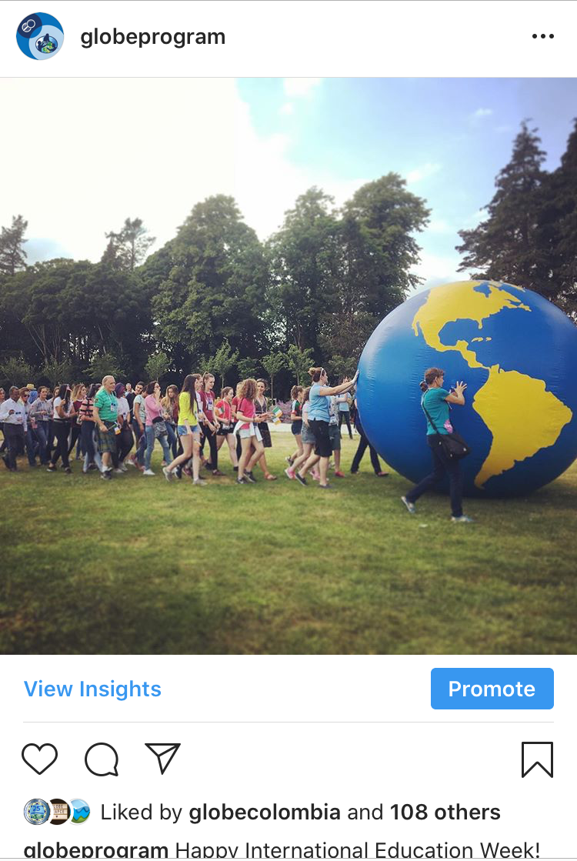
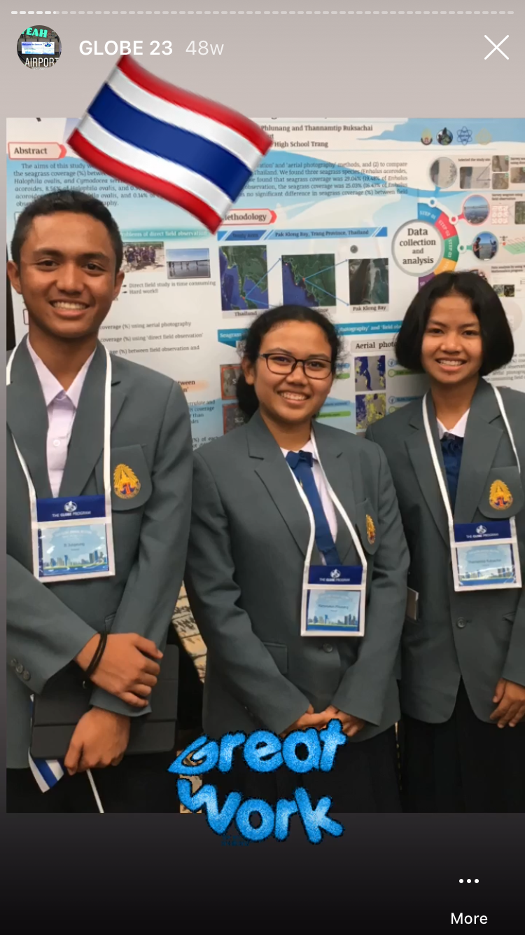
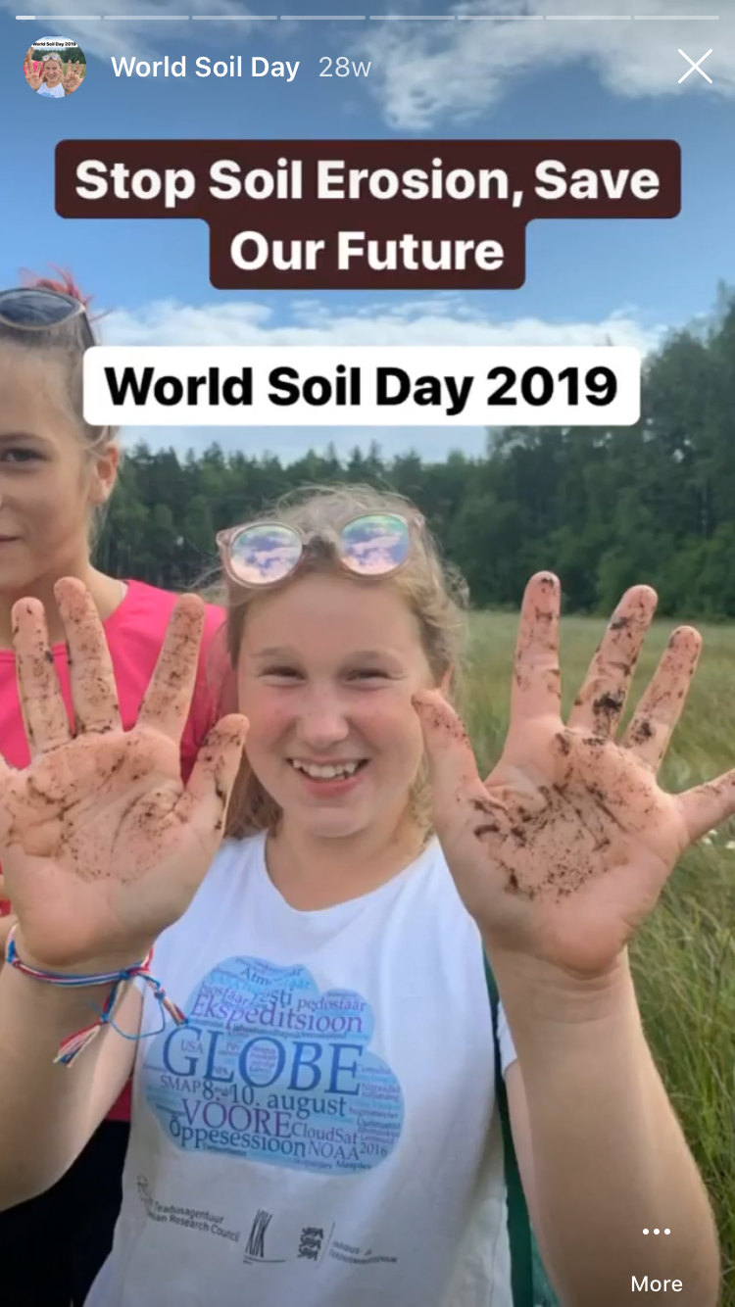
GLOBE INSTAGRAM July 2019-June 2020
  Posted weekly (with some additional posts) – 58 posts shared
  These were liked by over 3.7K people (our followers and the public)
  Produced 29 stories .
    Either monthly or daily coverage at a GLOBE event.
      These included:
      Daily coverage of #GLOBE23 in Michigan
      And themed stories, such as World Soils Day, and releases, anniversaries and GLOBE at Home.
        Stories on average reached between 180 people each time. Reaching about 5K people
Top Insta Post for this period was the Int. Ed. Week – liked by 109 people.
Notes:
And Instagram. We have always only had the one Instagram account and so no consolidation was needed there. We post weekly. And story both weekly and monthly. And have seen good growth and engagement on this platform as well.

Slide 15

2020 Community Cloud Challenge: Science is Better Together
#CloudChallenge
Notes:
Now coming up this Wednesday is the start of our 2020 Cloud Challenge. There are many ways to participate this tie around so head on over to the website to learn more, but just as a preview:

Slide 16
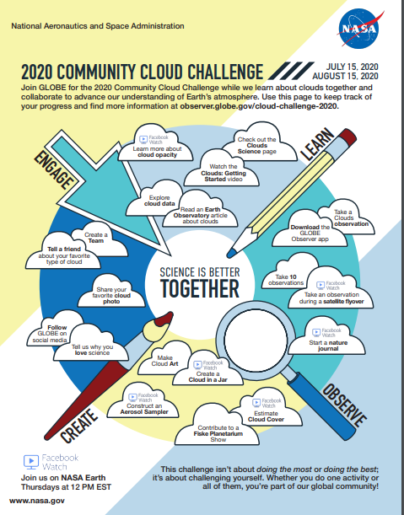
Poll Alert!
Many Ways to Participate!
Are you excited for this year’s cloud challenge?

Slide 17
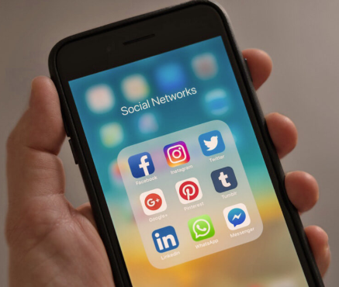
How to Participate in Social This Week
Use the hashtag (#VirtualGLOBE2020) and share with your friends and family what you are doing, thinking and learning
Notes:
Here during the virtual annual meeting you can participate on social by …

Slide 18
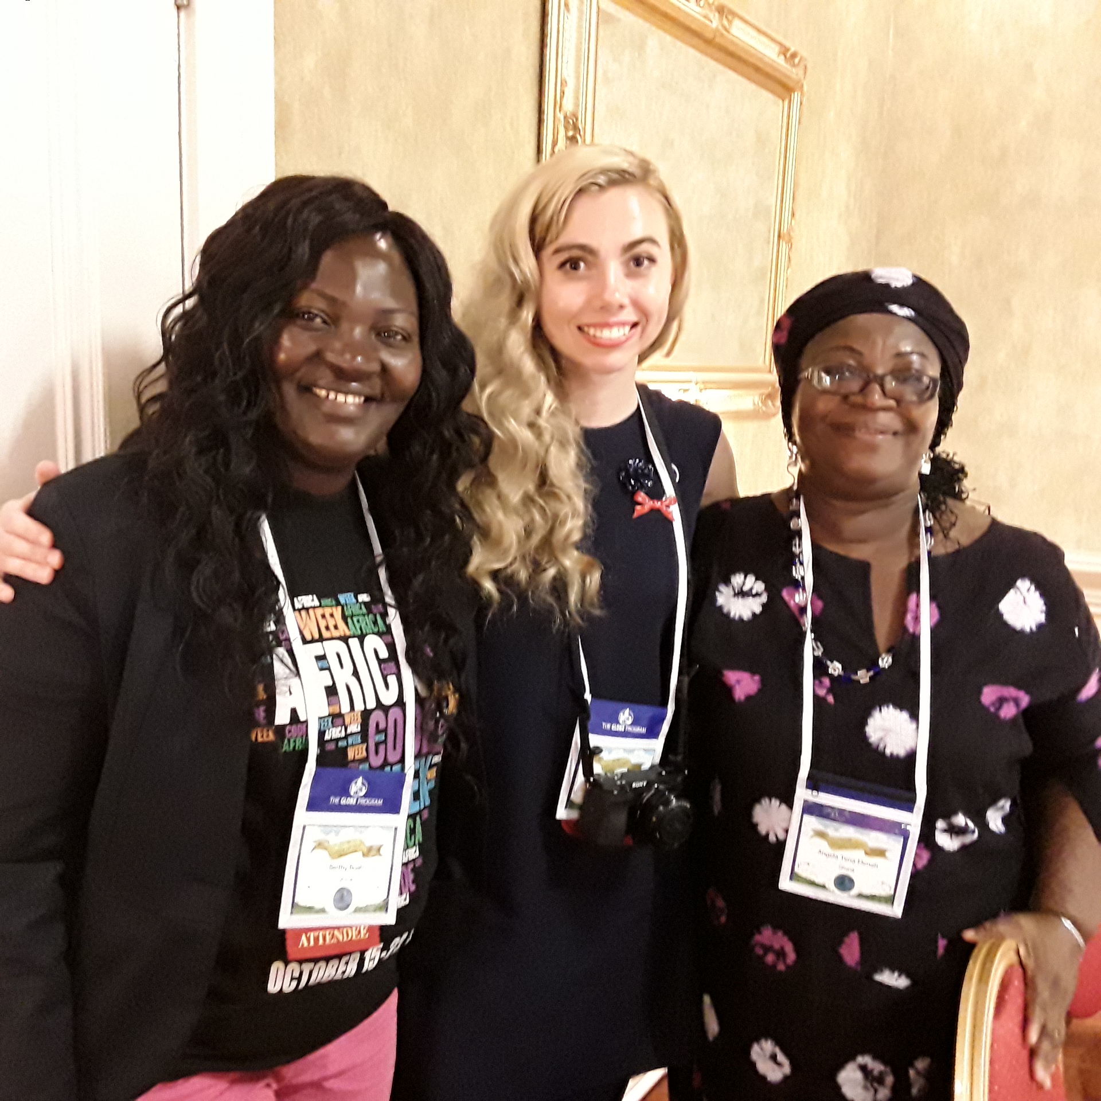
Celebrate The GLOBE Program’s 25th (#GLOBE25) Anniversary all week long by sharing on social media
  Share a picture a day (starting today) of past good times in person at GLOBE Annual Meetings or GLOBE Learning Expeditions
  And nominate three people you know or meet here to do the same each day
    Thank you to Claudia, Andrea, and Marta for this great idea ☺
Day 1 of 4: Let’s fill social media all week long with images and memories of good times together with @TheGLOBEProgram! I nominate @LauraAltin @AmosKaui and @AnaBPietro to do the same.
About this pic: Berthy and her mother are some of the kindest people I know. I loved meeting them both in Ireland in 2018! #GLOBE25 #VirtualGLOBE2020
Notes:
And I would like to invite you all to do the following. Help celebrate GLOBE’s 25th Remembering the past. Looking forward to the future. And I do hope the furture is one where we can all be together again and soon. But for now I do encourage you all to reach out to those you know and stay connected with them be it via a phone call or on social media.

Slide 19
Thank you!
Any Questions?
You can also contact me at:
autumn.burdick@ssaihq.com

Slide 20
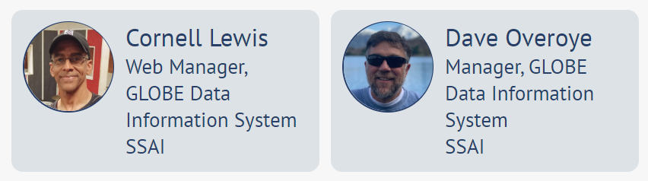
Be sure to tune in for our next session at: 2 pm MT.
Dave and Cornell will be back and presenting on: The New Data Entry System and GLOBE Observer.

