Slide 1

Diversity, Equity & Inclusion (DEI)
Task Force
Annual Meeting Presentation
Notes:
Julie

Slide 2
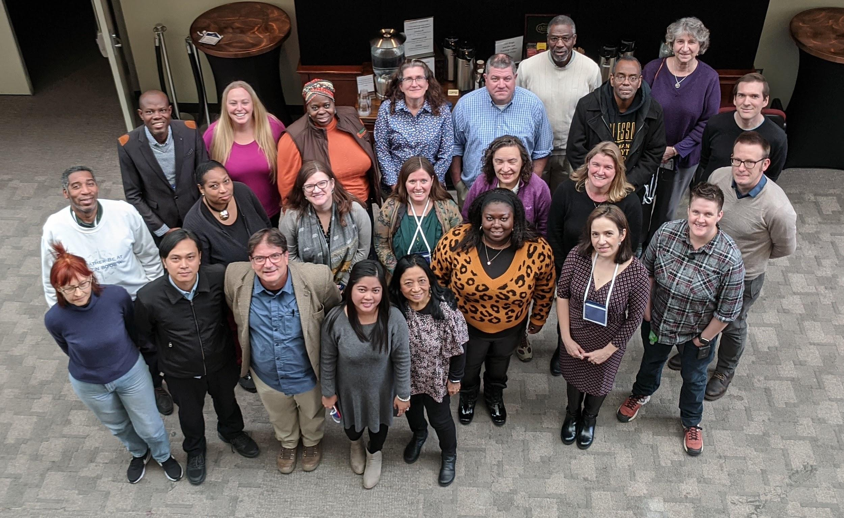
INTRODUCTION to the DEI TASK FORCE
Application process
Assembly of Task Force
Four day in-person meeting in February
Monthly Zoom Calls
Regular Emails and Shared Docs
Consensus versus Majority Rule
Goal: Statement + Action Plan
Q&A at the end of this session
Notes:
Julie

Slide 3
Task Force Members
Shadrack Agyiri (Ghana)
Jennifer Bourgeault (USA)
Katie Chapman (USA)
Kimberly Davis (USA)
Mindi DePaola (USA)
Francis Emralino (Philippines)
Wrayna Fairchild (USA)
Trena Ferrell (USA)
Rosalba Giarratano (USA)
Kate Goss (USA)
Nikitah Imani (USA)
Jill Karsten (USA)
Julie Malmberg (USA)
Josette Neal-De-Stanton (USA)
David Padgett (USA)
Richard Parsons (USA)
Marina Pavlic (Croatia)
Ana Prieto (Argentina)
Nate Raynor (USA)
Juan Felipe Restrepo Mesa (Colombia)
Elena Sparrow (USA)
Josephine Joy Tolentino (Philippines)
Notes:
Julie

Slide 4
VISION (bulleted for readability)
Our vision is a just and inclusive pursuit of global education and scientific inquiry.
Diversity and inclusion are recognized as being essential for the success of the program, its members, and the global Earth and sciences.
GLOBE is a program for people from all backgrounds and identities and we integrate diverse perspectives through inclusive and equitable practices in our community.
It is important that we recognize ongoing disparities for many communities in this world, as well as the limitations of our framework to address them.
We strive to create a welcoming place for all to participate in the research and education of The GLOBE Program.
Notes:
David and Josette talking about the process of how each came about
*Mention the bullet breakdown is NOT actually how the vision/mission is presented, we just broke it down for accessibility

Slide 5
MISSION (bulleted for readability)
Our mission is to empower learners around the world as diverse individuals and promote scientific inquiry, literacy, and action with cultural awareness.
We will strive to understand and appreciate the interdependence of humanity, cultures, and the natural environment and promote accountability based on our core values.
GLOBE will foster collaborations among diverse individuals and institutions to build and sustain a diverse, equitable, and inclusive program.
Notes:
David and Josette talking about the process of how each came about
This mission is about the importance of action!
*Mention the bullet breakdown is NOT actually how the vision/mission is presented, we just broke it down for accessibility

Slide 6
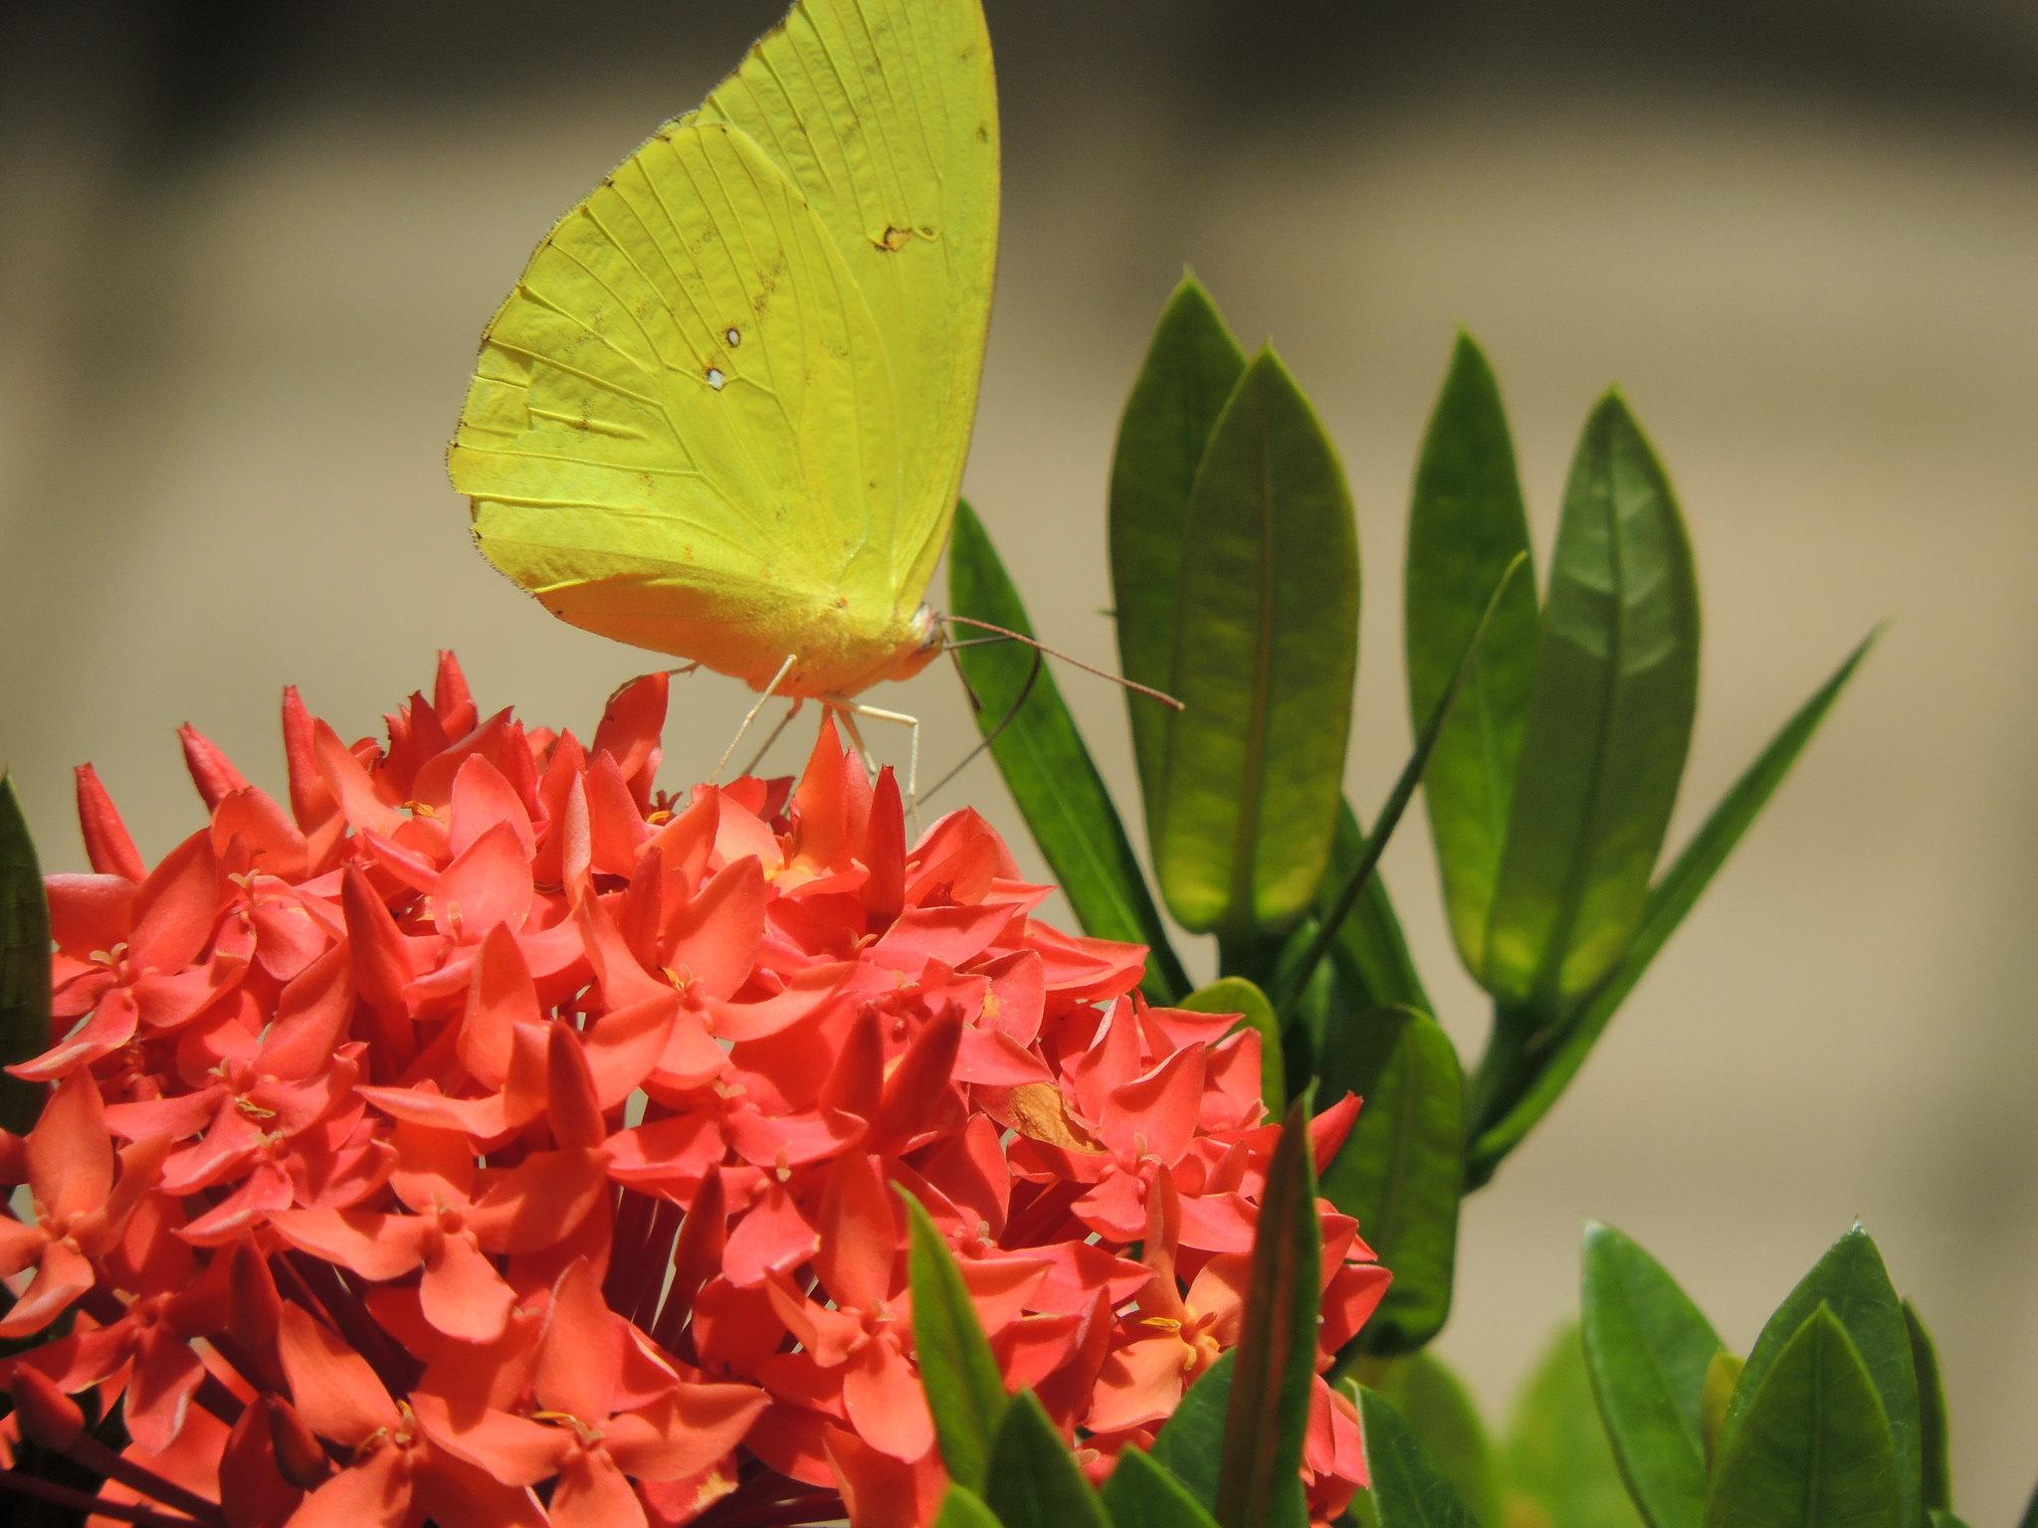
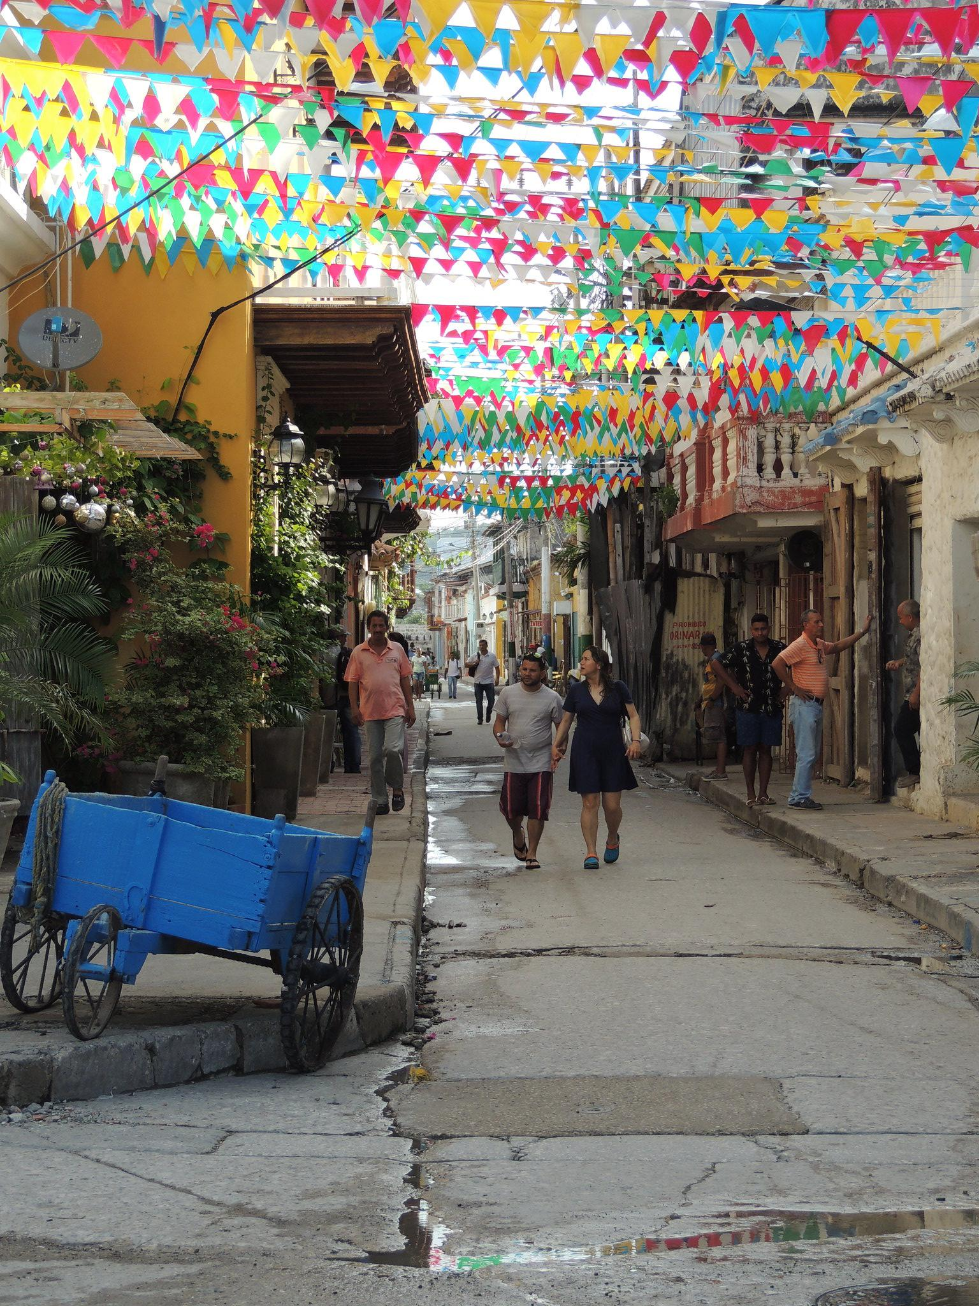
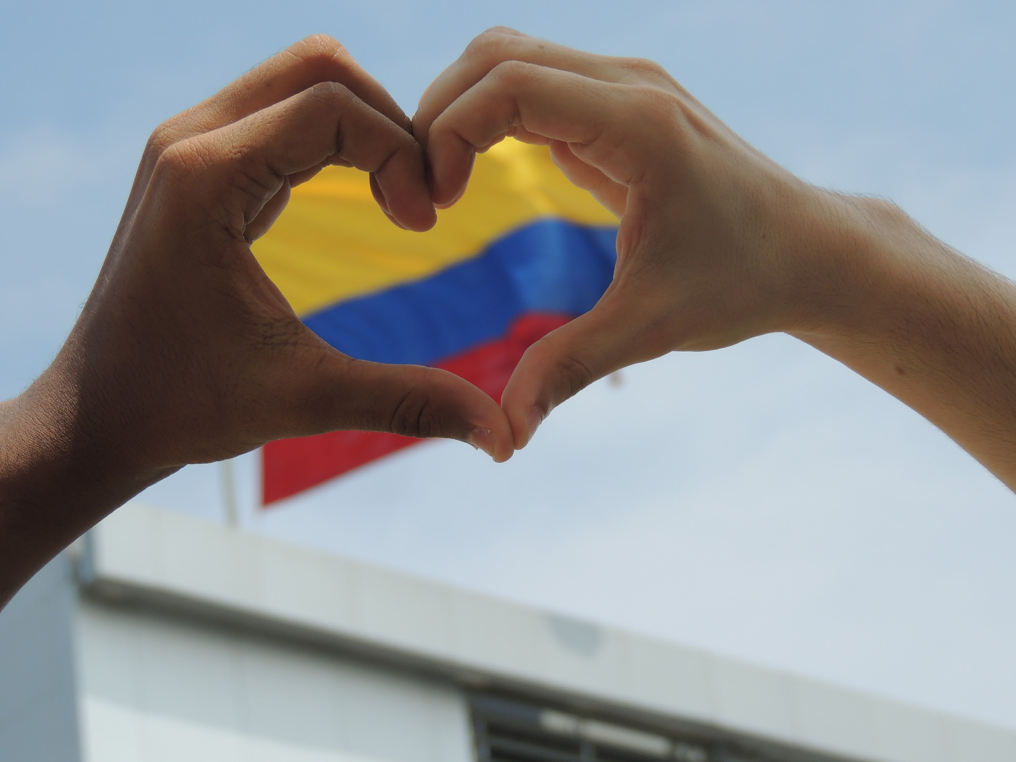
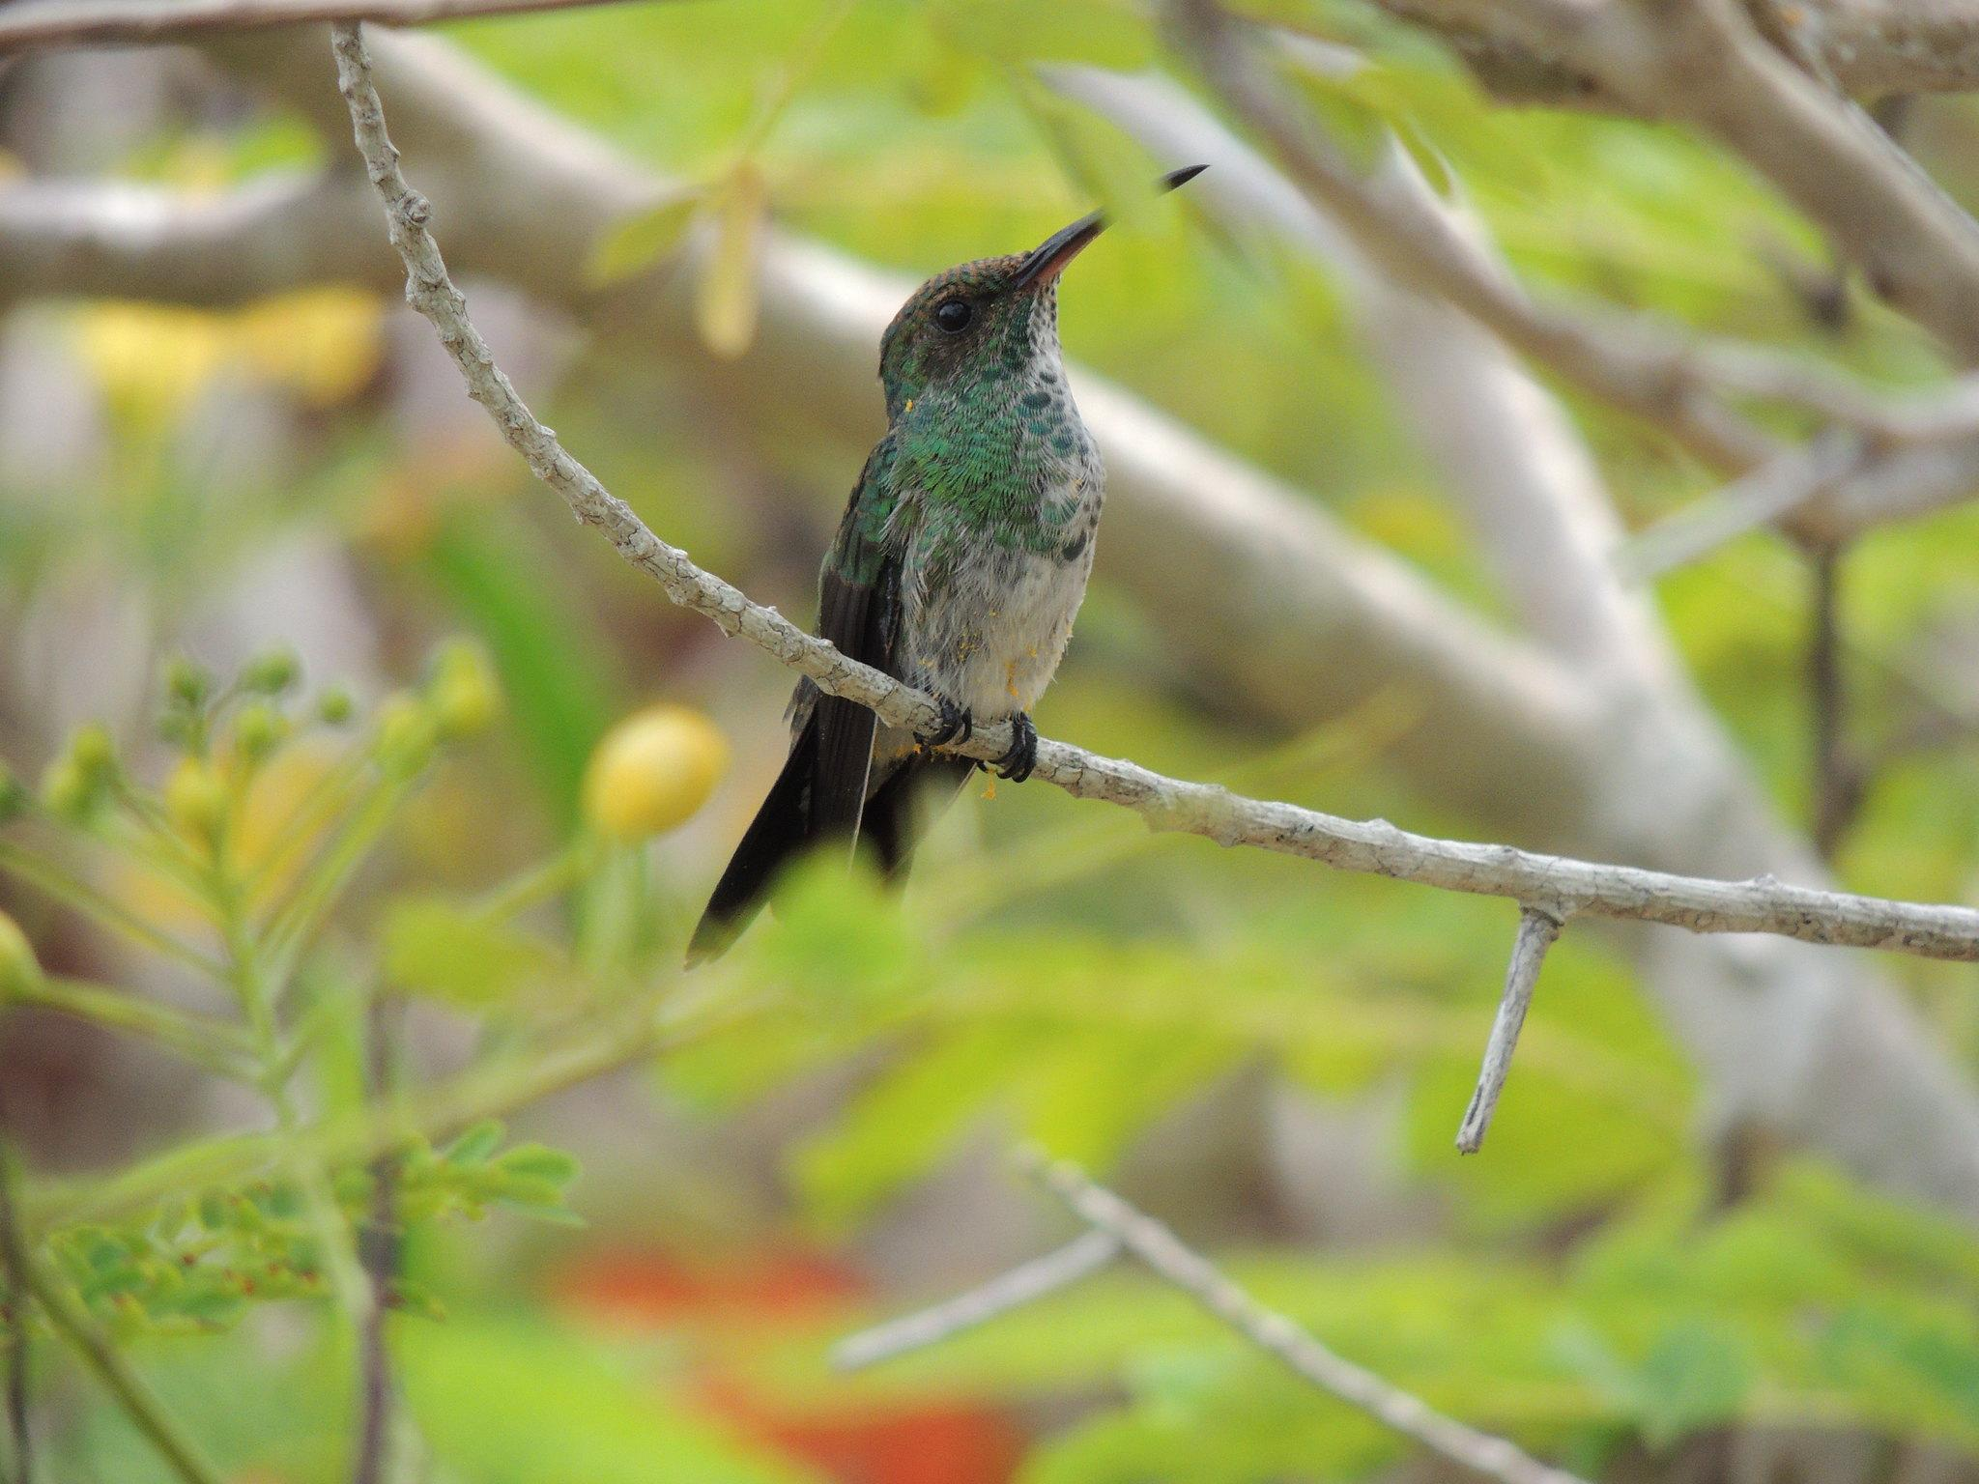
DIVERSITY 1/4
West Indies Jazmine (Gn. Ixora) and a butterfly, the Orange-barred Sulphur (Fam. Pieridae)
Colombia's flag inside a fingers´ heart
We all came from different countries, that is our most valuable treasure: different points of view, different cultures, different angles to seek for a solution to a problem.
My country is Colombia, a Megadiverse country.
Shining-green Hummingbird, endemic of Colombia´s North Coast. A Cartagena´s street. Pictures by Juan Felipe Restrepo
Notes:
Juan

Slide 7
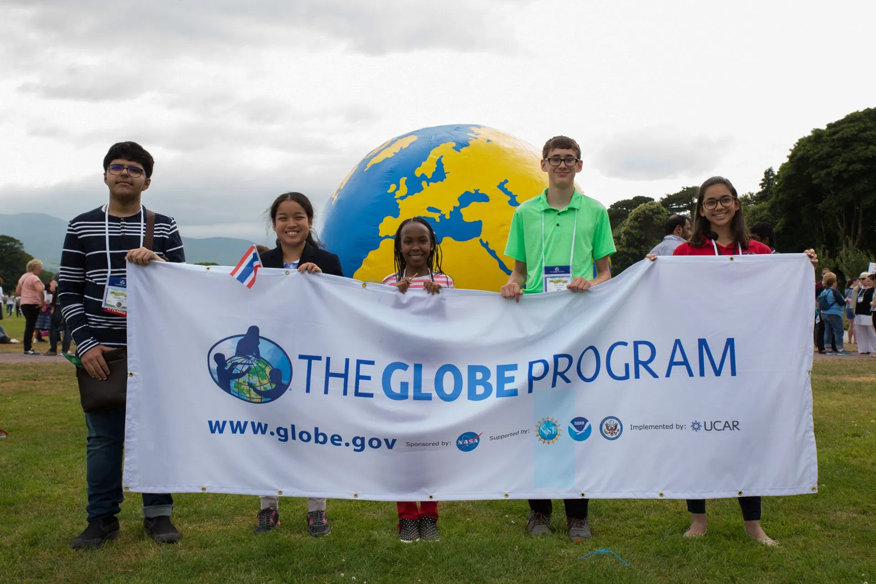
DIVERSITY 2/4
Diversity is the collective mixture of visible and invisible differences and similarities that enhance the societal relevance and impact of GLOBE and includes the full spectrum of personal attributes, cultural affiliations, and socioeconomic (or professional) statuses that characterize individuals within society.
To achieve diversity, understanding, respect, and appreciation of the interdependence of humanity, cultures, and the natural environment is required.
Students of different nationalities holding GLOBE’s banner
Notes:
Juan

Slide 8
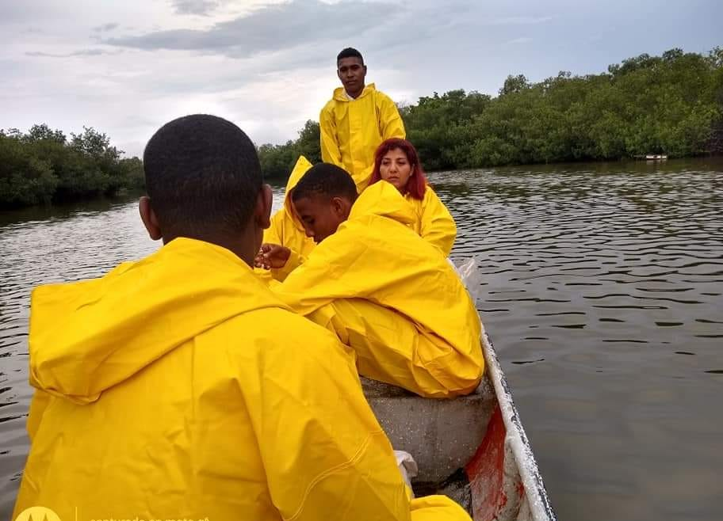
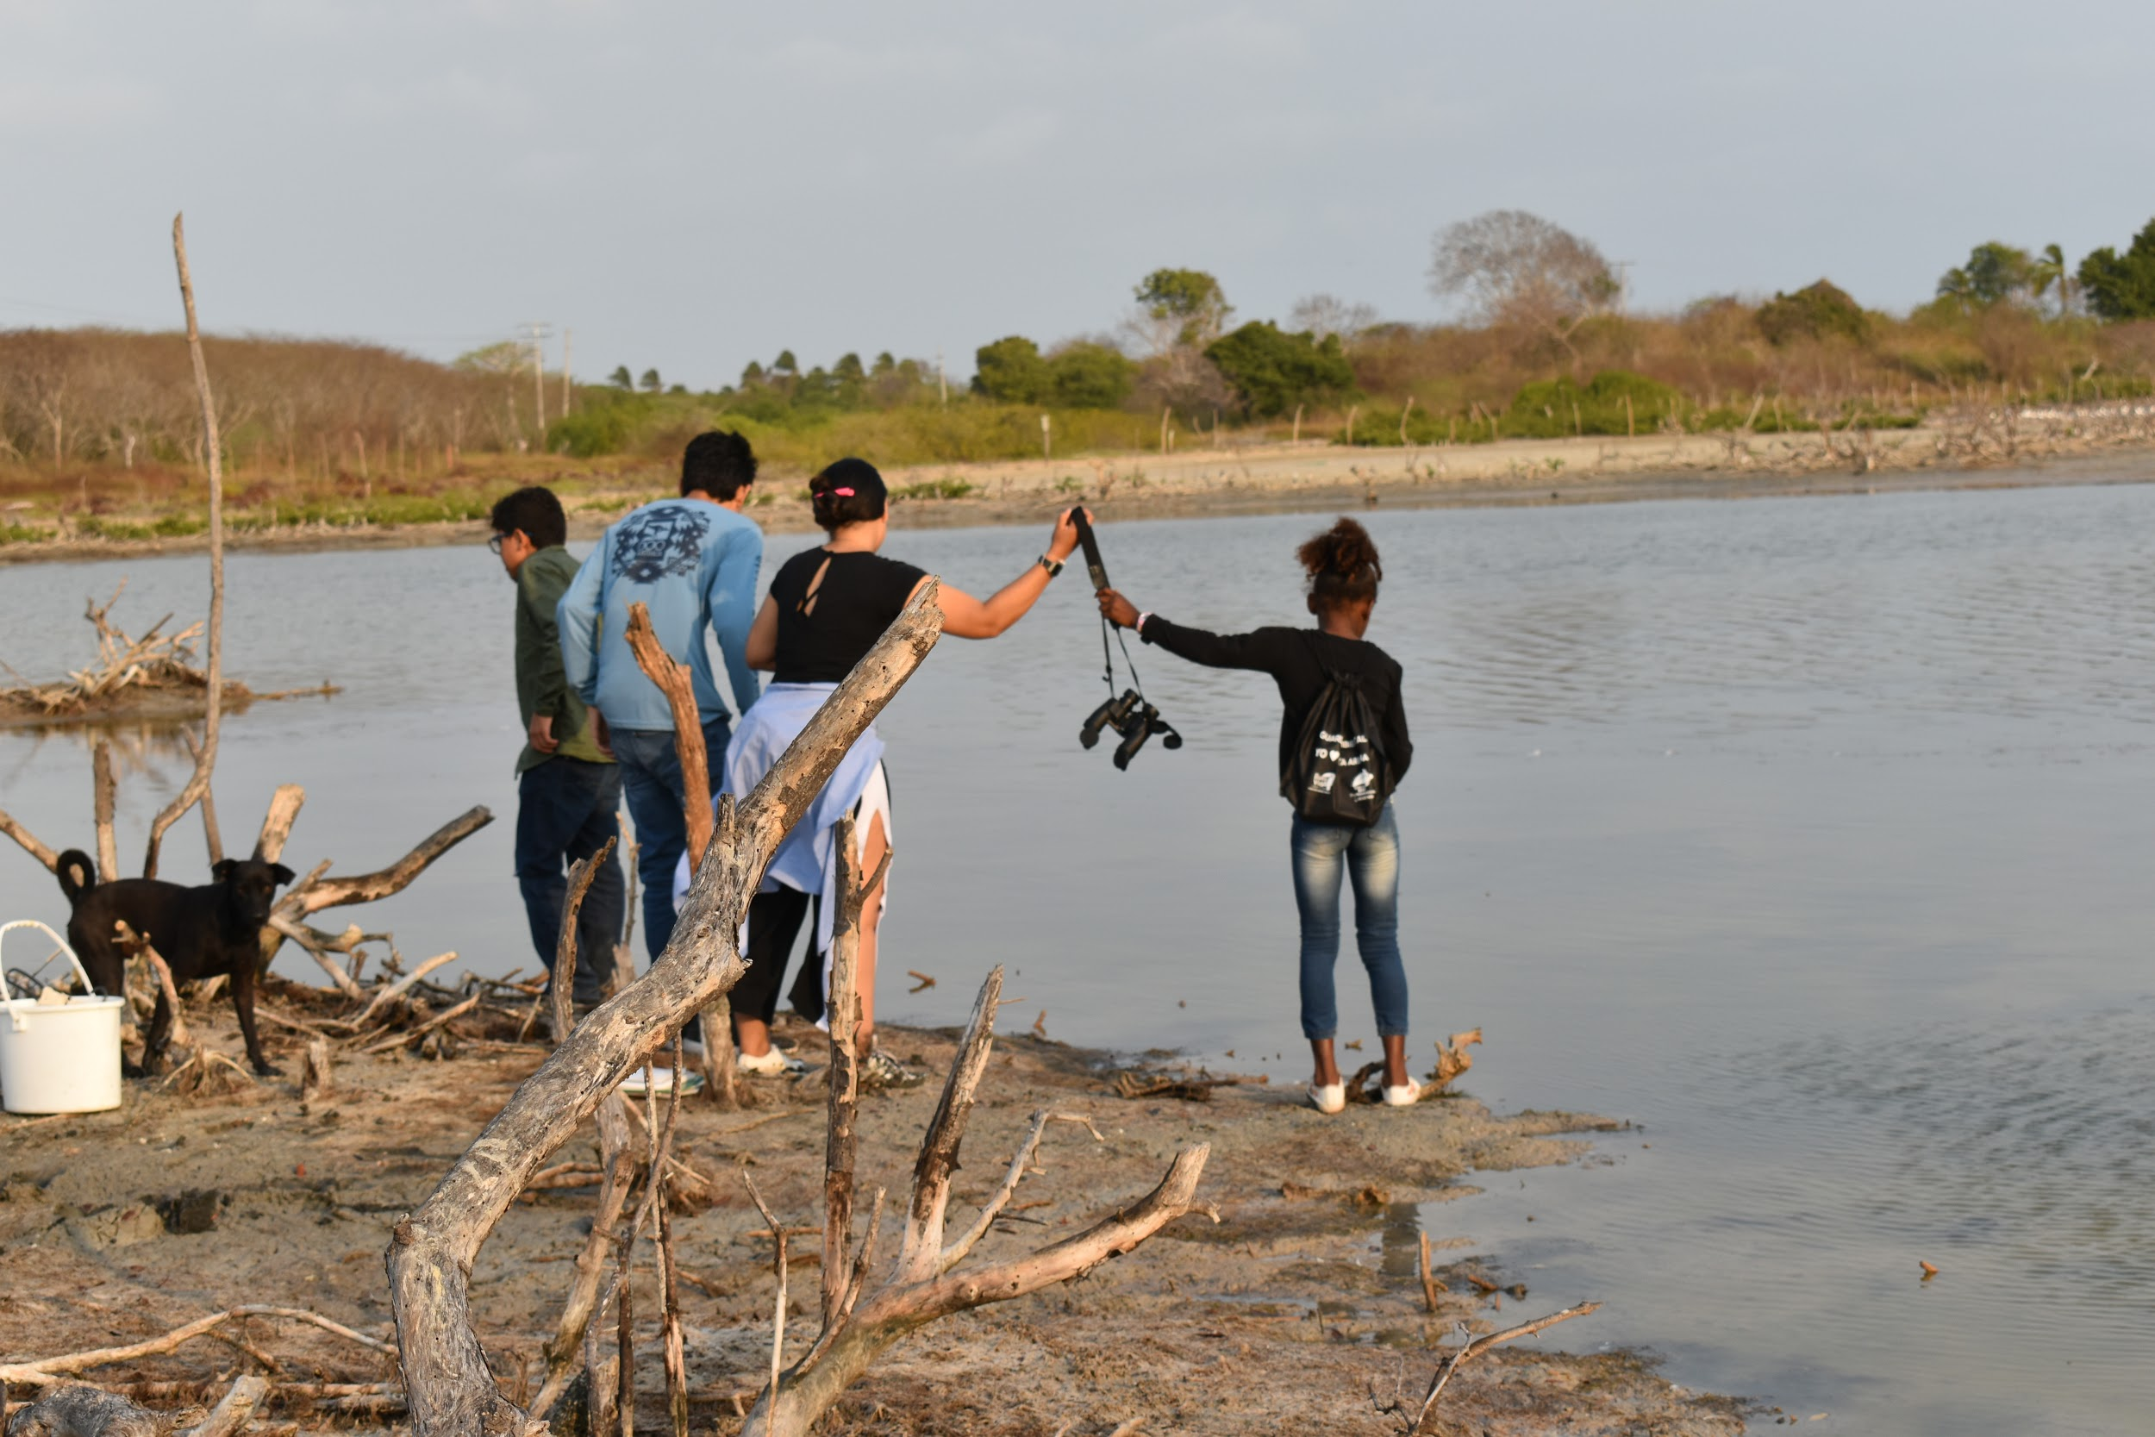
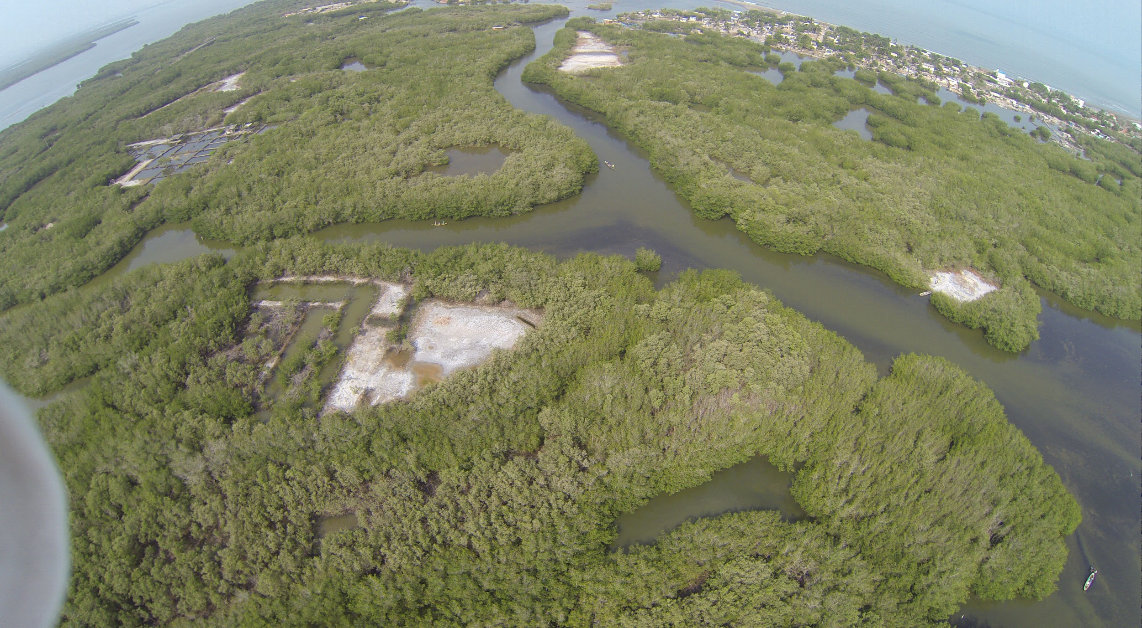
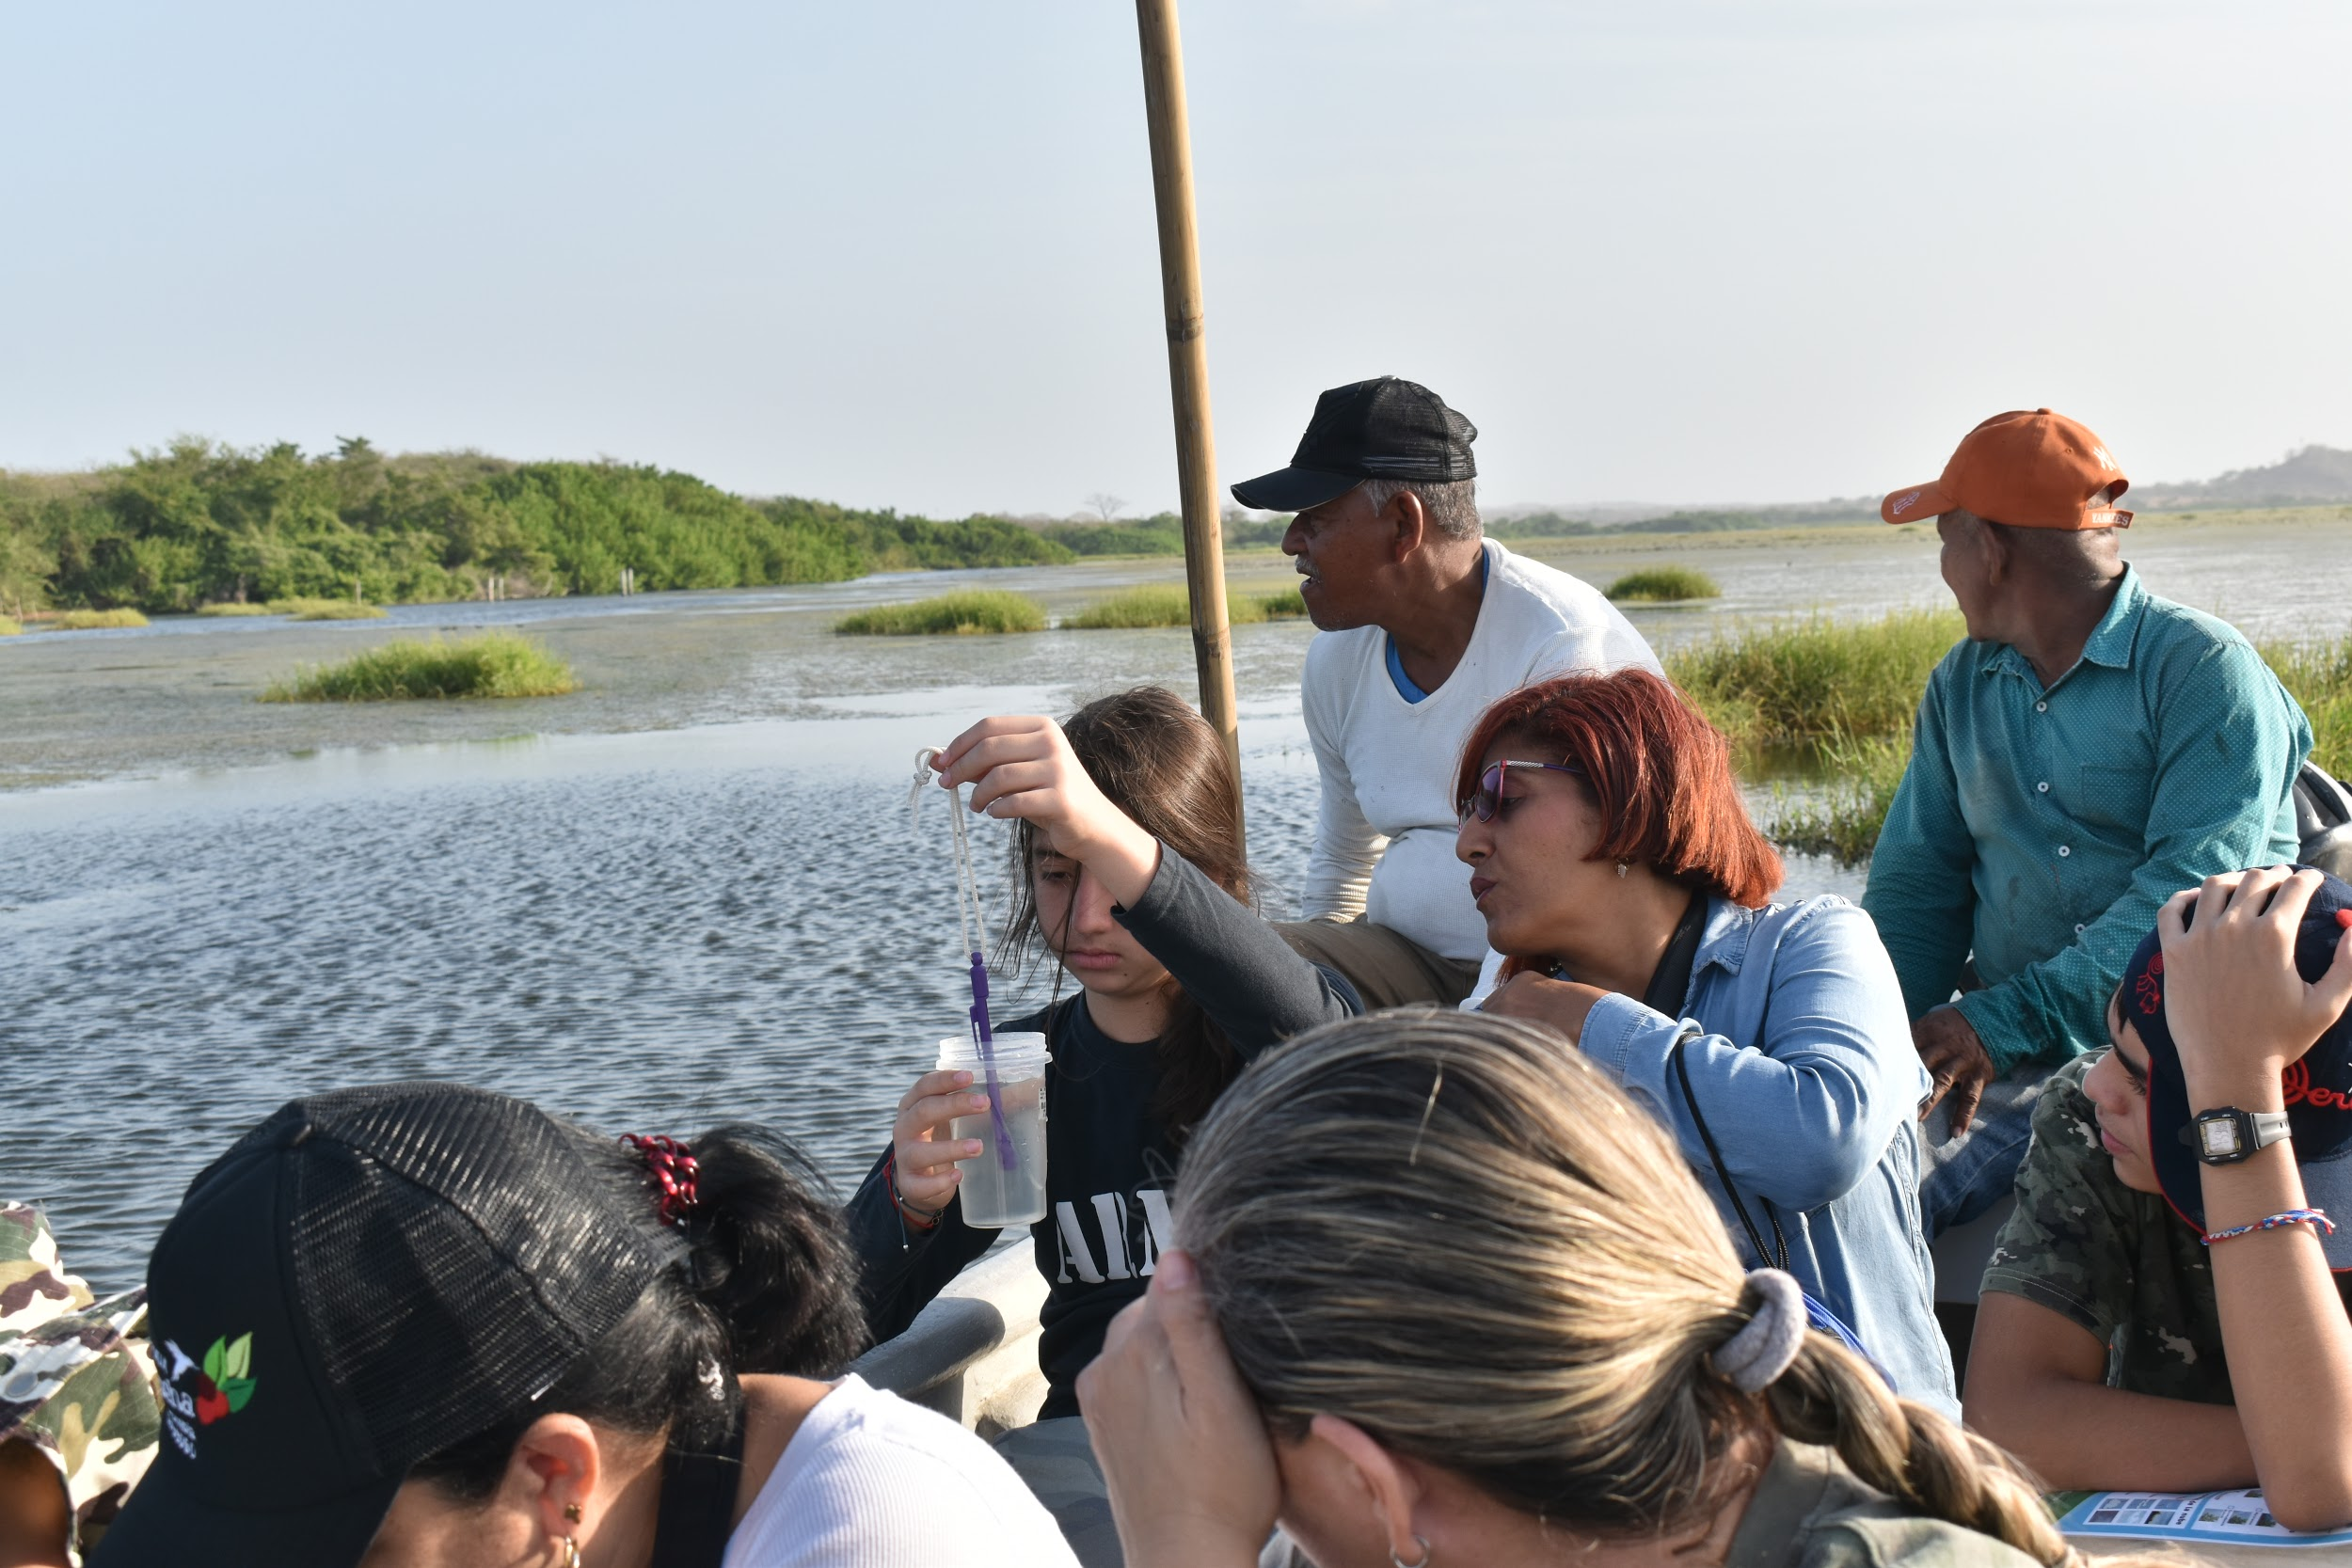
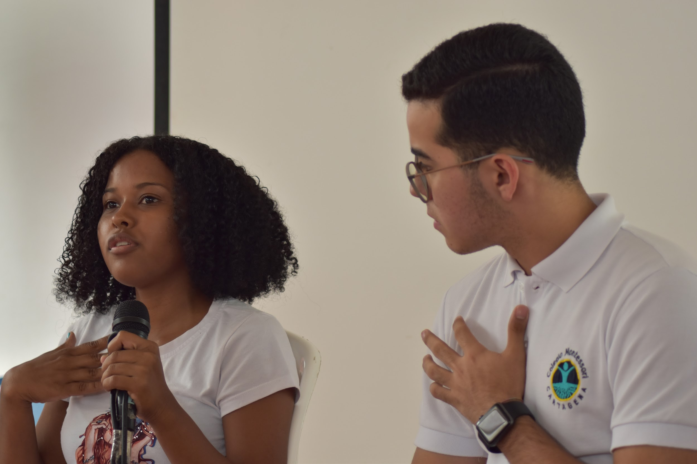
DIVERSITY 3/4
Kids discussing their points of view. Kids taking measurements. Pictures by Juan Felipe Restrepo
The Collective Mixture of Visible and Invisible differences and similarities, that enhance the societal relevance and impact of GLOBE.
La Virgen Wetland, Drone Picture by Ecoprogreso
A broken place...
Different points of view to fix it, and GLOBE as the unifying Citizen Science community where we can all be safe.
Notes:
Juan

Slide 9
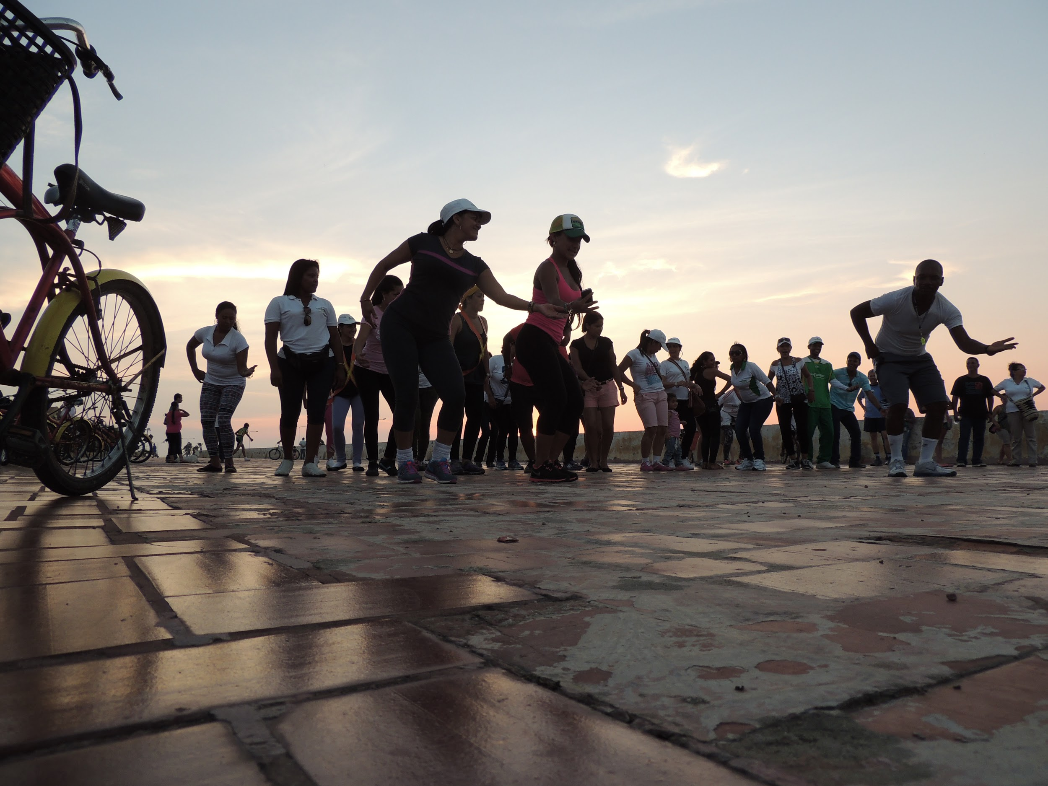
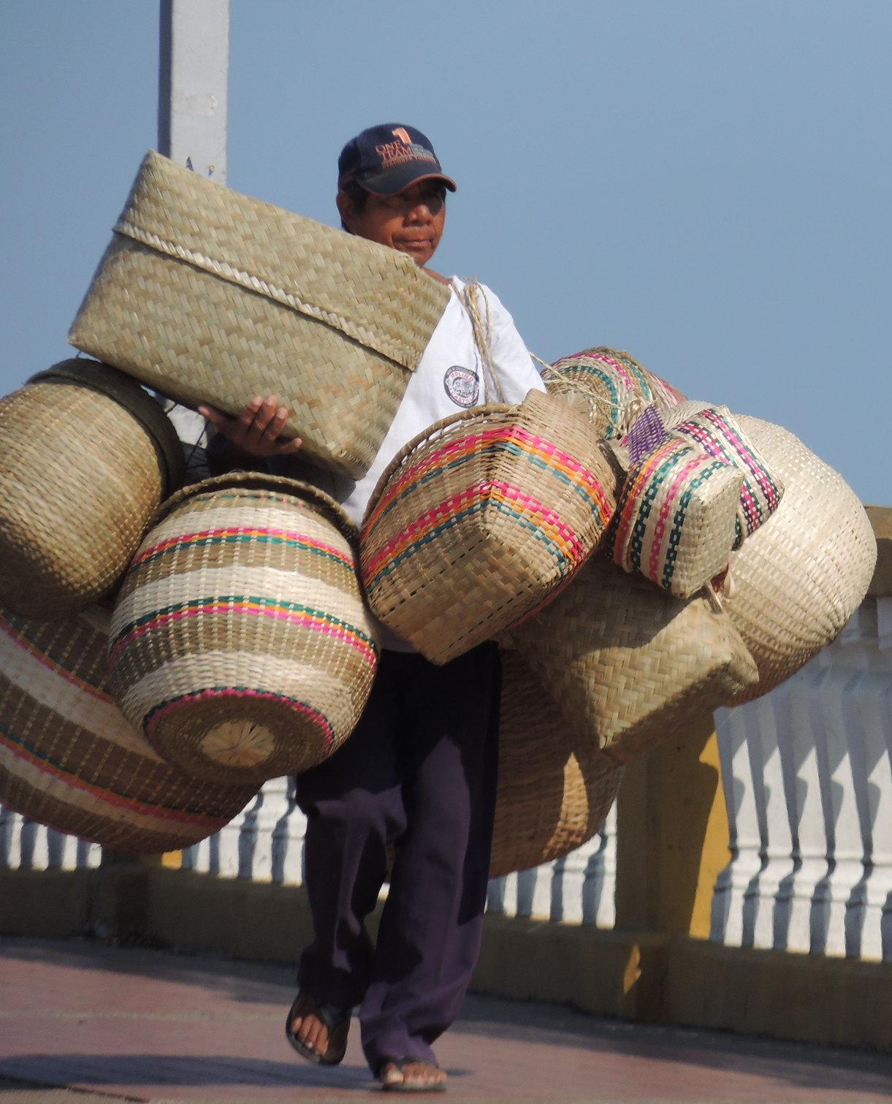
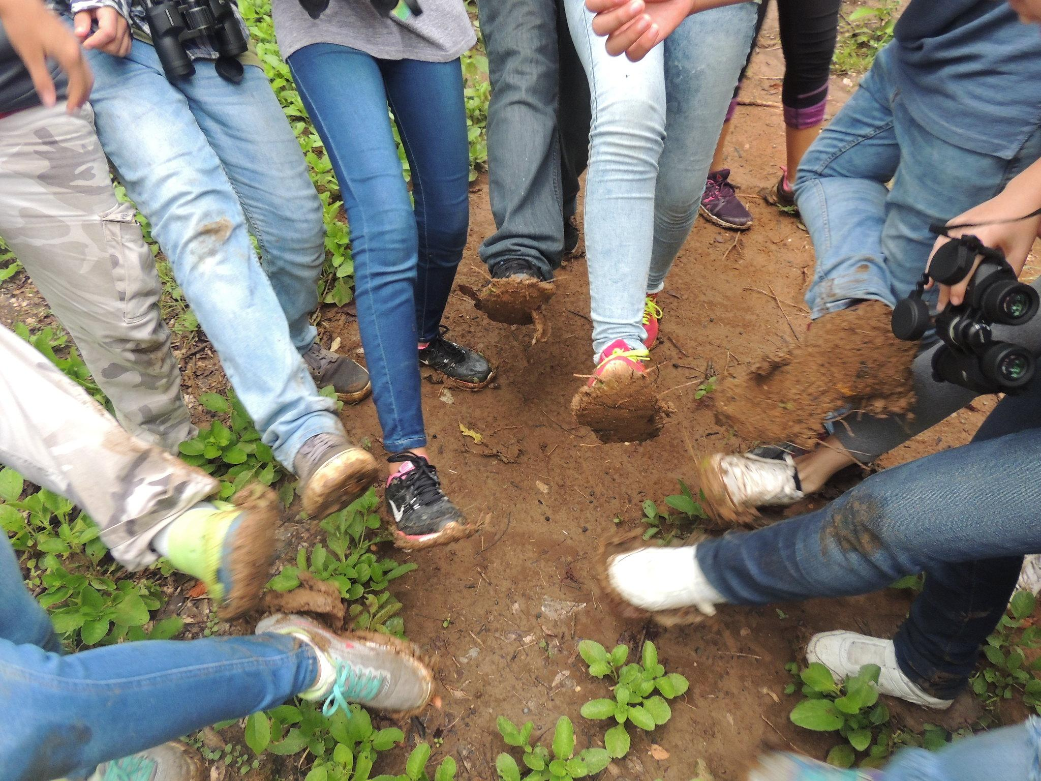
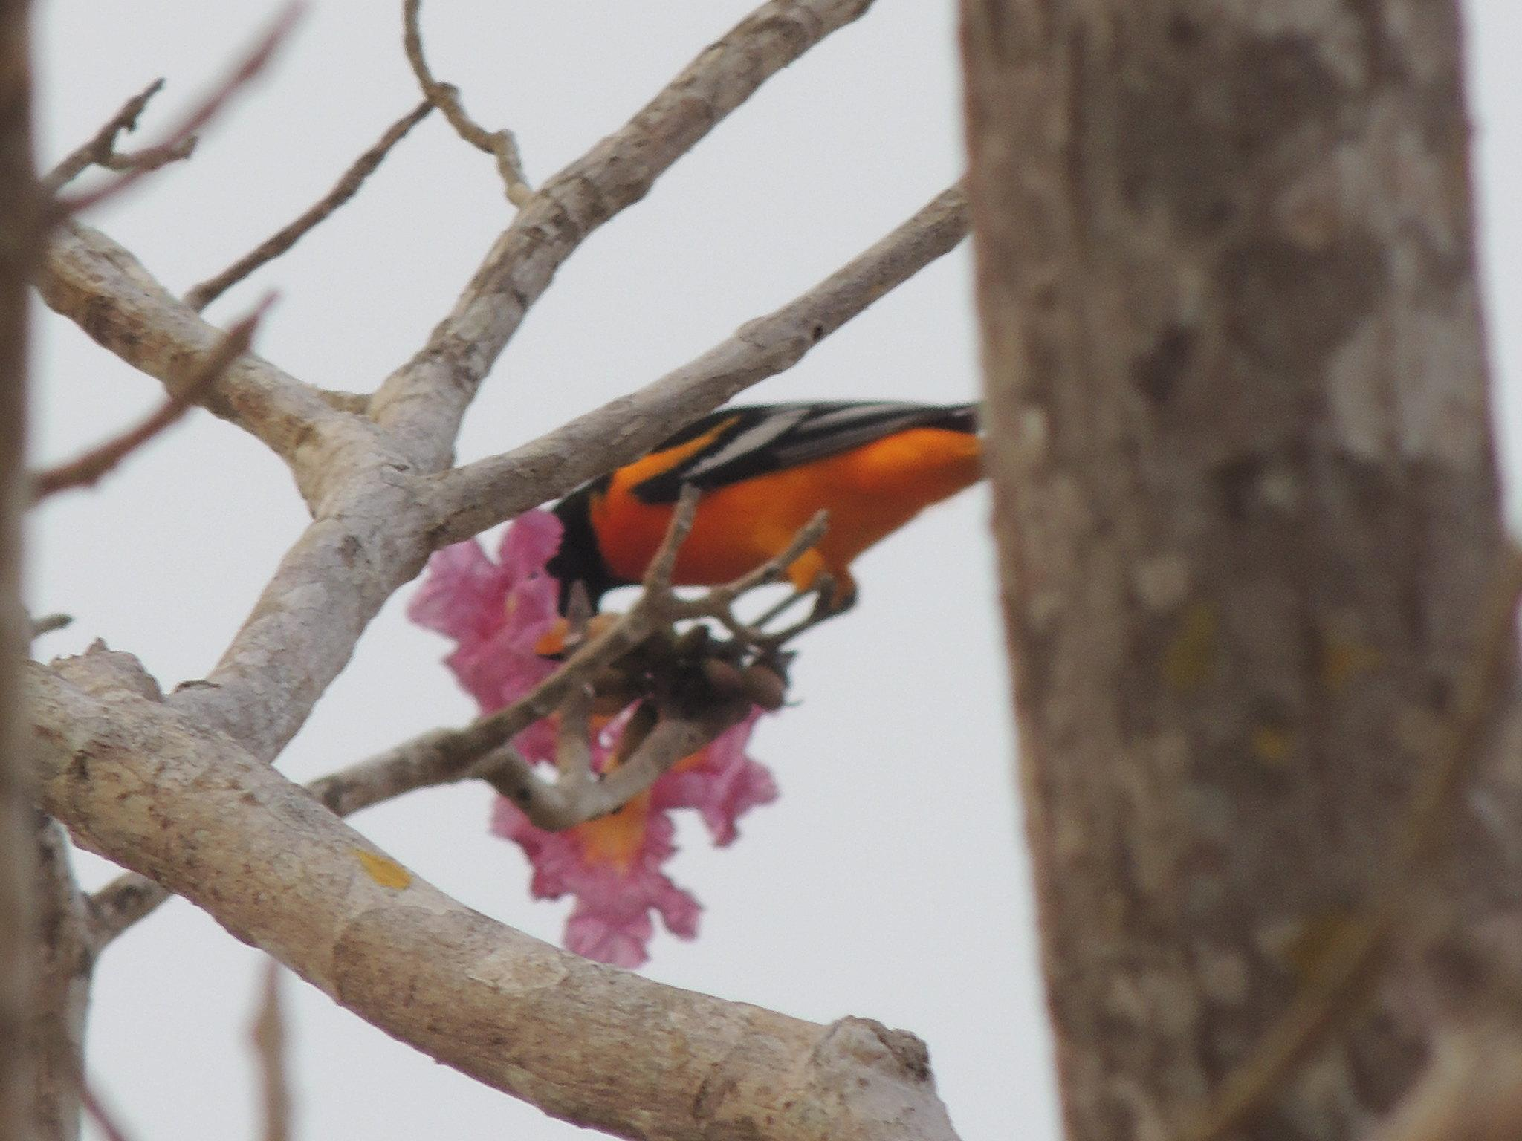
DIVERSITY 4/4
Understanding, respect, and appreciation of the interdependence of humanity, cultures, and the natural environment is required.
Cumbia dance
Artisan basketry
Muddy feet after a field trip
A Baltimore´s Oriole forging on a Pink Poui Flower
Notes:
Juan

Slide 10
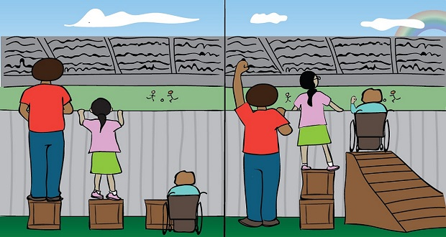
EQUITY
Equity is fair treatment, access, opportunity, and advancement for all people, with just inclusion in which all can participate, prosper, benefit, and reach their full potential.
This means striving to identify and eliminate barriers that have prevented the full participation of some groups.
Notes:
Kimberly

Slide 11
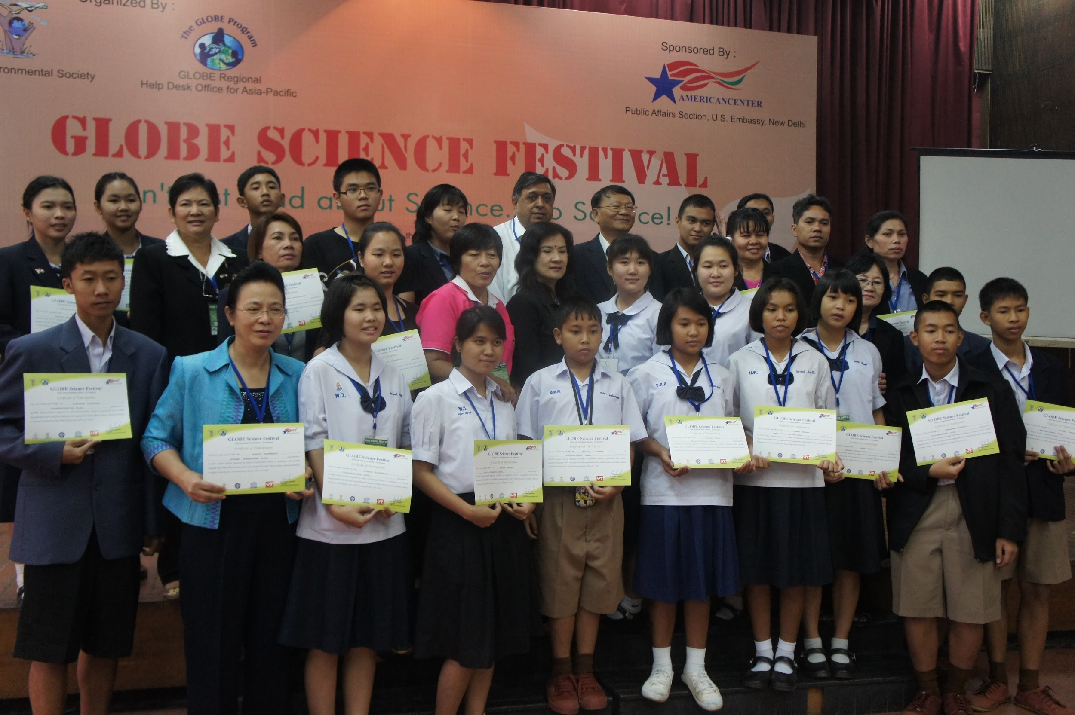
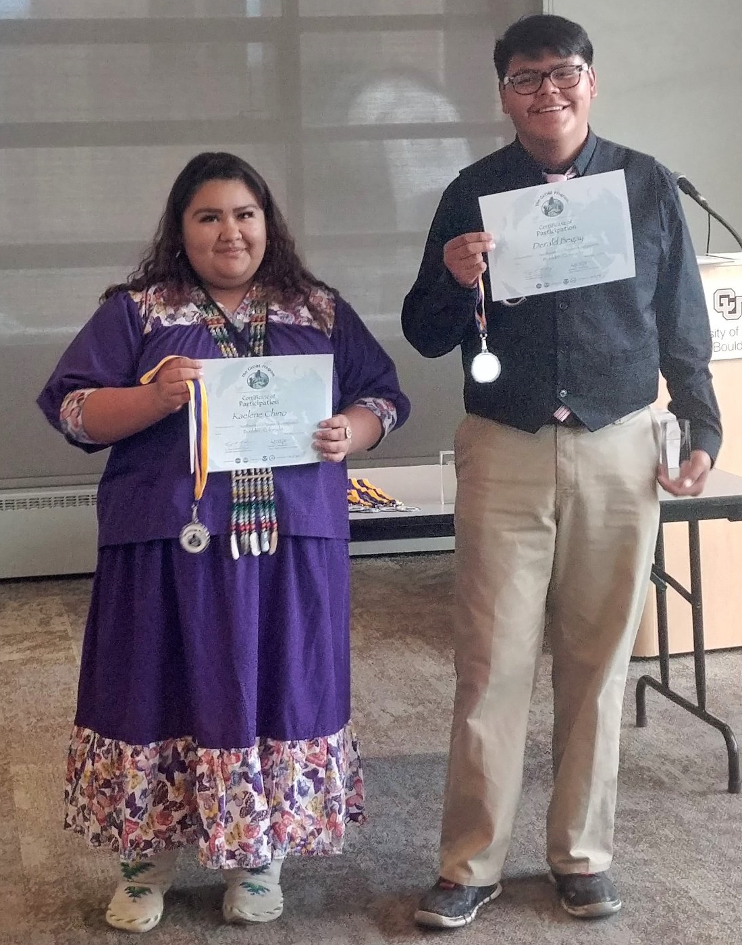
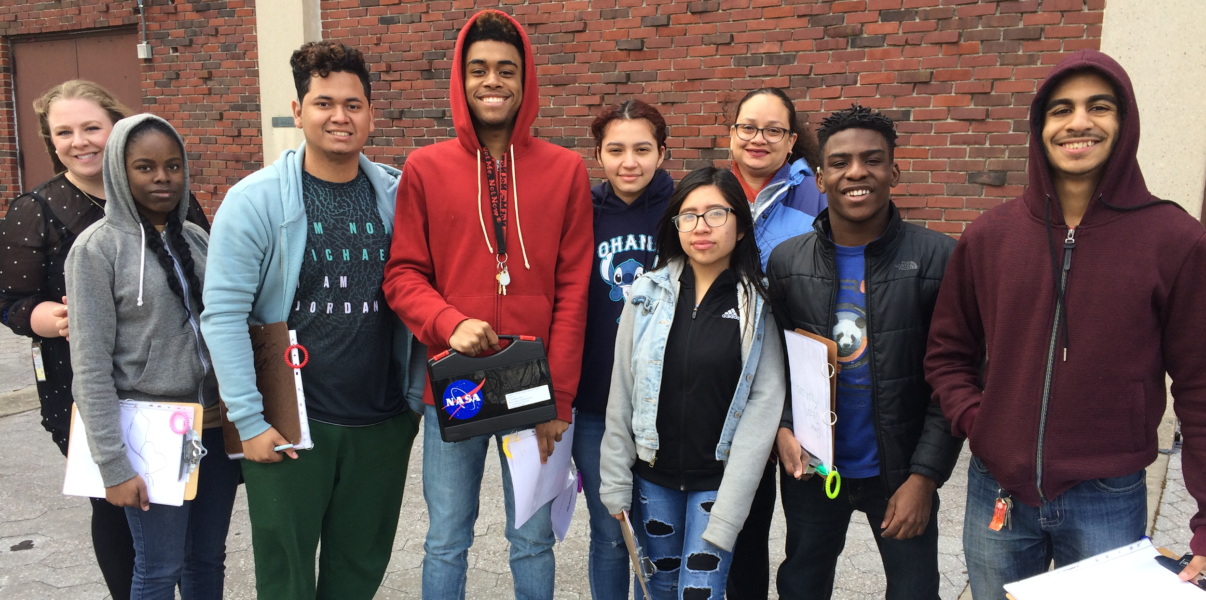
INCLUSION 1/3
Ensuring respect of the individual identities and contributions of participants engaged in executing GLOBE’s vision, mission, and strategic priorities. Ensuring that GLOBE is a safe, welcoming, and supportive environment for all. This requires cultivating a culture of involvement, and empowerment, and promoting and sustaining a sense of belonging.
Notes:
Rosalba

Slide 12
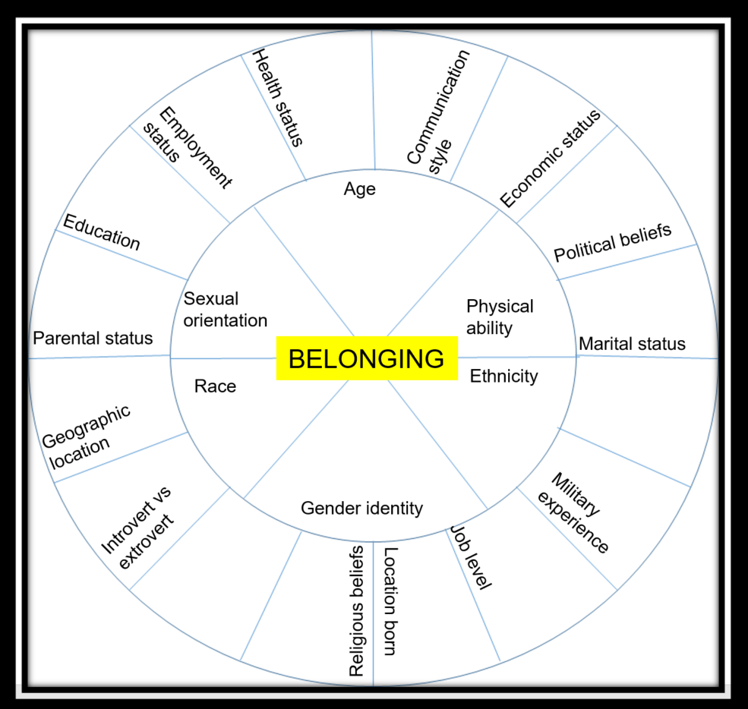
INCLUSION 2/3
Welcoming
Respect
Safe
BELONGING
Notes:
Rosalba

Slide 13
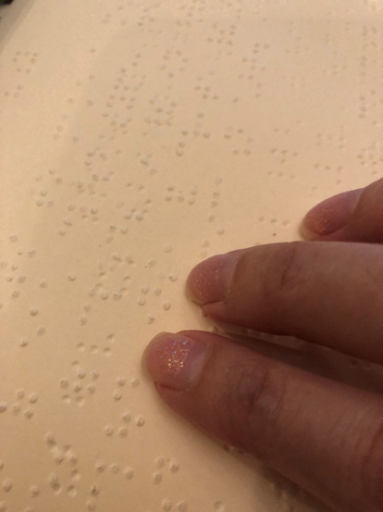
INCLUSION 3/3
Increasing accessibility
Guidelines when creating content (Unique Slide Titles, Alternative Text, Color Contrast, Reading Order)
Description
Captioning
Notes:
Rosalba

Slide 14
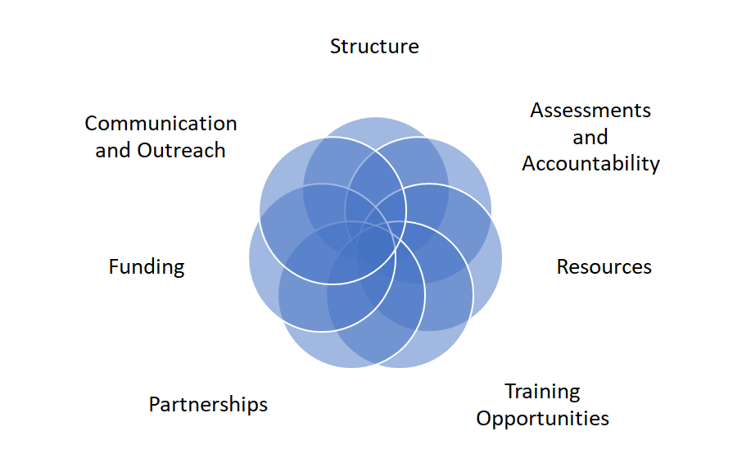
ACTION PLAN: GLOBE Action Areas 1/9
DEI
Notes:
Trena Ferrell and I will be covering this section. I am Elena Sparrow from the University of Alaska Fairbanks. So what actions can we in GLOBE can take? Here are the areas for taking action. We would like to infuse DEI into all of the GLOBE ecosystem. All these areas are connected and overlapping and action can be started anywhere. In this presentation we will start with the structure .

Slide 15
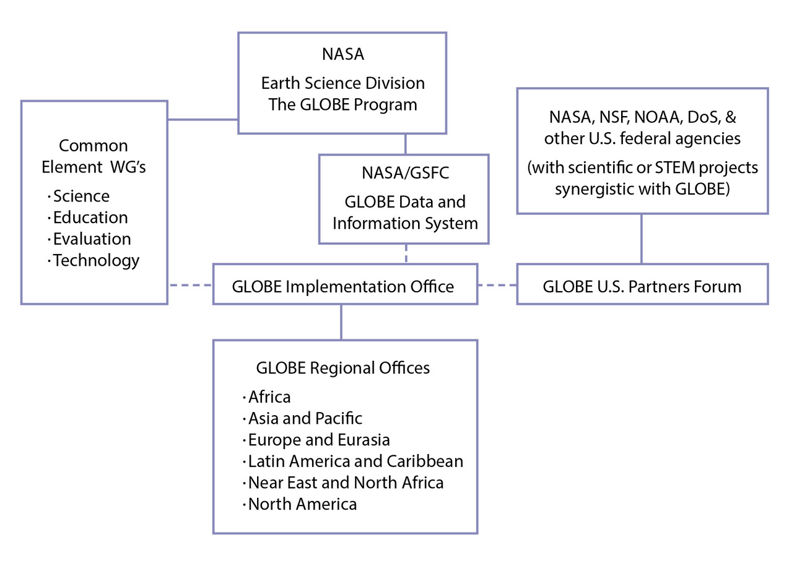
ACTION PLAN: Create DEI Working Group 2/9
Further and shepherd the implementation of the initial Action Plan
Several spaces in the Working Group filled by Task Force members for greater continuity
Notes:
To have long term change around Diversity, Equity and Inclusion, a Working Group focused on DEI needs to be created. This group would further and shepherd the implementation of the initial Action Plan written below. The Task Force recommends that several spaces in the initial Working Group be filled by Task Force members to allow greater continuity between the work the DEI Task Force has started and the work the Working Group will continue to do. Unlike other Working Groups, DEI needs to be infused in the whole GLOBE ecosystem.

Slide 16
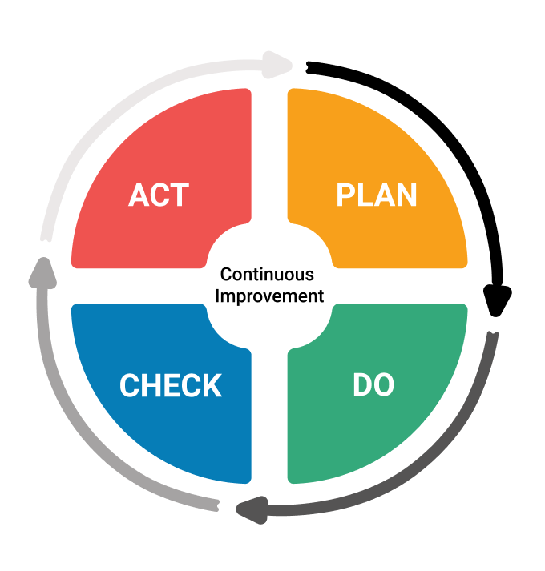
ACTION PLAN: Administer DEI Assessments 3/9
Establish a baseline for who is/is not currently being served
Promote accountability
Monitor progress in DEI activities within GLOBE
Assessing impact over time, with continual consideration of what adjustments are needed
Notes:
Start with a constituency-based community needs and resources assessment for DEI. This will help establish a baseline for who is/is not currently being served within the GLOBE community.
Promote accountability by monitoring progress in DEI activities within GLOBE and assessing their impact over time, with continual consideration of what adjustments are needed.
Plan - plan what you are doing
Do - do what you said you would
Check - check and receive feedback (external and internal) on what you did
Act - act accordingly to the check, make changes as needed, and repeat cycle

Slide 17
ACTION PLAN: Develop DEI based Resources 4/9
Create a Searchable Library of resources and Best Practices for Diversity, Equity and Inclusion
Improve accessibility of GLOBE Materials and Online Resources
GLOBE Instruments
More virtual participation
Notes:
Create a Searchable Library of resources and Best Practices for Diversity, Equity and Inclusion.
The Library would include resources for face-to-face or virtual GLOBE educational materials which reflect DEI principles, as well as a DEI taxonomy.
Improve accessibility of GLOBE Materials and Online Resources:
Caption and describe GLOBE videos
Develop a guidebook for how teachers can pursue grants to support GLOBE based on success stories within the community (make sure that regional examples are included).
Alumni network - invite them to fill in personnel gaps, provide role models, provide continuity of what you can do after GLOBE.
Make recommendations to ensure GLOBE’s website is accessible and it remains accessible each time it is updated, following Web Content Accessibility Guidelines (WCAG).
Continue to expand opportunities for virtual participation in things like training, collaborative projects, IVSS, etc. which can serve those who have technology but not a lot of other resources.
Consider accessibility to GLOBE Instruments:
Create shared GLOBE instrument pools that can be used by those who can’t afford to have their own.
Support the refurbishment of older GLOBE equipment that is being replaced with newer devices and re-distribute them to disadvantaged GLOBE participants.
Expand the types of instrumentation used within the program in order to capitalize on lower cost instruments. (tax incentives for some companies?)
Create regional resource officers who can help identify pertinent DEI resources for that community.
Continue to expand opportunities for virtual participation in things like training, collaborative projects, IVSS, etc. which can serve those who have technology but not a lot of other resources.

Slide 18
ACTION PLAN: Member DEI Training Opportunities 5/9
DEI Training for GLOBE Community Members
Strongly encourage DEI Training for GIO Staff, Working Group Members, US Partner Forum, and RCOs
Notes:
DEI Training for GLOBE Community Members:
Incorporate DEI into the “About GLOBE” eTraining for members of the GLOBE community.
Develop a larger pool of Mentor Trainers so we have the core expertise to expand participation; ensure that this includes diverse participants to serve as role models.
Create optional professional development/learning about DEI.
Provide training for GLOBE scientists/subject matter experts on mentorship that incorporates DEI principles.
Add Watercoolers with DEI topic Discussion
Strongly encouraged DEI Training for GIO Staff, Working Group Members, US Partner Forum, and RCOs.

Slide 19
ACTION PLAN: Form DEI Supportive Partnerships 6/9
Strategic partnerships with:
  DEI-relevant organizations (for PD, outreach)
  social scientists
  equipment suppliers
Leverage community partnerships:
  community and project-based science
  expand the participation of underrepresented populations
  mini-collaborations between established and new schools
Notes:
Pursue strategic partnerships with other organizations that can provide DEI-relevant expertise, help develop materials and/or offer professional development opportunities with DEI.
Partner with social scientists who would be interested in doing research on GLOBE DEI activities.
Create partnerships with equipment suppliers who can offer reduced cost equipment.
Leverage community partnerships:
Develop synergies with partner organizations especially with regard to citizen science projects that are located within regions.
Increase GLOBE’s relevance through expanded focus on community and project-based science that particularly supports or engages underrepresented groups or serves the GLOBE DEI priorities.
Continue to expand the participation of underrepresented populations within GLOBE, especially through increased recruitment in long-lived GLOBE schools and through reaching out to other schools serving under-represented populations.
Foster mini-collaborations between schools or teachers that link established GLOBE programs with new (and diverse) schools/teachers, that can provide some coaching and encouragement.

Slide 20
ACTION PLAN: Find Funding for DEI 7/9
Additional funding to support continued DEI efforts. Some ideas:
  Fund the DEI Working Group to continue DEI prioritization and efforts within GLOBE
  Fund the creation of a sharable research library that contains DEI materials
  Fund partnerships with faculty at minority serving institutions for DEI-related participation in GLOBE through support like stipends
Notes:
Additional funding will support continued DEI efforts. As a starting point, these are some ideas for what could be done were there additional funding towards DEI:
Fund the DEI Working Group to continue DEI prioritization and efforts within GLOBE.
Fund the creation of a sharable research library that contains DEI materials.
Support DEI-related participation in GLOBE through support like stipends to partner with faculty at minority-serving institutions.
Create a DEI GLOBE-named award and provide funding for it at these major science competitions. This would help promote branding and recognition for GLOBE science.
Promote the engagement of diverse scientists who routinely use GLOBE-generated data through the creation of mini-grant programs, with the requirement that the scientists follow the GLOBE DEI criteria as part of their efforts.
Identify some new DEI initiatives that go beyond GLOBE as usual operations that would be conducted on an on-going basis, but which specifically focus on diverse audiences (e.g., a recruitment campaign).

Slide 21
ACTION PLAN: Communicate DEI Initiatives 8/9
Increase branding, marketing, and outreach
Add DEI Section in monthly GIO News Briefs and highlight DEI opportunities
Create a media channel, web page and hashtag
Notes:
Increase the visibility of GLOBE among new audiences through expanded GLOBE branding, marketing, and outreach.
Create DEI marketing materials for GLOBE to raise the prominence of DEI as a priority.
Add DEI Section in monthly GIO Newsbriefs and highlight DEI opportunities.
Create a media channel, web page and hashtag that highlights inspiring stories about who is doing GLOBE, showcasing the diverse community to highlight DEI themes/projects.

Slide 22
ACTION PLAN: Summary of Action Areas 9/9
Notes:
Summary of Areas in the GLOBE Ecosystem targeted for DEI Action: How do we instill DEI consciousness in the different components of the GLOBE Ecosystem - Structure , Assessments & Accountability, Resources, GLOBE Members-Training Opportunities, Partnerships, Funding, Communication and Outreach and int each one of us in the GLOBE Family?
All areas are interconnected and instilled with DEI.

Slide 23
Q & A
You may access the website version of our Mobile Application using the following link: https://crowd.cc/2020virtualmeeting
Or use this quick link for getting to the CrowdCompass AttendeeHub app in the app store on a mobile or tablet device: https://crowd.cc/s/3RKlm
To access Q&A or Polling: In the app, click on the "My Schedule" icon. Then click on the session currently taking place. Q&A is located towards the top of each session and you will find the polls (if available) by scrolling to the bottom of the session.
Notes:
Julie and Katie facilitate - Task Force Answers

Slide 24
Feedback
You may continue to submit questions and comments through the Q&A for the next 30 minutes following this session.
All meeting participants will be receiving a survey following the Virtual Meeting and it will include a section for questions and comments about the DEI Presentation.
A survey for the whole GLOBE community on the DEI statements and plan will be going out soon!
Notes:
Katie

Slide 25
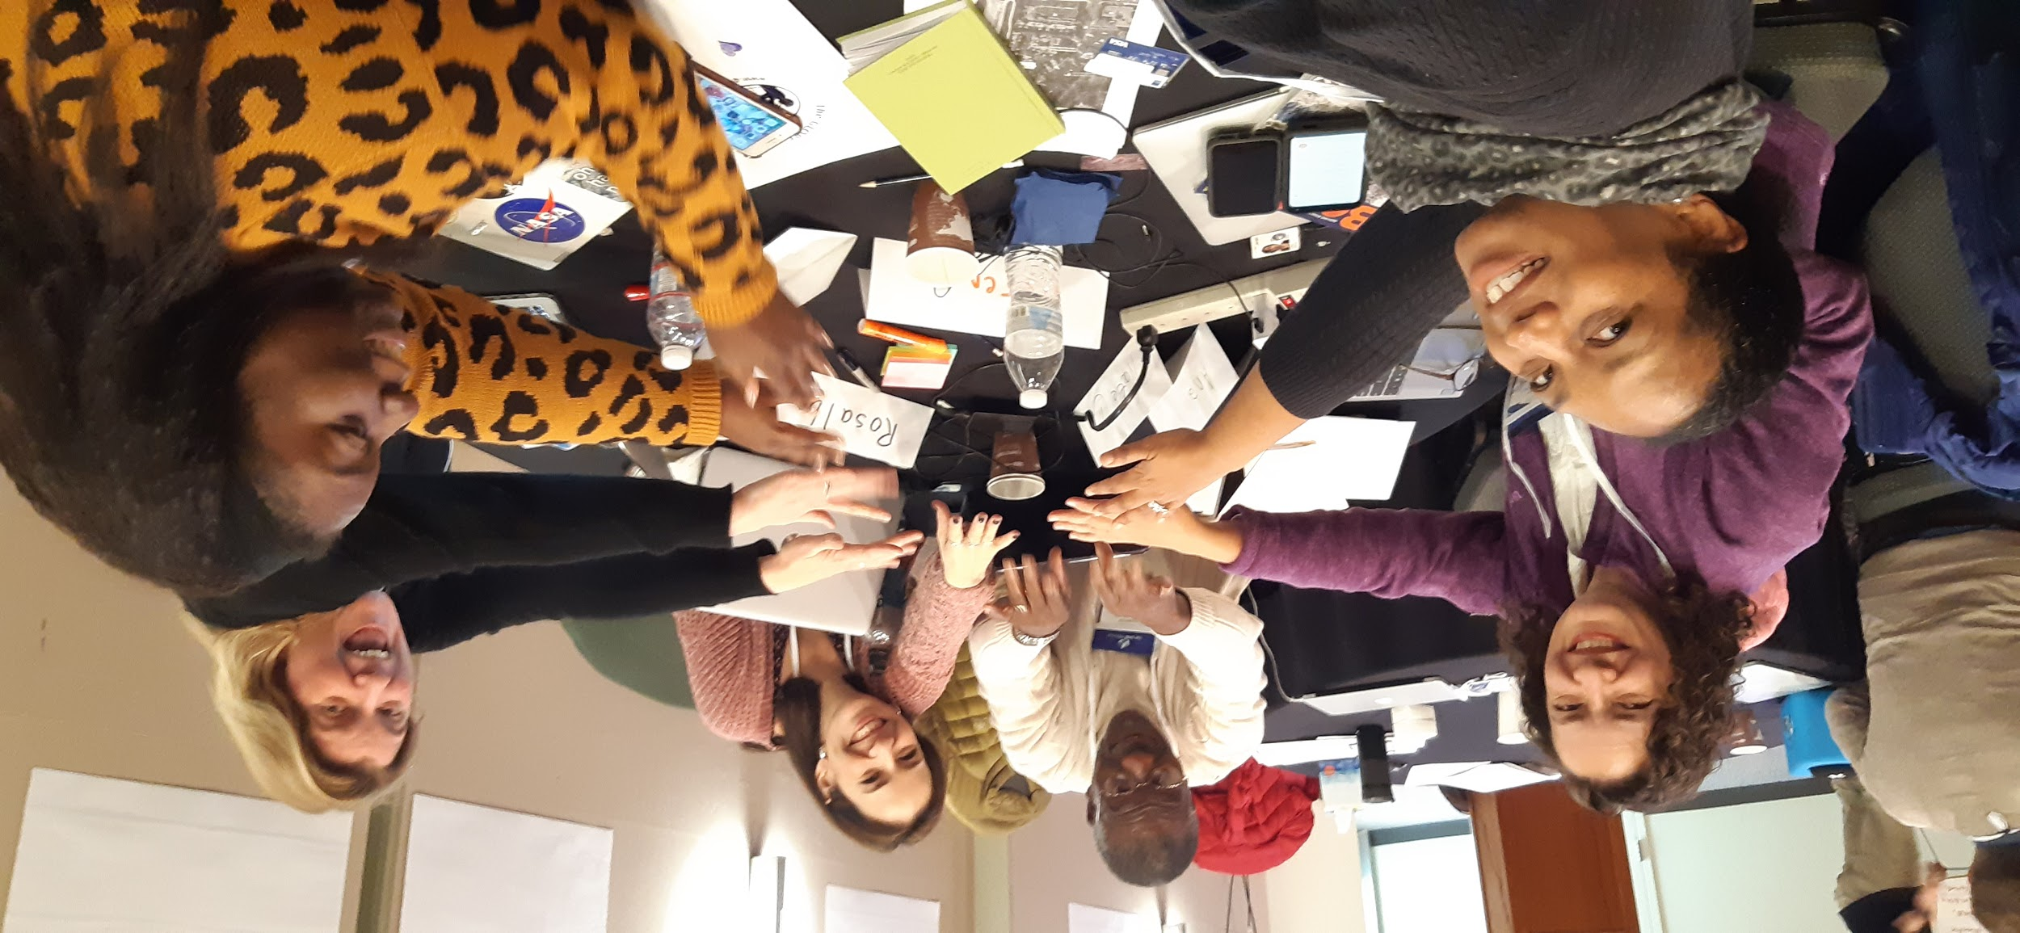
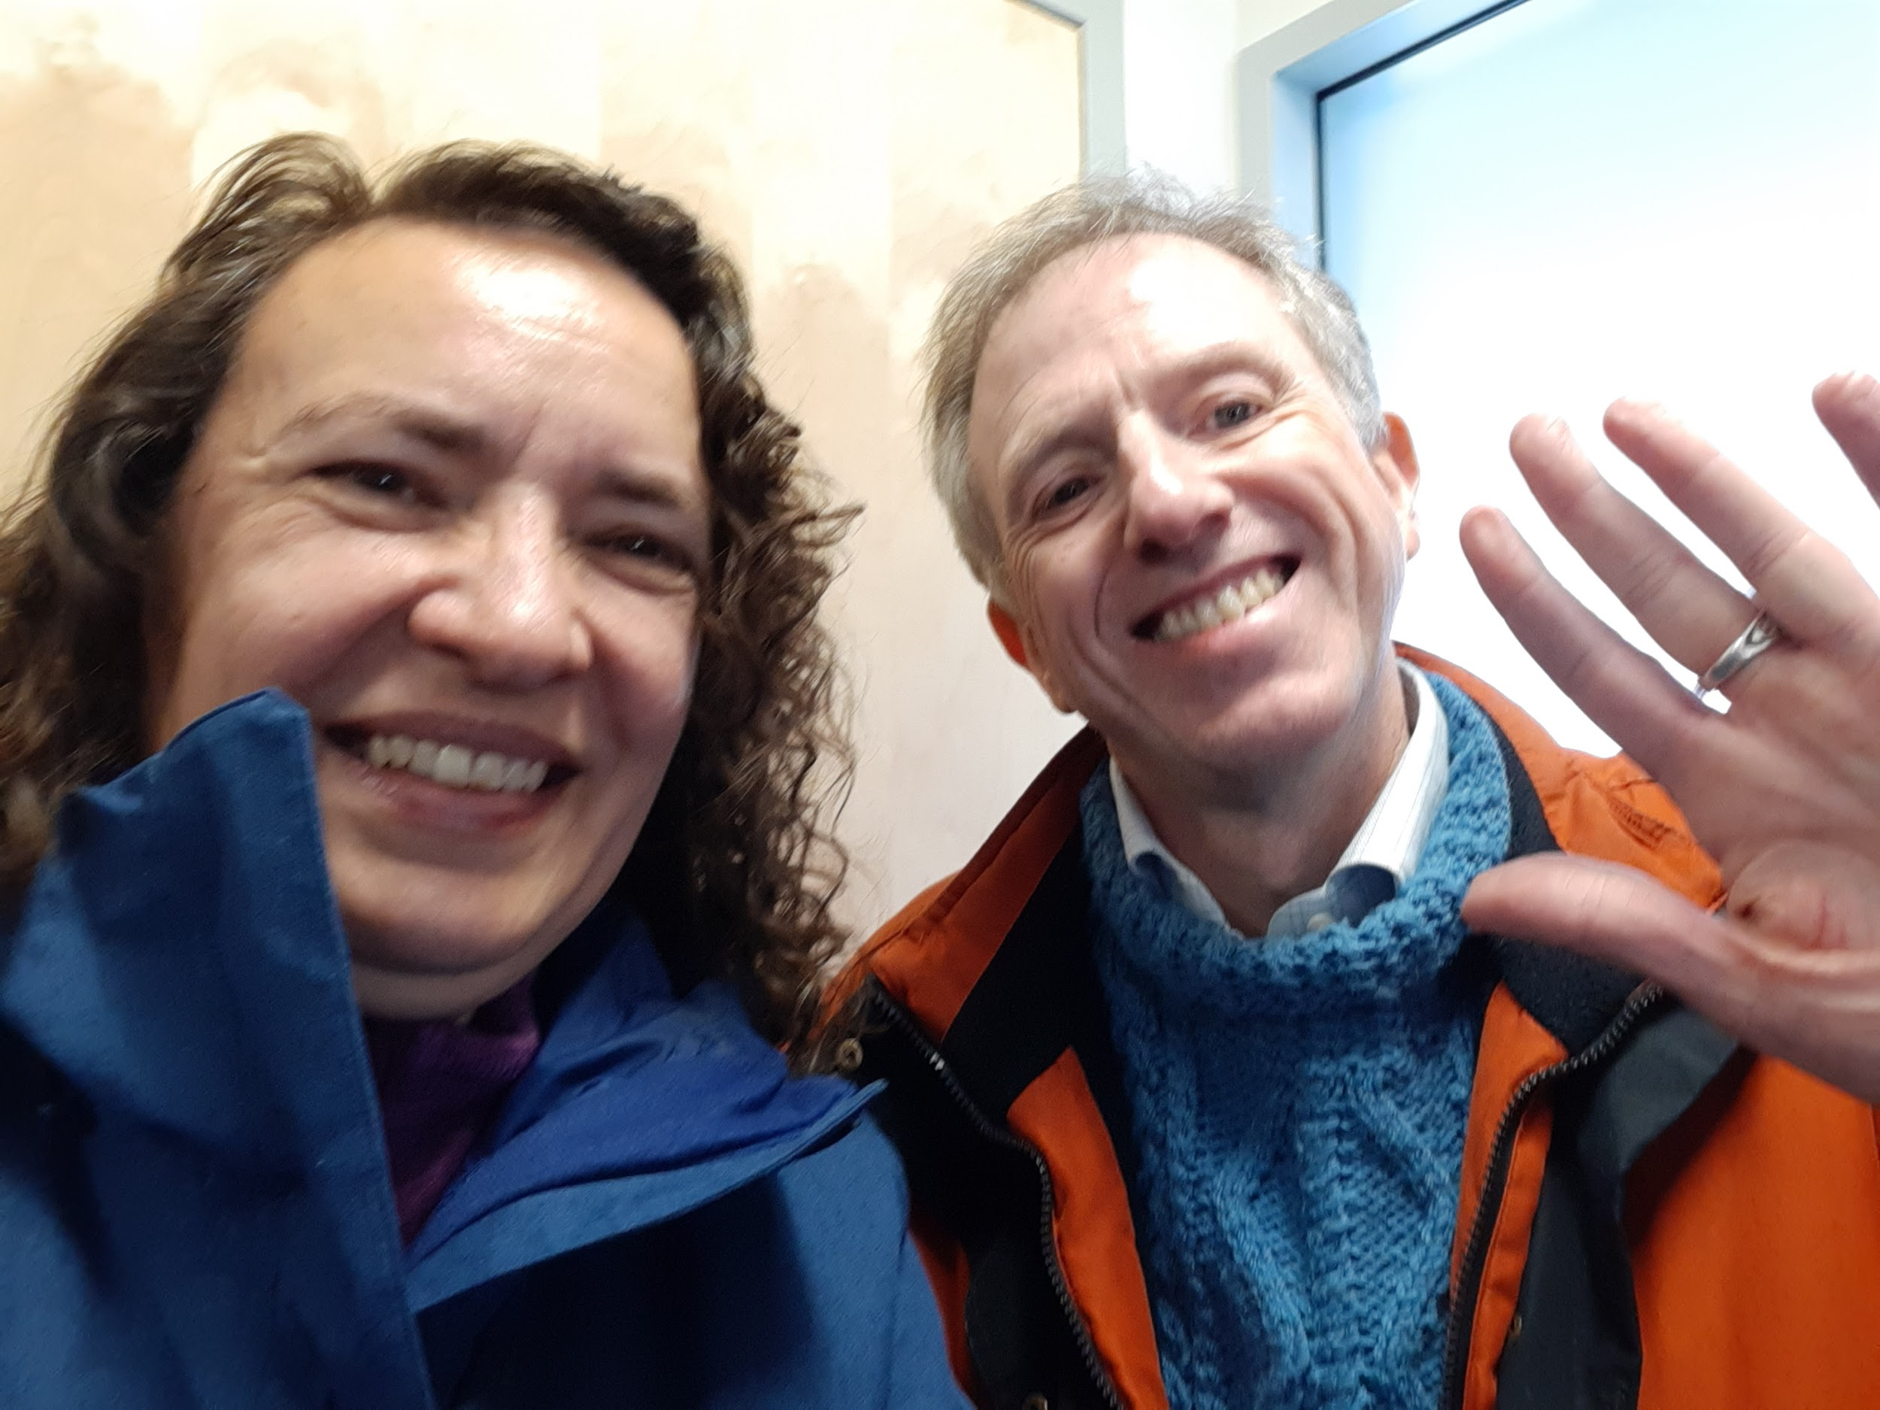
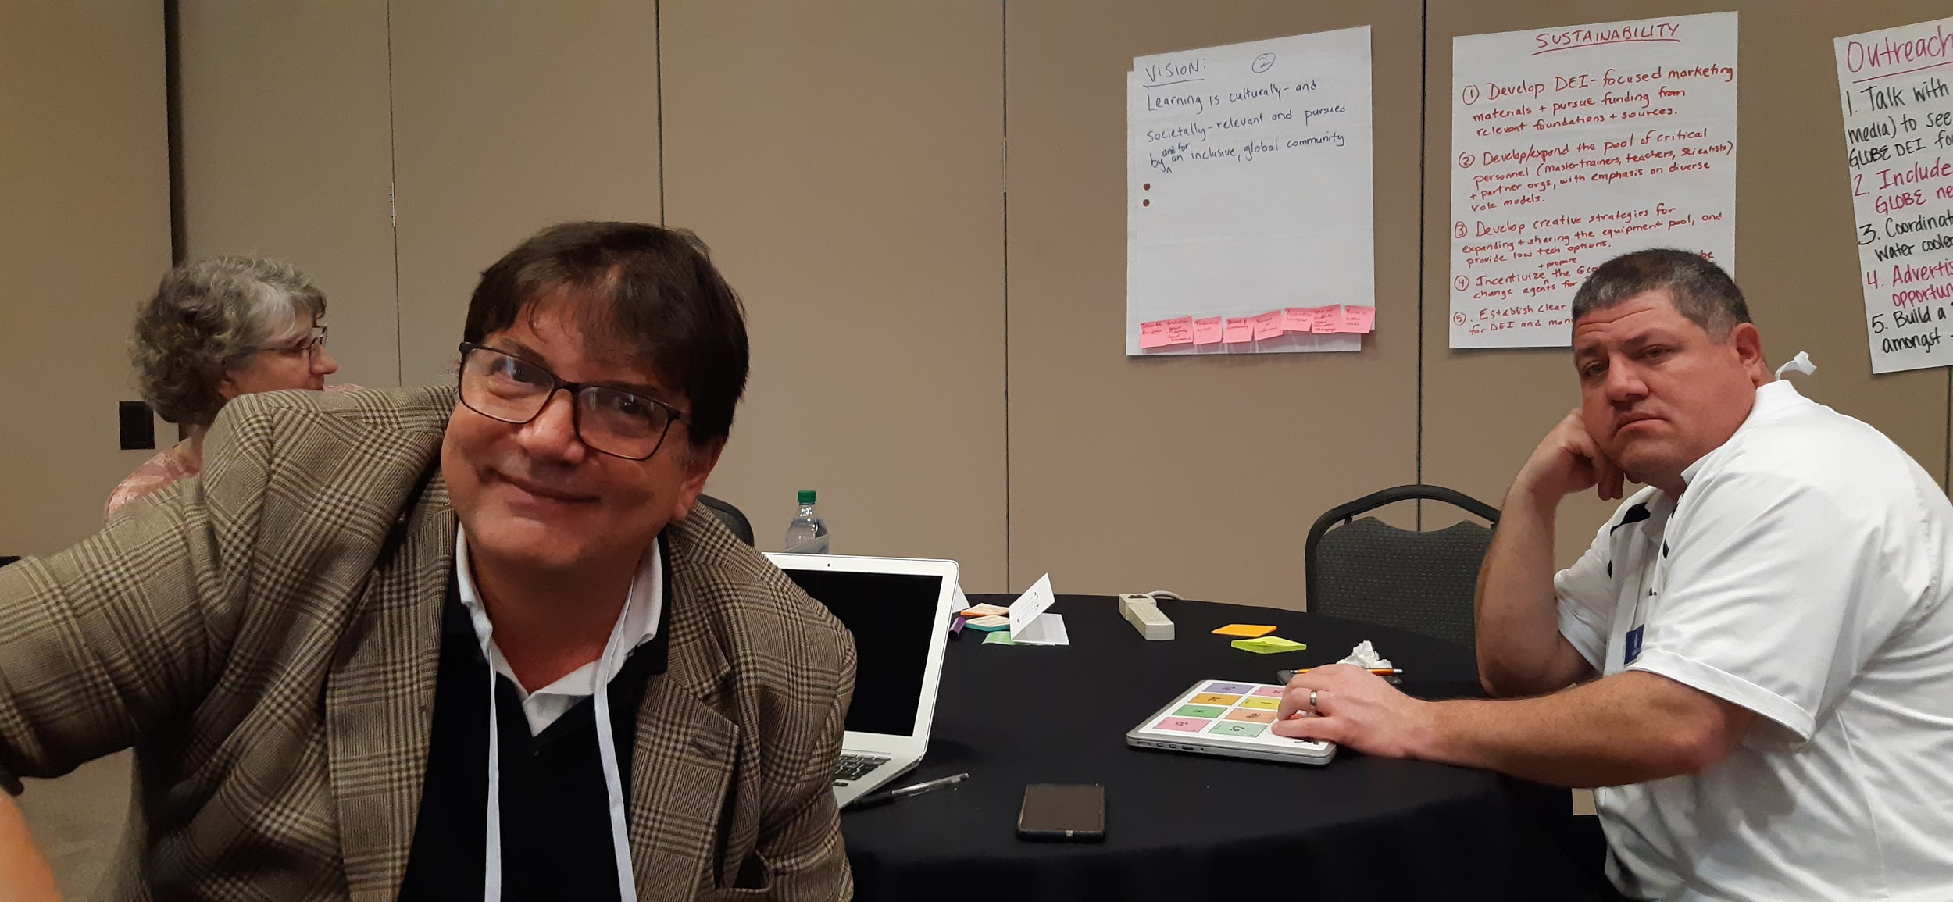
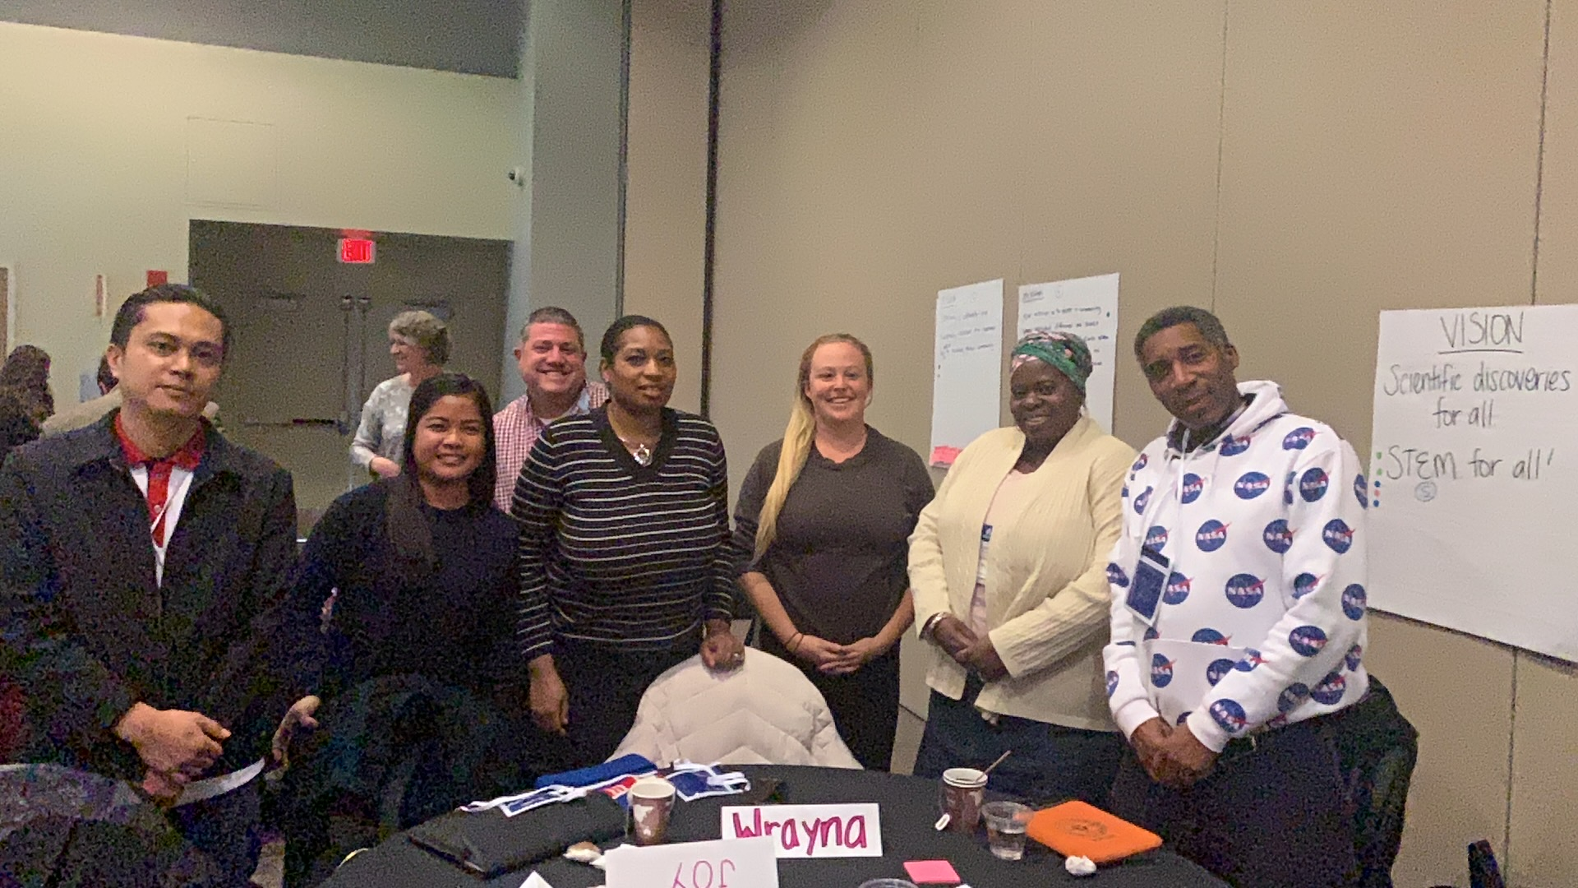
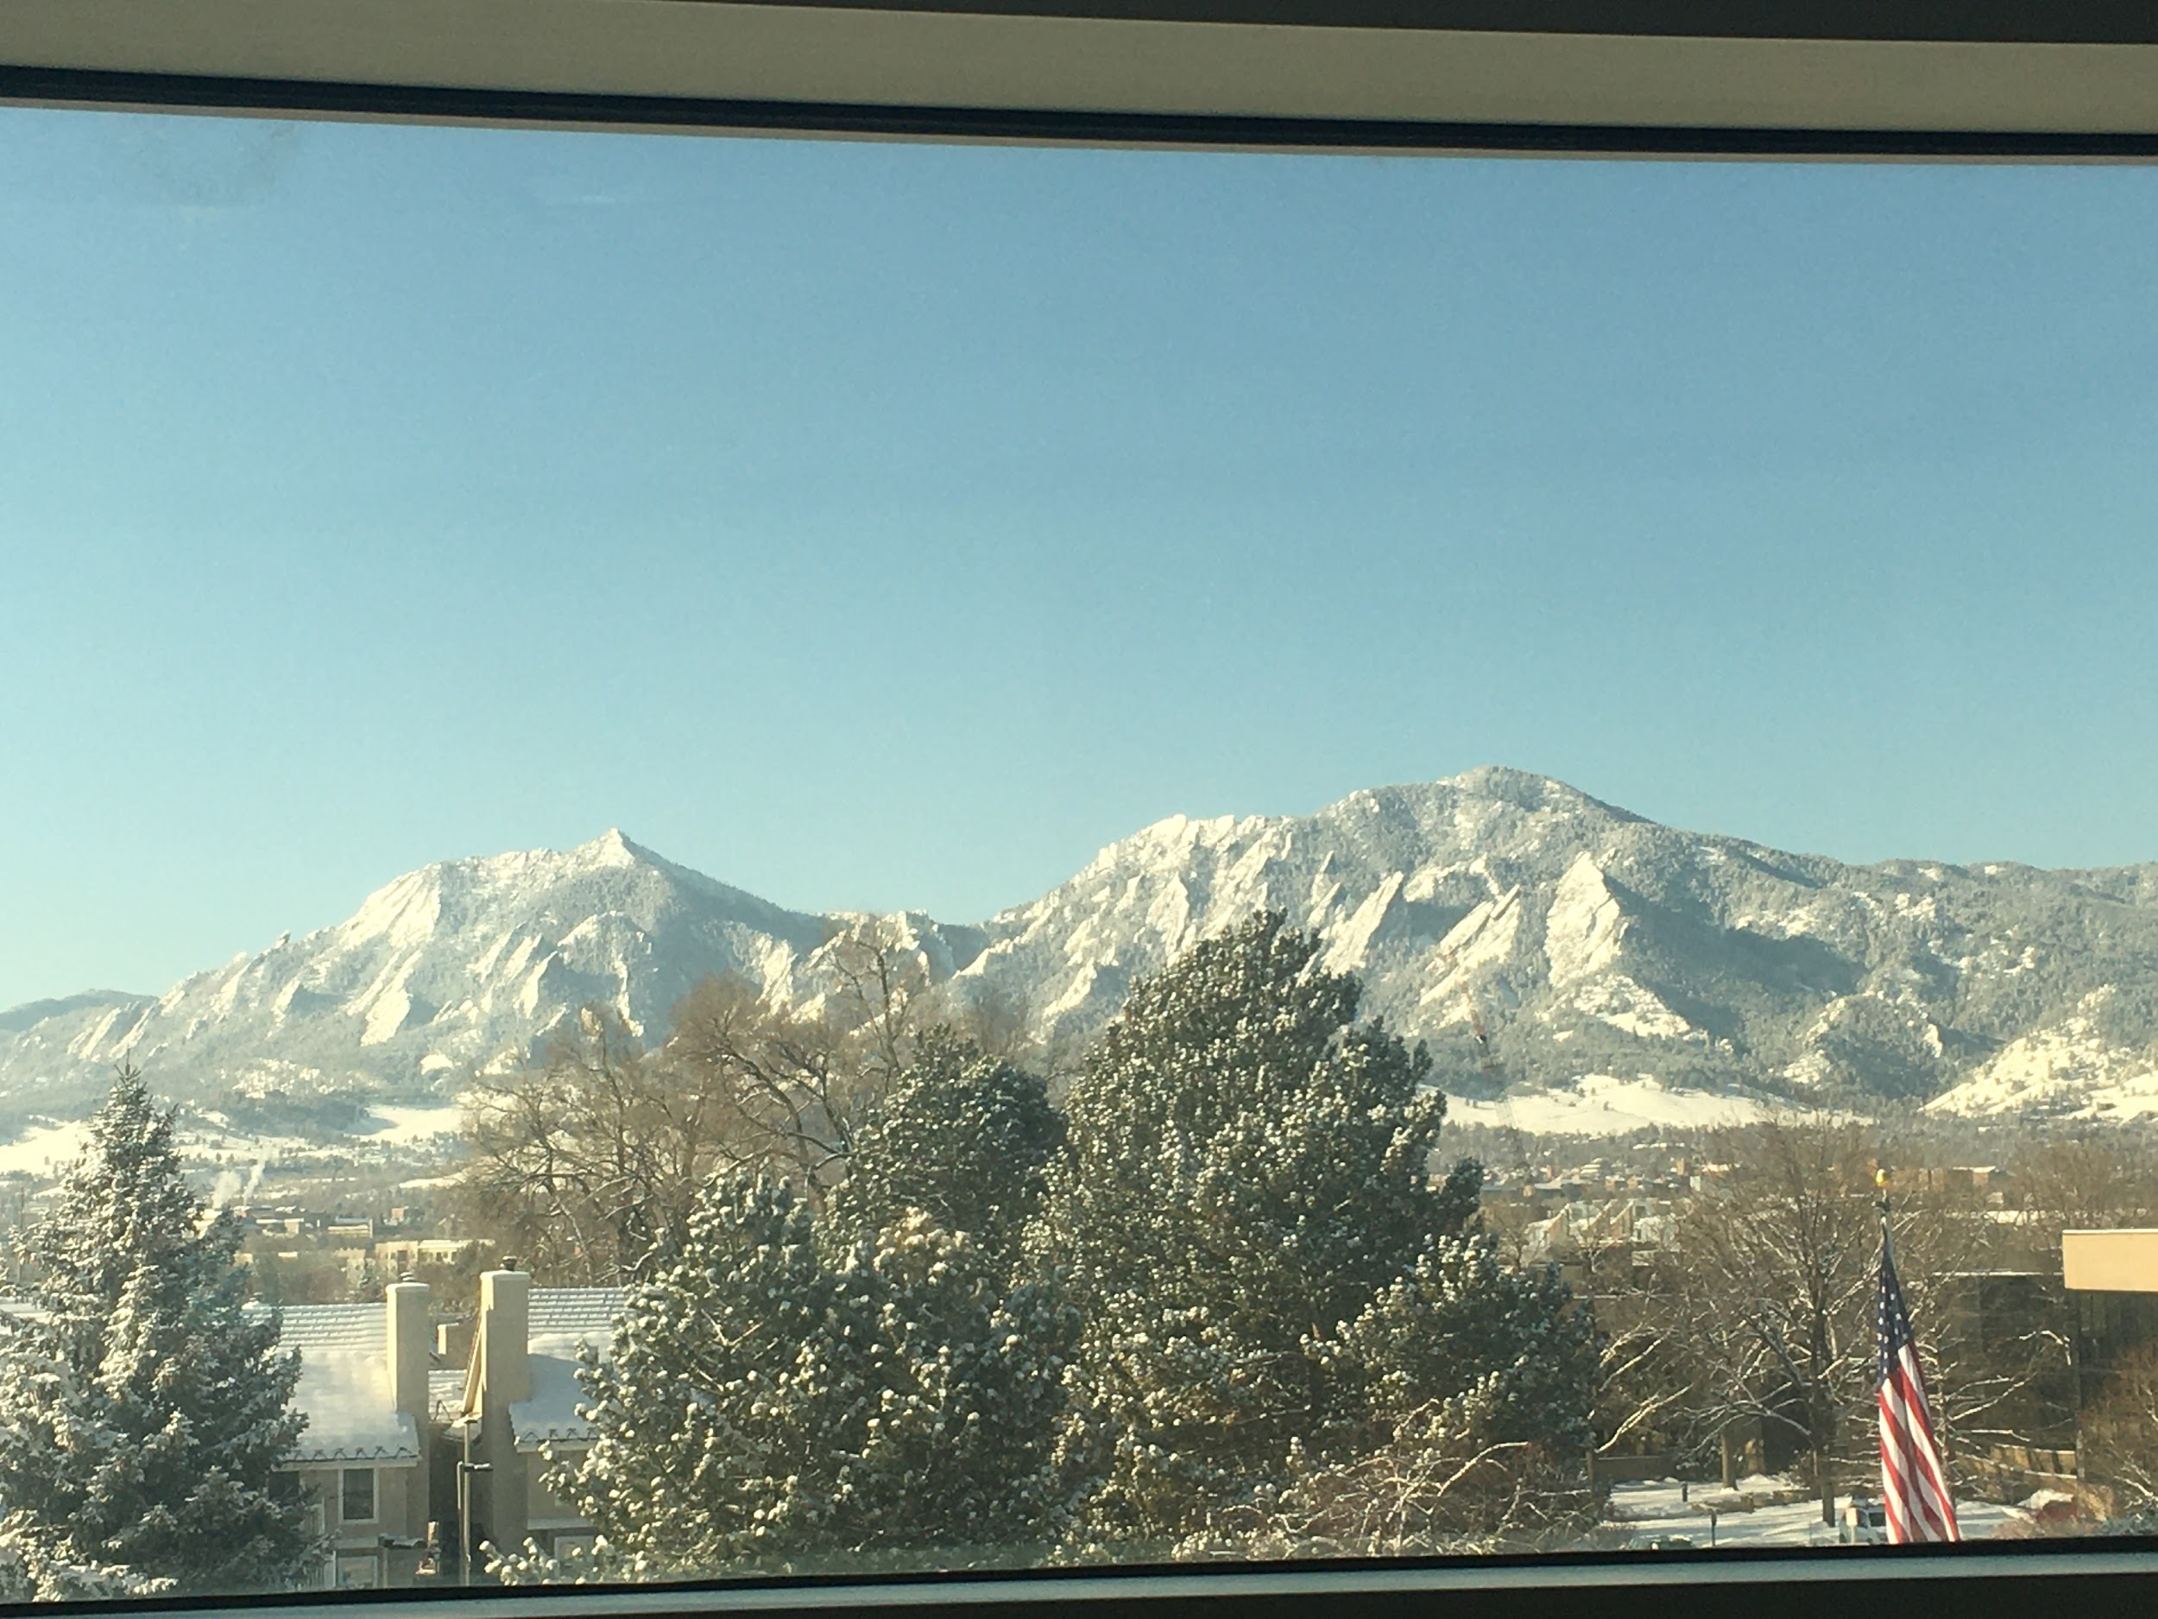
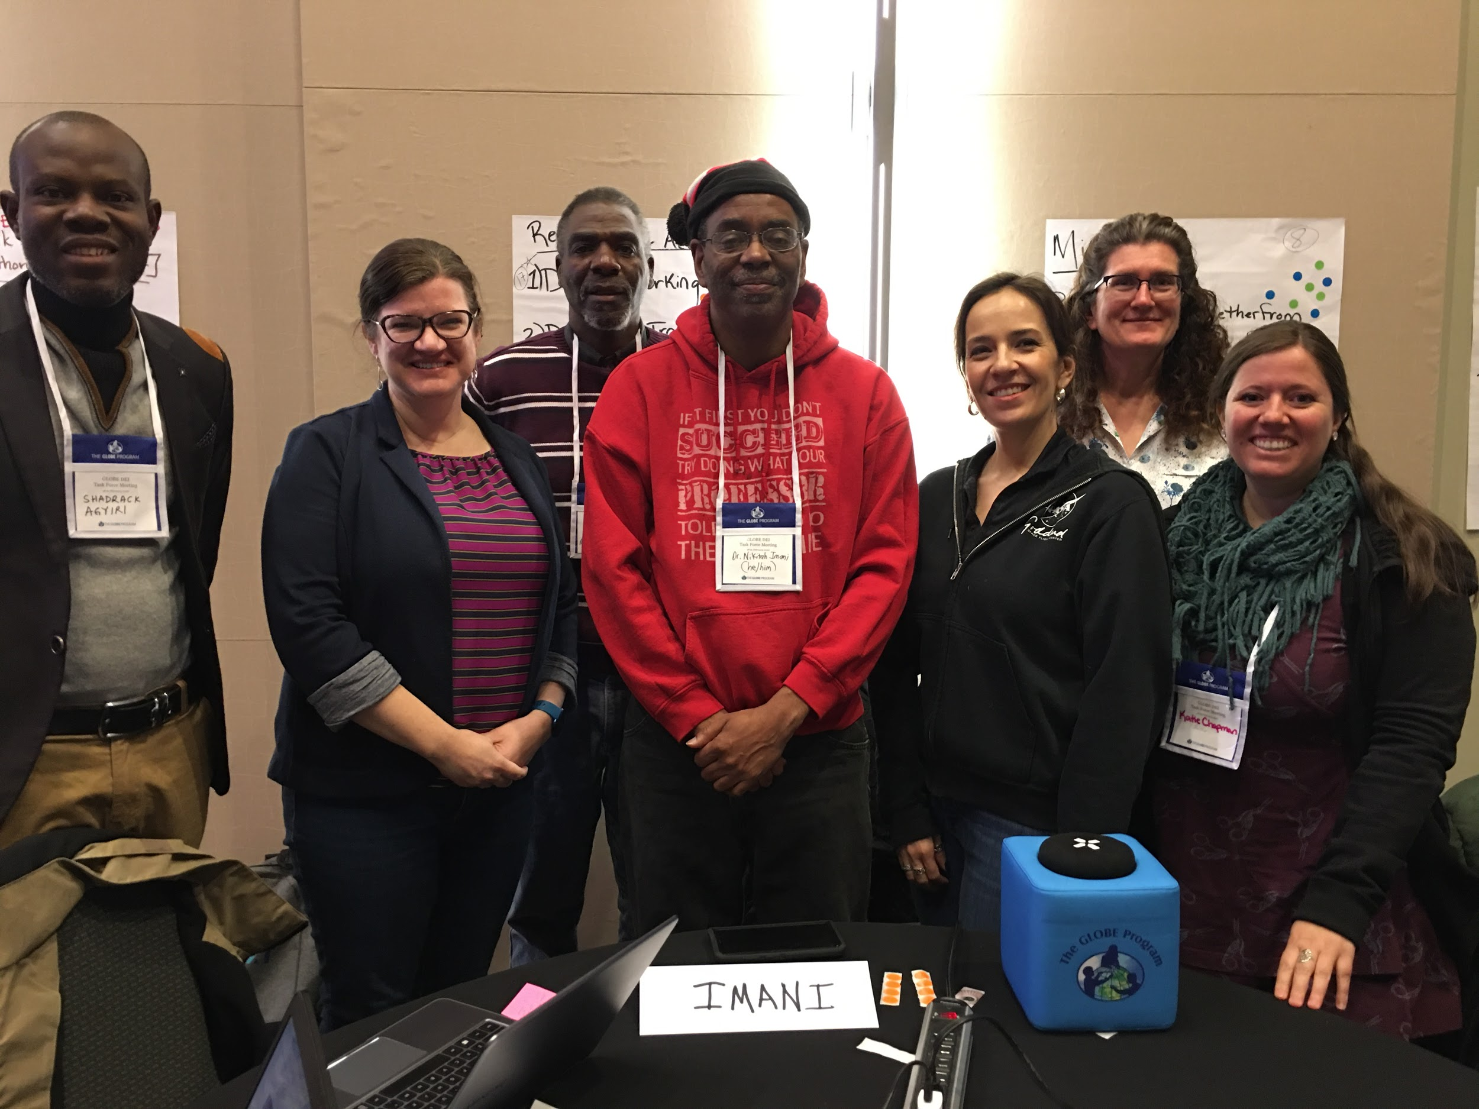
Thank you DEI Task Force!

