Slide 1
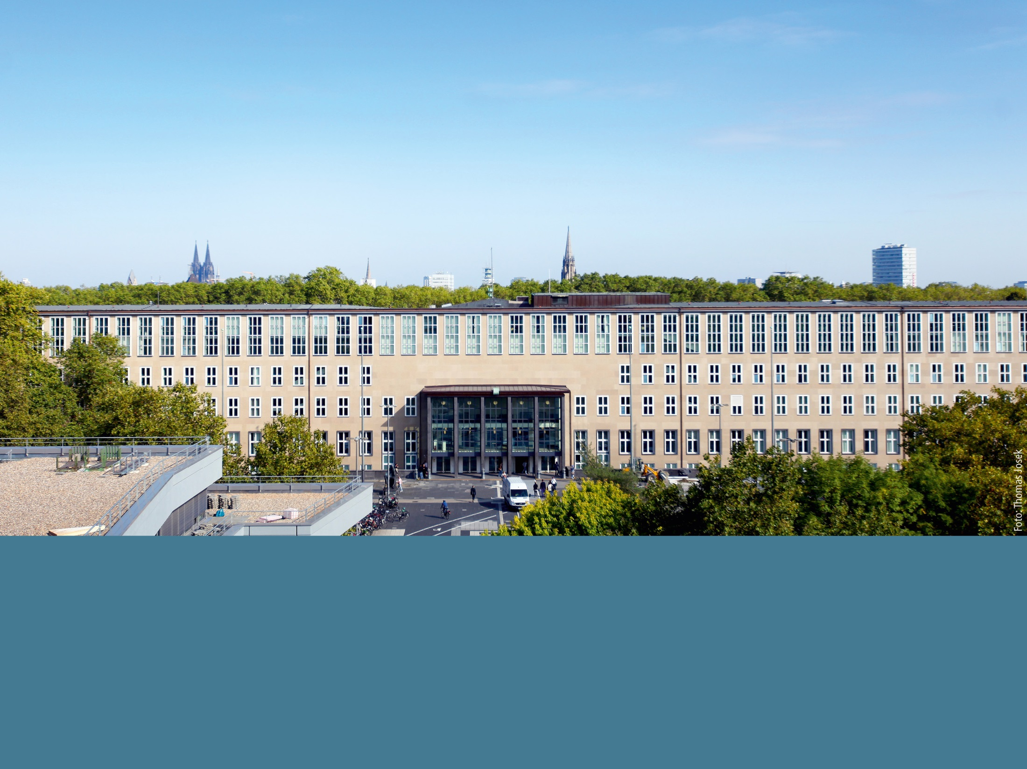


Nature in Urban Landscapes: Understanding Science, Activating the Society, Enhancing Participation
Using Learning, Exploring and Activity Paths (LEAPs) to engage Students and Citizen in Science
Prof. Dr. Karl Schneider and Dr. Verena Dlugoss
Institute of Geography
University of Cologne, Germany
karl.schneider@uni-koeln.de

Slide 2

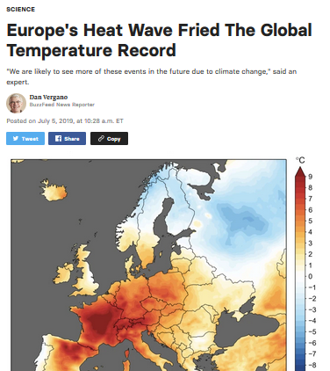
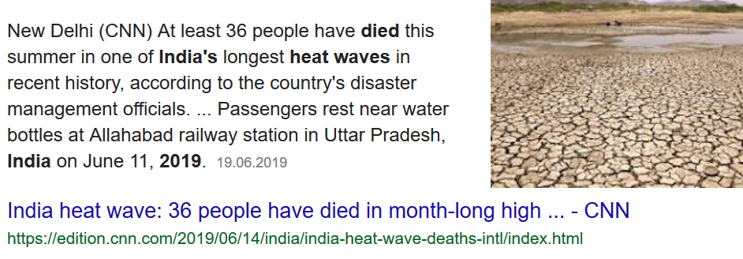
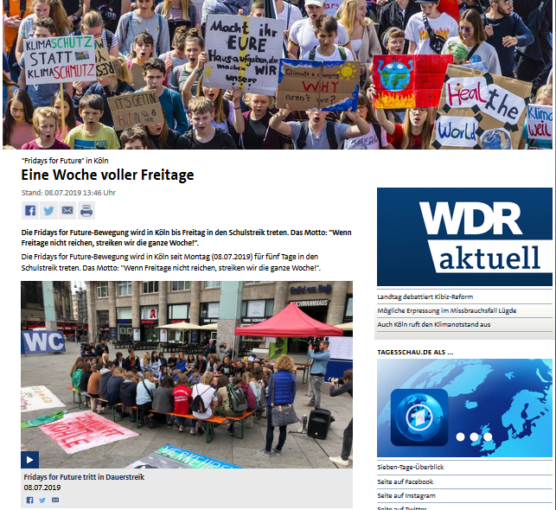
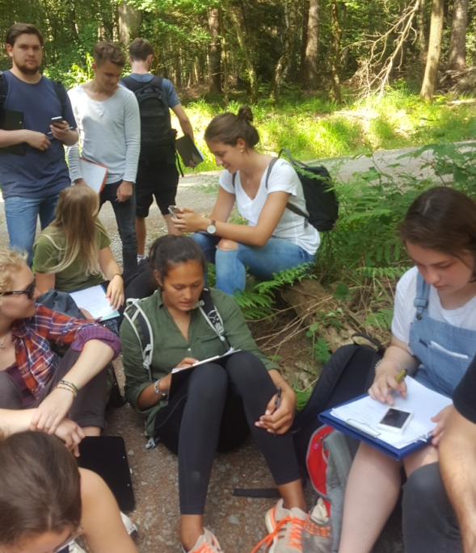
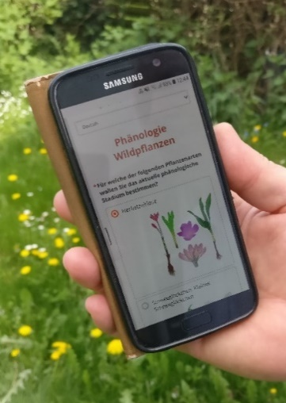

Climate and socioeconomic change is particularly obvious and relevant in cities.
Climate and socioeconomic change is particularly obvious and relevant in cities. Coping with these effects requires participation. Participation rests on education.
Motivation
Method
https://www.buzzfeednews.com/article/danvergano/europe-heat-wave-hottest-ever-june
https://www.tagesschau.de/regional/nordrheinwestfalen/fridays-for-future-151.html
https://www.youtube.com/watch?v=mkQENy0MRtc
Conclusion
Results
SWOT
Strength
Weakness
Opportunities
Threats

Slide 3
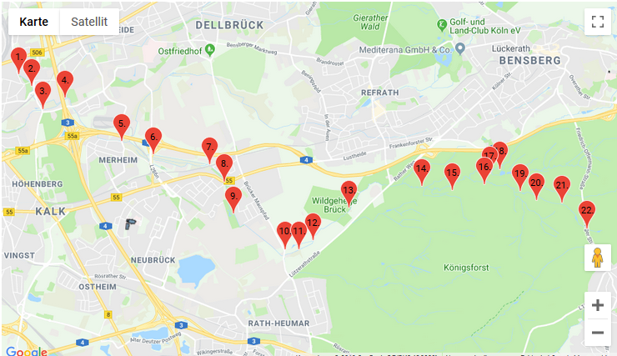
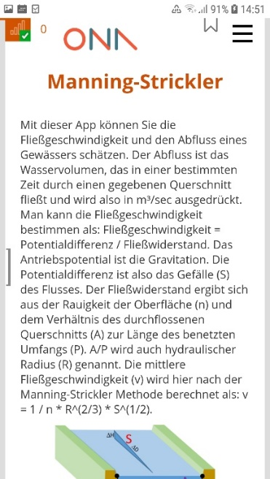
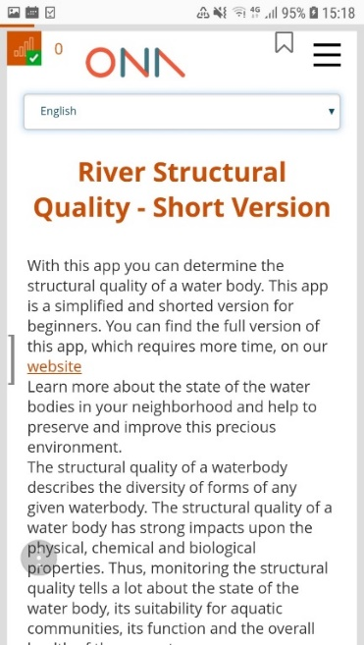
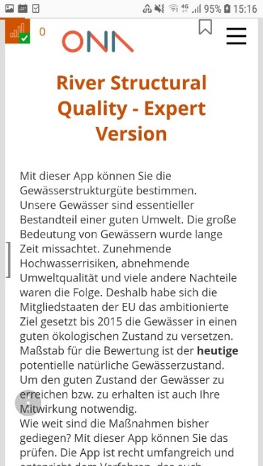
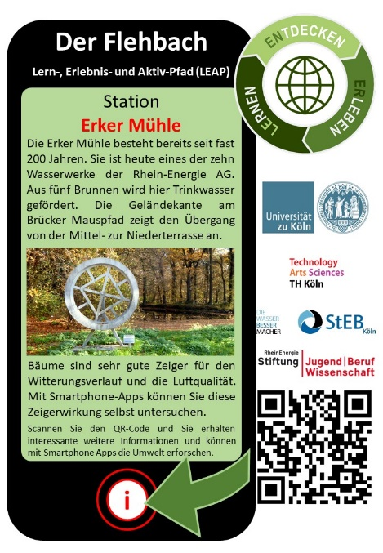
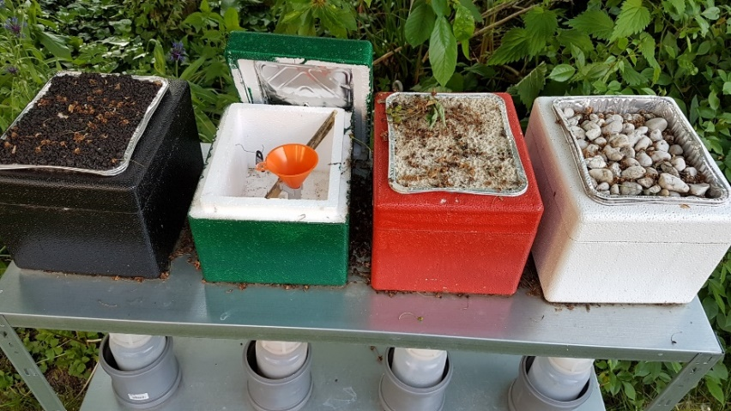
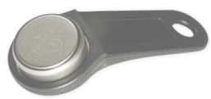
Facilitating participation should address people where they are, providing points of entry, which matters to them and showing concrete examples to become active.
LEAPs are Learning, Exploring and Activity Paths: The Flehbach LEAP addresses water issues in Cologne
Activation with site specific information, smartphone apps, ...
Station marker
I-Button: Temperature and humidity logger
... experiments, and cooperation (data sharing, school – citizen cooperation, events).
Percolating water from the lid

Slide 4
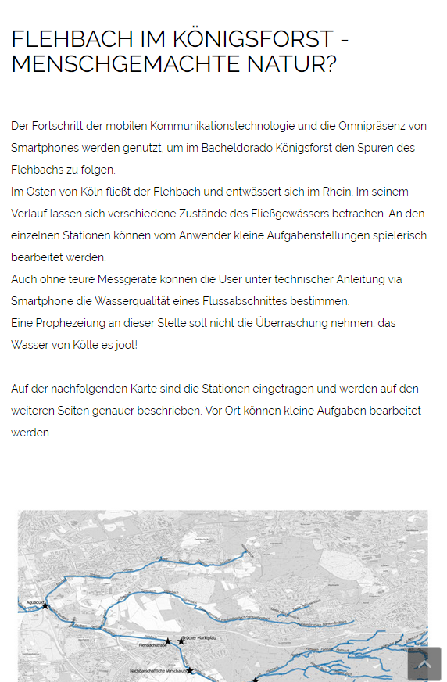
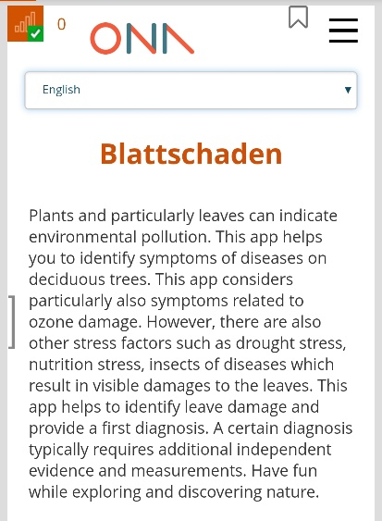
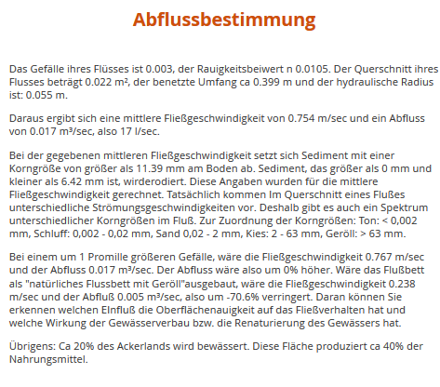
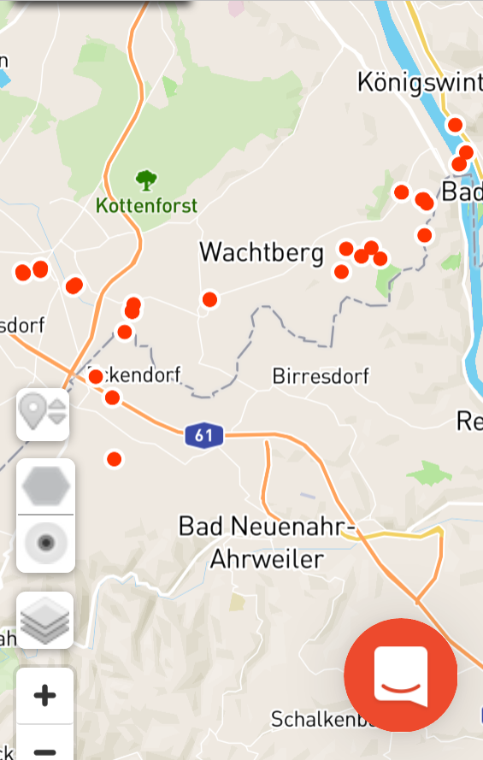




The Apps follow a scaffolding approach to motivate participation.
ENERLE: Explore Nature, Explain through Research, Learn in your Environment
1. Motivate and Inform:
Leads up to a research challenge
ENERLE
2. Activate:
Observational Guide
ENERLE
3. Provide Feedback
ENERLE
4. Foster Participation
ENERLE
http://www.geographie.uni-koeln.de/14706.html

Slide 5
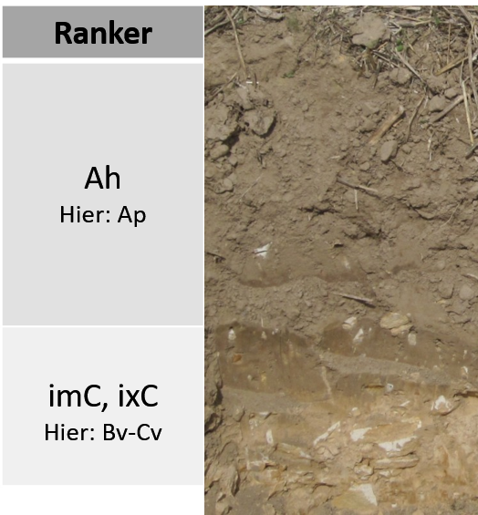
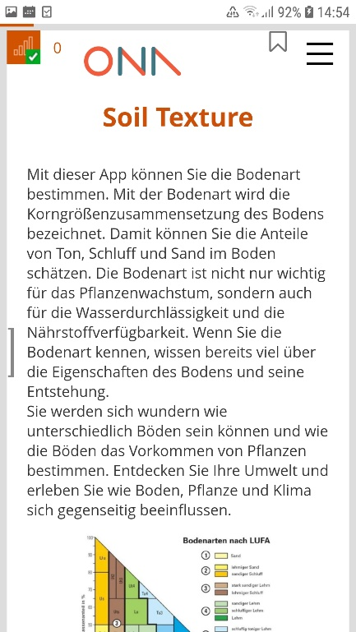


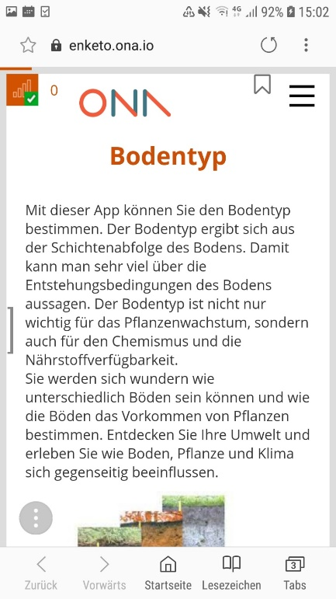
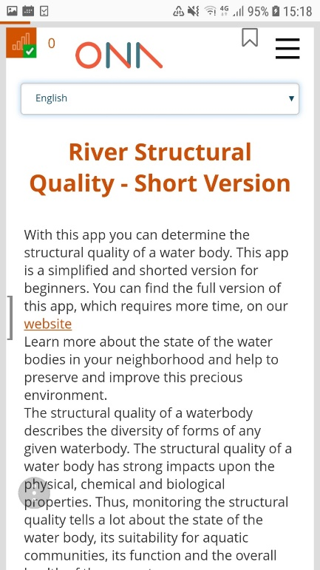
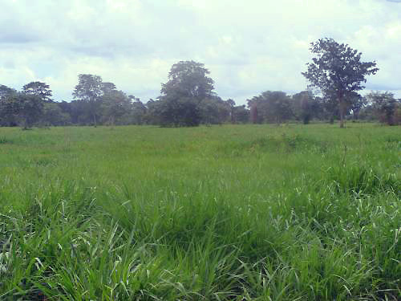
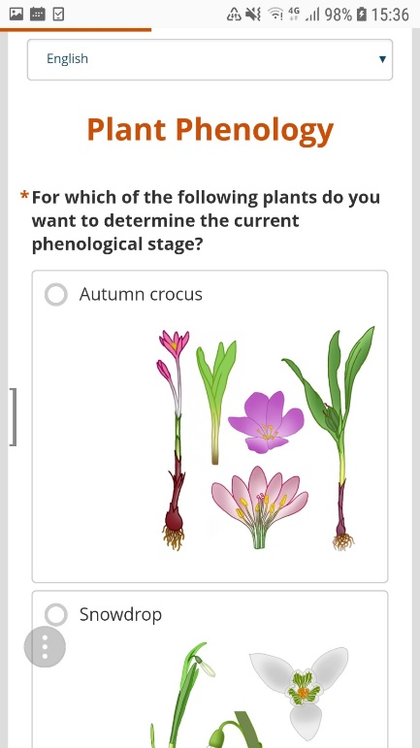
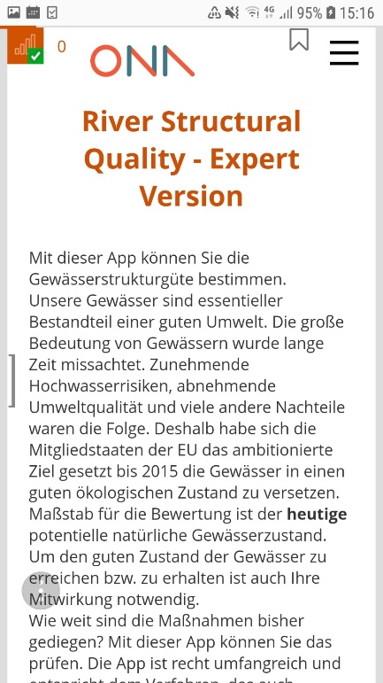
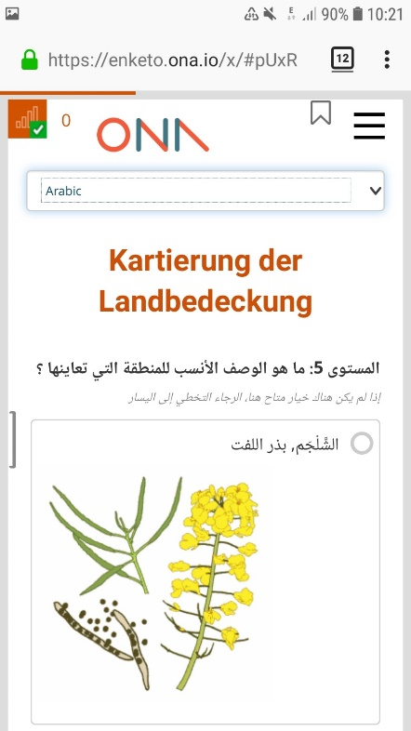
Using GLOBE protocols as role model, we developed a group of smartphone apps for Soil, Water, Vegetation, ...
Soil
Water
Vegetation

Slide 6

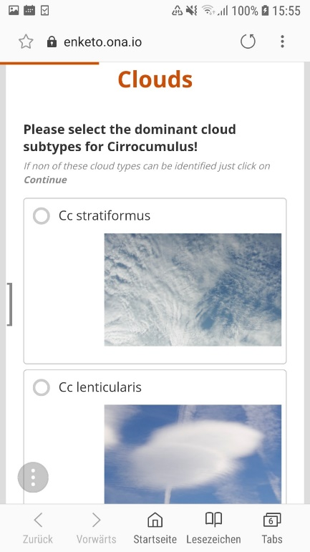
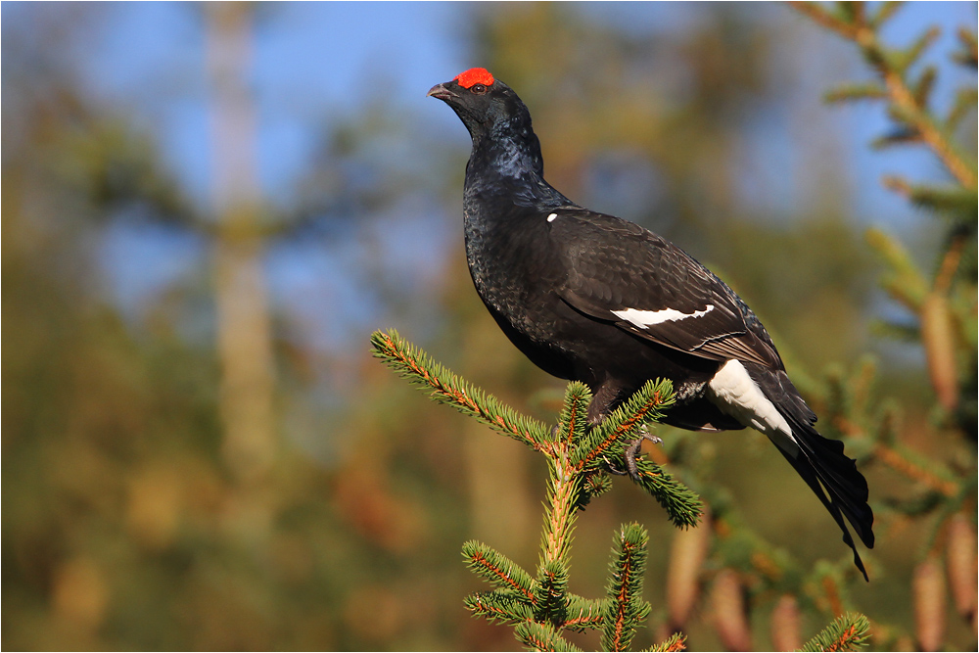
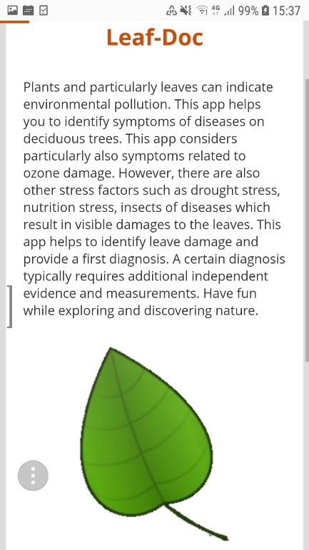
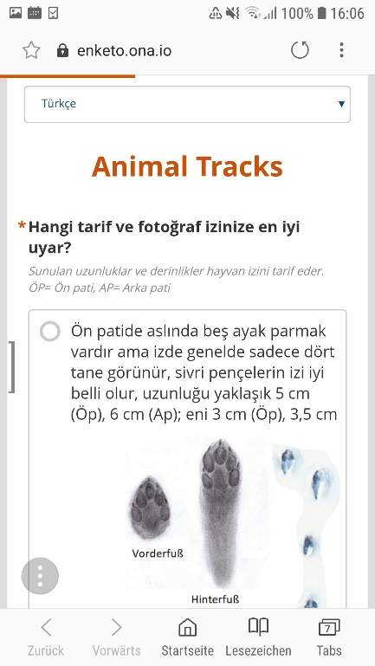
Using GLOBE protocols as role model, we developed a group of smartphone apps for Soil, Water, Vegetation, Atmosphere, Fauna in several languages.
Atmosphere
Fauna

Slide 7
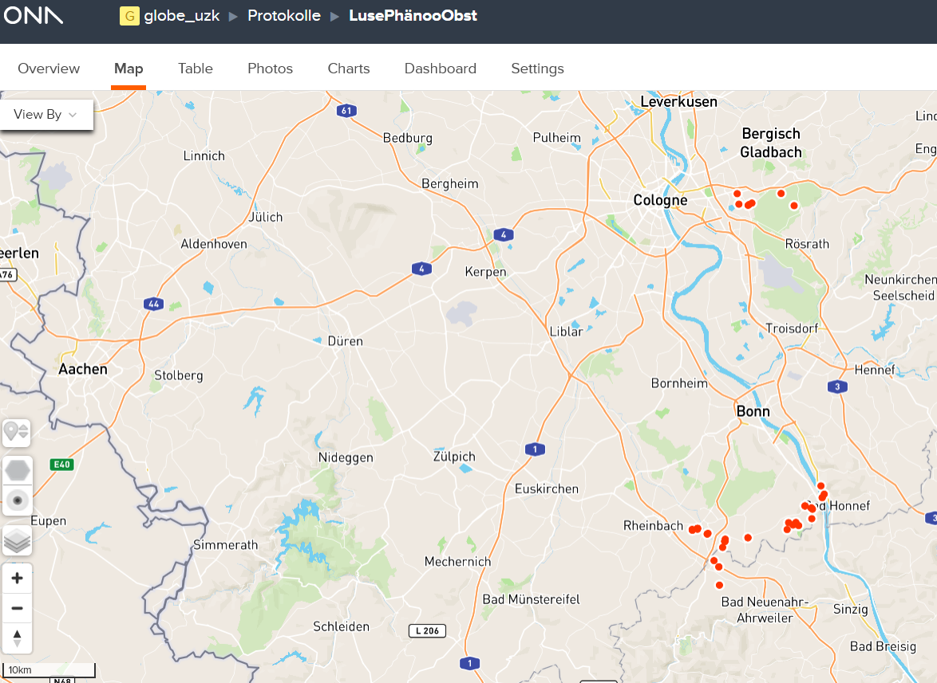
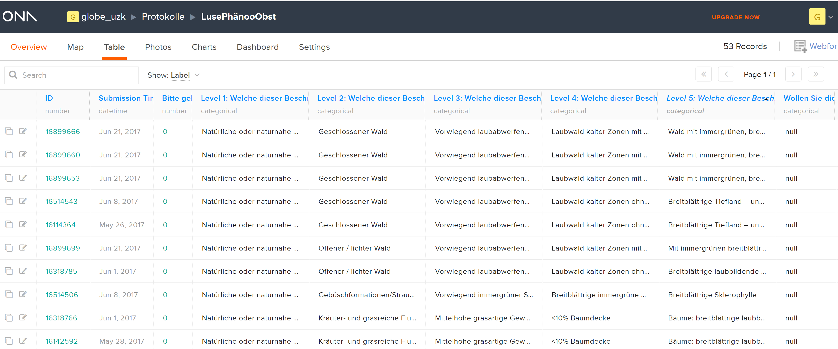
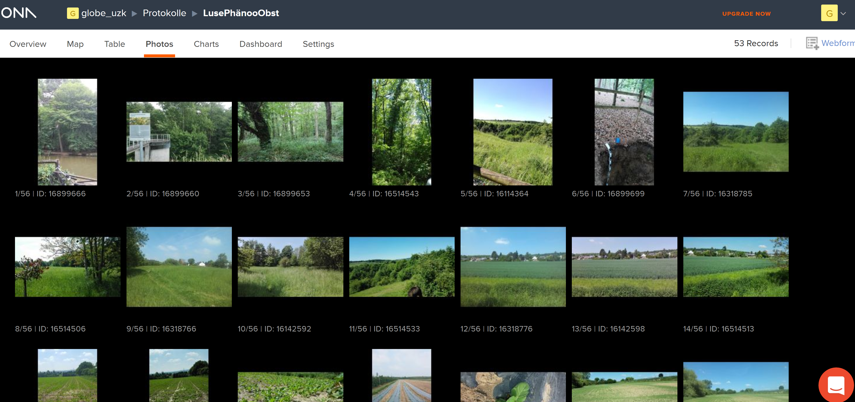
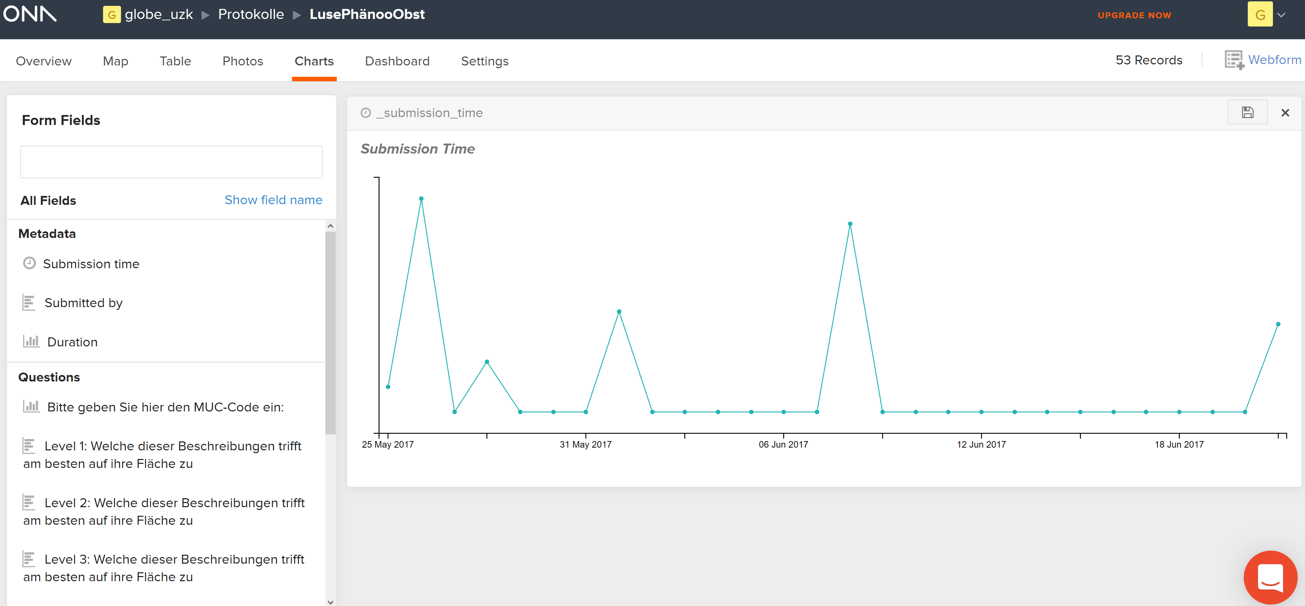
The data can be made publicly available. This supports cooperation.
Observations are shown on a map
Data are provided as tables
Photography are provided as prove and quality control
Activity graphs show participation

Slide 8
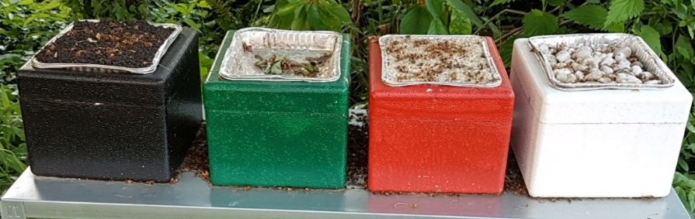
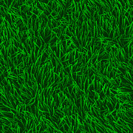
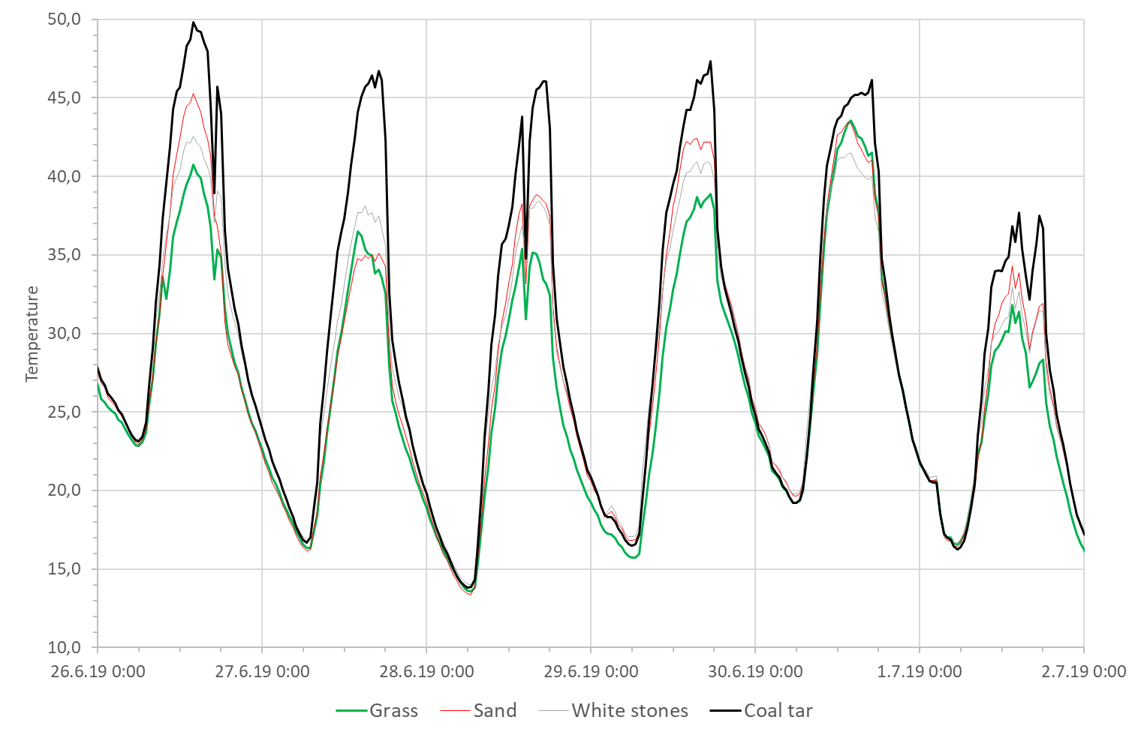
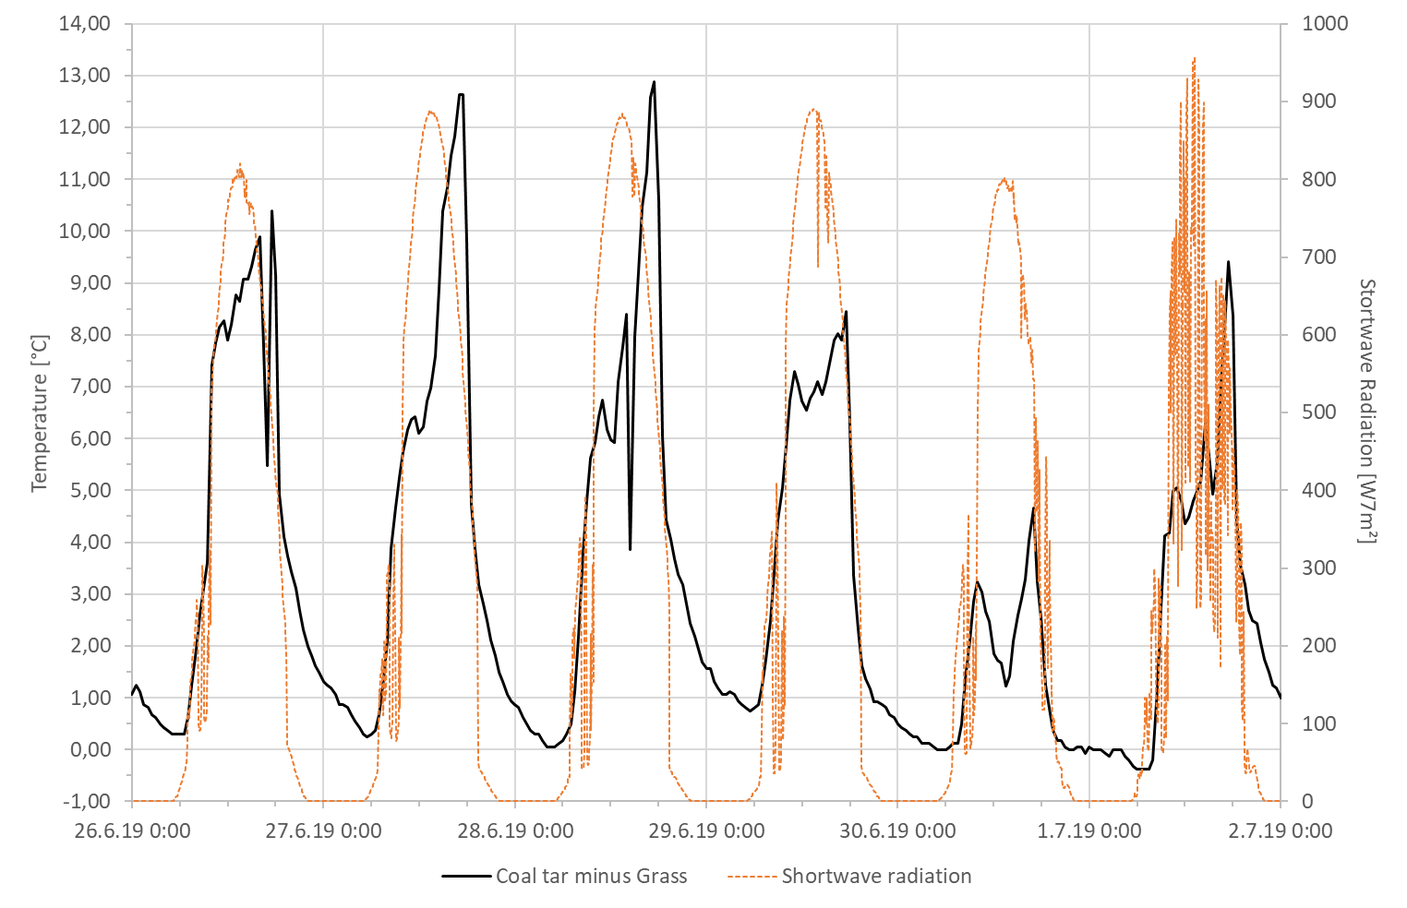
Nature in Urban Landscapes provide particularly suitable and relevant points of access to engage citizen in science.
Relevant in terms of climate change adaptation and mitigation
Temperature in climate boxes with different cover
Temperature difference of coal tar and grass top

Slide 9
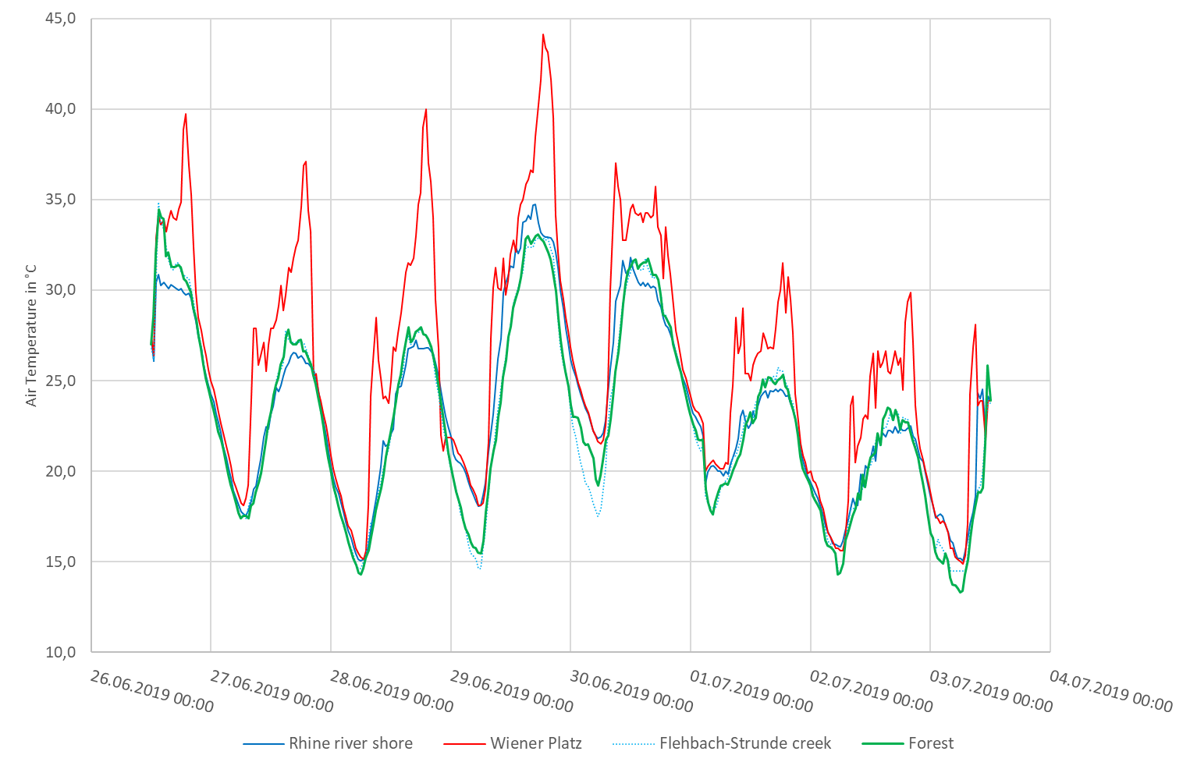
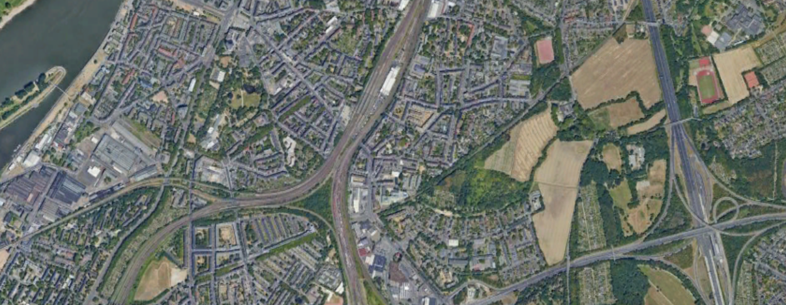
Nature in Urban Landscapes provide particularly suitable and relevant points of access to engage citizen in science.
Relevant in terms of climate change adaptation and mitigation
Relevant in showing the effect of the urban heat island in the own living environment

Slide 10
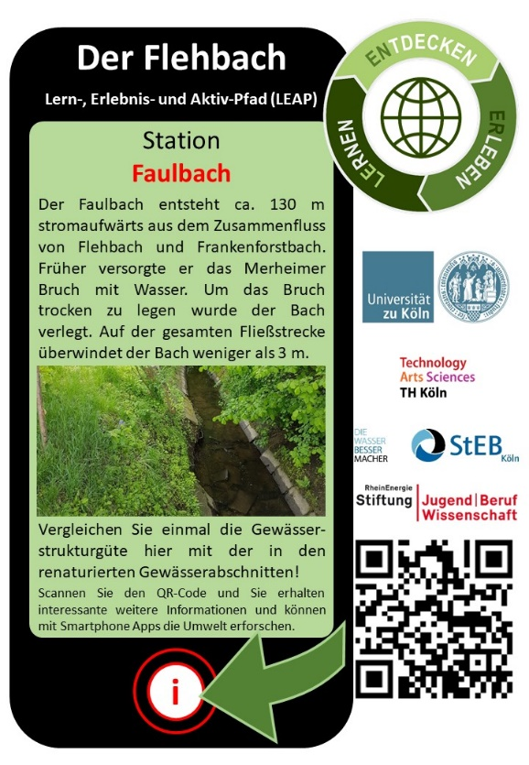
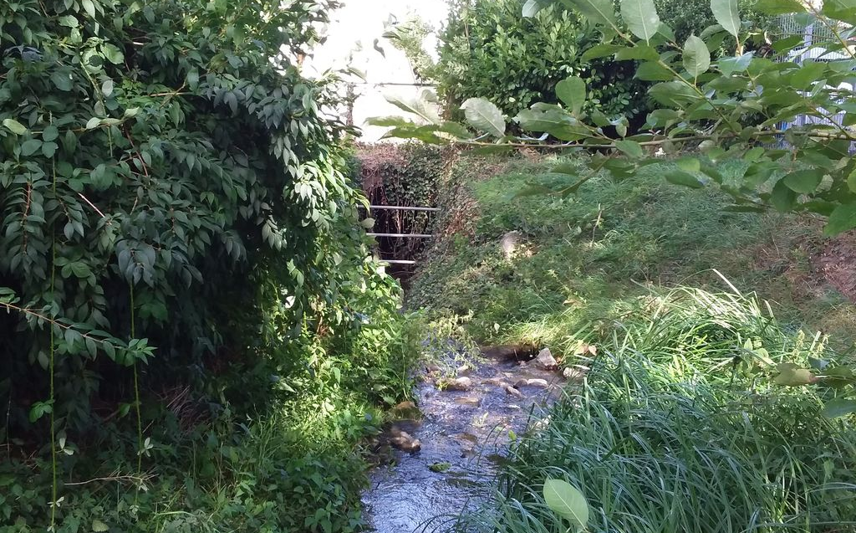
Nature in Urban Landscapes provide particularly suitable and relevant points of access to engage citizen in science.
Relevant in terms of climate change adaptation and mitigation
Relevant in showing the effect of the urban heat island in the own living environment
Relevant in terms of monitoring of progress in restoration of water bodies (EU-WFD)

Slide 11
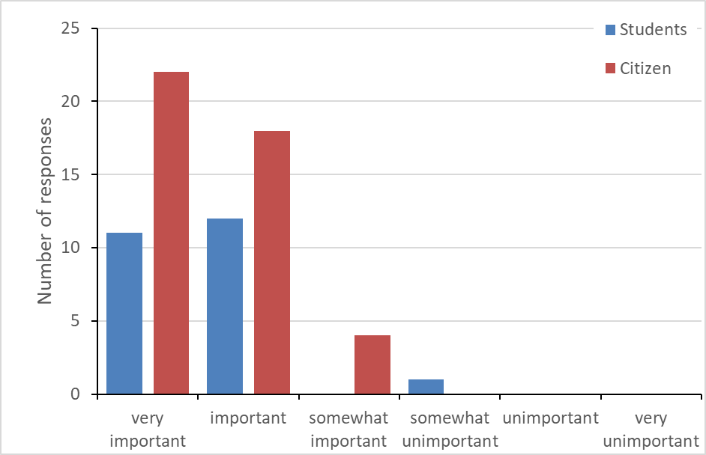
Nature in Urban Landscapes provide particularly suitable and relevant points of access to engage citizen in science.
Relevant in terms of climate change adaptation and mitigation
Relevant in showing the effect of the urban heat island in the own living environment
Relevant in terms of monitoring of progress in restoration of water bodies (EU-WFD)
Relevant in terms of learning about the own living environment
How important is the use of apps for you in terms of learning more about my neighborhood
# of students: 24
# of citizen: 44

Slide 12
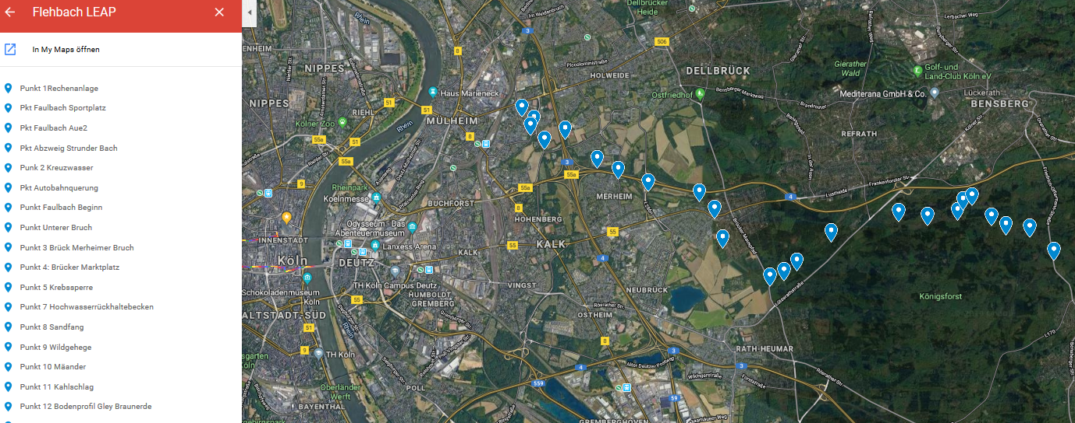
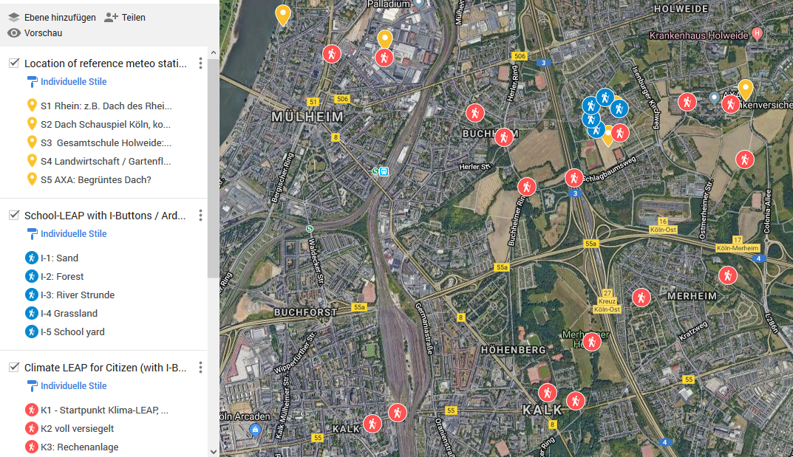
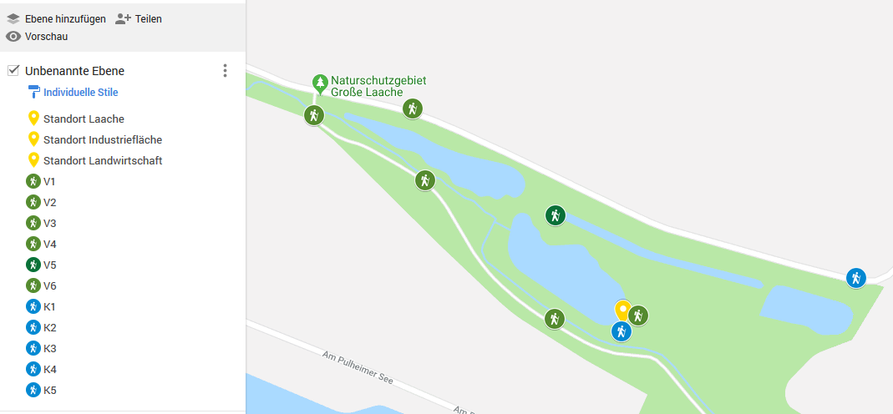
Thematic LEAPs are currently implemented in Cologne.
1. Flehbach LEAP completed, theme: Water
2. Cologne Climate LEAP in preparation, theme: Urban climate and air quality
3. Laache LEAP in planning, theme: Vegetation and watershed function

Slide 13
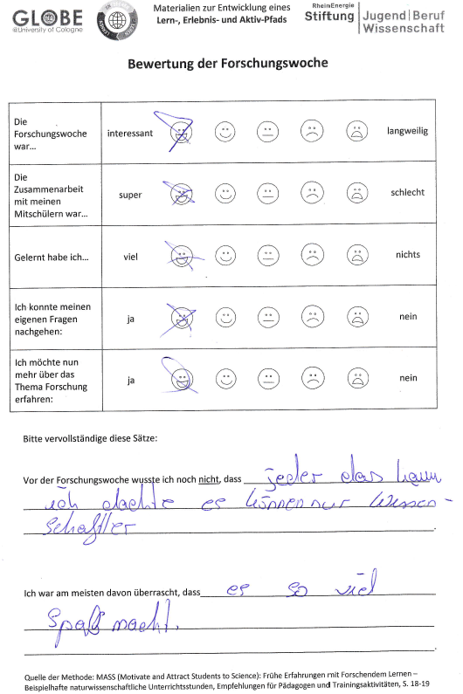
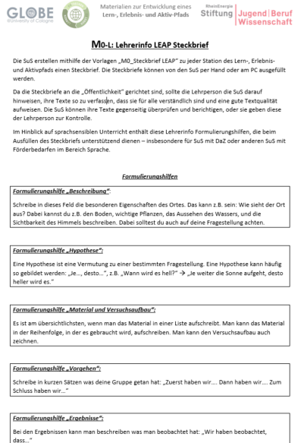
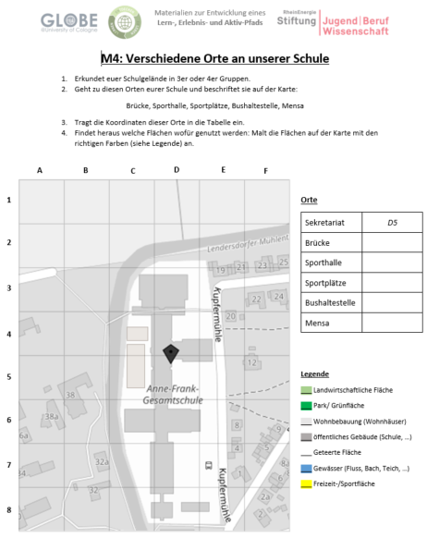
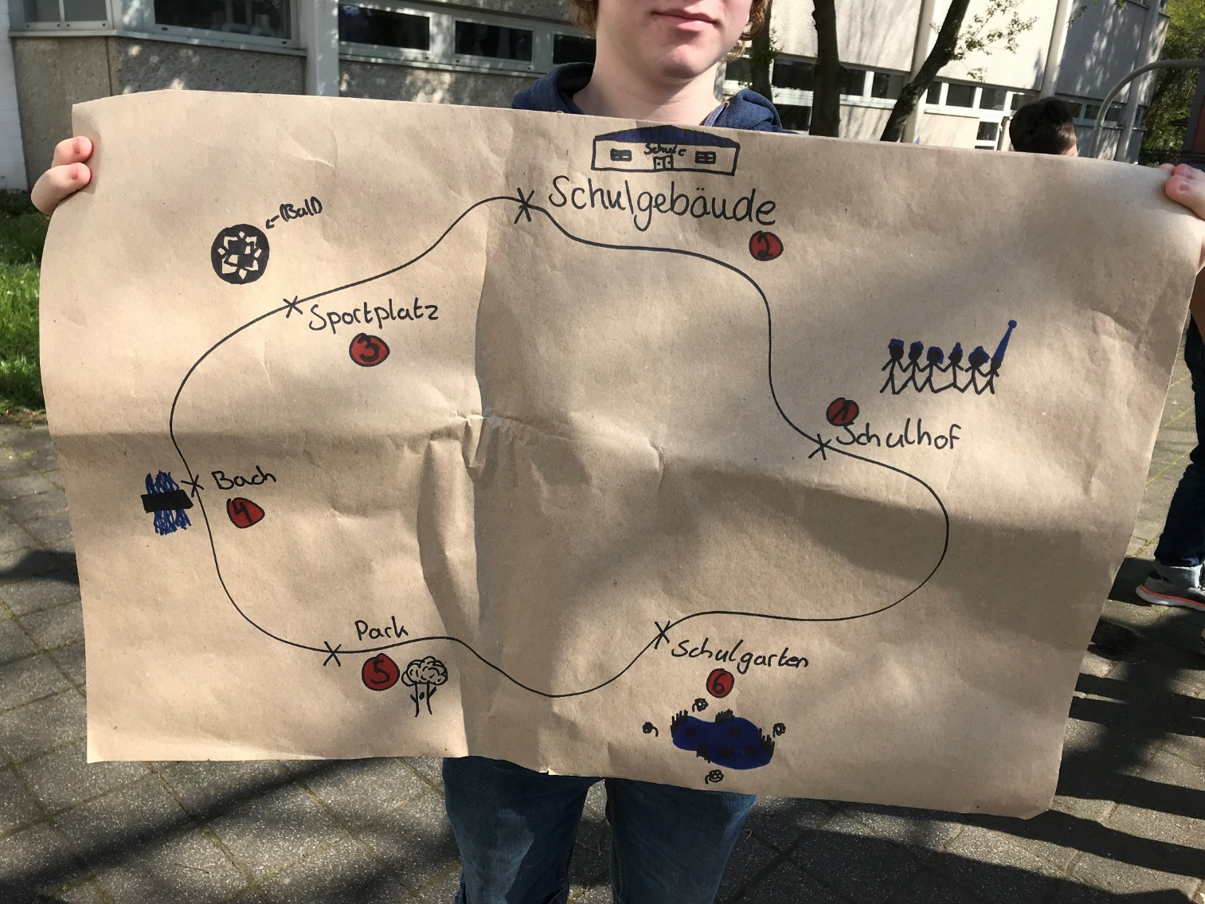
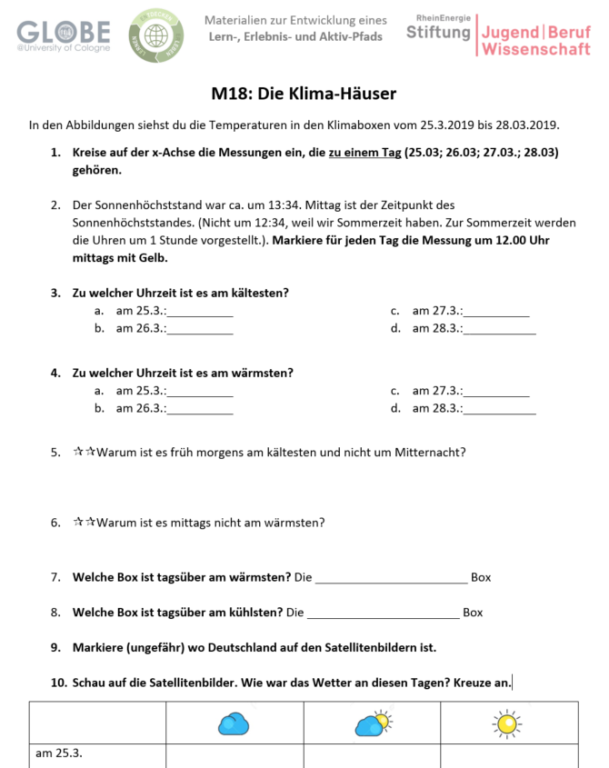

LEAPs can be created by students for their school.
Fully developed teaching materials for a project week (7th grade) were developed. These can be easily adapted and customized by teachers
1. Teacher Guide for research method
4. Evaluation
2. Teaching materials (sheet M1 ... M19)
3. Implementation
Experiment

Slide 14
Local information matters, particularly for citizens.
How important is the use of apps for you in terms of learning more about my neighborhood
# of students: 24
# of citizen: 44

Slide 15

Contributing to science motivates participation. This motivator is not as strong as learning about the own neighborhood.
How important is the use of apps for you in terms of contributing to science
# of students: 24
# of citizen: 44

Slide 16
Evaluation results of ENERLE and LEAPs
Strength
  Motivating to learn about the own living environment
  Clear structure
  Evidence based observation
  Individual learning
  Easy to implement different languages
  ....
Weakness
  Technical issues: e.g. slow loading, images are sometimes not shown, slow data transfer
  Lack of simple data analysis tool: Use of tables generated from ODK is complex and requires a data translator
  ...
Opportunities
  Activation of citizen
  Learning beyond classroom
  Training of language skills
  Integration of new citizen
  Interface to GLOBE database
  ...
Threats
  Smartphones used for other activities during class
  Reduced attention to instructions
  Data misuse (e.g. images)
  ...

Slide 17

Special thanks to
Max Brunke: Graphic design
Cem Kirkici: Translation to Turkish
Abdulla Alshahri: Translation to Arabic
Funding:

Slide 19
Some assertions to discuss
We currently have a particularly strong need and opportunity (e.g. Fridays for Future) to reinvigorate the method of science as key approach to make informed decisions.
Our youth has a keen interest in science and we are not responding sufficiently. Instead schooling often focuses on reproduction of content knowledge rather than building competence.
We need to go the full way from observation, to stringent and reproducible methods to data evaluation and evidence based interpretation, too often we stop with data collection.

