Slide 1
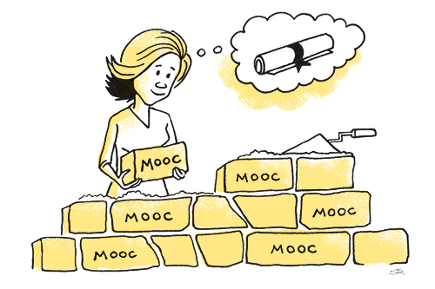


Digital Science
A Perfect Match in Globe Program
Dr. Farid Hamdan –Globe NC -ISRAEL .
Fredi2811@gmail.com
MOOC-Massive Open On line Course.

Slide 2
Approaches
Collaborative learning
Co-operative learning
Writing groups
Peer teaching
Learning communities
Problem-based learning
Discussion groups

Slide 3
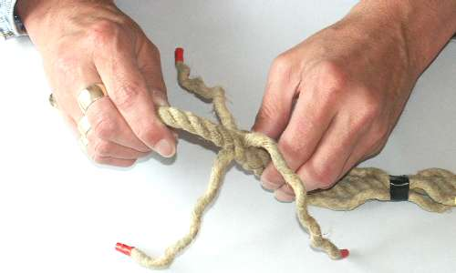
Educational goals
Involvement
Co-operation and teamwork
Community responsibility
Notes:
Since we use collaborative learning to help students learn more effectively it is important to consider teaching strategies that go beyond a mere mastery of content and ideas. Collaborative learning promotes and educational agenda that encompasses several intertwined rationales
Involvement – by its very nature collaborative learning is both socially and intellectually involving. Research has shown that it makes a significant difference in student performance and subsequently student retention.
Cooperation and teamwork – In collaborative activities students inevitably encounter difference and have to work to recognise and deal with it. This helps build a community of learners.
Community – Habits of participation and responsibility to a subject/classroom community can help in the broader communities. Collaborative learning encourages students to develop an active voice in shaping their ideas and values and also developing a sensitive ear to the views and opinions of thers.
In the hands of an expert rope maker loose strands can be skilfully woven together to form a rope with greater strength and durability. The same can be said of a committed and creative lecturer.

Slide 4
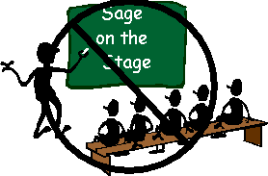
Why use cooperative learning?
promote student learning and academic achievement
enhance student satisfaction with their learning experience
help students develop skills in oral communication
develop students' social skills
promote student self-esteem
increase student retention
develop a community of learners
Notes:
Cooperative efforts result in participants striving for mutual benefit so that all group members:
gain from each other's efforts. (Your success benefits me and my success benefits you.)
recognize that all group members share a common fate. (We all sink or swim together here.)
know that one's performance is mutually caused by oneself and one's team members. (We can not do it without you.)
feel proud and jointly celebrate when a group member is recognized for achievement. (We all congratulate you on your accomplishment!).

Slide 5
5 Elements of cooperative learning
Positive interdependence
Face-to-face interaction
Individual and group accountability
Interpersonal and small group skills
Group processing

Slide 6
Curriculum issues
Prescriptive Curriculum
Experiential Curriculum
Teacher-centered Student-centred
Linear & rational Coherent & relevant
Part to whole organisation Whole to part organisation
Teaching as transmitting Teaching as facilitating
Learning as receiving Learning as constructing
Structured environment Flexible environment

Slide 7
How programming benefits Globe Teachers
Increasing relevance of study to the digital age
1
Interdisciplinary teaching
2
Enhanced digital understanding for the teacher
3
Pedagogical change
4
Constructionism
The teacher as a guide

Slide 8
How programming benefits Globe STUDENTS
Good presentation of latest thinking and ideas.
Peer discussion, debate, exchange, and challenge.
Creativity , Motivation , Self Regulation .
Learning to code and to think computationally and scientifically.
Creating for others – engaging others in environmental study.
Certification of attendance.

Slide 9

Postive interdependence
Each group member's efforts are required and indispensable for group success
Each group member has a unique contribution to make to the joint effort because of his or her resources and/or role and task responsibilities
Sink or swim together!

Slide 10
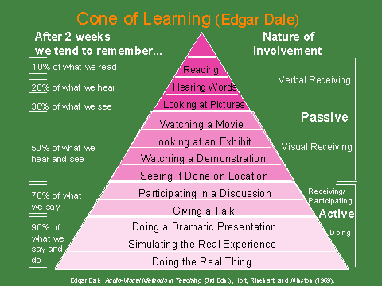

Slide 11

Group processing
Group members discuss how well they are achieving their goals and maintaining effective working relationships
Describe what member actions are helpful and not helpful
Make decisions about what behaviours to continue or change
Notes:
The teacher acts as facilitator, encourages positive interaction and commends achievement
The group members create dynamics, per responsibility and a combined outcome that is greater than the sum of individual outcomes.

Slide 12
Community types
Learning community: focus on learning together, sharing, developing relationships
Communities of practice: focus on developing professional practice
Community of enquiry: focus on enquiring about and issue/area
Knowledge community: focus on developing knowledge

Slide 13
Cyber communities
The best way to predict the future is to invent it.
Teaching/learning
Face-to-face Blended Online
“…the cornerstone of an online community lies in the presence of socially close, strong, intimate ties, the development of trust, shared values and social organisation.
The quality of peoples’ relations is an important characteristic in an online community
(This will be the modified role of the teacher as an e-moderator!)
Notes:
With change being the only contestant, increased accountability, the need for cost reduction and higher education driven mainly by market forces we really need to be aware of what we face in the future. If we embrace the teaching approaches learnt on the PGCHET then any changes to our approaches should be incremental and participatory rather than radical and imposed.
The best way to predict the future is to invent it.

Slide 14
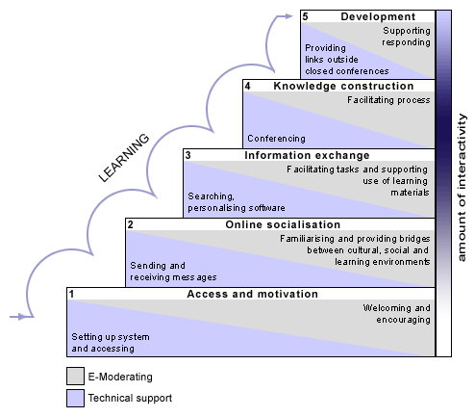
E-Learning (teacher to moderator)
Salmon (2005)
Notes:
Working online creates a wide range of feelings in students (and teachers, as well) and very often it tend to be the experience of isolation. Isolation has two dimensions. One is distance in place (being alone) and the other is psychological (distance in thoughts, feeling alone).
5 stages to build an effective online learning community
Access & Motivation. Exploring the technology and motivation building are key issues. The e-moderator helps meeting people and learn the environment.
Socialisation. Building on the first stage, this stage focuses on social processes and 'community building'. Moderator does bridge building.
Information Exchange. Information is exchanged and co-operative tasks can be achieved. Interaction happens with contents, other participants and the e-moderator that assists exploration activities.
Knowledge Construction. Knowledge development and discussion activities become important. Participants start recognizing the value of text-based asynchronous interaction and take control of knowledge construction.
Development. Participants become responsible for their own learning and that of their group. Ideas are applied to individual contexts. This stage is characterised by reflection and assessment.
The 5-stage model is also at the core of Salmon's e-tivity frameworks for enhancing active and participative online learning by individuals and groups and to create an effective cyber community

Slide 15
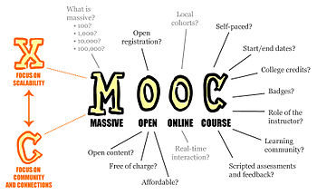
FARID HAMDAN , Detroit 2019

Slide 16
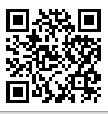
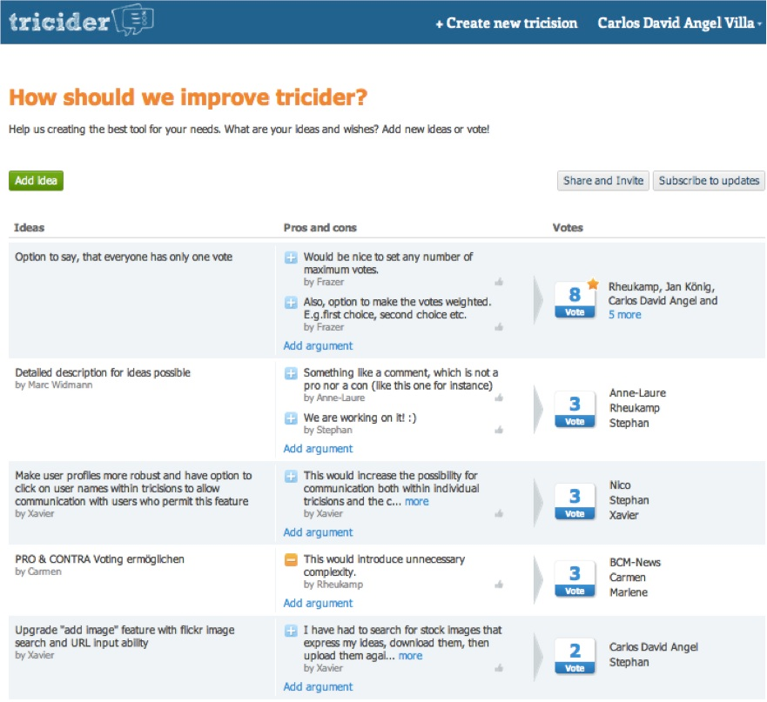
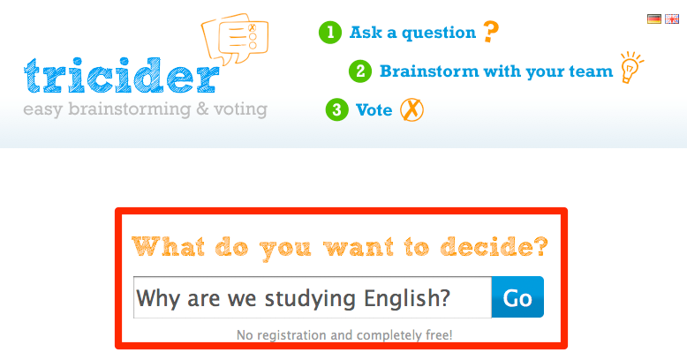
https://goo.gl/TnokD4 Tricider
Notes:
https://goo.gl/TnokD4

Slide 17
MOOCs…..
  are open to anyone – no mandatory qualifications
  have no fees for study
  Offer a Flexible Learning Schedule
  Work together on common goals.
  have enrolments at start >>> learners at end
  have learners who are not students of universities
  are fully online
  are very lightly tutored & supported
  Develop digital literacy Skills .
  do offer assessment (in various forms)
  have low study hours per week, on modules not degree programs
  offer ‘certificates of completion’ rather than credits (but…)
FARID HAMDAN , Killarney 2018
Notes:
Digital literacy refers to an individual's ability to find, evaluate, produce and communicate clear information through writing and other forms of communication on various digital platforms. Digital literacy showcases an individual's grammar, computer, writing, and typing skills on platforms, such as, social media sites and blog sites

Slide 18

Why are Universities doing this?
  Reputation – early adopter of educational technology
  Exploration of a new pedagogical ‘space’ to inform practice
  Wish to reach more courses .
  Sharing experiences with peer universities
  Fun !

Slide 19
Globe Mooc Model In Israel
Identification an appropriate short course in a well known academic university .
https://www.edx.org
2. Globe Teachers Motivation Globe Students .
3. Globe Social Media for Globe Schools Collaboration .
https://www.futurelearn.com/courses/grow-from-soil-to-sky/2/register
https://www.futurelearn.com/courses/grow-from-soil-to-sky

Slide 20

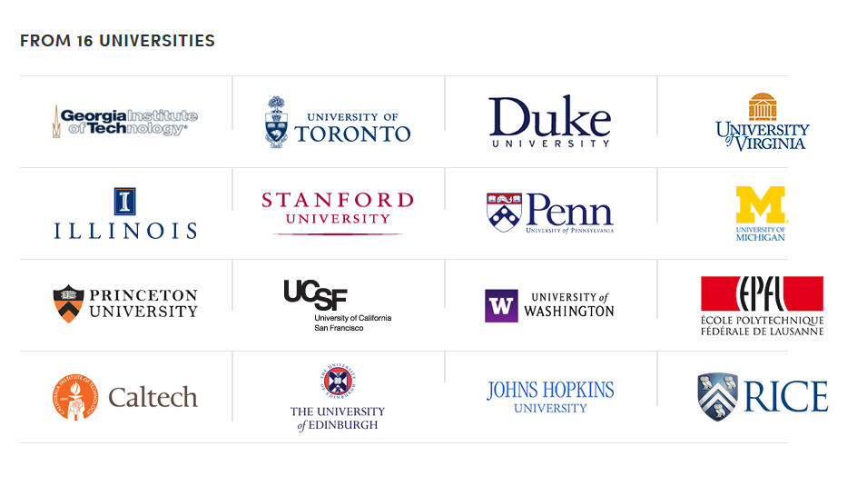

Slide 21
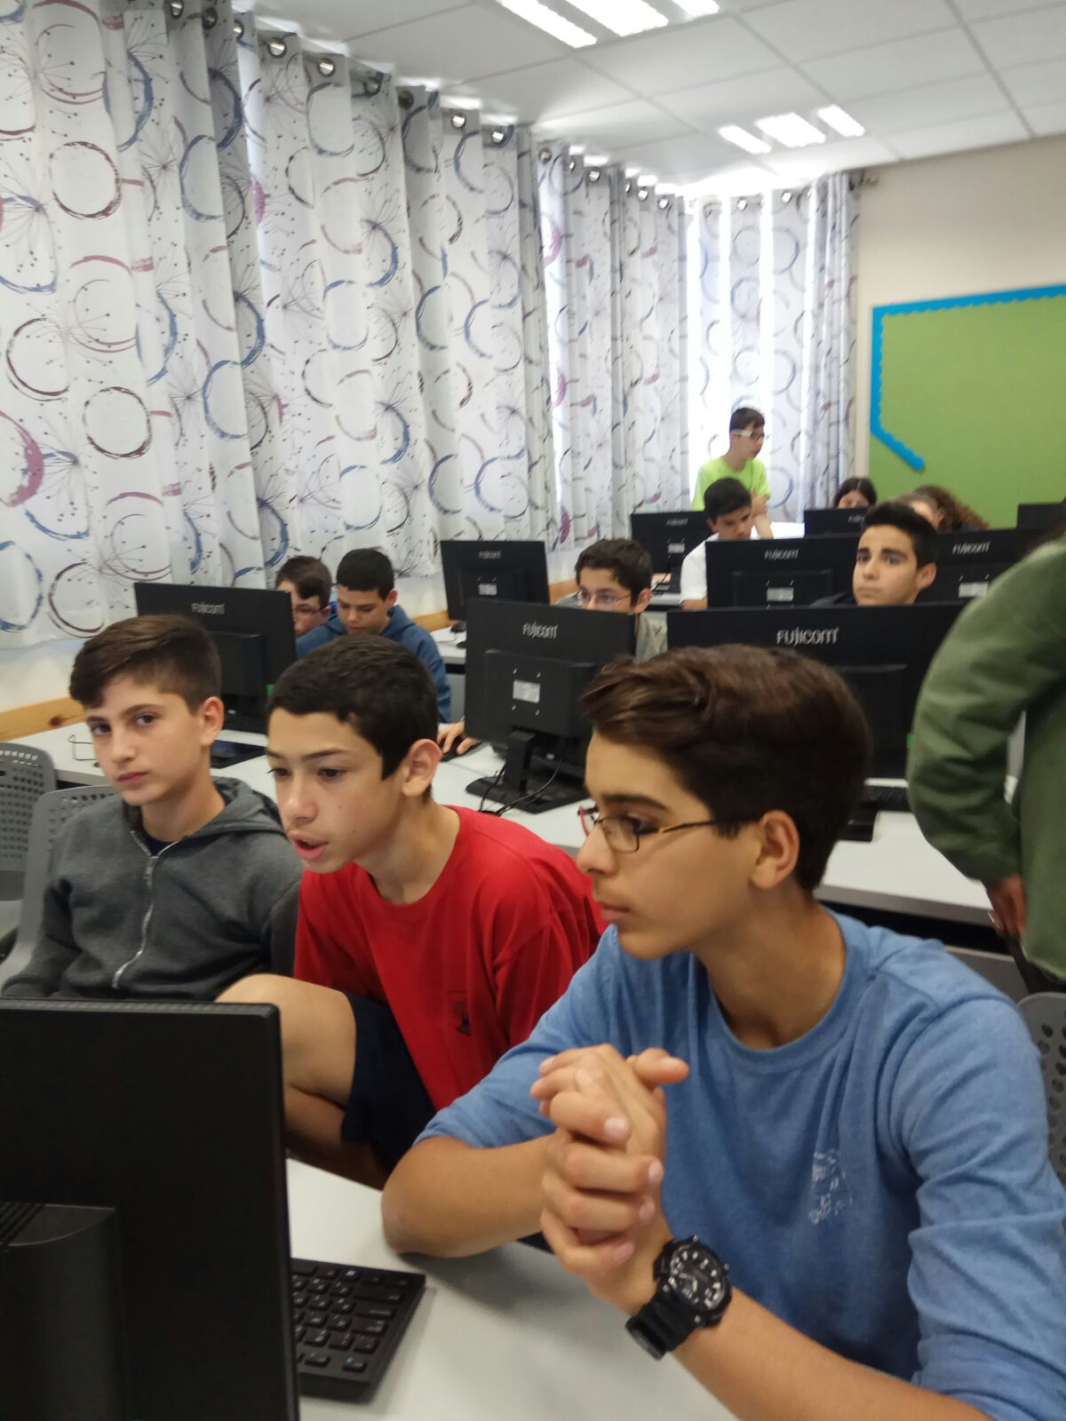
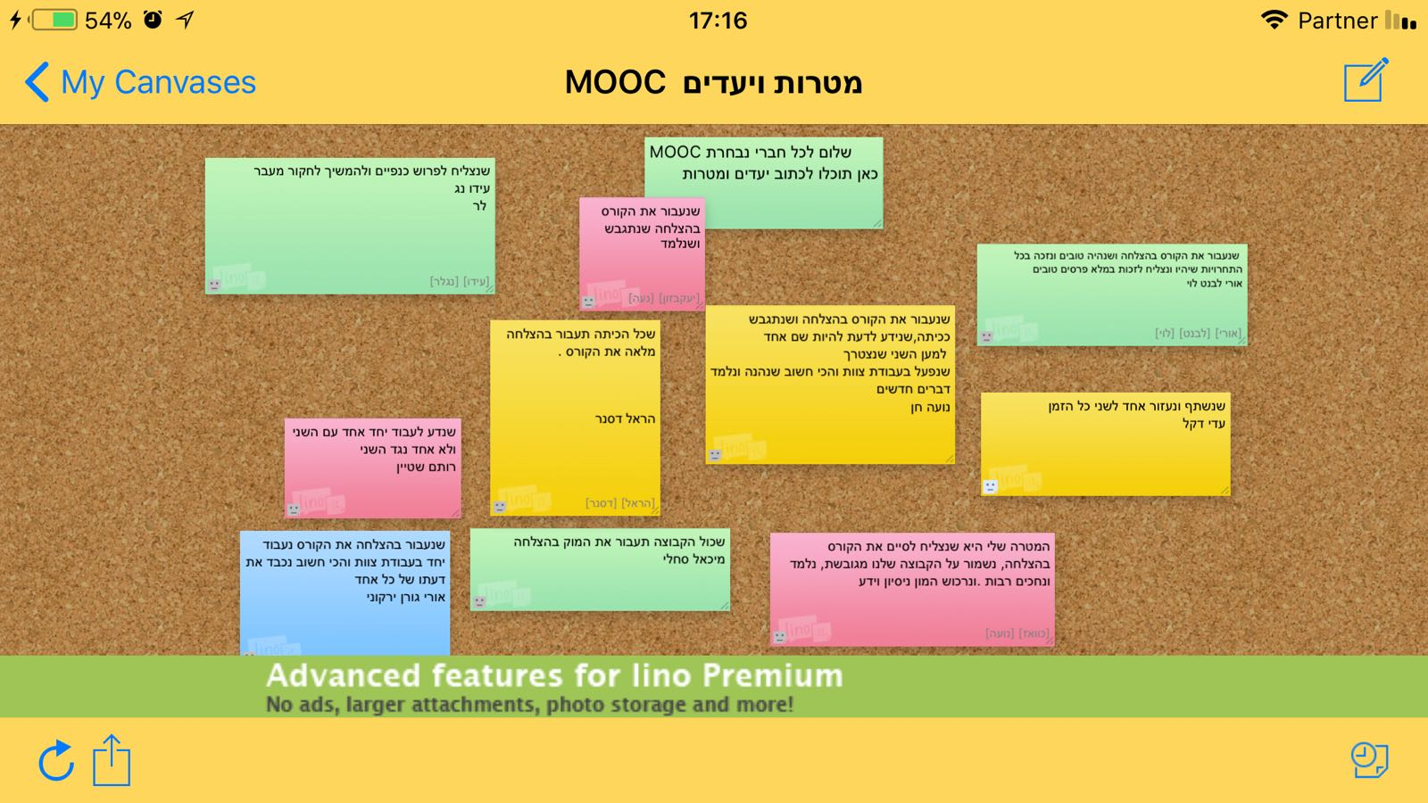
Globe Mooc Model In Israel
The most popular way to work together !!
First, We made a list of goals that we want to achieve in the course .
Our mentors (students from the class) divided the class randomly, into five groups of six students in each group.
Every group worked on a different assignment in a specific module.
project globe.mp4
Our mooc subject was FROM SOIL TO SKY .
DUNDEE UNIVERSITY / AUSTRALIA .

Slide 22
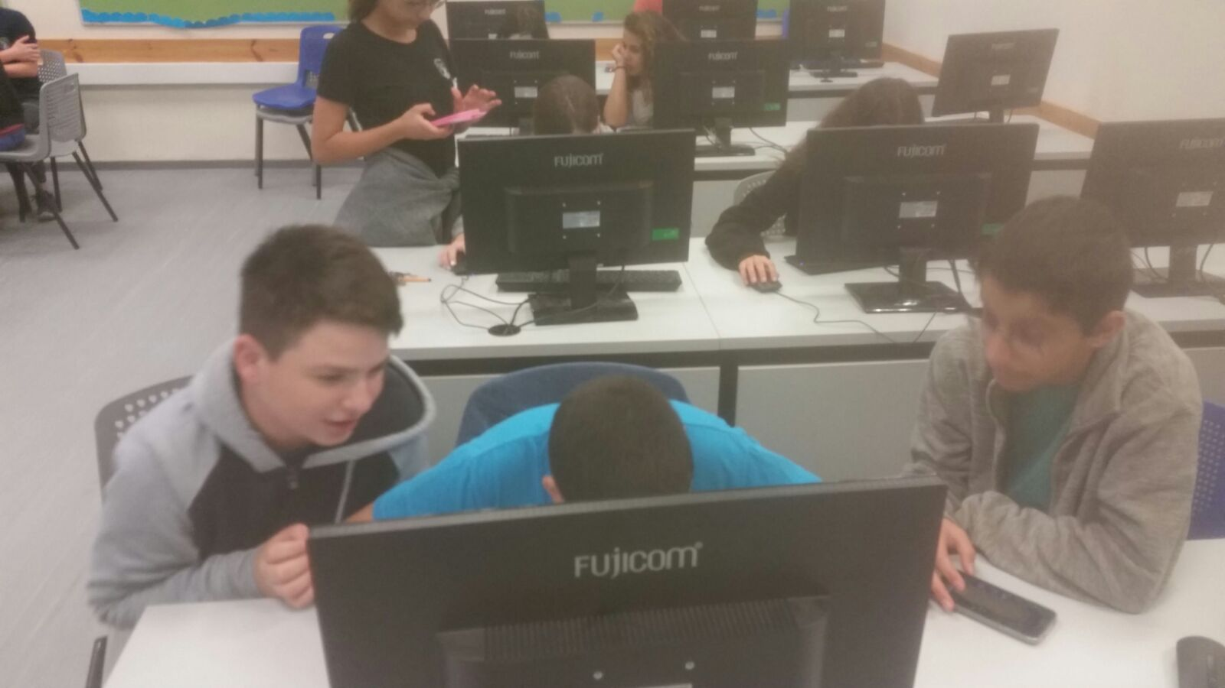
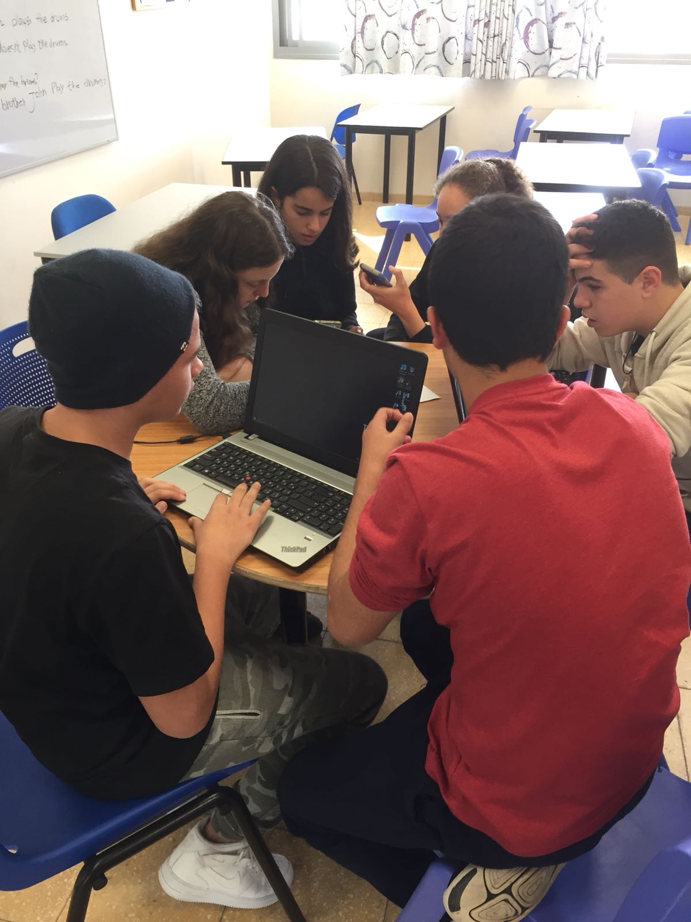
Feedback by Globe Israeli Students (Jewish ,Arabs, Religious , Secular)
We have enjoyed taking part in the Mooc course.
It was an amazing and learning experience for every one as a team.
We learned about the soil, kind of soils and how to conduct a research.
Our vocabulary has been enriched, and we have acquired new tools in research, in communication that we didn’t know before.
We became more united and as we worked in a team each student has contributed his personal knowledge to the process until we have achieved successfully our assignment.

Slide 23
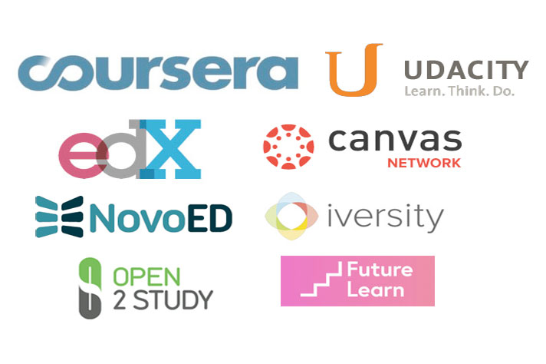

GLOBE MOOC ISRAEL 2019
Mrs.Kohavit Lankary

Slide 24
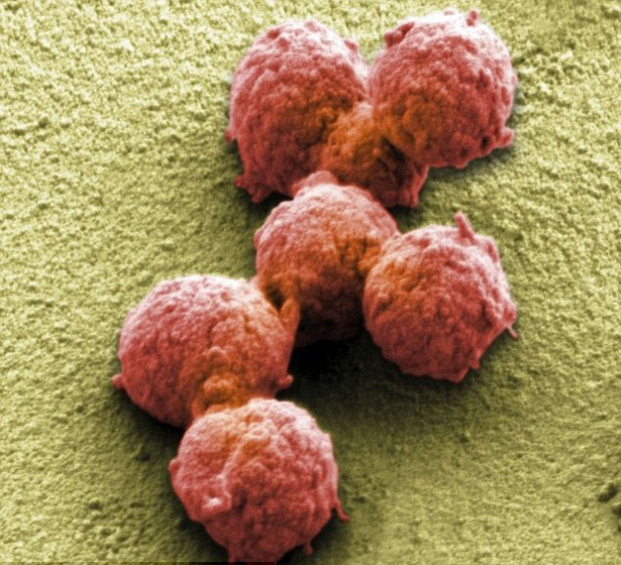

Types Of ידום דיאלוג
https://prezi.com/view/qkeFIAkhDmHT54qbQEhg/
A digital collaborative issue where scientific question of a
sciencific can be proposed
ניתוח ודיון שיתופי של מאמרים וסוגי מידע ברשת
Notes:
להכניס מסמך שיתופי - לעבודה

Slide 25

Digital Science For Collaborative Learning
Enhances Problem-solving Skills
Inspires Critical Thinking
Improves Social Interactions and Supports Diversity
Aid the Development of Self-management Skills
Development of Oral Communication Skills
Fosters the Development of Interpersonal Relationships
Collaborative learning not only enhances the learning process but also makes students happy.
Dr. Farid Hamdan –Globe NC -ISRAEL .
Fredi2811@gmail.com
Notes:
https://www.eztalks.com/online-education/advantages-of-collaborative-learning.html

