Slide 1
LICEO DE PARAÍSO
Students:
Mauricio Vargas Montero
Angie Araya Zúñiga
Teachers:
Rocío Brenes Corrales
Vera Brenes Corrales
Iván Orozco Abarca

Slide 2
Name of the project
Comparative analysis of water quality in the Pollo River in three points of its course.

Slide 3
Research Question
Does water quality of the Pollo River vary throughout its course?

Slide 4
Hypothesis
1- If the “Chilera Kamuk”, located near Pollo River, has no water treatment plant, then its waste pollute the waterway.
2- If the inhabitants of the Pollo River deposit solid and liquid waste, then they pollute the river.

Slide 5
Main Objective
To determine water quality in the Pollo River in three points throughout its course in the district of Paraíso.

Slide 6
Specific objectives
1- To define three research points in the course of Pollo River in the district of Paraíso.
2- To apply in each one of the points the Leaf Pack protocol, GLOBE protols using the Xplorer-GLX and a toxicology essay.
3- To analyze the results obtained in the three defined points.
4- To communicate the obtained results to the community through the students.

Slide 7
Macroinvertebrates
Conceptual framework
Small animals with no backbone and can be seen without a microscope.
Among them we have: insect larvae like mosquitoes, gadlies, caddisflies that are born in the water and then turn into terrestrial insects when mature. Also snails, crayfish, worms and leaches.
These creatures inhabit mud or gravel in the bottom of ponds or streams.

Slide 8
Macroinvertebrates
Conceptual framework
They can tell us a lot about conditions of a body of water.
Many are sensitive to changes in pH, dissolved oxygen, temperature, salinity and other habitat parameters.

Slide 9
Macroinvertebrates
Conceptual framework
They show not only water quality but ecosystem situation.
Present in almost all types of aquatic habitats.
Many species
Sedentary
Long life cycles that show effects of intermittent disturbal, variable concentrations.
Easy to collect and identify.

Slide 10
LEAF PACK NETWORK
Conceptual framework
Network of teachers and students that research ecosystems of local rivers, using experimental packs of leaves that provide important information about the relationship between forests around rivers and the ecology of waterways.

Slide 11
LEAF PACK NETWORK
Conceptual framework
Experiment involves preparation of artificial pack of leaves (dry leaves placed in net bag), placing of the pack in the waterway for three to four weeks and study of the packs in class to discover the different types of aquatic insects used as indicators of the river´s health.

Slide 12
Ecotoxicology
Conceptual framework
Used for ecotoxicology essays and evaluating methods for water quality.
Studies and analyzes the effects of chemical and physical agents on living organisms, with particular attention to populations and communities of defined ecosystems.
Objective of developing essay protocols to be used as early prediction tools that allow defining adequate places with acceptable levels, and working as guides for regulatory entities for decision making.

Slide 13
Ecotoxicology
Conceptual framework
Developed through a sampling program collecting a portion of material that represents the true composition of the sample; which is why the quality of data will depend on activities like:
Formulating particular objectives of the sampling program
Collecting representative samples
Developing an adequate management and preservation of samples
Performing an adequate analysis program
These activities are essential to assure that the environmental data have quality and validation.

Slide 14
Xplorer-GLX
Conceptual framework
PASCO´s manual informatics system of data acquisition, graphic generation and analysis designed for the study of environmental sciences and monitoring of water quality in rivers, lakes, ponds, wells or any other type of freshwater source.

Slide 15
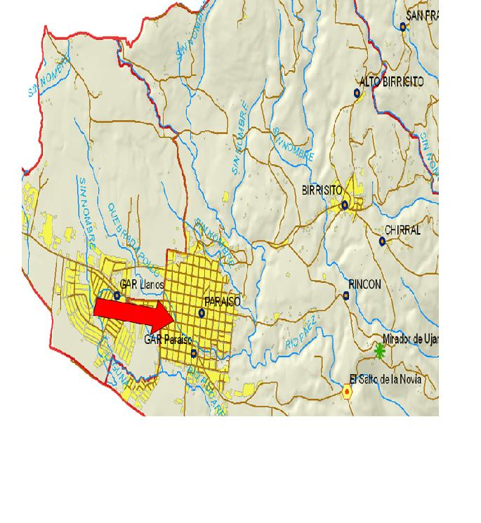
Pollo River:
Belongs to the Reventazón-Parismina Watershed. Located in the Province of Cartago, County of Paraíso, District of Paraíso.

Slide 16
Study Site Description
Site #1.
Latitude: 9, 842789 North
Longitude: 83,875229 West
Altitude : 1380 meters above sea level
Waters were clean, branches and leaves in the river, surrounding vegetation with Heliocarpus, Ficus, Acnistus, Erythrina
To the north there was a fence that divided a plant nursery from the residence were site #1 was defined.

Slide 17
Site #2 Latitude: 9, 842438 North Longitude: 83,877475 West Altitude : 1362 meters above sea level
This site is located 25 m east of La Chilera industry in Paraíso.
Vegetation like:
Coffee plantation
Heliocarpus, Ficus, Acnistus, Heliocarpus, Erythrina
Three pipelines that discharge in the river, one from Chilera, one from the gutter and one from the river.
Trees and rocks
Very dirty water with a very strong and unpleasant smell like rotten pepper, which causes stinging in the nose, throat and eyes if close to the water.

Slide 18
Site #3 Latitude: 9, 837036 North Longitude: 83,867691 West Altitude : 1333 meters above sea level
300 m north of Liceo de Paraíso:
In this site we found a lot of bamboo and epiphytes that hang from the branches of trees. There are homes on both sides and a pipe is seen to the south discharging soapy water to the river.
Garbage like paper, cans, bottles, tyres, and others is seen.
The owner of the home to the north of this site has reforested it with various trees.

Slide 19
Methodology
A total of 4 fieldtrips were made to the different sites. The first and second fieldtrip correspond to the application ot the Leaf Pack protocol, On the third fieldtrip samples were collected to apply the toxicology essay and on the fourth fieldtrip the Xplorer GLX was used to conduct GLOBE protocols.

Slide 20
Methodology First and second fieldtrip
On the first and second fieldtrips work with the Leaf Pack protocol was performed, which is why at least three types of common leaves were collected on site, they were weighted so that when a mass of 30 g was obtained they were introduced in a net bag with the site name.

Slide 21
Methodology First and second fieldtrip
They were then placed and held in the chosen site in the river. 3 weeks later they were removed to collect the macroinvertebrates found in them and classify them.

Slide 22
Methodology Third fieldtrip
A water sample was collected from each site. Afterwards onions were used by placing them in the water samples in labeled Gerber jars. Also, tap water was used as a control of normal growth in the test and salt water as a positive control, meaning roots would not grow here. Three water samples were used on each site to place the onions in. After three days, the roots were measured with a ruler. A change in the normal growth of the roots is used as an index of toxicity.

Slide 23
Methodology Fourth fieldtrip
The Xplorer-GLX was used as a data adquisition tool to carry out GLOBE protocols.
Used to locate latitude, longitude and altitude of the defined sites. Also, three measurements of dissolved oxygen, pH, temperature and conductivity were collected on each one of the sites and later averaged.

Slide 24
Results
After classifying the collected macroinvertebrates from each one of the leaf packs, the Leaf Pack protocols was applied and the following results were obtained:

Slide 25
Macroinvertebrates
Table # 1 Site # 1
Date: 6/14/2011
Latitude: 9.84325 North Longitude: 83.875150 West
Ambient temperature: 27°C
Date : 6/14/2011
Ambient temperature: 26°C
Time: 12:25 p.m.
Name | Quantity
Chironomidae | 1
Other Trichoptera | 1
Molluscs | 1

Slide 26
Macroinvertebrates
Table # 2 Site # 2
Fecha : 14/6/2011
Latitude: 9.836940 North Longitude: 83.875031 West
Ambient temperature: 23°C
Date : 6/14/2011
Ambient temperature: 26°C
Time: 1:28 p.m.
Name | Quantity
Chironomidae | 18
Annelidae (Oligochaeta) | 4
Molluscs | 1

Slide 27
Macroinvertebrates
Table # 3 Site # 3
Date : 6/14/2011
Latitude: 9.842620 North Longitude: 83.867720 West
Ambient temperature: 20°C
Date: 6/14/2011
Ambient temperature: 22°C
Time: 2:11 p.m.
Name | Quantity
Coleoptera | 3
Molluscs | 1
Ephemeroptera | 5

Slide 28
Results Analysis
After applying the Leaf Pack Network protocol we obtained the following results:

Slide 29
Calculation for macroinvertebrate analysis
Table # 1
Category | A # Total in pack | B # Average of all packs | C Pollution tolerance value | D Total tolerance value
EPHEMEROPTHERA | 5 | 1,66 | 3,6 | 6
Other Trichoptera | 1 | 0,33 | 2,8 | 0,93
COLEOPTERA | 3 | 1 | 4,6 | 4,6
CHIRONOMIDAE | 1 | 0,33 | 6 | 2
Other Diptera | 18 | 6 | 6 | 36
GASTRÓPODA | 3 | 1 | 7 | 7
OLIGOCHAETA | 4 | 1,33 | 8 | 10,66
Total | 35 | 11,65 |  | 67,19

Slide 30
Calculation for macroinvertebrate analysis
EPT Richness (Number of categories Ephemeróptera, Plecoptero and Trichoptera, indicators of good water quality) = 2
Number of distinct listed categories with the exception of LPT richness = 5
5 + 2 = 7
Variety of categories + EPT Richness = Total diversity

Slide 31
Calculation for macroinvertebrate analysis
% of EPT
Step 1: EPT number (Ephemeróptera, Plecoptera and Trichoptera) = 6
Step 2: Divide value of step 1/ Macro total
6 / 35 = 0,1714
Step 3: Convert to percentage multiplying value from step 2 * 100
0,17 * 100 = 17,14 % EPT
% of EPT = 17,14

Slide 32
Calculation for macroinvertebrate analysis
Biological index: represents the sensitivity or relative tolerance of macroinvertebrates to environmental stress
Sum of total tolerance value column in table #1 = 67,19
Divide tolerance value / # Average of all packs = 11,65
Biotic index = 67,19 / 11,65 = 5,76
Water quality evaluation = Medium
(Possibility of considerable organic pollution)

Slide 33
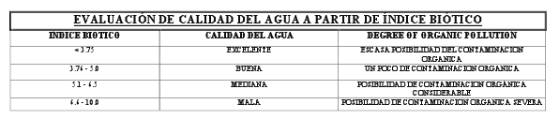
Calculation for macroinvertebrate analysis

Slide 34
Results
72 hours after the onion bulbs were placed in the water samples the following results were obtained:

Slide 35
Toxicological essay
Table # 5
Increase in root size in the onion bulb after remaining in the sample 72 hours.
Tap water |  | Water with sodium chloride |  | Site # 1 |  | Site # 2 |  | Site # 3
# 1 | # 2 | # 1 | # 2 | # 1 | # 2 | # 1 | # 2 | # 1 | # 2
1 cm | 1cm | 0 cm | 0 cm | 3,25 | 2,25 | 2 cm | 2,15 | 1,5 cm | 1,25

Slide 36
Result analysis
After applying the toxicology essay to the samples we observed that there is presence of toxicity because there was a change in the normal growth of roots in relation to the control sample, nevertheless, root growth was greater in one of the samples from site #1 than in the samples from the other sites which indicates a higher presence of toxins in that site.

Slide 37
Results
Using the Xplorer-GLX to carry out GLOBE protocols, the following data was obtained on each one of the sites:

Slide 38
GLX Measurements
Table # 4
Date : 9/27/2011
 | Site # 1 | Site # 2 | Site # 3
Time | 7:30 a.m. | 7:40 a.m. | 2 p.m
Latitude | 9,842789 North | 9,842438 North | 9,837036 North
Longitude | 83,875229 West | 83,877475 West | 83,867691 West
Altitude | 1380 | 1362 | 1333
Water temperature average | 19,12 | 19,59 | 22,22
Dissolved oxygen average | 2,96 | 2,7 | 1,2
pH average | 7,48 | 7,30 | 7,26
Conductivity10X average | 176 | 202 | 265

Slide 39
Result Analysis
From the measurements take with the GLX on the three sites we observed the following:
The water temperature in the first two sites is very similar but the one on the third site is around 2 degrees higher.
The presence of dissolved oxygen is higher in sites #1 and #2 than in site #3
pH value is very similar on all sites.
Conductivity increases along the river course, being lower on site #1 than site #2 and this one lower than site #3.

Slide 40
Conclusions
After applying the Leaf Pack protocol we could see that for the comparative research we made it was necessary to place three packs of leaves on each site because when we evaluated water quality we obtained a general biotic index which was not useful to compare between the three sites.
The results obtained from the toxicology essay prove that there is a higher presence of toxins in the water on site #1 than in the other two sites which concerned us a lot because most of the potable water consumed in the community comes from a spring close to this site.

Slide 41
Conclusions
Although water is necessary for crop growth, if water from Pollo River is used for irrigation, the food we consume could come to our tables polluted, affecting our health.
When comparing the obtained results from the three sites of the river, we determined the presence of pollutants throughout the course of the river, this becomes worse when going through the community, because levels of dissolved oxygen decreased on the third site.

Slide 42
Conclusions
In respect to pH, a normal range was observed, which is why, considering the degree of pollution, it would be advisable to research it posteriorly.
Ranges of conductivity along the course of the river are within the normal range, although we observed an increase, being lower on site #1 than site #2 and this one lower than site #3.

Slide 43
Conclusions
After analyzing the water from all three selected sites in Pollo River to perform our research, we believed Chilera Kamuk was polluting its course by depositing its residues in the river, surprisingly, the obtained data demonstrate that before collecting these residues the water is already polluted, which is why, we will posteriorly research starting from the spring to determine which are the main sources of pollution.

Slide 44
Conclusions
After performing our research we think Chilera performs some sort of water treatment because, even though it is the site which seems most polluted and shows the worst smell, results show us it is not the one with the most toxins or least amount of dissolved oxygen.

Slide 45
Conclusions
Inhabitants of the community of Paraíso pollute Pollo River with their solid and liquid waste because we observed pipes draining on it in all three sites. Furthermore, obtained results in this research show that on site #3 dissolved oxygen decreases and water temperature increases, meaning there is a higher presence of pollutants.

Slide 46
Recommendations
To inform municipal entities and the Ministry of Health of the obtained results from this research to have their support and obtain more specialized results.
To communicate the obtained results from this study to inhabitants of the community so other entities are seeked to support us to increase water quality in Pollo River.
To perform a new investigation starting from the spring all the way to the first analyzed site in this study to determine other sources of pollution.

Slide 47
Recommendations
For a better result with the Leaf Pack Network protocol in researches than compare results from different sites within a river, three packs of leaves should be places on each site because it is the most effective way of doing a comparative analysis; doing it with only one pack limits the result.
Let the student body of Liceo de Paraíso know about the researches and results obtained with the GLOBE program as a serious, scientific and attractive learning program.

Slide 48
Recommendations
To create awareness among the community inhabitants, of the harm done to the Pollo River´s waters when waste from homes are poured into it so that adequate waste management is done.
To coordinate with Kamuk a study of the water treatment they perform before pouring their waste in the river.

Slide 49
LIMITATIONS
We did not have the economic means to send the results to specialized laboratories and obtain more precise data to complement our research.
When applying the Leaf Pack Network protocol, we only used one leaf pack on each site, which did not allow a comparative analysis because the results were given in a global fashion.

Slide 50
Bibliography
Castillo, Gabriela. Ensayos toxicológicos y métodos de evaluación de calidad de aguas. Centro Internacional de Investigaciones para el Desarrollo. Instituto Mexicano de Tecnología del Agua.
Fundación Omar Dengo. Abril 2011. Compendio de materiales Guía de trabajo en Hidrología. Programa Internacional GLOBE.
Notes:
de

