Slide 1
Climate Change Correlation With Malaria Cases
Kaitlin Stessney
Akron, Ohio
Roswell Kent Middle School

Slide 2
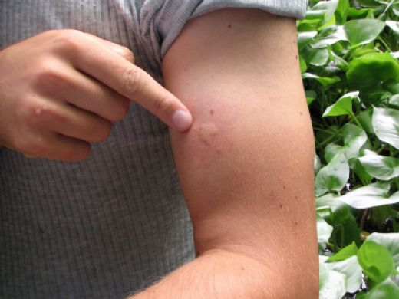
How did I come across this project, and how did I do it?
One day we were studying Malaria in Science and it sparked my interest because, here in Ohio, there are a lot of mosquitoes, and I happen to be allergic to mosquito bites and they get all swollen and yucky.

Slide 3
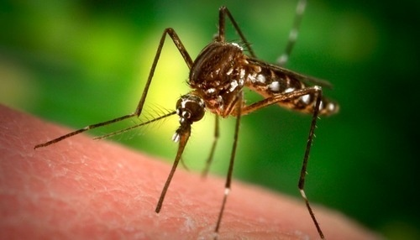
That made me begin to start wondering, Could Malaria come to Ohio, or other highly populated areas? So, I started researching about Malaria and discovered that Malaria is a bacterial virus transferred through the saliva of the female Anopheles mosquito, but there are over 50 different types of the Anopheles mosquitoes.
50+

Slide 4
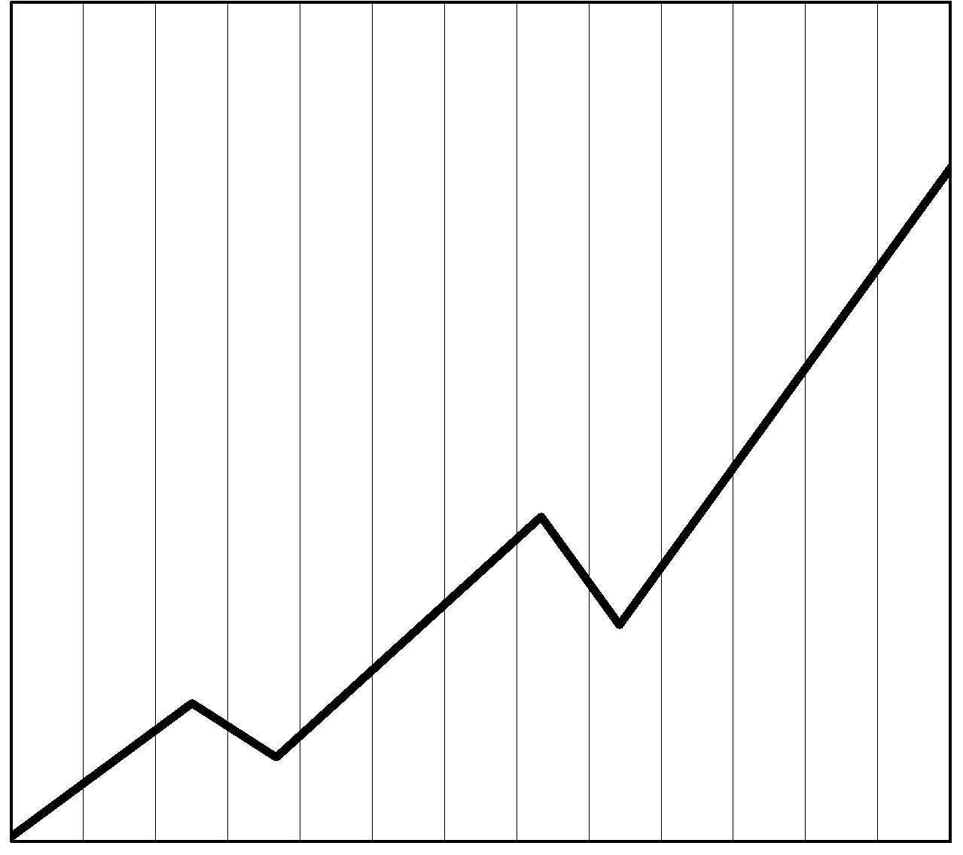
One variable for the female Anopheles mosquito to survive is that that average air temperature has to stay tropical. This was the variable I based my project off of, the air temperature verses the amount of Malaria cases. I chose climate change because it’s the weather over a period of 30 years at the minimum and thought that it would show the results better than just a few years.

Slide 5
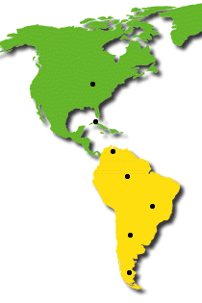
I decided to make the area of my test rather large by choosing seven cities 11.5° North and South of the equator. Each city is in between 60° and 120° longitude, under 100 meters in elevation, and is in an urban area.

Slide 6
I got air temperature data for each city from the GLOBE website but, for the years of data that were not available, I took the data off of Wunderground, a weather database, for the thirty year period with increments of five years.
G lobal
L earning
O bservations to
B enefit the
E nviroment

Slide 7
I then went on to medical websites to get the amount of Malaria cases for each city for each year, next I compared the two variables by putting them both in a graph for each city for every five years dating from 1980 to 2010. My hypothesis is that I think that as the air temperature rises or falls the amount of Malaria cases with rise or fall with it in a correlating pattern.

Slide 8
The next few slides are a comparison between my least effected area and my most effected area. These graphs perfectly represents my data. The red bars are the amount or Malaria cases per month, and the blue line is the average air temperature per month in degrees Celsius.

Slide 16
My data does support my hypothesis greatly. I hope to expand my project to different countries, different variables, and hopefully, constant results. I will try my hardest to continue this project year after year and combine all of them into a giant senior project. I also hope that my project will help doctors and scientists with some understanding of Malaria, and to help keep others as well as myself safe. (:

