Slide 1

The Kingdom of Saudi Arabia
Prince Saud bin Naif Educational Complex, Dammam
(The GLOBE program)
Mangrove is Wealth
Extinction of Mangroves Plant from the Coast of the Eastern Region
(Problems and Solutions)
Researchers (GLOBE Students ):
Muhammad Jabr Al Naimi, Fawaz Saleh Al Rasheed and Ghanem Ali Al Ghamdi
Under the Supervision of GLOBE Teacher:
Aali Al Zahrani

Slide 2

Introduction
Eastern Region and Arabian Gulf coast suffering in general from many environmental problems, especially after the Gulf War in 1991 . Also, by virtue of the site of trade and commercial exchanges and the movement of oil tankers.
As well as spread in recent time big environmental problem which is bridging and dredging on the coast of Eastern Region and Arabian Gulf in order to urbanization.
Here in this research we like to point out these problems, the environment and its impact on marine organisms, particularly mangrove plant. So in this research we will give some information about the mangrove plant and its importance as well as the environmental problem filling and dredging and caused problems for the environment. Then we will present some recommendations to solve this environmental problem which will coming strongly to the Arabian Gulf.

Slide 3
First: Scientific background
(1)What is mangrove plant ?
Mangrove trees Perennial evergreen grows in the marshes with salt and fresh water, As well as growing near the shores of the sea in areas of tidal flood water so that water drown the root group Permanently.
Mangrove grows mainly in tropical and subtropical protected severe ocean currents, but it can grow in areas prone to storms.
There are many classification of mangrove combine common features. These trees bear the extreme salinity of the soil as it bears to live in oxygen-poor soils. So it is able to grow in moist soil or water immersed completely.
The scientific name of the mangrove is «Avicenna - Marin», The common name is a compound of two words : the first Portuguese «Mangue» means the tree, And the second English «Grove» means «origin of trees».
The mangrove trees known to the Arabs, the old name called «Al-Qarm». Have been mentioned by bin Mandor in “Lessan Al-Arab”

Slide 4
(2) Mangrove Plant environments
Mangrove trees grow in the tropics and subtropics, Specifically in the coastal environments saline or brackish, And relatively low exposure to strong waves, Such as small gulfs ending to the coasts as a help to break the power of the destructive waves of small plants, Lakes and estuaries, or shallow areas in the islands near the coast. It is grown at the border between sea and land.
Mangrove need water swamps rich in organic matter to grow healthy.
It can also live in the sand with few coarse pores, and does not harm it if this sand covered with mud.
As they grow without problems in some areas where the salinity concentration of at least.

Slide 5
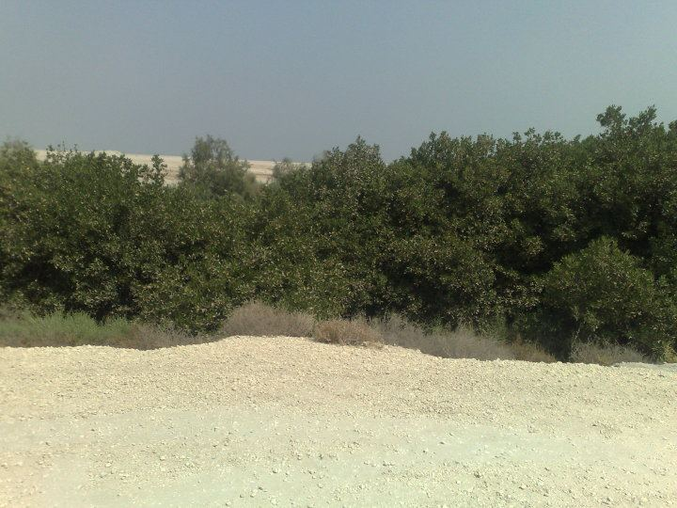
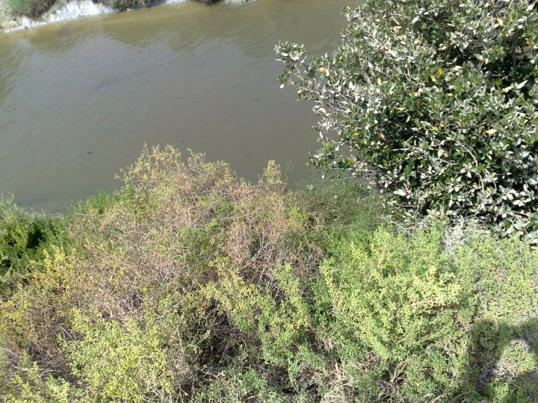
(3) Pictures of mangrove plant

Slide 6
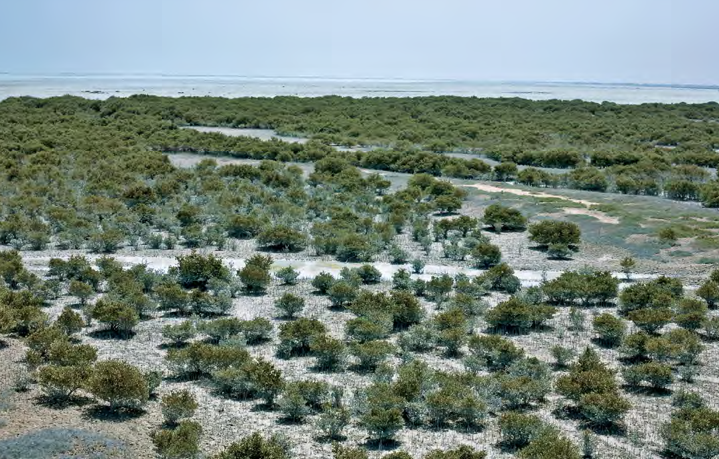
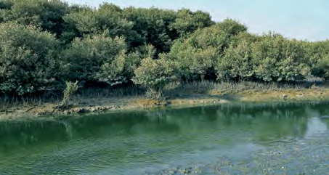
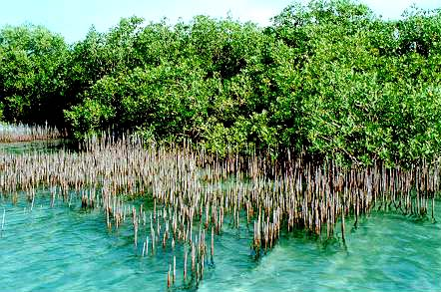
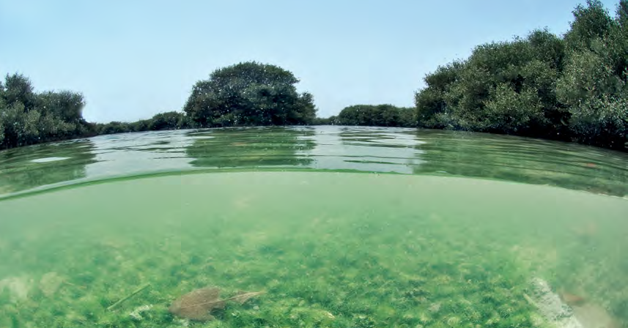
Different environments of mangroves plant in Saudi Arabia

Slide 7
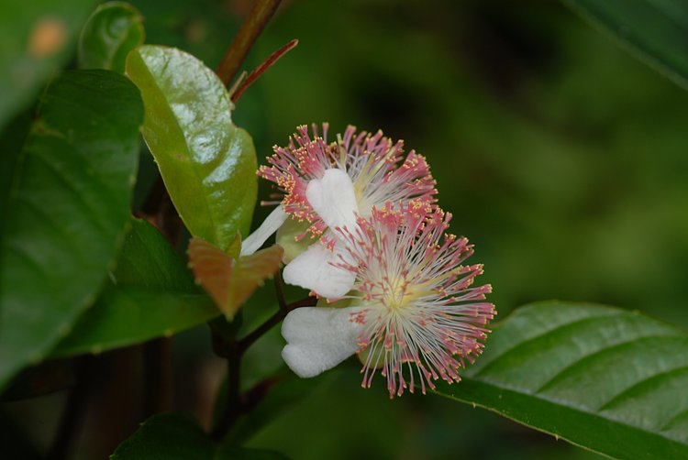
(4) Methods of reproduction of the mangrove
This plant reproduces by Spindle-shaped seeds.
Transmitted by portable water from one region to another.
Where comes out from the seed a strong root, instilling in the soil roughly similar to the way the coconut grows.

Slide 8
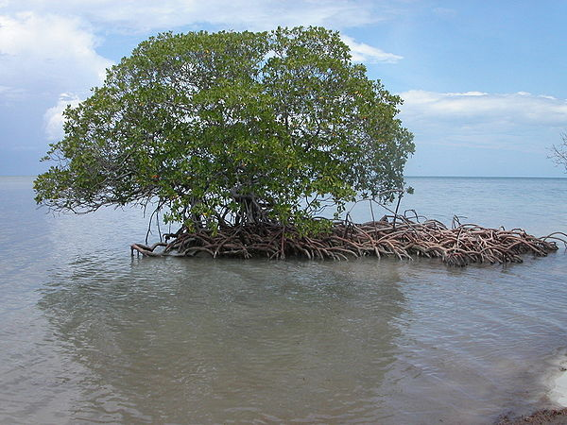
(5)The benefits of mangrove plant
The mangrove is the community for many small fish and invertebrates and many plants and animals (outstanding), as well as large birds, Where there are Food Network based on organic production of coastal mangrove swamps.
The local population use branches as fuel high-value. This explains the heavy damage that occurs to groups of this plant near residential areas.
Fish that live in shallow water usually, came with tidal waves to these areas to feed on the invertebrate marine organisms that live in these shallow ecosystems.

Slide 9
4-Mangrove forest protect beaches from erosion and contribute to the growth of the wild and marine environment.
5- The source of the hormones components such as turbines and steroids as well as the presence of a Coumarin compound, which is the source used in drugs combinations .
6-Mangrove seedling plants extract was used in ancient tonic for men.
7-Extracted from it medical supplies to treat gum disease and liver disease.
8-A recent chemical analysis of parts of the developing mangroves plant on the coasts of Saudi Arabia, turned out to contain materials that are the source for the production of tonic hormones.
9-Help to build the soil by collecting sediment around the prop roots and aerobic respiratory root.
10-Its produced large amounts of the crumbs which in turn will participate in the productivity of many Beach objects.
11-Interlocking veins of the tree works as a filter combines contaminated materials and prevent them from moving to the sea. This may harm it, but it is a fundamental benefit in keeping the water clean.

Slide 10
(6) Factors (problems) that affect the mangrove plant
Mangrove plant Environment exposed to many of the risks that threaten their existence in the world, such as rise of sea level due to warming increased.
Mangrove Exposure to removal and destruction and the continuing deterioration as a result of population explosion and urbanization and conversion of coastal marine areas to residential neighborhoods or ports for ships and shores of the promenade, both in the Kingdom or other countries.
The impact of waste reclamation and dredging.
The impact of sewage on the environment of the mangrove plant, especially in the intertidal areas and nearby islands from the beach.
Over-exploitation of mangrove plants in the process of grazing and collect firewood.
Mangrove plant exposure to the problems of oil pollution as a result of leakage and a result of tanker traffic particularly in the Arabian Gulf , as well as water sanitation and its discharge in the Arabian Gulf.

Slide 11
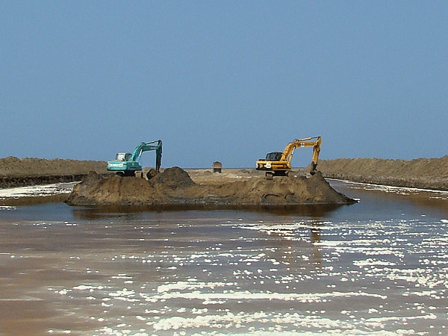
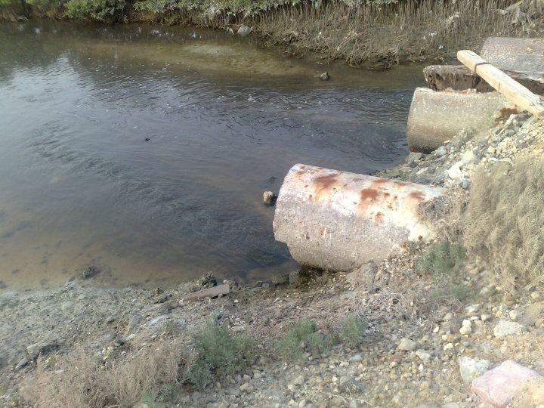
Reclamation and sewage of the most important problems that lead to the extinction of mangrove plant

Slide 12
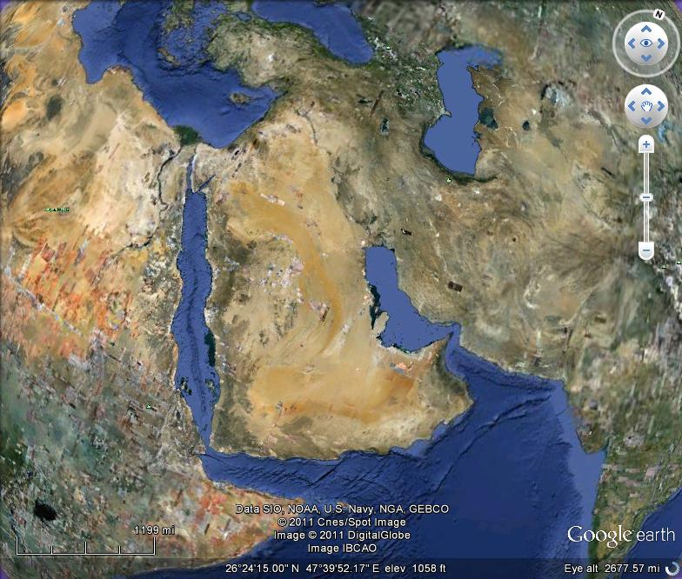
(7) Presence places of Mangrove plant in Saudi Arabia
Located on the shores of the Red Sea and Arabian Gulf. Where there are 204 km 2 mangrove plant in the Kingdom, mostly on the coasts of the Red Sea while there are here on the Arabian Gulf in the neighboring beaches of Abu Ali and Tarot island in the Eastern Region.
And began to die out clearly in the Eastern Region.

Slide 13
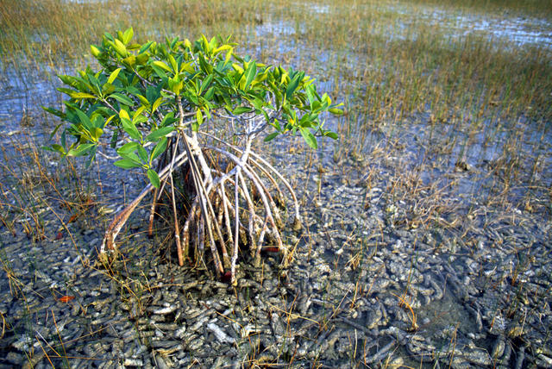
(8)Presence places of Mangrove plant in Eastern Region
Tarot Island, Raheemh city , Safawa, Qatif, Dammam, Khafji,Ras Tanura, Jubail ,
Abu Ali Island.

Slide 14
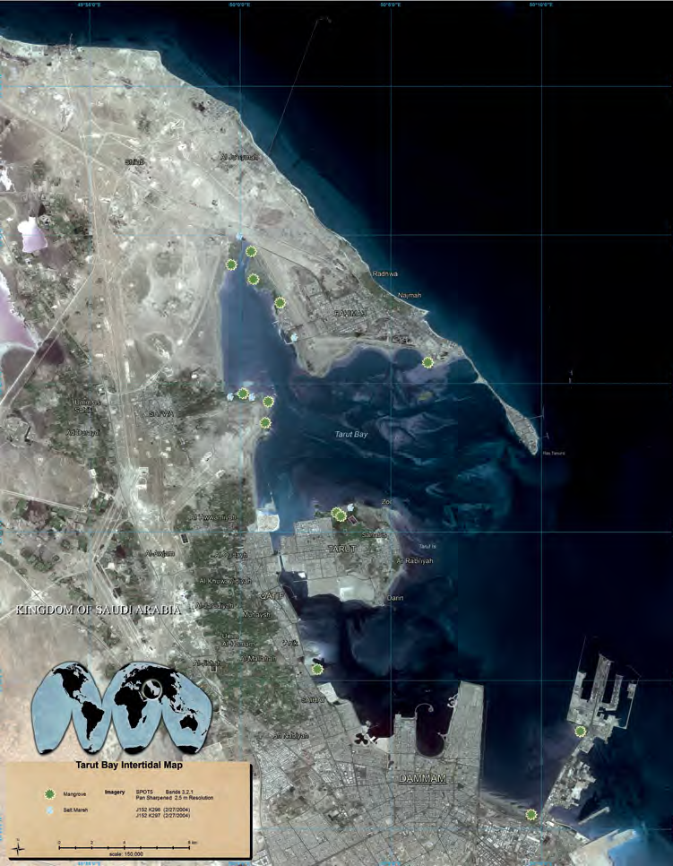
Mangroves spread places in the coast of the Eastern Region

Slide 15
Second : Investigation and visits
In this research we tried to ask questions and try to answer them through visits to government agencies and eligibility institutions specialized, Which is aware of and recognize the importance of mangrove plant on the environmental integration in the Eastern Region coast
Where the first visit to Amant Dammam and interview His Excellency Eng. / Daifallah Al-Otaibi Secretary-General of Amant Al-Dammam, who welcomed us in the beginning, where he expressed his cooperation and guiding us to the Specialist employee about the problem is Ahmed Al-Shahrani
Which confirmed the existence of the reclamation and dredging Committee .
which Established under the ordinance No. 937 / x in Date of 28/09/1419 .
In charge of the establishment this committee to study applications for reclamation and dredging.
it is composed of several government agencies Represented by (Ministry of Municipal and Rural Affairs -Secretariat for the organization - Ministry of Defense - General Authority for Meteorology and Environmental Protection - Ministry of Interior - Border Guard - Ministry of Agriculture - Directorate General for Fisheries -Directorate General for Environment of aquaculture has been added as the Ministry of Finance as a member of the Committee.

Slide 16
He Confirmed issuance of an order No. 1004 dated 01.20.1419 E prevents the filling and it was applied And the imposition of fines by offenders . He also stressed that the concerned authorities in this matter has a great and effective role in the protection of mangrove and coastal plants in general
We have then a visit to the General Presidency of Meteorology and Environment Protection, who assured us that the General Presidency of Meteorology and Environment Protection has active role in common with some government agencies to maintain mangroves plant and try to monitor all the excesses over this plant and make the reasons to maintain it and that by preventing the filling and dredging and the prevention of throwing waste sanitation and waste vessels and leaks oil and address that by technical and mechanical ways, as confirmed to us that the General Directorate of fisheries has role in the cultivation of this plant on the coast of the eastern region under the program implemented with the United Nations and the areas affected by the first Gulf War in 1991
It also confirmed to us by Dr. Asaad Al-dekair (faculty member at King Fahd University of Petroleum and Minerals / Environment Department ) the importance of environmental awareness and attention to mangrove plant and care from extinction.

Slide 17
We also then visited the Saudi Aramco Department of Environmental Health, and they assured us also on the existence of the problem and that there is a role for Saudi Aramco in the social services to the community and the environment to maintain the mangrove plant and awareness
so as we visited the beaches of the island of Tarot and Awamiya and tried to interview some of the fisher men or farmers of the region's people who confirmed that all the bodies and NGOs in the region monitor and prevent abuses on the mangrove Plant
and Mr. Shukry a fisher man from the people of the region, assured us that the fisheries less than in the past because of extinction, and damage to plant mangrove.

Slide 18
Third: filling and dredging and its impact on plant mangrove
The coast of the eastern region Suffer from the problems of land reclamation and dredging which caused serious environmental problems was the most important one is elimination of organisms
the Tarot island was the largest island in the Arabian Gulf 40 years ago it was separated by the sea by a distance estimated at 5 km but because of continued land reclamation and dredging made ​​it attached geographically to Qatif
the estimated area covered by land reclamation in the Arabic Gulf and Red Sea more than 2500 kilometers. Fishermen and who interested in the marine environment afraid of causing reclamation and dredging in the elimination of these rich ecosystems
After the beach was a haven for some small living creatures before they migrate to deep water in addition to that it was full of mangrove plant which is the environment for these organisms. After reclamation and dredging the beach changed and the environmental problem occurred . And the shores of the eastern region were filled with " mangrove“ trees. There was forests along the coasts of many cities, regions and islands of the eastern region.

Slide 19
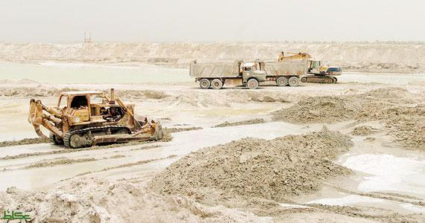
Reclamation and dredging on the coasts of the eastern region

Slide 20
How does the reclamation and dredging effect to mangroves plant and cause many environmental problems?
Mangrove plant is very suitable for the proliferation of a number of large and small fish and invertebrates, plants and animals outstanding and shrimp, as well as large birds, where there are Food network based on organic production of the swamps "mangrove" port, which Accounts for about 60 per cent of the diet of "shrimp“. Also fed by the fish that live in shallow water.
Previously concluded that the over-filling and dredging may destroy the mangrove plant, and when this happens, we do the process of extinction sequence starting from a plant mangrove and ends the disappearance of fish or extinction that feed on plankton and small organisms that live between the mangroves plant and so disappear the birds that feed on fish and thus the effect will be evident in the lack of fish and therefore affected the economy of the fishermen and the consumer.

Slide 21
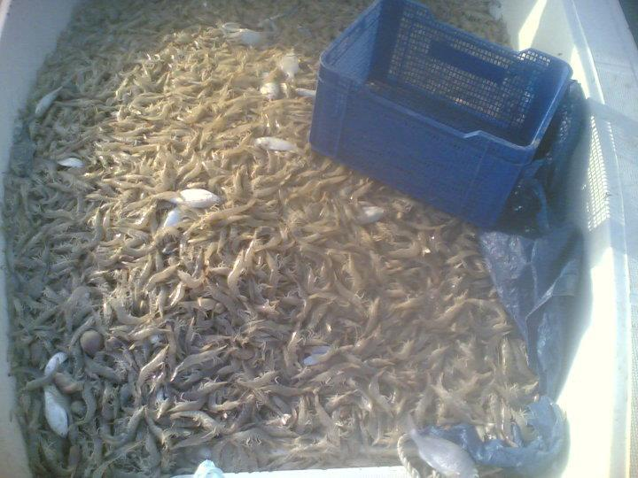
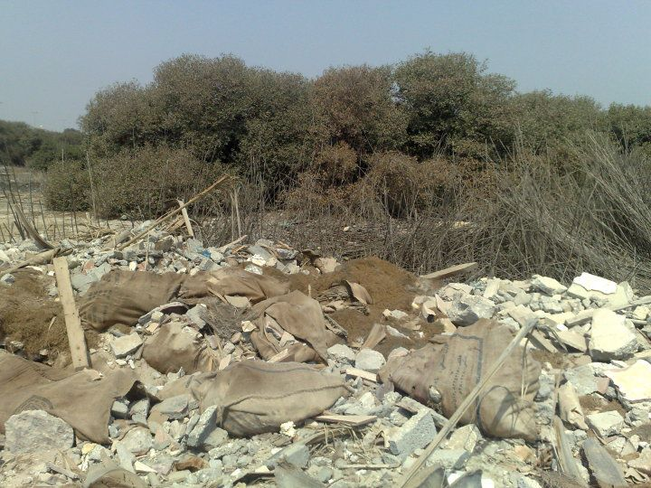
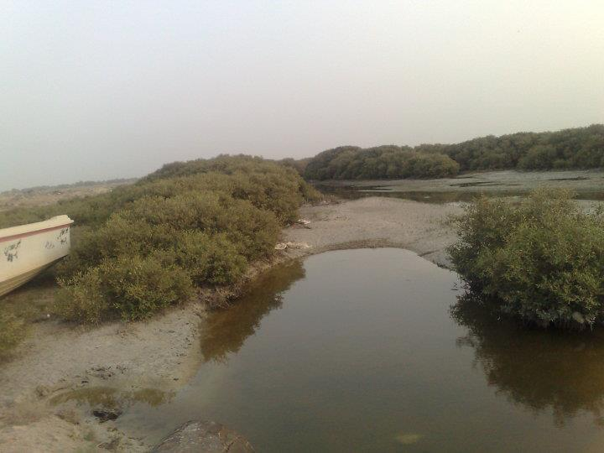

Slide 22
Fourth: Case studies and questionnaires
Dear brother, this questionnaire will help us after God in the task of our research on (the extinction of mangrove plant from the shores of the eastern region) is simply a step in the search index does not entail you when you participate in any responsibility
Name:
Profession
Title (region):
Means of communication:
E-mail:
 | Questions | yes | no | maybe
1 | Do you know the mangrove plant? | 42% | 58% | -
2 | Do you practice the profession of fishing? | 22% | 78%
3 | Are fisheries decreased in the recent period? | 77% | 3% | 20%
4 | Did shrimp less than in the past? | 83% | 7% | 10%
5 | Do you like the beach to be created by the very nature of God? | 83% | 17%
6 | Do you support the beaches bridge in order to the urban expansion and the establishment of housing schemes? | 11% | 83% | 7%
7 | Do you support the bridge to the beaches of development projects (roads - Corniche -bridges and bridges)? | 60% | 7% | 35%
8 | Do you suffer from high price of fish? | 90% | 10%
9 | Do you suffer from high prices of shrimp? | 90% | 10%

Slide 23
Results of the referendum | Questions that have been put forward
Yes, only 42% know it, while 58% do not know | 1-Do you know the mangrove plant?
22% Yes fishing fish while 78% do not fishing fish | 2-Do you practice the profession of fishing?
3% do not know, while 20% did not say no, while 77% confirmed that the fish I said about the former and | 3-Are fisheries decreased in the recent period?
Confirmed that 83% less than in the past where the eastern region was one of the regions of the most availability of shrimp in the world, While 10% found no difference from the past, while 7%do not know | 4-Did shrimp less than in the past?
83% yes, while 17% do not like. This confirms that the nature and the human instinct shore like human nature and try to maintain and benefit from them without damaging it | 5-Do you like the beach to be created by the very nature of God?
83% do not support it while 11% support it and 7% did not know anything about the subject This confirms that the reclamation and dredging of the most important factors in the extinction of mangrove plant and that everyone did not support it | 6-Do you support the beaches bridge in order to the urban expansion and the establishment of housing schemes?
60% do not support it while 35% do not mind to have, while 5% do not know. The answer to this question confirms the community's rejection of the bridge, even for projects and they assert that the development of alternatives and finding another solutions | 7-Do you support the bridge to the beaches of development projects (roads - Corniche -bridges and bridges)?
More than 90% said they suffer from high prices, while less than 10% do not suffer and this confirms the difference between the previous and the current time in a few fish and shrimp in the eastern region and thus the high prices of fish and shrimp are large and clear from the past | 8-Do you suffer from high price of fish?
 | 9-Do you suffer from high prices of shrimp?

Slide 24

Fifth:applications and solutions
1-The effective application of environmental laws.
2-Prevent the filling and dredging and the imposition of censorship on the field and the allocation of security to protect beaches.
3-Find solutions and alternatives to the problems of land reclamation and dredging, such as expansion on land and the creation of bridges to link the islands coasts instead of landfill.
4-Cultivation of mangrove plant.
5-Increased environmental awareness among parents and decision makers of the importance of mangrove.
6-Teaching parents new ways to benefit from this plant such as its use as a farmer for fish and crustaceans, and others which may draw the attention of parents to maintain mangrove plant.

Slide 25
7- The work of an environmental monitoring program of the Mangrove.
8-Monitor the plant breeding and production of seedling growth and success in different locations for plant growth.
9-Stop building the traditional and random along the coast of the sea so as not to be affected by plant communities.
10-Study of micro-organisms associated with this plant and the possibility of benefit from it.
11- Determine the whereabouts of this plant in the coming years and the previous to Guide us to places of propagation.
12-Develop or assign a special security to protect beaches from encroachment.
13- Prevent and stop throwing sewage on the beaches.

Slide 26
Conclusion
This research (mangrove wealth)
Within activities and events of GLOBE in Prince Saud bin Naif Educational Complex.
And our commitment to provide a useful manual for the most important problems of modern threats to plant mangroves in general and in the eastern region in particular, as we have some of the visits and the most important studies and recommendations and solutions to fix the problem and wish to God that we have been successful in that.
With greetings from the researchers:
Ghanem al-ghamdi, Muhammad J.AlNaimi and Fawaz AlRasheed

Slide 27
Acknowledgment
This environmental research is for all who contributed to the collection and take it out...... :
-For our parents.
- To the school administrators, teachers and students.
- Mr. Aali Al-Zahrani our research supervisor .
- To government agencies with jurisdiction.
- For the people of the Eastern Region.
- For fans of mangrove plants and the environment in general.

Slide 28
Resources
Kathiresan، B.L. . K. Kathiresan, B.L. Bingham, Biology of mangroves and mangrove Ecosystems, Advances in Marine Biology, Academic Press, 2001, Volume 40, Pages 81-251.
N.F.Y. Tam, Chapter 11 - Conservation and Uses of Mangroves in Hong Kong and Mainland China, In: M.H. Wong, Editor(s), Wetlands Ecosystems in Asia, Elsevier, Amsterdam, 2004, Pages 161-182,.
R.R. Twilley, Mangrove Wetlands, In: Editors-in-Chief: Sven Erik Jorgensen and Brian Fath, Editor(s)-in-Chief, Encyclopedia of Ecology, Academic Press, Oxford, 2008, Pages 2198-2208
Yara Schaeffer-Novelli, Gilberto Cintron-Molero, Mario Luiz G. Soares, Chapter Nine Mangroves as indicators of sea level change in the muddy coasts of the world, In: Terry Healy, Ying Wang and Judy-Ann Healy, Editor(s), Proceedings in Marine Science, Elsevier, 2002, Volume 4, Pages 245-262
C. Tingsabadh, S. Pongkijvorasin, Chapter 15 - Economic Valuation of Mangroves for Improved Usage and Management in Thailand, In: M.H. Wong, Editor(s), Wetlands Ecosystems in Asia, Elsevier, Amsterdam, 2004, Pages 263-281

Slide 29
Peter J. Hogarth, Mangrove Ecosystems, In: Editor-in-Chief: Simon A. Levin, Editor(s)-in-Chief, Encyclopedia of Biodiversity, Elsevier, New York, 2001, Pages 853-870
M. Spalding, TROPICAL ECOSYSTEMS | Mangroves, In: Editor-in-Chief: Jeffery Burley, Editor(s)-in-Chief, Encyclopedia of Forest Sciences, Elsevier, Oxford, 2004, Pages 1704-1712.
M.D. Spalding, Mangroves, In: Editors-in-Chief: John H. Steele, Karl K. Turekian, and Steve A. Thorpe, Editor(s)-in-Chief, Encyclopedia of Ocean Sciences (Second Edition), Academic Press, Oxford, 2001, Pages 496-504,
Friedhelm Göltenboth, Sabine Schoppe, 10 - Mangroves, In: Friedhelm Göltenboth, Kris H. Timotius, Paciencia Po Milan and Josef Margraf, Editor(s), Ecology of Insular Southeast Asia, Elsevier, Amsterdam, 2006, Pages 187-214
R.J. Edwards, SEA LEVEL STUDIES | Low Energy Coasts Sedimentary Indicators, In: Editor-in-Chief: Scott A. Elias, Editor(s)-in-Chief, Encyclopedia of Quaternary Science, Elsevier, Oxford, 2007, Pages 2994-3006

Slide 30
Contents
Introduction……………………………………………………….………........2
First: Scientific background …………………………………..…………… 3
(1) What is mangrove plant? ……………………….……………………… 3
(2) Mangrove Plant environments ………………………………………. 4
(3) Pictures of mangrove plant ……………………………………………. 5-6
(4) Methods of reproduction of the mangrove.......................7
(5) The benefits of mangrove plan ………………………………………. 8-9
(6) Factors (problems) that affect the mangrove plant ………… 10-11
(7) Presence places of Mangrove plant in Saudi Arabia …….... 12
(8) Presence places of Mangrove plant in Eastern Region …… 13-14
Second: Investigation and visits …………………………………………. 15-17

Slide 31
Third: filling and dredging and its impact on plant mangrove ..... 18-21
Fourth: Case studies and questionnaires ……………………….….……… 22 -23
Fifth: Applications and solutions ……………………………..……….……… 24-25
Conclusion ………………………………………………………………….…..……… 26
Acknowledgment …………………………………………………………….……… 27
Resources …………….………………………………………….………………….… 28-29
Contents ………………………………………………………………………...….… 30-31

